Slide 1

DIGITAL BUSINESS
STUDY PROGRAM
Trufi Murdiani, S.T., M.A.
Lecturer

Slide 2
Curriculum Vitae

Slide 3
01
Basic Informations
02
Educations
03
Training and Workshops
04
Achievements
05
Personal Interests

Slide 4
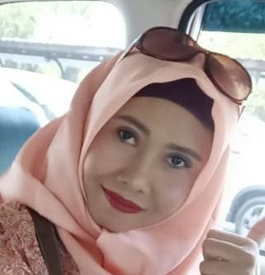
Trufi Murdiani
Bekasi, June 25, 1975
Lecturer at Digital Business Study Program, IIB Darmajaya
“
“
When it is obvious that the goals cannot be reached, don’t adjust the goals, adjust the action steps. (Confusius 551-497 BC)
Basics

Slide 5
Former Experiences
 Managing Editor of Lampung Ekspres Daily Newspaper
 Managing Editor of Radar Tanggamus Newspaper from Radar Lampung Group
 Editor on Economic and Business of Radar Lampung Daily Newspaper
 Senior Editor of Teknokra, Unila Students Monthly Bulletin
 Director of Gajah Sakti Polytechnic, Metro
 Editor in Chief of Prasetiya Mandiri Campus Magazine

Slide 6
Educations
Formal
Informal
2012
2009 | Short Course
Master of Arts | Ateneo de Manila University
Reporting On Regional Integration In South East Asia History, IIInstitutions and Policies of ASEAN | Bangkok & Hua Hin
2004
2008 | Short Course
Bachelor in Civil Engineering
Economic and Financial Reporting | Berlin |
Fully scholarship by InWEnt from DAAD Germany
1999
2008
Diploma in Civil Engineering | Unila
Conflict Conscious Journalism Training by AJI Indonesia

Slide 7
Training and Workshops
International Conference on ASEAN-EU Science, Technology and
Innovations in Hanoi,
Vietnam
Training on CAD: 3D Modelling and Draftingheld by Jurusan Teknik Mesin Unila
2015
2016
2016
2018
2020
International Conference on Information Technology and Business, held by
LP4M IIB Darmajaya
in Lampung
National Conference on
Applied Science, Engineering Business and Information
Technology in Padang, held
by Universitas Negeri
Padang
Digital Marketing Training, held by
IIB Darmajaya & Edukasi 4.0
and some workshops held by
LLDIKTI II Sumbagsel and
other trainings from 2016-2019

Slide 8
Achievements
Author of two
biography books:
1. Biography of K.H. Arief Mahya
2. Biography of Alzier Dianis
Thabranie
Winner of some writing competitions:
2008: 1st Winner of Honda Writing Competition
2006: 1st Hope Winner of Telkomsel Writing Contest in
Sumbagsel Region
2004: Best Writer of General Election Reporting
2002: 2nd Winner of Krakatau Festival Writing Contest
Writing some articles
pubished on various
journals and proceedings

Slide 9
Personal Interests
Create charity and events
Read books and literatures
Love to travel
Visit historical places and
experience different cultures and culinaries

Slide 10



Thank you
@murdiani06 Trufy Murdiani Trufi Murdiani missmurdian1@gmail.com

