Slide 1

REGULATION FOR ENGLISH CLASS
E- learning via https://lms.darmajaya.ac.id
2nd semester 2021

Slide 2
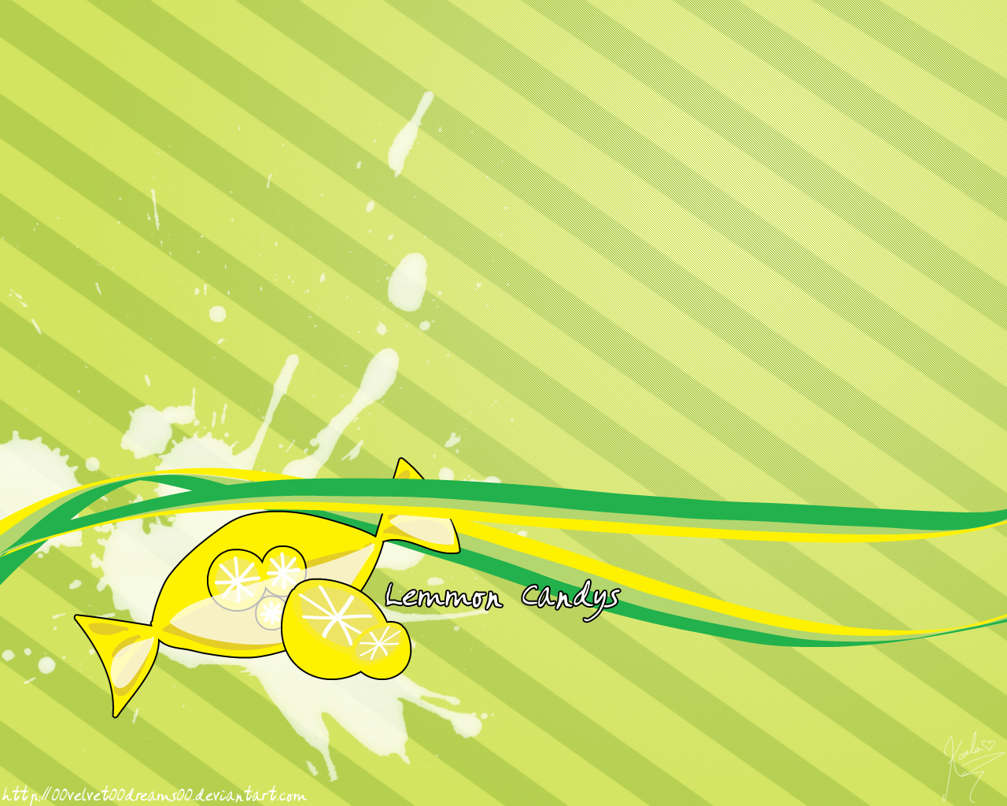
English Lecturer’s Biography
Name : Sulastri, S.Pd., M.Pd
Place, Date of Birth : Bandar Lampung, February 3rd, 1988
Phone Number : 085658821006
Email Address : trilastri3@gmail.com
Education Background : University of Lampung English Education Department
Experience in Teaching :
English Lecturer at IIB Darmajaya (since 2012)
English Lecturer at DCC Amik (since 2015)
English Lecturer at ABA (since 2015)
Matriculation Instructor of UIN RIL (since 2017)
Language center Instructor of UNILa (since 2020)

Slide 3

Meeting
  one semester consists of 16 meetings, which will be divided become:
  a. 14 meetings for discussing the material
  b. 1 meeting for Mid Term (UTS)
  c. 1 more meeting for Final term (UAS)
Presence
The students must fill the presence in lms.darmajaya.ac.id by typing “present/ hadir”.
The students also can join in offline class based on the “time” (odd or even number of presence list)

Slide 4

Starting and Ending the class
Teaching learning process will be run around 100 minutes for every single meeting. Limitation time for coming late just 15 minutes (for offline class)
Assignment
The assignment will be given in the end of the class in order to improve the students’ ability in English

Slide 5

Scoring system
Students’ score can be gotten from:
a. Presence 30 %
b. Mid term 30 %
c. Final term 30 %
d. Assignment 10%.
(there will be additional score for the activeness during teaching learning process).
Dress code for Offline class
The students are required to wear a formal clothes, such as; shirt, trousers skirt and no sandals but it should be shoes

Slide 6

The students must have English module which has been shared in lms (PDF)
The English module must be brought in every meeting (in offline class)
The students must be the member of Whatsapp group in order to keep the connectivity which relates to teaching learning process with the lecturer by following the link that has been shared in lms

Slide 7

further information about teaching learning process can be reached to Ms. Sulastri as the lecturer of this calss in WA number 085658821006
stay safe and keep your social distancing. Thank you

