Slide 1

4
Managing Quality and
Innovation
PowerPoint presentation to accompany
Heizer and Render
Operations Management, Eleventh Edition
Principles of Operations Management, Ninth Edition
PowerPoint slides by Jeff Heyl

Slide 2
Quality and Strategy
Managing quality supports differentiation, low cost, and response strategies
Quality helps firms increase sales and reduce costs
Building a quality organization is a demanding task

Slide 3
Two Ways Quality
Improves Profitability
Sales Gains via
Improved response
Flexible pricing
Improved reputation
Improved Quality
Increased Profits
Reduced Costs via
Increased productivity
Lower rework and scrap costs
Lower warranty costs

Slide 4
The Flow of Activities
Organizational Practices
Leadership, Mission statement, Effective operating procedures, Staff support, Training
Yields: What is important and what is to be
accomplished
Quality Principles
Customer focus, Continuous improvement, Benchmarking, Just-in-time, Tools of TQM
Yields: How to do what is important and to be
accomplished
Employee Fulfillment
Empowerment, Organizational commitment
Yields: Employee attitudes that can accomplish
what is important
Customer Satisfaction
Winning orders, Repeat customers
Yields: An effective organization with
a competitive advantage

Slide 5
Defining Quality
An operations manager’s objective is to build a total quality management system that identifies and satisfies customer needs

Slide 6
Defining Quality
The totality of features and characteristics of a product or service that bears on its ability to satisfy stated or implied needs
American Society for Quality

Slide 7
Different Views
User-based: better performance, more features
Manufacturing-based: conformance to standards, making it right the first time
Product-based: specific and measurable attributes of the product

Slide 8
Implications of Quality
Company reputation
  Perception of new products
  Employment practices
  Supplier relations
Product liability
  Reduce risk
Global implications
  Improved ability to compete

Slide 9
Malcolm Baldrige National Quality Award
Established in 1988 by the U.S. government
Designed to promote TQM practices
Recent winners include
Lockheed Martin Missiles and Fire Control, MESA Products Inc., North Mississippi Health Services, City of Irving, Concordia Publishing House, Henry Ford Health System, MEDRAD, Nestlé Purina PetCare Co., Montgomery County Public Schools

Slide 10
Baldrige Criteria
Applicants are evaluated on:
CATEGORIES | POINTS
Leadership | 120
Strategic Planning | 85
Customer Focus | 85
Measurement, Analysis, and Knowledge Management | 90
Workforce Focus | 85
Operations Focus | 85
Results | 450

Slide 11
ISO 9000
International Quality Standards
International recognition
Encourages quality management procedures, detailed documentation, work instructions, and recordkeeping
2009 revision emphasized sustained success
Over one million certifications in 178 countries
Critical for global business

Slide 12
ISO 9000
International Quality Standards
Management principles
  Top management leadership
  Customer satisfaction
  Continual improvement
  Involvement of people
  Process analysis
  Use of data-driven decision making
  A systems approach to management
  Mutually beneficial supplier relationships

Slide 13
Costs of Quality
Prevention costs - reducing the potential for defects
Appraisal costs - evaluating products, parts, and services
Internal failure costs - producing defective parts or service before delivery
External failure costs - defects discovered after delivery

Slide 14
Costs of Quality
Total Cost
Total Cost
External Failure
Internal Failure
Prevention
Appraisal
Quality Improvement

Slide 15
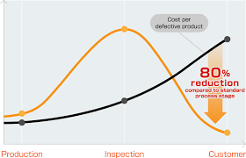
Cost of Defect Product

Slide 16
Leaders in Quality
LEADER | PHILOSOPHY/CONTRIBUTION
W. Edwards Deming | Deming insisted management accept responsibility for building good systems. The employee cannot produce products that on average exceed the quality of what the process is capable of producing. His 14 points for implementing quality improvement are presented in this chapter.
Joseph M. Juran | A pioneer in teaching the Japanese how to improve quality, Juran believed strongly in top-management commitment, support, and involvement in the quality effort. He was also a believer in teams that continually seek to raise quality standards. Juran varies from Deming somewhat in focusing on the customer and defining quality as fitness for use, not necessarily the written specifications.

Slide 17
Leaders in Quality
LEADER | PHILOSOPHY/CONTRIBUTION
Amarnd Feigenbaum | His 1961 book Total Quality Control laid out 40 steps to quality improvement processes. He viewed quality not as a set of tools but as a total field that integrated the processes of a company. His work in how people learn from each other’s successes led to the field of cross-functional teamwork.
Philip B. Crosby | Quality Is Free was Crosby’s attention-getting book published in 1979. Crosby believed that in the traditional trade-off between the cost of improving quality and the cost of poor quality, the cost of poor quality is understated. The cost of poor quality should include all of the things that are involved in not doing the job right the first time. Crosby coined the term zero defects and stated, “There is absolutely no reason for having errors or defects in any product or service.”

Slide 18
Ethics and Quality Management
Operations managers must deliver healthy, safe, quality products and services
Poor quality risks injuries, lawsuits, recalls, and regulation
Ethical conduct must dictate response to problems
All stakeholders much be considered

Slide 19
Total Quality Management
Encompasses entire organization from supplier to customer
Stresses a commitment by management to have a continuing companywide drive toward excellence in all aspects of products and services that are important to the customer

Slide 20
Deming’s Fourteen Points
Deming’s 14 Points for Implementing Quality Improvement
1. Create consistency of purpose
2. Lead to promote change
3. Build quality into the product; stop depending on inspections to catch problems
4. Build long-term relationships based on performance instead of awarding business on price
5. Continuously improve product, quality, and service
6. Start training
Emphasize leadership
8. Drive out fear
9. Break down barriers between departments
10. Stop haranguing workers
11. Support, help, and improve
12. Remove barriers to pride in work
13. Institute a vigorous program of education and self-improvement
14. Put everyone in the company to work on the transformation

Slide 21
Seven Concepts of TQM
Continuous improvement
Six Sigma
Employee empowerment
Benchmarking
Just-in-time (JIT)
Taguchi concepts
Knowledge of TQM tools

Slide 22
1. Continuous Improvement
Never-ending process of continual improvement
Covers people, equipment, materials, procedures
Every operation can be improved
Kaizen describes the ongoing process of unending improvement
TQM and zero defects also used to describe continuous improvement

Slide 23
Shewhart’s PDCA Model
4. Act
Implement the plan, document
Plan
Identify the pattern and make a plan
3. Check
Is the plan working?
2. Do
Test the plan

Slide 24
2. Six Sigma
Two meanings
  Statistical definition of a process that is 99.9997% capable, 3.4 defects per million opportunities (DPMO)
  A program designed to reduce defects, lower costs, save time, and improve customer satisfaction
A comprehensive system for achieving and sustaining business success

Slide 25
Six Sigma
Lower limits
Upper limits
2,700 defects/million
3.4 defects/million
Mean
±3σ
±6σ

Slide 26
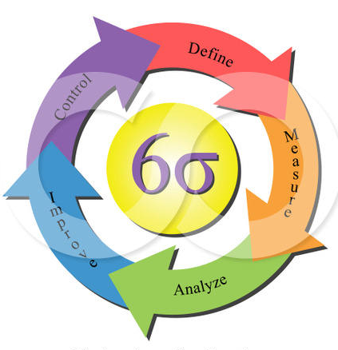
Six Sigma Program
Originally developed by Motorola, adopted and enhanced by Honeywell and GE
Highly structured approach to process improvement
    A strategy
    A discipline – DMAIC
    A set of 7 tools

Slide 27
Six Sigma
Defines the project’s purpose, scope, and outputs, identifies the required process information keeping in mind the customer’s definition of quality
Measures the process and collects data
Analyzes the data ensuring
repeatability and reproducibility
Improves by modifying or
redesigning existing
processes and procedures
Controls the new process
to make sure performance
levels are maintained
DMAIC Approach

Slide 28
Implementing Six Sigma
Emphasize defects per million opportunities as a standard metric
Provide extensive training
Focus on corporate sponsor support (Champions)
Create qualified process improvement experts (Black Belts, Green Belts, etc.)
Set stretch objectives
This cannot be accomplished without a major commitment from top level management

Slide 29

3. Employee Empowerment
Getting employees involved in product and process improvements
  85% of quality problems are due
  to process and material
Techniques
  Build communication networks
  that include employees
  Develop open, supportive supervisors
  Move responsibility to employees
  Build a high-morale organization
  Create formal team structures

Slide 30
Quality Circles
Group of employees who meet regularly to solve problems
Trained in planning, problem solving, and statistical methods
Often led by a facilitator
Very effective when done properly

Slide 31
Quality Circles
Quality Circle adalah kelompok kecil untuk melakukan kegiatan pengendalian kualitas pada unit kerja yang sama. Kelompok kecil ini secara berkelanjutan menjadi bagian dari aktivitas pengendalian kualitas untuk pengembangan diri dan peningkatan dan pengembangan bersama dengan melakukan lokakarya, menggunakan teknik pengendalian kualitas dengan melibatkan semua anggota yang berpartisipasi (Ishikawa).

Slide 32
4. Benchmarking
Selecting best practices to use as a standard for performance
Determine what to benchmark
Form a benchmark team
Identify benchmarking partners
Collect and analyze benchmarking information
Take action to match or exceed the benchmark

Slide 33
Best Practices for Resolving Customer Complaints
BEST PRACTICE | JUSTIFICATION
Make it easy for clients to complain | It is free market research
Respond quickly to complaints | It adds customers and loyalty
Resolve complaints on first contact | It reduces cost
Use computers to manage complaints | Discover trends, share them, and align your services
Recruit the best for customer service jobs | It should be part of formal training and career advancement

Slide 34
Internal Benchmarking
When the organization is large enough
Data more accessible
Can and should be established in a variety of areas

Slide 35
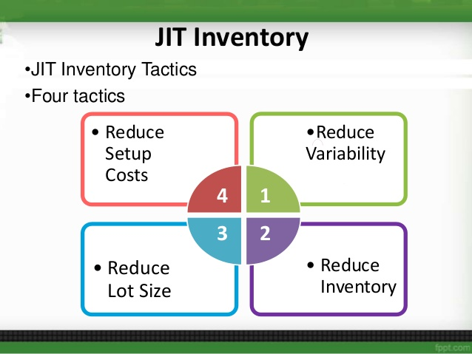
5. Just-in-Time (JIT)
Relationship to quality:
JIT cuts the cost of quality
JIT improves quality
Better quality means less inventory and better, easier-to-employ JIT system

Slide 36
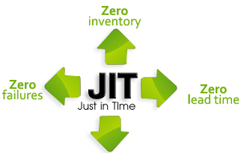
Just-in-Time (JIT)
‘Pull’ system of production scheduling including supply management
  Production only when signaled
Allows reduced inventory levels
  Inventory costs money and hides process and material problems
Encourages improved process and product quality

Slide 37
6. Taguchi Concepts
Engineering and experimental design methods to improve product and process design
  Identify key component and process variables affecting product variation
Taguchi Concepts
  Quality robustness
  Quality loss function
  Target-oriented quality

Slide 38
Quality Robustness
Ability to produce products uniformly in adverse manufacturing and environmental conditions
  Remove the effects of adverse conditions
  Small variations in materials and process do not destroy product quality

Slide 39
Quality Loss Function
Shows that costs increase as the product moves away from what the customer wants
Costs include customer dissatisfaction, warranty and service, internal
scrap and repair, and costs to society
Traditional conformance specifications are too simplistic
Target-oriented quality

Slide 40
Quality Loss Function
High loss
L = D²C
Unacceptable
where
L = loss to society
D² = square of the distance from target value
C = cost of deviation
Loss (to producing organization, customer, and society)
Poor
Fair
Good
Low loss
Best
Target-oriented quality yields more product in the “best” category
Target-oriented quality brings product toward the target value
Frequency
Conformance-oriented quality keeps products within 3 standard deviations
Lower
Target
Upper
Specification

Slide 41
7. TQM Tools
Tools for Generating Ideas
  Check Sheet
  Scatter Diagram
  Cause-and-Effect Diagram
Tools to Organize the Data
  Pareto Chart
  Flowchart (Process Diagram)
Tools for Identifying Problems
  Histogram
  Statistical Process Control Chart

Slide 42
Seven Tools of TQM
(1) Check Sheet: An organized method of recording data
Tipe Cacat Kejadian Peristiwa (Hari) | Hari |  |  |  |  |  |  | TOTAL
 | Minggu | Senin | Selasa | Rabu | Kamis | Jum'at | Sabtu
Cacat 1 | 0 | 3 | 4 | 2 | 2 | 2 | 2 | 15
Cacat 2 | 0 | 2 | 1 | 2 | 1 | 1 | 3 | 10
Cacat 3 | 1 | 0 | 1 | 0 | 1 | 1 | 1 | 5
Cacat 4 | 0 | 3 | 3 | 1 | 1 | 0 | 0 | 8
Cacat 5 | 1 | 0 | 1 | 1 | 0 | 0 | 1 | 4
Cacat 6 | 3 | 4 | 4 | 3 | 3 | 4 | 4 | 25
Cacat 7 | 1 | 1 | 1 | 1 | 1 | 0 | 1 | 6
Cacat 8 | 0 | 1 | 1 | 1 | 2 | 1 | 1 | 7
Cacat 9 | 0 | 2 | 2 | 1 | 2 | 3 | 1 | 11
Cacat 10 | 0 | 1 | 0 | 1 | 1 | 0 | 0 | 3
TOTAL | 6 | 17 | 18 | 13 | 14 | 12 | 14 | 94

Slide 43
Seven Tools of TQM
(2) Scatter Diagram: A graph of the value of one variable vs. another variable

Slide 44
Seven Tools of TQM
(3) Cause-and-Effect Diagram: A tool that identifies process elements (causes) that might effect an outcome
Mesin
Metode
Manual
Kurang Perawatan
Berubah-ubah
Suhu tidak Optimal
Produk Tempe Cacat
Suhu Ruangan
Bahan baku kurang baik
Karyawan tidak teliti
Tidak Bersih
Kelelahan
Lingkungan
Material
Manusia

Slide 45
Seven Tools of TQM
(4) Pareto Chart: A graph to identify and plot problems or defects in descending order of frequency
Gambar. Diagram Pareto berdasarkan jumlah cacat

Slide 46
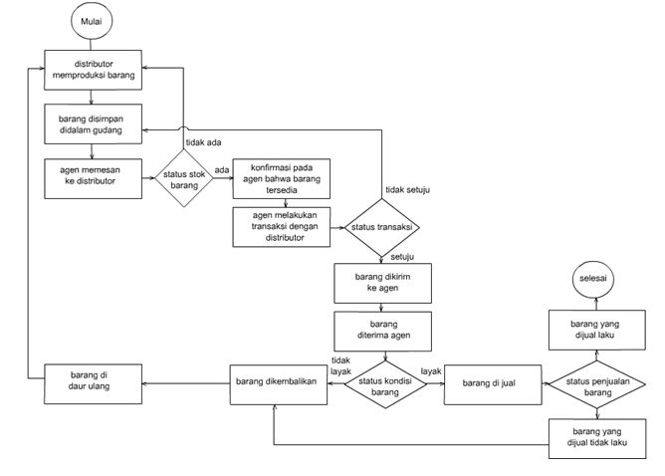
Seven Tools of TQM
(5) Flowchart (Process Diagram): A chart that describes the steps in a process

Slide 47
Seven Tools of TQM
(6) Histogram: A distribution showing the frequency of occurrences of a variable
Distribution
Frequency
Repair time (minutes)

Slide 48
Seven Tools of TQM
(7) Statistical Process Control Chart: A chart with time on the horizontal axis to plot values of a statistic
Upper control limit
Target value
Lower control limit
Time

Slide 49
Inspection
Involves examining items to see if an item is good or defective
Detect a defective product
  Does not correct deficiencies in process or product
  It is expensive
Issues
  When to inspect
  Where in process to inspect

Slide 50
When and Where to Inspect
At the supplier’s plant while the supplier is producing
At your facility upon receipt of goods from your supplier
Before costly or irreversible processes
During the step-by-step production process
When production or service is complete
Before delivery to your customer
At the point of customer contact

Slide 51
Inspection
Many problems
  Worker fatigue
  Measurement error
  Process variability
Cannot inspect quality into a product
Robust design, empowered employees, and sound processes are better solutions

Slide 52

Source Inspection
Also known as source control
The next step in the process is your customer
Ensure perfect
product to your
customer

Slide 53

Source Inspection
Poka-yoke is the concept of foolproof devices or techniques designed to pass only acceptable product
Checklists ensure
consistency and
completeness

Slide 54
TQM In Services
Service quality is more difficult to measure than the quality of goods
Service quality perceptions depend on
  Intangible differences between products
  Intangible expectations customers have of those products

Slide 55
Service Quality
The Operations Manager must recognize:
The tangible component of services is important
The service process is important
The service is judged against the customer’s expectations
Exceptions will occur

Slide 56
Service Specifications

Slide 57
Determinants of Service Quality
Reliability involves consistency of performance and dependability
Responsiveness concerns the willingness or readiness of employees to provide service
Competence means possession of the required skills and knowledge to perform the service
Access involves approachability and ease of contact
Courtesy involves politeness, respect, consideration, and friendliness
Communication means keeping customers informed and listening to them
Credibility involves trustworthiness, believability, and honesty
Security is the freedom from danger, risk, or doubt
Understanding/knowing the customer involves making the effort to understand the customer’s needs
Tangibles include the physical evidence of the service

Slide 58
Service Recovery Strategy
Managers should have a plan for when services fail
Marriott’s LEARN routine
  Listen
  Empathize
  Apologize
  React
  Notify

