Slide 1
Introduction to Accounting and Business
By Rieka Ramadhaniyah

Slide 2
Nature of Business and Accounting
A business is an organization in which basic resources (inputs), such as materials and labor, are assembled and processed to provide goods or services (outputs) to customers.
The objective of most businesses is to earn a profit. Profit is the difference between the amounts received from customers for goods or services and the amounts paid for the inputs used to provide the goods or services
basic resources (inputs), such as materials and labor
assembled and processed
goods or services (outputs) to customers

Slide 3
Nature of Business and Accounting
Type of Business:
Service Business : Provide services rather than products to customers.
Merchandising Business : Sell products they purchase from other business to customers.
Manufacturing Business : Change basic input into products that are sold to customers.

Slide 4
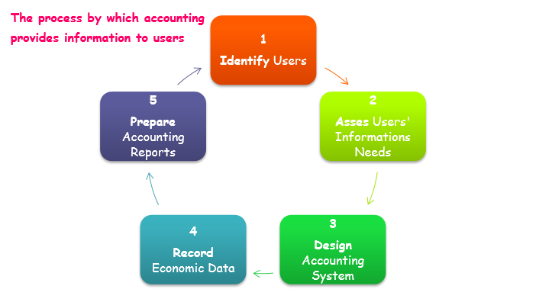
The Role of Accounting in Business
Accounting can be defined as an information system that provides reports to users about the economic activities and condition of a business.

Slide 5
Type of Accounting
Managerial Accounting : The area of accounting that provides internal users with information.
Financial Accounting : The area of accounting that provides external users with information.
The objective of financial accounting is to provide relevant and timely information for the decision-making needs of users outside of the business.
General-purpose financial statements are one type of financial accounting report that is distributed to external users

Slide 6
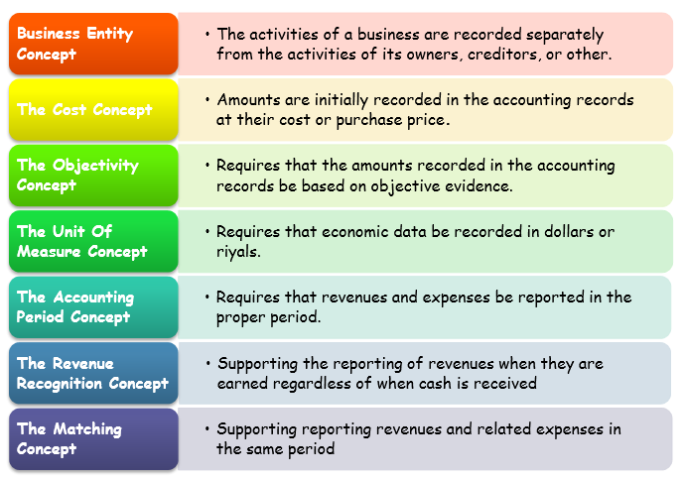
Accounting principles
Generally Accepted Accounting Principles
Financial accountants follow generally accepted accounting principles (GAAP) in preparing reports.

Slide 7
The Accounting Equation
The resources owned by a business are its assets.
The rights of creditors are the debts of the business and are called liabilities.
The rights of the owners are called owner’s equity.
The equation
Assets = Liabilities + Owner’s Equity
Assets = Liabilities + Capital – Drawings + Revenues - Expenses Drawings + Expenses + Assets = Liabilities + Capital + Revenues

Slide 8
Elements of Accounting Equation
ASSETS → Resources owned by the business
Type off Assets
Fixed Assets → Land, Buildings, Furniture, Cars, Machinery and Equipment.
Current Assets → Cash, Marketable Securities, Accounts Receivable, Notes receivables, Merchandise Inventory, Supplies, Prepaid Expenses, and Accrued Revenues.
Intangible Assets → Goodwill, Copy Right, Patent, Trade Mark.
LIABILITIES → The rights of creditors
Type of Liabilities
Long-Term Liabilities → Bonds and Long-Term Loans.
Short-Term Liabilities → Accounts Payable, Notes Payable, Short-Term Loans, Accrued Expenses, and Unearned Revenues.
OWNER’S EQUITY → the rights of the owners
Capital and Net Income (Revenues – Expenses)
Notes:
Business Transaction : is an economic event or condition that directly changes an entity’s financial condition or its results of operations.
Account payable : is liability created by a purchase on account.
Account receivable : is a claim against a customer, which is an asset. Expenses → Assets used in this process of earning revenue.
Revenue : the Amount of money that A business earned by selling goods or services to its customers

Slide 9
Practice 1
D:\Rieka Data\PA Pemadatan\Contoh Soal Ch 1.docx

Slide 10
That’s the matery for
for 2nd meeting
See You on Thursday
@LMS Darmajaya

