Slide 1

8
Manajemen
Persediaan
PowerPoint presentation to accompany
Heizer and Render
Operations Management, Eleventh Edition
Principles of Operations Management, Ninth Edition
PowerPoint slides by Jeff Heyl

Slide 2

The top e-commerce companies in Indonesia
e-commerce companies started as a “virtual” retailer – no inventory, no warehouses, no overhead; just computers taking orders to be filled by others
Growth has forced to become e-commerce companies leader on Indonesian

Slide 3
Express Courier & Delivery Services
Courier services operate on all scales, from within specific towns or cities, to regional, national and global services.
Large courier companies include DHL, Postaplus, DTDC, FedEx, EMS International, TNT, UPS, India Post and Aramex. These offer services worldwide, typically via a hub and spoke model.
In Indonesia, JNE, TIKI, J&T, Dakota, Lions Express, etc.
Couriers services utilizing Courier Software provide electronic Proof of Delivery and electronic Tracking details.

Slide 4
Inventory Management
The objective of inventory management is to strike a balance between inventory investment and customer service

Slide 5
Importance of Inventory
One of the most expensive assets of many companies representing as much as 50% of total invested capital
Operations managers must balance inventory investment and customer service
Balance the advantages and disadvantages of small and large inventories

Slide 6
Importance of Inventory
Pressures for small inventories
  Inventory holding cost
  Cost of capital
  Storage and handling costs
  Taxes, insurance, and shrinkage
Pressures for large inventories
  Customer service
  Ordering cost
  Setup cost
  Labor and equipment utilization
  Transportation cost
  Payments to suppliers

Slide 7
Functions of Inventory
To provide a selection of goods for anticipated demand and to separate the firm from fluctuations in demand
To decouple or separate various parts of the production process
To take advantage of quantity discounts
To hedge against inflation

Slide 8
Reasons for Holding Inventory
To meet anticipated customer demand
To protect against stock outs
To take advantage of economic ordercycles
To maintain independence of operations
To allow for smooth and ﬂexibleproduction operations
To guard against price increases

Slide 9
Types of Inventory
Raw material
  Purchased but not processed
Work-in-process (WIP)
  Undergone some change but not completed
  A function of cycle time for a product
Maintenance/repair/operating (MRO)
  Necessary to keep machinery and processes productive
Finished goods
  Completed product awaiting shipment

Slide 10
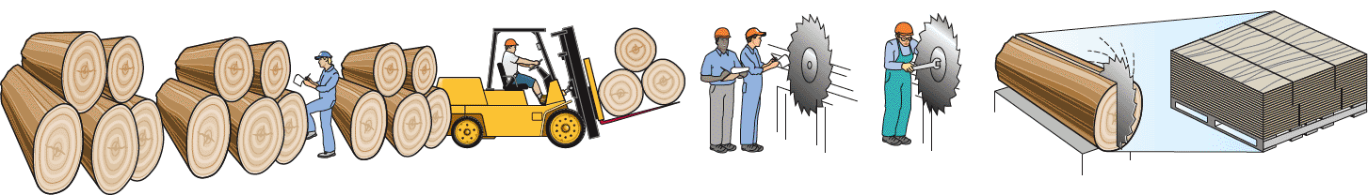
The Material Flow Cycle
Cycle time
95% 5%
Input Wait for Wait to Move Wait in queue Setup Run Output
inspection be moved time for operator time time
Most of the time that work is in-process (95% of the cycle time) is not productive time.

Slide 11
Managing Inventory (ABC analysis)
How inventory items can be classified (ABC analysis)
How accurate inventory records can be maintained.
Stock-keeping units (SKU)
Identify the classes so management can control inventory levels
A Pareto chart

Slide 12
ABC Analysis
Divides inventory into three classes based on annual dollar volume
  Class A - high annual dollar volume
  Class B - medium annual dollar volume
  Class C - low annual dollar volume
Used to establish policies that focus on the few critical parts and not the many trivial ones

Slide 13
ABC Analysis
ABC Calculation
(1) | (2) | (3) |  | (4) |  | (5) |  | (6) |  |  | (7)
ITEM STOCK NUMBER | PERCENT OF NUMBER OF ITEMS STOCKED | ANNUAL VOLUME (UNITS) | x | UNIT COST | = | ANNUAL DOLLAR VOLUME |  | PERCENT OF ANNUAL DOLLAR VOLUME |  |  | CLASS
#10286 | 20% | 1,000 |  | $ 90.00 |  |  | $ 90,000 |  | 38.8% |  | A
#11526 |  | 500 |  | 154.00 |  |  | 77,000 |  | 33.2% |  | A
#12760 |  | 1,550 |  | 17.00 |  |  | 26,350 |  | 11.3% |  | B
#10867 | 30% | 350 |  | 42.86 |  |  | 15,001 |  | 6.4% |  | B
#10500 |  | 1,000 |  | 12.50 |  |  | 12,500 |  | 5.4% |  | B
#12572 |  | 600 |  | $ 14.17 |  |  | $ 8,502 |  | 3.7% |  | C
#14075 |  | 2,000 |  | .60 |  |  | 1,200 |  | .5% |  | C
#01036 | 50% | 100 |  | 8.50 |  |  | 850 |  | .4% |  | C
#01307 |  | 1,200 |  | .42 |  |  | 504 |  | .2% |  | C
#10572 |  | 250 |  | .60 |  |  | 150 |  | .1% |  | C
 |  | 8,550 |  |  |  |  | $232,057 |  | 100.0%
72%
23%
5%

Slide 14
ABC Analysis
A Items
80 –
70 –
60 –
50 –
40 –
30 –
20 –
10 –
0 –
Percentage of annual dollar usage
B Items
C Items
| | | | | | | | | |
10 20 30 40 50 60 70 80 90 100
Percentage of inventory items

Slide 15
ABC Analysis
Other criteria than annual dollar volume may be used
  High shortage or holding cost
  Anticipated engineering changes
  Delivery problems
  Quality problems
Policies employed may include
  More emphasis on supplier development for A items
  Tighter physical inventory control for A items
  More care in forecasting A items

Slide 16
Record Accuracy
Accurate records are a critical ingredient in production and inventory systems
  Periodic systems require regular checks of inventory
    Two-bin system
  Perpetual inventory tracks receipts and subtractions on a continuing basis
    May be semi-automated

Slide 17

Record Accuracy
Incoming and outgoing
record keeping must be
accurate
Stockrooms should be secure
Necessary to make precise decisions about ordering, scheduling, and shipping

Slide 18

Control of Service Inventories
Can be a critical component
of profitability
Losses may come from
shrinkage or pilferage
Applicable techniques include
  Good personnel selection, training, and discipline
  Tight control of incoming shipments
  Effective control of all goods leaving facility

Slide 19
Inventory Models
Independent demand - the demand for item is independent of the demand for any other item in inventory
Dependent demand - the demand for item is dependent upon the demand for some other item in the inventory

Slide 20
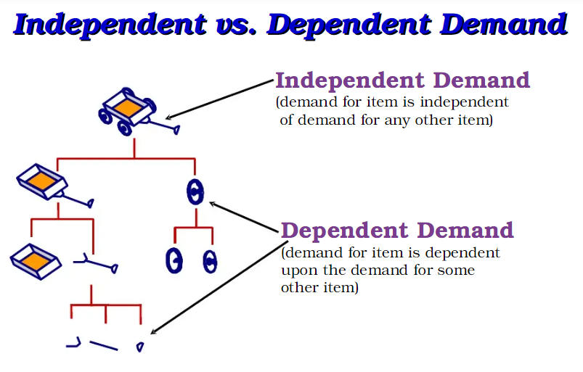
Inventory Models

Slide 21
Inventory Models
Holding costs - the costs of holding or “carrying” inventory over time
Ordering costs - the costs of placing an order and receiving goods
Setup costs - cost to prepare a machine or process for manufacturing an order
  May be highly correlated with setup time

Slide 22
Holding Costs
TABLE | Determining Inventory Holding Costs
CATEGORY |  | COST (AND RANGE) AS A PERCENT OF INVENTORY VALUE
Housing costs (building rent or depreciation, operating costs, taxes, insurance) |  |  | 6% (3 - 10%)
Material handling costs (equipment lease or depreciation, power, operating cost) |  |  | 3% (1 - 3.5%)
Labor cost (receiving, warehousing, security) |  |  | 3% (3 - 5%)
Investment costs (borrowing costs, taxes, and insurance on inventory) |  |  | 11% (6 - 24%)
Pilferage, space, and obsolescence (much higher in industries undergoing rapid change like PCs and cell phones) |  |  | 3% (2 - 5%)
Overall carrying cost |  |  | 26%

Slide 23
Holding Costs
TABLE 12.1 | Determining Inventory Holding Costs
CATEGORY |  | COST (AND RANGE) AS A PERCENT OF INVENTORY VALUE
Housing costs (building rent or depreciation, operating costs, taxes, insurance) |  |  | 6% (3 - 10%)
Material handling costs (equipment lease or depreciation, power, operating cost) |  |  | 3% (1 - 3.5%)
Labor cost (receiving, warehousing, security) |  |  | 3% (3 - 5%)
Investment costs (borrowing costs, taxes, and insurance on inventory) |  |  | 11% (6 - 24%)
Pilferage, space, and obsolescence (much higher in industries undergoing rapid change like PCs and cell phones) |  |  | 3% (2 - 5%)
Overall carrying cost |  |  | 26%
Holding costs vary considerably depending on the business, location, and interest rates. Generally greater than 15%, some high tech and fashion items have holding costs greater than 40%.

Slide 24
Inventory Models for Independent Demand
Need to determine when and how much to order
Basic economic order quantity (EOQ) model
Production order quantity model
Quantity discount model

Slide 25
Basic EOQ Model
Important assumptions
Demand is known, constant, and independent
Lead time is known and constant
Receipt of inventory is instantaneous and complete
Quantity discounts are not possible
Only variable costs are setup (or ordering) and holding
Stockouts can be completely avoided

Slide 26
Inventory Usage Over Time
(EOQ Model)
Total order received
Average inventory on hand
Q
2
Order quantity = Q (maximum inventory level)
Usage rate
Inventory level
Minimum inventory
0
Time

Slide 27
Minimizing Costs
Objective is to minimize total costs
Total cost of holding and setup (order)
Minimum total cost
Holding cost
Annual cost
Setup (order) cost
Optimal order quantity (Q*)
Order quantity

Slide 28
Minimizing Costs
By minimizing the sum of setup (or ordering) and holding costs, total costs are minimized
Optimal order size Q* will minimize total cost
A reduction in either cost reduces the total cost
Optimal order quantity occurs when holding cost and setup cost are equal

Slide 29
Minimizing Costs
Q = Number of pieces per order
Q* = Optimal number of pieces per order (EOQ)
D = Annual demand in units for the inventory item
S = Setup or ordering cost for each order
H = Holding or carrying cost per unit per year
Annual setup cost = (Number of orders placed per year)
x (Setup or order cost per order)
Annual demand
Number of units in each order
Setup or order cost per order
=

Slide 30
Minimizing Costs
Q = Number of pieces per order
Q* = Optimal number of pieces per order (EOQ)
D = Annual demand in units for the inventory item
S = Setup or ordering cost for each order
H = Holding or carrying cost per unit per year
Annual holding cost = (Average inventory level)
x (Holding cost per unit per year)
Order quantity
2
=
(Holding cost per unit per year)

Slide 31
Minimizing Costs
Q = Number of pieces per order
Q* = Optimal number of pieces per order (EOQ)
D = Annual demand in units for the inventory item
S = Setup or ordering cost for each order
H = Holding or carrying cost per unit per year
Optimal order quantity is found when annual setup cost equals annual holding cost
Solving for Q*

Slide 32
An EOQ Example
Determine optimal number of needles to order
D = 1,000 units
S = $10 per order
H = $.50 per unit per year

Slide 33
An EOQ Example
Determine expected number of orders
D = 1,000 units Q* = 200 units
S = $10 per order
H = $.50 per unit per year
Expected number of orders
Demand
Order quantity
= N = =
1,000
200
N = = 5 orders per year

Slide 34
An EOQ Example
Determine optimal time between orders
D = 1,000 units Q* = 200 units
S = $10 per order N = 5 orders/year
H = $.50 per unit per year
Expected time between orders
Number of working days per year
Expected number of orders
= T =
250
5
T = = 50 days between orders

Slide 35
An EOQ Example
Determine the total annual cost
D = 1,000 units Q* = 200 units
S = $10 per order N = 5 orders/year
H = $.50 per unit per year T = 50 days
Total annual cost = Setup cost + Holding cost

Slide 36
The EOQ Model
When including actual cost of material P
Total annual cost = Setup cost + Holding cost + Product cost

Slide 37
Robust Model
The EOQ model is robust
It works even if all parameters and assumptions are not met
The total cost curve is relatively flat in the area of the EOQ

Slide 38
The EOQ Model
Only 2% less than the total cost of $125 when the order quantity was 200
Determine optimal number of needles to order
D = 1,000 units Q* = 200 units
S = $10 per order N = 5 orders/year
H = $.50 per unit per year T = 50 days
1,500 units

Slide 39
Reorder Points
EOQ answers the “how much” question
The reorder point (ROP) tells “when” to order
Lead time (L) is the time between placing and receiving an order
Demand per day
Lead time for a new order in days
ROP =
= d x L
D
Number of working days in a year
d =

Slide 40
Reorder Point Curve
Q*
Resupply takes place as order arrives
Slope = units/day = d
Inventory level (units)
ROP (units)
Time (days)
Lead time = L

Slide 41
Reorder Point Curve Example
Demand = 8,000 iPods per year
250 working day year
Lead time for orders is 3 working days, may take 4
D
Number of working days in a year
d =
= 8,000/250 = 32 units
ROP = d x L
= 32 units per day x 3 days = 96 units
= 32 units per day x 4 days = 128 units

Slide 42
Production Order Quantity Model
Used when inventory builds up over a period of time after an order is placed
Used when units are produced and sold simultaneously
Part of inventory cycle during which production (and usage) is taking place
Demand part of cycle with no production (only usage)
Inventory level
Maximum inventory
t
Time

Slide 43
Production Order Quantity Model
Q = Number of pieces per order p = Daily production rate
H = Holding cost per unit per year d = Daily demand/usage rate
t = Length of the production run in days
Annual inventory holding cost
= (Average inventory level) x
Holding cost
per unit per year
Annual inventory level
= (Maximum inventory level)/2
Maximum inventory level
Total produced during the production run
Total used during the production run
= –
= pt – dt

Slide 44
Production Order Quantity Model
Q = Number of pieces per order p = Daily production rate
H = Holding cost per unit per year d = Daily demand/usage rate
t = Length of the production run in days
Maximum inventory level
Total produced during the production run
Total used during the production run
= –
= pt – dt
However, Q = total produced = pt ; thus t = Q/p
Maximum inventory level
Q
p
Q
p
d
p
= p – d = Q 1 –
Maximum inventory level
2
Q
2
d
p
Holding cost = (H) = 1 – H

Slide 45
Production Order Quantity Model
Q = Number of pieces per order p = Daily production rate
H = Holding cost per unit per year d = Daily demand/usage rate
t = Length of the production run in days

Slide 46
Production Order Quantity Model (Example)
D = 1,000 units p = 8 units per day
S = $10 d = 4 units per day
H = $0.50 per unit per year

Slide 47
Production Order Quantity Model
Note:
D
Number of days the plant is in operation
1,000
250
d = 4 = =
When annual data are used the equation becomes

Slide 48
Quantity Discount Models
Reduced prices are often available when larger quantities are purchased
Trade-off is between reduced product cost and increased holding cost
TABLE 12.2 |  | A Quantity Discount Schedule
DISCOUNT NUMBER | DISCOUNT QUANTITY |  | DISCOUNT (%) | DISCOUNT PRICE (P)
1 | 0 to 999 |  | no discount | $5.00
2 | 1,000 to 1,999 |  | 4 | $4.80
3 | 2,000 and over |  | 5 | $4.75

Slide 49
Quantity Discount Models
Total annual cost = Setup cost + Holding cost + Product cost
where Q = Quantity ordered P = Price per unit
D = Annual demand in units H = Holding cost per unit per year
S = Ordering or setup cost per order
Because unit price varies, holding cost (H) is expressed as a percent (I) of unit price (P)

Slide 50
Quantity Discount Models
Steps in analyzing a quantity discount
For each discount, calculate Q*
If Q* for a discount doesn’t qualify, choose the lowest possible quantity to get the discount
Compute the total cost for each Q* or adjusted value from Step 2
Select the Q* that gives the lowest total cost

Slide 51
Quantity Discount Models
Total cost curve for discount 2
Total cost curve for discount 1
Total cost $
Total cost curve for discount 3
b
a
Q* for discount 2 is below the allowable range at point a and must be adjusted upward to 1,000 units at point b
1st price break
2nd price break
0
1,000
2,000
Order quantity
Figure 12.7

Slide 52
Quantity Discount Models (Example)
Calculate Q* for every discount
2(5,000)(49)
(.2)(5.00)
Q₁* = = 700 cars/order
2(5,000)(49)
(.2)(4.80)
Q₂* = = 714 cars/order
2(5,000)(49)
(.2)(4.75)
Q₃* = = 718 cars/order

Slide 53
Quantity Discount Models (Example)
Calculate Q* for every discount
2(5,000)(49)
(.2)(5.00)
Q₁* = = 700 cars/order
2(5,000)(49)
(.2)(4.80)
Q₂* = = 714 cars/order
1,000 — adjusted
2(5,000)(49)
(.2)(4.75)
Q₃* = = 718 cars/order
2,000 — adjusted

Slide 54
Quantity Discount Models (Example)
TABLE 12.3 |  | Total Cost Computations for Wohl’s Discount Store
DISCOUNT NUMBER | UNIT PRICE |  | ORDER QUANTITY | ANNUAL PRODUCT COST | ANNUAL ORDERING COST | ANNUAL HOLDING COST | TOTAL
1 | $5.00 |  | 700 | $25,000 | $350 | $350 | $25,700
2 | $4.80 |  | 1,000 | $24,000 | $245 | $480 | $24,725
3 | $4.75 |  | 2,000 | $23.750 | $122.50 | $950 | $24,822.50
Choose the price and quantity that gives the lowest total cost
Buy 1,000 units at $4.80 per unit

Slide 55


