Slide 1


Wireless Security
Keamanan Komputer dan Jaringan VER 2019

Slide 2

What have made wireless networks so popular?

Slide 3
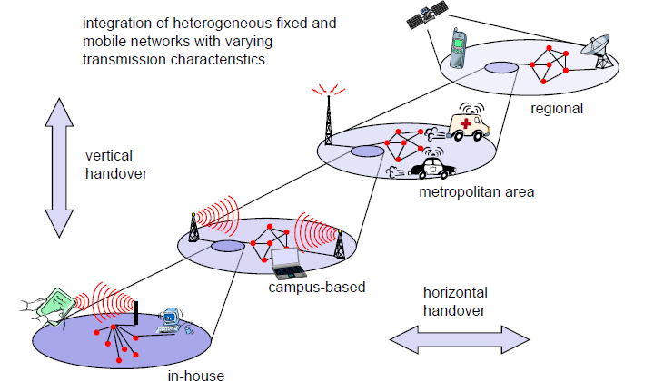
Wireless

Slide 4
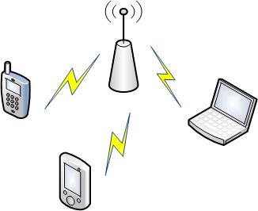
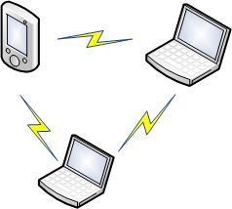
Wireless LAN Architecture
IEEE 802.11 base
  Institute of Electrical and Electronic Engineers (IEEE) has issued number of protocols.
Wireless Fidelity (Wi – Fi)
  WiFI Alliance : promoting WLAN.
Infrastructure Mode
Ad-hoc Mode

Slide 5
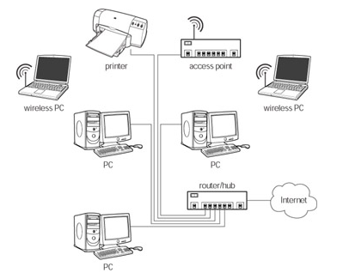
A Hybrid wireless and Ethernet network

Slide 6
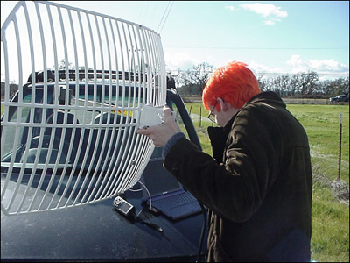
Drawback of Wi-Fi
    Radio frequency interference
  Using radio wave to transmit the signal.
  Signal interference issues
Security flaw
  Easy to eavesdrop
  Poor Authentication
  Rouge Access Point
  DoS attack

Slide 7
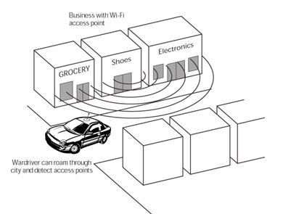
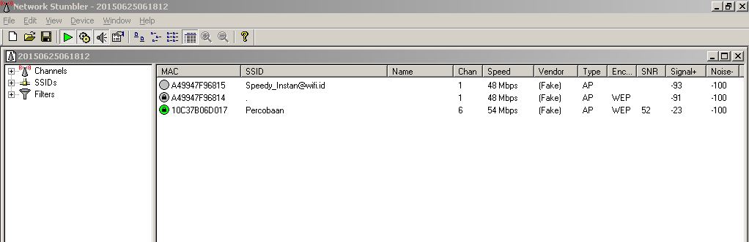
Wardriving
Wardriving is the act of driving around with equipment that can be used to detect Wi-Fi access points located in homes and businesses.

Slide 8
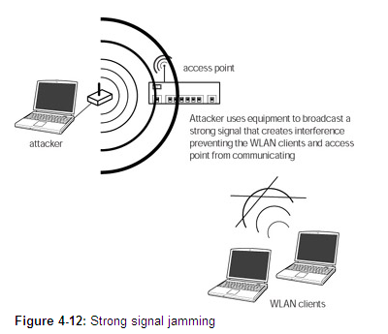
Strong signal jamming
In this simple and direct DoS attack, an attacker uses a wireless transmitter to broadcast interference on the same frequency channel used by the access point, effectively drowning it out and creating so much radio frequency (RF) noise that Wi-Fi devices in the area can’t operate

Slide 9
Security Protection
  Access Control
    Implements Media Access Control (MAC) address filtering.
  Wired Equivalent Privacy (WEP)
    Wireless encryption.
    RC4 algorithm.
  Authentication
    To ensure all the legitimate user enable to use or access the sources/services.
    Type of authentication :
      open system base : Service Set Identifier (SSID).
      shared key authentication : WEP.

Slide 10
MAC Filtering
How it works
  Access permission is given based on MAC address listed.
Security Flaw
  MAC address is spoofed easily.
  Man – in – the – middle attack (MIMA)

Slide 11
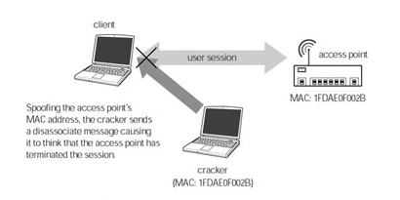
MAC Spoofing

Slide 12
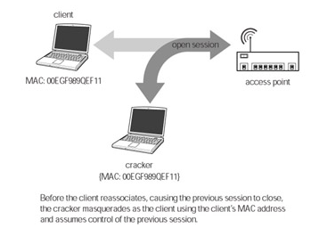
MAC Spoofing

Slide 13
WEP
  The goals:
    Authentication
    Confidentiality
    Integrity
  Use shared key and random 24-bit string initialization vector (IV).
Two levels encryption:
  64 bits key : 40-bit encryption and 24-bit IV (Initial Vector)
  128 bits : 104-bit encryption and 24-bit IV

Slide 14
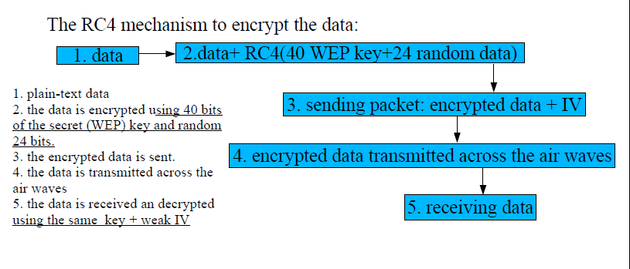
How WEP work (1)

Slide 15
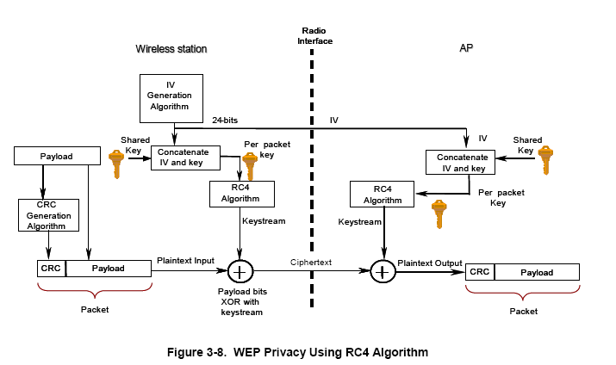
How WEP work (2)

Slide 16
WEP Authentication (1)
Authentication Request
Access
Point
Authentication Challenge
Station
Authentication Response
Authentication Result
Notes:
1. An authentication request management frame is sent requesting use of “shared key” authentication
2. The responder sends an authentication management frame containing 128 octets of challenge text to the initiator (this text is in the clear – plaintext) generated using the WEP pseudo-random number generator with the “shared secret” and a random initialization vector (IV). The IV is always sent in the clear.
3. The initiator encrypts the challenge with the shared key and the IV and sends to responder.
4. The responder verifies the 32-bit CRC integrity check value (ICV) and verifies that the challenge matches. Success/fail status is returned to the initiator

Slide 17
WEP Authentication (2)
1. The client station transmits an authorization request.
2. The access point returns a challenge string in the clear.
3. The client chooses an IV.
4. Using the IV and secret base key, the client encrypts the challenge string.
5. The client station sends the IV and encrypted challenge string to the access point.
6. The access point also encrypts the challenge string using the transmitted IV and the same secret base key.
7. If the client’s encrypted challenge string is identical to the challenge string sent by the client station, the association occurs.

Slide 18
Security Flaw
IV is too small and transmitted in clearttext form.
IV static.
WEP combines IV with key.
WEP does not provide protection to integrity.
  Non-cryptographic Cyclic Redundancy Check (CRC) to check the integrity a packet and acknowledge it with correct checksum.

Slide 19
SSID
Device identity.
Security Flaw
  Not support encryption.
  Rouge Access Point attack.
  Spoofing attack.

Slide 20
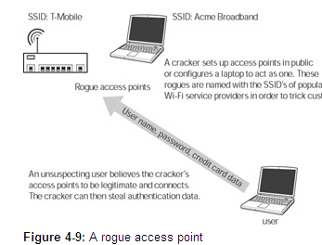
Rogue Access Point
a rogue access point is an access point set up by a cracker to collect data such as passwords, usernames, or credit card numbers.

Slide 21
WPA
Using Temporal Key Integrity Protocol (TKIP) as solution to the encryption problem in WEP.
  Dynamic key
  Adding the size of IV
  Michael (message integrity check) to prevent message modification.
Using Extensible Authentication Protocol (EAP) to authenticate including digital certificate, username & password, smart card, and another.

Slide 22
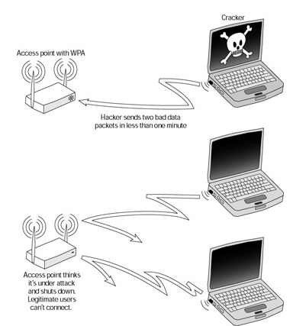
DoS attack

Slide 23
802.11i
802.11i Architecture consist of :
  IEEE 802.1x for authenticating.
    Using EAP and server authentikasi
  Robust Secure Network provide high security level to secure user and network communication.
    IEEE 802.1X to access control.
  AES (Advanced Encryption Standard)-based CCMP (Counter Mode/CBC – MAC Protocol) to provide confidentiality, integrity, and authetication.

Slide 24
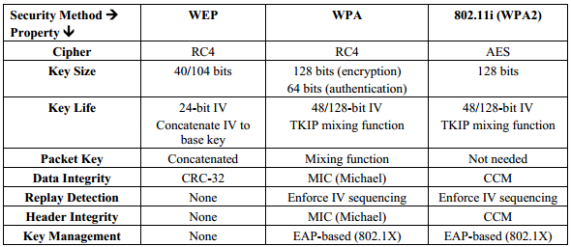
The comparison of WEP, WPA, and IEEE 802.11i

Slide 25
END

