Slide 1

Chapter 7
Collaborative Computing Technologies: Group Support Systems
Turban, Aronson, and Liang Decision Support Systems and Intelligent Systems, Seventh Edition

Slide 2
Learning Objectives
Understand concepts and fundamentals of groupwork, communications, and collaboration.
Examine how computer systems enhance communication and collaboration.
Understand the principles and capabilities of GSS.
Explore the concepts of time/place frameworks.
Learn how GSS interplays with the concepts of process gain and loss, and task gain and loss.
See how GSS utilizes parallelism and anonymity.
Understand the fundamentals of electronic meetings.
Examine GSS’ three technologies.
Learn how the Web enables GSS, electronic meetings, and collaborative computing.
Explain hoe distance learning is enabled by GSS.
Show how GSS enhances creativity.

Slide 3
Chrysler Scores with Groupware Vignette
SCORE initiative
Identified waste in supply chain
Enhanced relationships
Accessed through Internet or modem
Enhanced communication and collaboration
Used good project management principles

Slide 4
Groupwork
Groupwork
  Collaboration and communication
Members can be located in different places and work at different times
Information may be located external to the project
Allows for rapid solutions
May exhibit normal team problems of synergy or conflict
Often Internet based
Groupware tools support groupwork
Work called computer-supported cooperative work
Collaborative computing

Slide 5
Communication Support
No collaboration without communication
Internet supplies fast, reliable, inexpensive support
Groups need not only communication, but information and knowledge

Slide 6
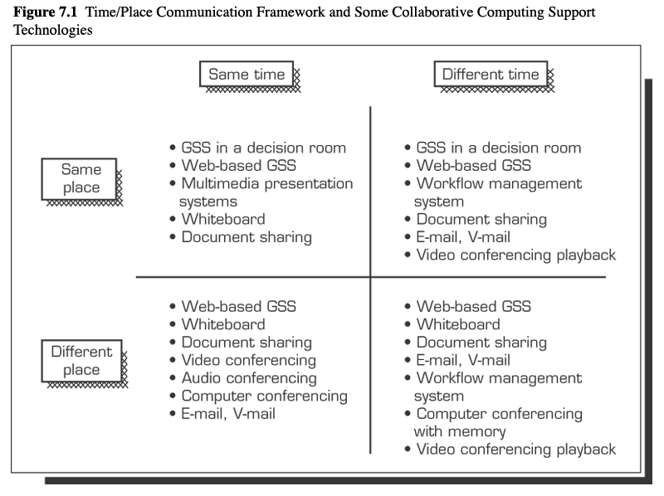
Time/Place Communication Framework
Effectiveness of collaborative group depends on
  Time
    synchronous or asynchronous transmission of information
  Place
    location of participants

Slide 7
Groupware
Software providing collaborative support to groups
Different time/place applications
Most use Internet technologies
Most offer one or more capabilities
  Electronic brainstorming
    Free flow of ideas and comments
  Electronic conferencing or videoconferencing
  Group scheduling and calendars
  Conflict resolution
  Model building
  Electronic document sharing
  Voting services
Electronic meeting services also available
Enterprise-wide systems expensive in cost and human resources

Slide 8
Popular Groupware
Lotus Notes/Domino
Microsoft Netmeeting
Groove Workspace
GroupSystems MeetingRoom and OnLine
WebEx

Slide 9
Benefits and Problems
Benefits of groupwork
  Process gains
    Nominal group technique
    Delphi method
  Technology applied as GSS
    Hardware and software combined to enhance groupwork
    Collaborative computing
Problems in groupwork
  Process losses
  inefficient

Slide 10
GSS
Common group activities with computer assistance
  Information retrieval
  Information sharing
    Parallelism
    Anonymity
  Information use
Support participants
  Improve productivity and effectiveness of meetings
    More efficient decision-making
    Increase effectiveness of decisions

Slide 11
GSS Technology Deployment
Special purpose decision room
  Electronic meeting rooms
  Software operates across LAN
  Allowed for face-to-face meetings
  Trained facilitator coordinates meeting
  Group leader structures meeting with facilitator
Multiple use facility
  General purpose computer lab
  Effective way to lower costs
  Trained facilitator coordinates meeting
  Group leader structures meeting with facilitator
Web-based groupware with clients
  Anytime/anyplace meetings with deadlines established
  Software bought or leased
  No facility costs
  Flexible

Slide 12
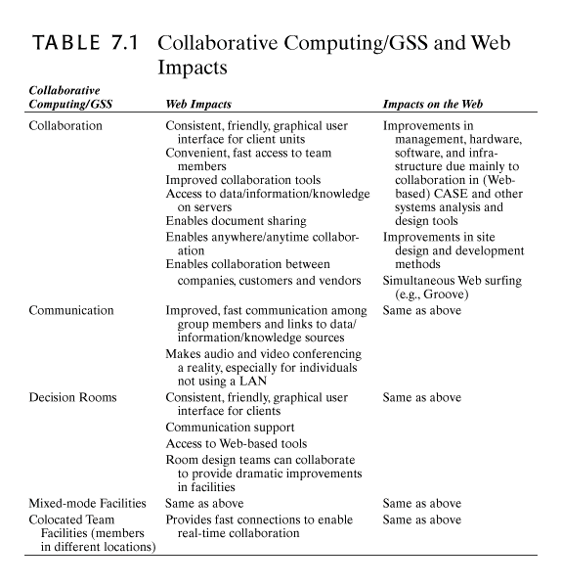

Slide 13
GSS Meeting Process
Group leader meets with facilitator to plan meeting structure.
Participants meet on computers.
Group leader or facilitator poses question.
Participants brainstorm by entering comments into computer.
Facilitator employs idea organization software to sort comments into common themes.
Results are displayed.
Facilitator or group leader leads discussion.
Themes are prioritized.
Highest priority topics are either sent through the process again for further discussion or a vote is taken.

Slide 14
GSS Meeting Process
Standard Process
  Exploratory idea generation
  Idea organization tool
  Prioritization
  New idea generation
  Selection of final idea
Success based upon effectiveness, reduction in costs, better decisions, increased productivity

Slide 15
GSS and Distance Education
Classroom collaborative computing advantages
  Brainstorming, chat, discussion boards
  Distribution of information, lectures
    Publishes to course site
    Videoconferenced
    Consistent materials
  Textbooks can be bound or electronic
  E-mails and listservs
    One-on-one interaction
  Allows for global classrooms
  Anytime/anyplace with fixed deadlines
    Flexible time frame
    Doesn’t interfere with work shift
  Low delivery costs with large audiences

Slide 16
GSS and Distance Education, continued
Disadvantages:
  Fewer social interactions
  Communication problems
  Students must be self-starters and highly disciplined
  Classes require major technical and administrative support
  Technical infrastructure must be reliable
  Courses may need to be redesigned for online
  Special training
Corporate training online:
  Allows anytime/anyplace training
  Lowers costs
  Decreases time away from jobs
  Shortens learning process
  Delivered via Intranet, intranets, extranets, audio and video conferencing

Slide 17
Creativity Support System
Creativity
  Fundamental human trait
  Level of achievement
  Can be learned
Organizations recognize value in innovation
Stimulated by electronic brainstorming software
  Free flow idea generation
Creative computer programs
  Smartbots function as facilitators
  Identify analogies in letter patterns
  Draw art
  Write poems
Computer programs stimulate human productivity

