Slide 1

The Adjectives Used for Showing ‘Similarity’ and ‘Difference’

Slide 2

There are some adjectives that we can use To show the similarity, those words are:
1. similar to (sama seperti)
  Example : Her answer was similar to mine.
2. similar (sama)
  Example : your ideas and mine are similar

Slide 3

Note:
‘similar to’ digunakan diantara dua benda yang dibandingkan
  Example : Her answer was similar to mine.
benda ke 1 benda2
Sedangkan ‘similiar’digunakan setelah dua kata benda atau kata benda jamak.
Example : your ideas and mine are similar
2kata benda/jamaks

Slide 4
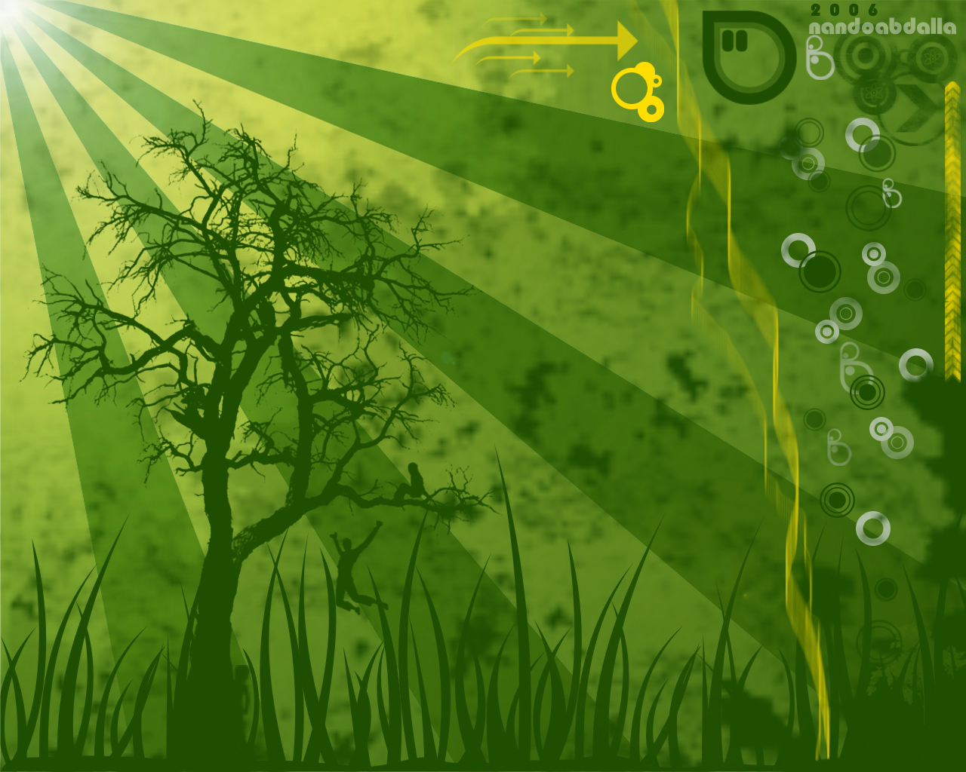
3. alike (sama/ serupa)
  Example : Sam and Andrew look alike.
4. like (seperti)
Example : I bought a new car like yours
Note:
Alike memiliki arti yang nyaris mirip seperti “like”. Tapi perbedaan like dan alike ada di penggunaannya. Like digunakan untuk menyatakan kemiripan, sedangkan alike digunakan untuk menyatakan kesamaan

Slide 5

There is an adjective that we can use To show the difference, there is:
1. different from (berbeda dari)
  Example : This book is different from the one you borrowed.
2. different (berbeda)
Example : Even though they are twins, but their characteristics are different

Slide 6

NOTE:
‘different from’ digunakan diantara dua benda yang dibandingkan
  Example : My new car is different from yours.
benda ke 1 benda2
Sedangkan ‘different’digunakan setelah dua kata benda atau kata benda jamak.
Example : You and I are totally different
2kata benda/jamaks

