Slide 1

QUESTION TAG

Slide 2

A question tag is a special construction in English. Question tag ialah kalimat (statement) yang diikuti oleh mini- question.
Tag question are used frequently in conversation to encourage agreement or to verify a statement. Question tags are more common in speaking than writing.
Kita sering menggunakan question tags ketika kita mengharapkan pendengar setuju dengan pernyataan kita. Dalam hal ini, jika pernyataan berbentuk positive, maka kita menggunakan negative question tag dan begitu juga sebalinya.

Slide 3
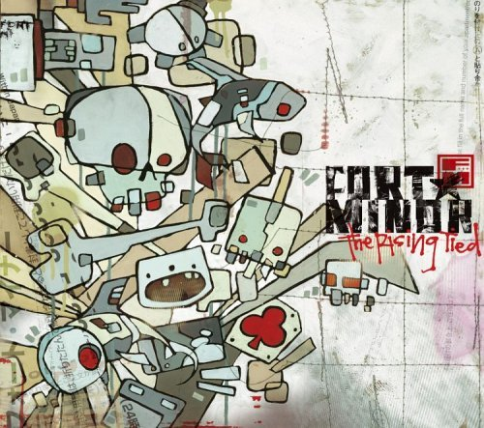
For Nominal sentence (adjective , adverb or noun)
S + to be + adjective or noun + , + to be + S
Example:
They are a romantic couple, aren’t they?
We weren’t best friend anymore since 1999, were we?
Sani is here, isn’t she?
Remember: “Jika kalimat berbentuk positive maka question tag is harus berbentuk negative, dan begitu juga sebaliknya.

Slide 4

Special case:
- I am a sweet teacher, aren’t I?
Explanation: aren’t I is common in spoken English, while am I not is only on formal English.
-This/ That is your book, isn’t it?
Explanation: the tag pronoun for this/ that = it because this/ that are singular
-These/Those are yours, aren’t they?
Explanation: the tag pronoun for These/Those=they because these/those are plural

Slide 5

For Verbal sentence
S + Verb + , + auxiliary verb + S
The example of positive statement:
She agrees with me, doesn’t she?
They came to my party, didn’t they?
You have done your homework, haven’t you?
We will go to around the world, won’t we?
Remember: “jika verbal sentence berbentuk positive maka question tag bergantung pada penggunakan jenis tensis/ modalnya
The example negative statement:
She didn't agree with me, did she?
They didn’t come to my party, did they?
You have not done your homework, have you?
We will not go to around the world, will we?

Slide 6

Analyze these sentence
I owe you twenty dollars, ………..?
This is my apple,…………..?
She understood the question, …………?
The Golden gate bridge is located in San Francisco,…..?
George Washington Carver suggested many
A
different uses for peanuts, isn’t it?
B C D

Slide 7

6. They sing a dangdut song, didn’t they?
7. That is mine,……?
8. Hemingway has written short stories as well as novels, ……?
9. The climate is changing very slowly in the northern United States, …………?
10. I am a sweet friend,…………?

