Slide 1
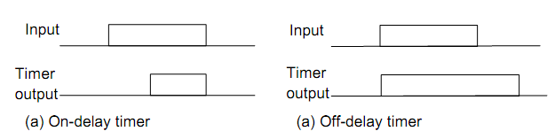
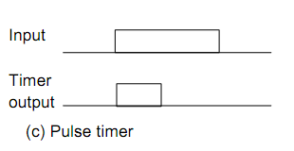
Timers
X.1
Types of timer
Versi: 01

Slide 2

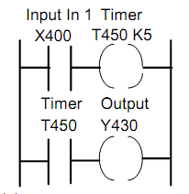
X.2
Programming Timers
On delay timer
Mitsubishi
The timers like a relay with coil
Versi: 01

Slide 3
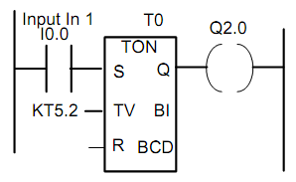
X.3
Siemens
Delay item in the rung
Versi: 01

Slide 4
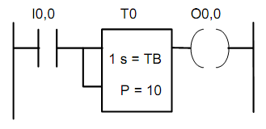
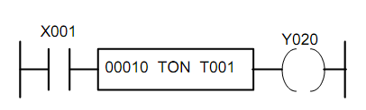
X.4
Telemecanique.
Toshiba
Versi: 01

Slide 5
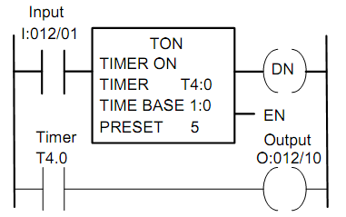
X.5
Allen-Bradley
Versi: 01

Slide 6
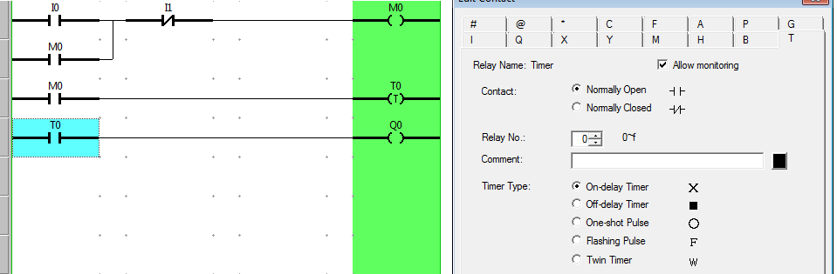
X.6
OMRON ZEN
Versi: 01

