Slide 1
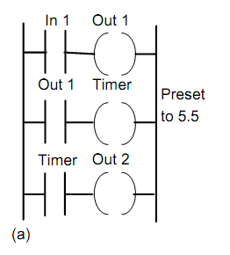
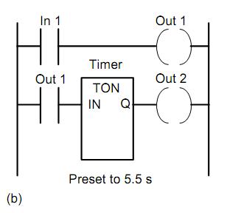
Timers (cont.)
XI.1
Sequencing
Versi: 01

Slide 2

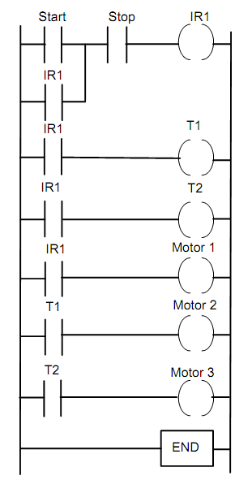
XI.2
Timers can be start three outputs
Versi: 01

Slide 3
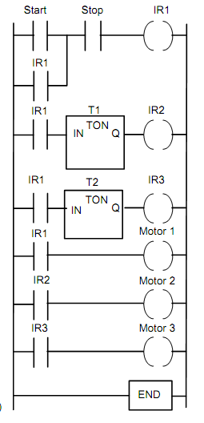
XI.3
Versi: 01

Slide 4
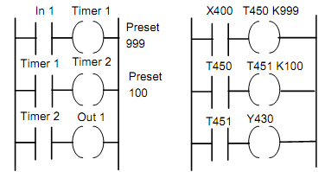
XI.4
Cascaded Timers
Versi: 01

Slide 5
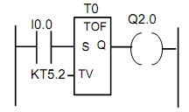

XI.5
Off Delay timers
Siemens
Versi: 01

Slide 6
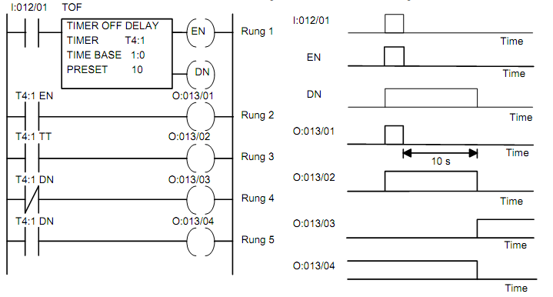
XI.6
Allen-Bradley
Versi: 01

