Slide 1



Bahan Ajar
Materi Pembelajaran
Matakuliah :
Sistem Tertanam
Kode Matakuliah : SKO20416
Prodi : SISTEM KOMPUTER
Dosen Pengampu Matakuliah:
Dodi Yudo Setyawan, S.Si., M.T.I

Slide 2
Operator matematika

Slide 3
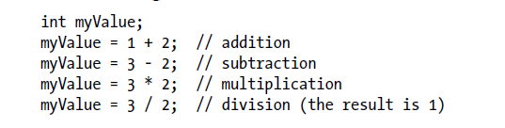
Adding, Subtracting, Multiplying, and Dividing

Slide 4
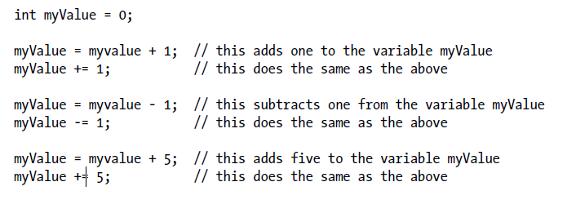
Incrementing and Decrementing Values

Slide 5
Finding the Remainder After Dividing Two Values

Slide 6

Determining the Absolute Value

Slide 7

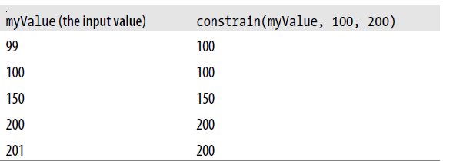
Constraining a Number to a Range of Values

Slide 8
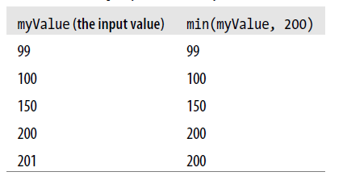
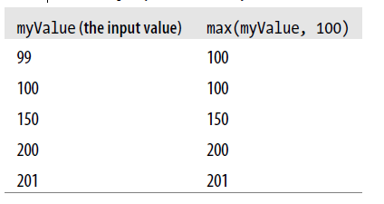
Finding the Minimum or Maximum of Some Values

Slide 9
Terimakasih

