Slide 1



Bahan Ajar
Materi Pembelajaran
Matakuliah :
Sistem Tertanam
Kode Matakuliah : SKO20416
Prodi : SISTEM KOMPUTER
Dosen Pengampu Matakuliah:
Dodi Yudo Setyawan, S.Si., M.T.I

Slide 2
Audio Output

Slide 3
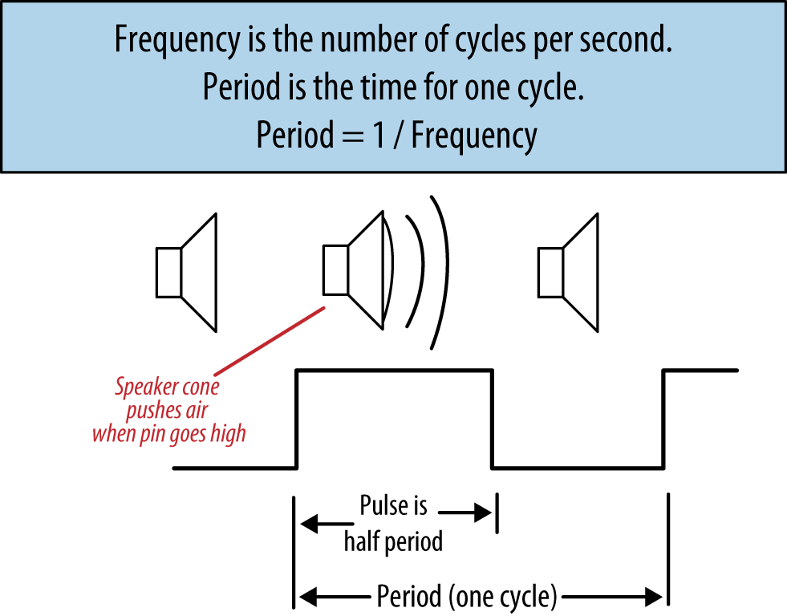
Generating sound using digital pulses

Slide 4
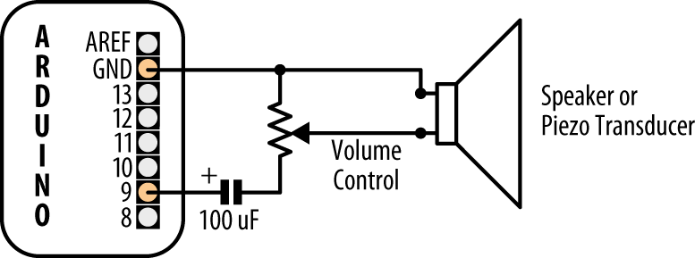
Connecting to an audio transducer

Slide 5
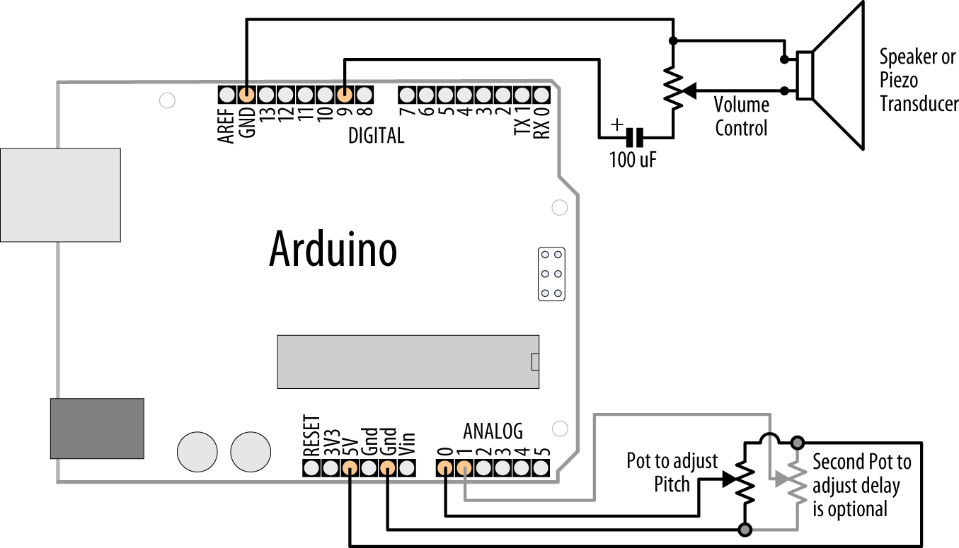
Playing Tones

Slide 6
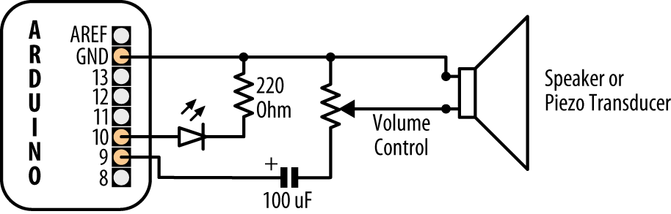
Generating Audio Tones and Fading an LED

Slide 7
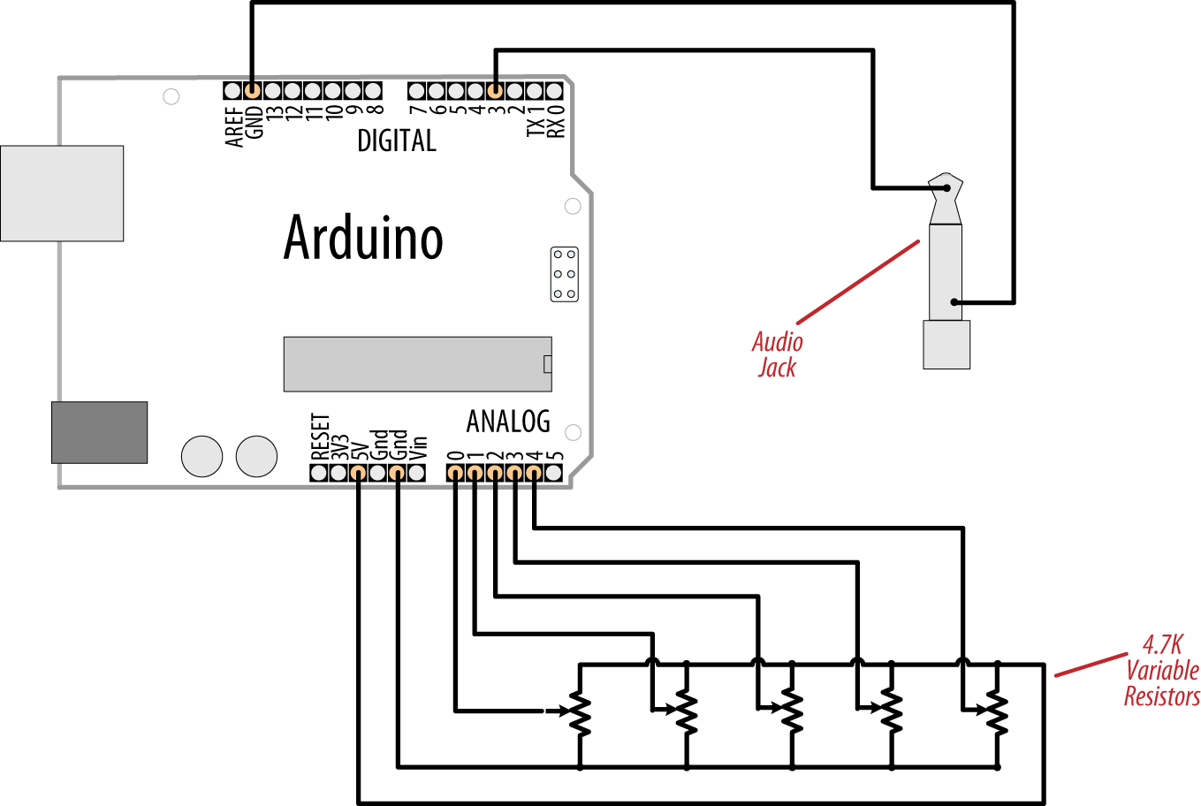
Making an Audio Synthesizer

Slide 8
Simple

