Slide 1



Bahan Ajar
Materi Pembelajaran
Matakuliah :
Sistem Tertanam
Kode Matakuliah : SKO20416
Prodi : SISTEM KOMPUTER
Dosen Pengampu Matakuliah:
Dodi Yudo Setyawan, S.Si., M.T.I

Slide 2
Liquid crystal displays
(LCDs)

Slide 3
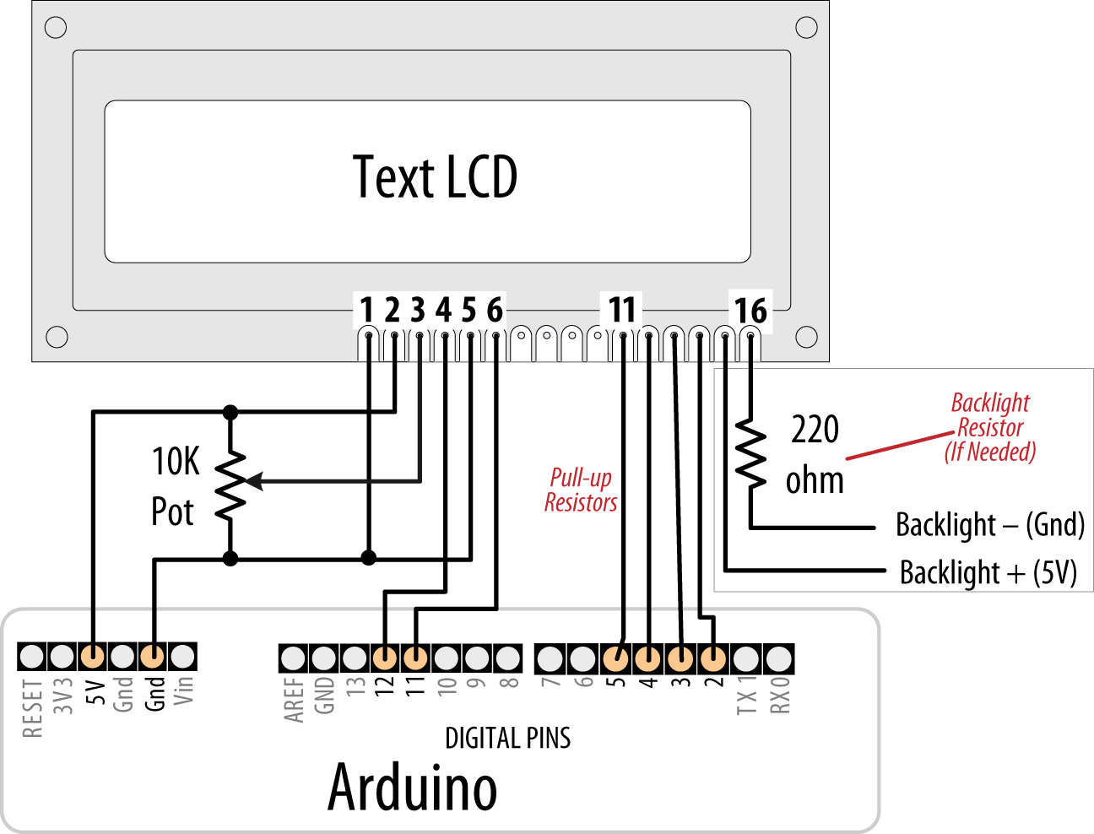
Connecting and Using a Text LCD Display

Slide 4
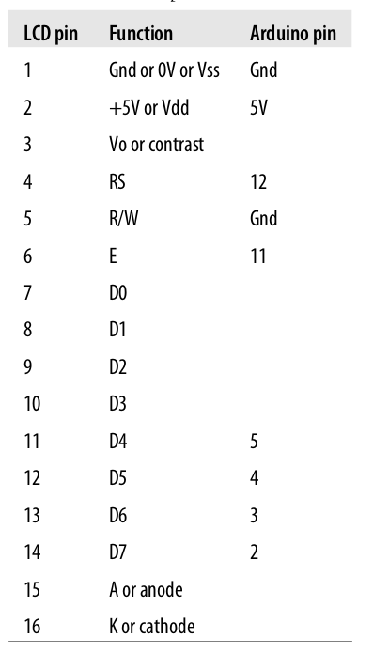

Slide 5
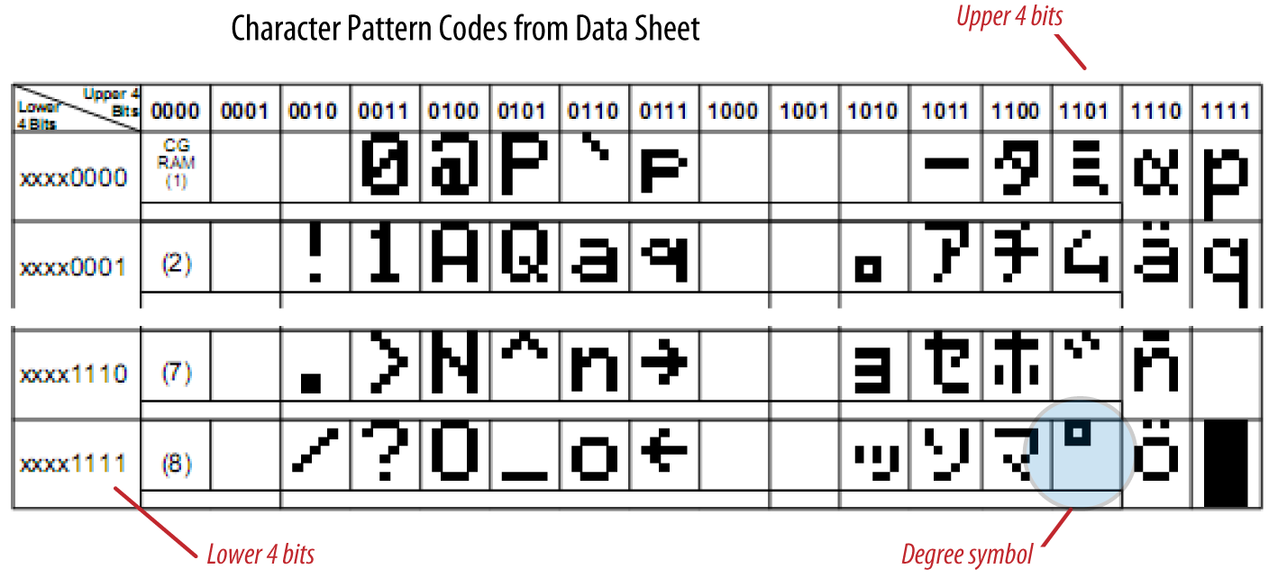
Displaying Special Symbols

Slide 6
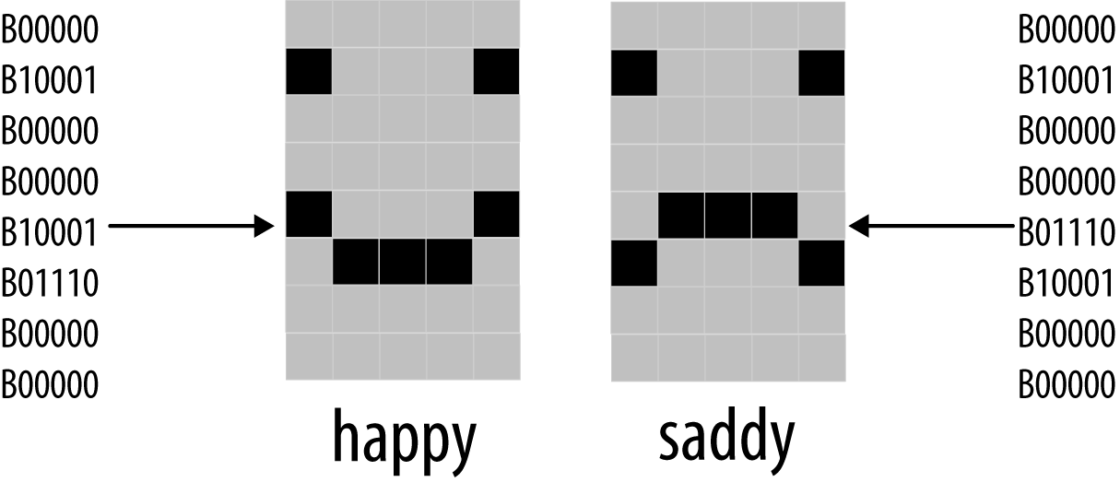
Creating Custom Characters

Slide 7
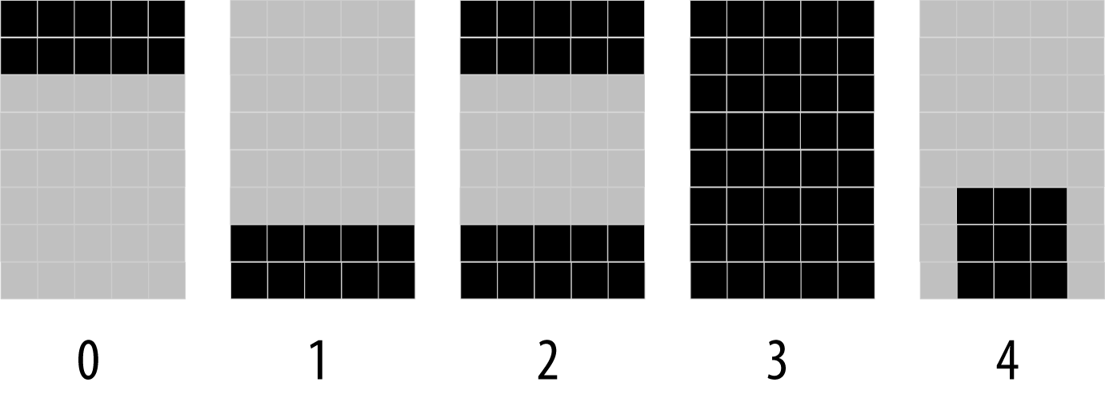
Displaying Symbols Larger Than a Single Character

Slide 8
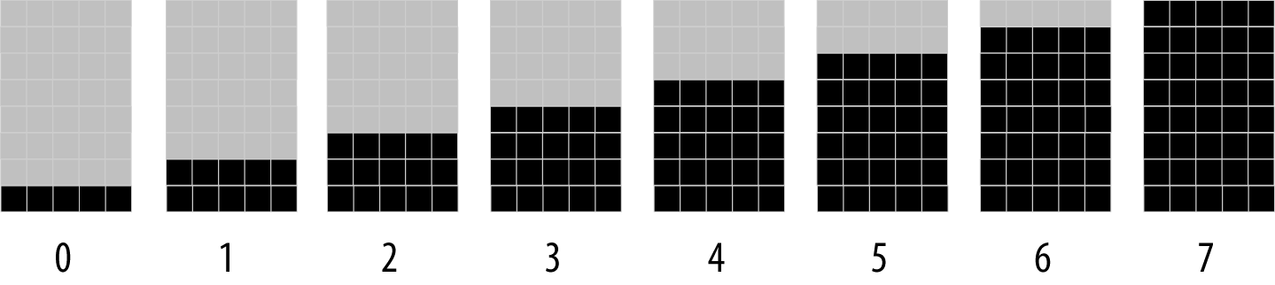
Displaying Pixels Smaller Than a Single Character

Slide 9
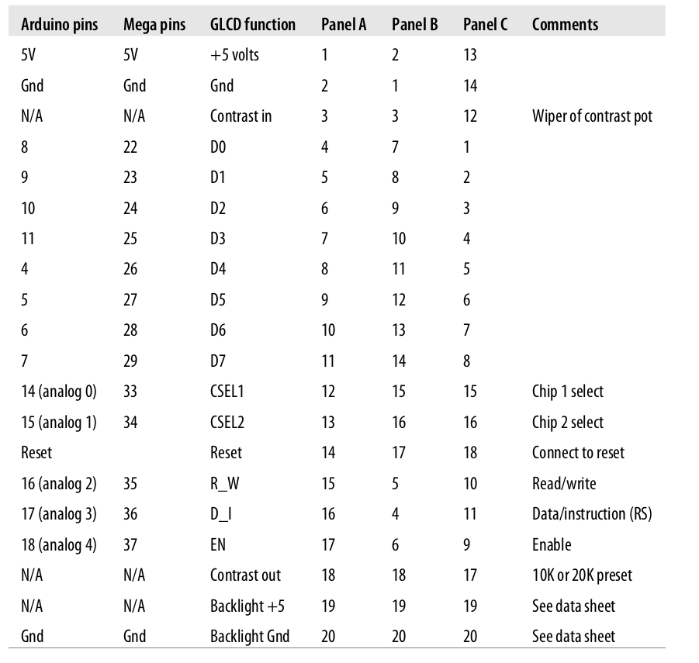
Connecting and Using a Graphical LCD Display

Slide 10
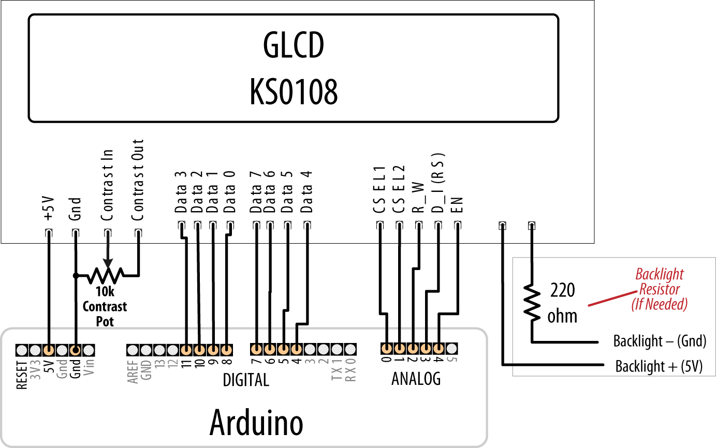
GLCD wiring for type A panels; check your data sheet for pinout

Slide 11
Terimakasih

