Slide 1

6.888:
Lecture 4
Data Center Load Balancing
Mohammad Alizadeh
Spring 2016

Slide 2

Motivation
DC networks need large bisection bandwidth for distributed apps (big data, HPC, web services, etc)
Multi-rooted tree [Fat-tree, Leaf-Spine, …]
Full bisection bandwidth, achieved via multipathing
Single-rooted tree
High oversubscription
Core
Spine
Agg
Leaf
Access
1000s of server ports
1000s of server ports
Notes:
To set the context, the primary motivation for this work is that datacenter networks need to provide large amounts of bisection bandwidth to support distributed applications; if you consider applications like big data analytics, hPC, or web services, they all require significant network IO between components that are spread across 100s or even 1000s of servers.
In response to this, in recent years, the single rooted tree topologies that have been used in enterprise networks for decades are being replaced with multi-rooted topologies. These new topologies, also called fat-tree or Leaf-Spine, are great -- they can scale bandwidth arbitrarily by just adding more paths; for example, adding more spine switches in a Leaf-Spine design.

Slide 3
Motivation
DC networks need large bisection bandwidth for distributed apps (big data, HPC, web services, etc)
Multi-rooted tree [Fat-tree, Leaf-Spine, …]
Full bisection bandwidth, achieved via multipathing
Spine
Leaf
1000s of server ports
Notes:
So the whole industry is moving in this direction -- of using multi-rooted topologies to build networks with full or near-full bisection bandwidth.
This is great… but if we take a step back, it’s not really what we want.

Slide 4
Multi-rooted != Ideal DC Network
Ideal DC network:
Big output-queued switch
Multi-rooted tree
≈
Can’t build it ☹
1000s of server ports
1000s of server ports
No internal bottlenecks ➔ predictable
Simplifies BW management [Bw guarantees, QoS, …]
Need efficient load balancing
Possible
bottlenecks
Notes:
A multi-rooted topology is not the “ideal” datacenter network.
What is the ideal network? The ideal network would be a big switch – or more precisely a big output-queued switch. That’s a switch that whenever…

Slide 5

Today: ECMP Load Balancing
Pick among equal-cost paths by a hash of 5-tuple
Randomized load balancing
Preserves packet order
Problems:
Hash collisions
(coarse granularity)
Local & stateless
(bad with asymmetry;
e.g., due to link failures)
H(f) % 3 = 0

Slide 6
Solution Landscape
Centralized
Distributed
[Hedera, Planck, Fastpass, …]
In-Network
Host-Based
Cong. Oblivious
Cong. Aware
Cong. Oblivious
Cong. Aware
[ECMP, WCMP,
packet-spray, …]
[Flare, TeXCP, CONGA,
DeTail, HULA, …]
[Presto]
[MPTCP, FlowBender…]

Slide 7
MPTCP
Slides by Damon Wischik (with minor modifications)

Slide 8
What problem is MPTCP trying to solve?
Multipath ‘pools’ links.
=
Two separate links
A pool of links
TCP controls how a link is shared.
How should a pool be shared?
Notes:
In a circuit-switched network, there is a dedicated channel for each flow. It’s rigid and inflexible: when one flow is silent, the other flow can’t fill in. Packet switching gives you much more flexibility (whether you use it for ATM virtual circuits, or for full-blown IP).
Multipath brings flexibility of the same sort. Pic 3 is rigid and inflexible, Pic 4 is flexible.
In the case of packet switching, you need to be careful about how the flows share the link. Pic 1 circuits made it easy – they give strict isolation between flows. But with Pic 2 packet switching, you need a control plane. It could be with ATM and admission control. Or it could be TCP congestion control, which says how end-systems should adapt their rates so that the network shares its capacity fairly.
What sort of control plane do we need, to ensure that a multipath network works well?

Slide 9
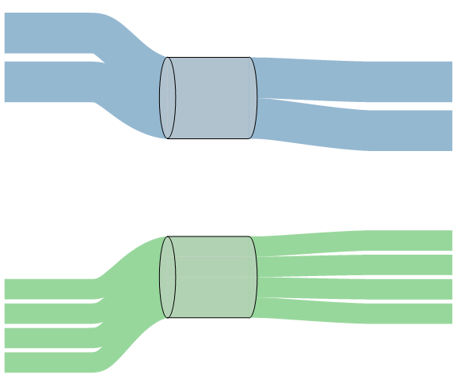
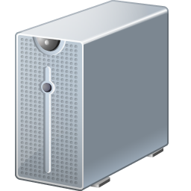
Application: Multihomed web server
2 TCPs
@ 50Mb/s
100Mb/s
100Mb/s
4 TCPs
@ 25Mb/s
Notes:
Web server, dual-homed. ... This is, ideally, what should happen.

Slide 10
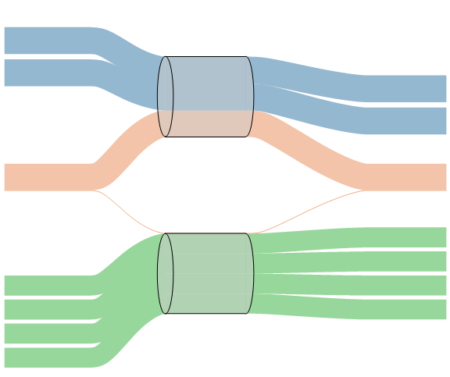
Application: Multihomed web server
2 TCPs
@ 33Mb/s
100Mb/s
1 MPTCP
@ 33Mb/s
100Mb/s
4 TCPs
@ 25Mb/s

Slide 11
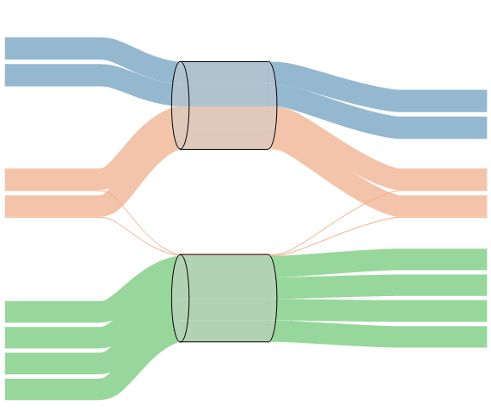
Application: Multihomed web server
2 TCPs
@ 25Mb/s
100Mb/s
2 MPTCPs
@ 25Mb/s
100Mb/s
4 TCPs
@ 25Mb/s
The total capacity, 200Mb/s, is shared out evenly between all 8 flows.
Notes:
At this point, the total access capacity is shared evenly between all the flows.

Slide 12
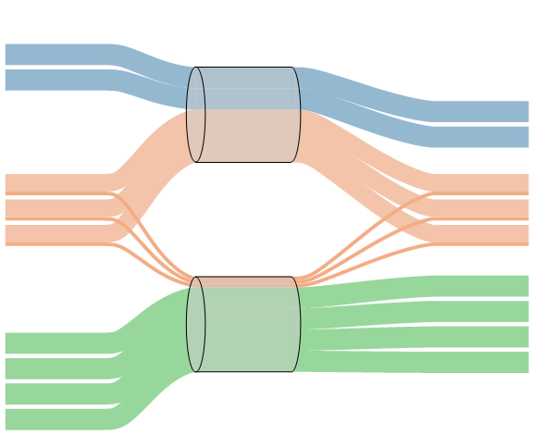
Application: Multihomed web server
2 TCPs
@ 22Mb/s
100Mb/s
3 MPTCPs
@ 22Mb/s
100Mb/s
4 TCPs
@ 22Mb/s
The total capacity, 200Mb/s, is shared out evenly between all 9 flows.
It’s as if they were all sharing a single 200Mb/s link. The two links can be said to form a 200Mb/s pool.

Slide 13
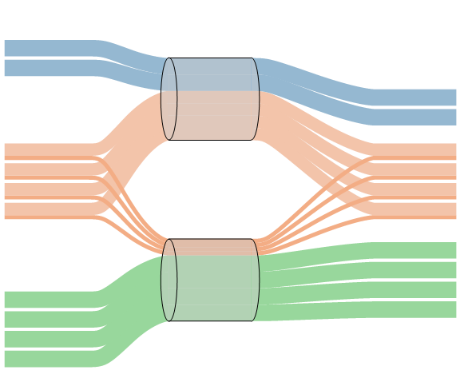
Application: Multihomed web server
2 TCPs
@ 20Mb/s
100Mb/s
4 MPTCPs
@ 20Mb/s
100Mb/s
4 TCPs
@ 20Mb/s
The total capacity, 200Mb/s, is shared out evenly between all 10 flows.
It’s as if they were all sharing a single 200Mb/s link. The two links can be said to form a 200Mb/s pool.

Slide 14

Application: WIFI & cellular together
How should your phone balance its traffic across very different paths?
wifi path:
high loss, small RTT
3G path:
low loss, high RTT
Notes:
It’s obviously good to use both interfaces, to get reliability. But if you just transmit away full blast, is it unfair to the other users?
If you decide not to blast away, how should you balance your traffic, when the paths are so different?

Slide 15
Application: Datacenters
Can we make the network behave like a large pool of capacity?

Slide 16
MPTCP is a general-purpose multipath replacement for TCP.

Slide 17
What is the MPTCP protocol?
MPTCP is a replacement for TCP which lets you use multiple paths simultaneously.
user space
socket API
The sender stripes packets across paths
MPTCP
The receiver puts the packets in the correct order
TCP
MPTCP
IP
addr
addr₁
addr₂
Notes:
I’m interested in the congestion control component.
What I talk about is generic: if you want multipath CompoundTCP, or multipath SCTP, or multipath CubicTCP, you’ll need to face the same design issues. We have made our algorithm fit nicely with TCP, but merely as a starting point.

Slide 18
What is the MPTCP protocol?
MPTCP is a replacement for TCP which lets you use multiple paths simultaneously.
user space
socket API
The sender stripes packets across paths
MPTCP
The receiver puts the packets in the correct order
TCP
MPTCP
IP
addr
addr
port p₁
a switch with port-based routing
port p₂
Notes:
I’m interested in the congestion control component.
What I talk about is generic: if you want multipath CompoundTCP, or multipath SCTP, or multipath CubicTCP, you’ll need to face the same design issues. We have made our algorithm fit nicely with TCP, but merely as a starting point.

Slide 19
Design goal 1:
Multipath TCP should be fair to regular TCP at shared bottlenecks
To be fair, Multipath TCP should take as much capacity as TCP at a bottleneck link, no matter how many paths it is using.
A multipath TCP flow with two subflows
Regular TCP
Strawman solution:
Run “½ TCP” on each path
Notes:
This is the very first thing that comes to mind with multipath TCP, and it’s something that many other people have solved in different ways.
This is just a warm-up... Design Goal 3 is a much “richer” generalization of this goal, which accommodates different topologies, different RTTs. So there’s no point giving an evaluation here.

Slide 20
Design goal 2:
MPTCP should use efficient paths
Each flow has a choice of a 1-hop and a 2-hop path.
How should split its traffic?
12Mb/s
12Mb/s
12Mb/s
Notes:
I’m thinking of the paths as given. MPTCP has the choice of how to split its traffic over those given paths.

Slide 21
Design goal 2:
MPTCP should use efficient paths
If each flow split its traffic 1:1 ...
12Mb/s
8Mb/s
12Mb/s
8Mb/s
8Mb/s
12Mb/s

Slide 22
Design goal 2:
MPTCP should use efficient paths
If each flow split its traffic 2:1 ...
12Mb/s
9Mb/s
12Mb/s
9Mb/s
9Mb/s
12Mb/s

Slide 23
Design goal 2:
MPTCP should use efficient paths
If each flow split its traffic 4:1 ...
12Mb/s
10Mb/s
12Mb/s
10Mb/s
10Mb/s
12Mb/s

Slide 24
Design goal 2:
MPTCP should use efficient paths
If each flow split its traffic ∞:1 ...
12Mb/s
12Mb/s
12Mb/s
12Mb/s
12Mb/s
12Mb/s

Slide 25
Design goal 2:
MPTCP should use efficient paths
12Mb/s
12Mb/s
12Mb/s
12Mb/s
12Mb/s
12Mb/s
Theoretical solution (Kelly+Voice 2005; Han, Towsley et al. 2006)
MPTCP should send all its traffic on its least-congested paths.
Theorem. This will lead to the most efficient allocation possible, given a network topology and a set of available paths.

Slide 26
Design goal 3:
MPTCP should be fair compared to TCP
Design Goal 2 says to send all your traffic on the least congested path, in this case 3G. But this has high RTT, hence it will give low throughput.
wifi path:
high loss, small RTT
c
d
3G path:
low loss, high RTT
Goal 3a. A Multipath TCP user should get at least as much throughput as a single-path TCP would on the best of the available paths.
Goal 3b. A Multipath TCP flow should take no more capacity on any link than a single-path TCP would.
Notes:
Let’s get back to fairness. This is a more systematic and general way to think about fairness, than the simple bottleneck idea I started with.
If we follow Design Goal 2, we’ll push all our traffic onto the low-loss path, i.e. 3G. But 3G has high RTT, which means that a TCP flow would get low throughput. In order to be fair to TCP, we shouldn’t send very much traffic over 3G. But then the user is suffering because of MPTCP, which is no good.
We want the user to have an incentive to use MPTCP, and we want the network to have an incentive to permit MPTCP. Here’s a more precise way to put it.

Slide 27
Design goals
Goal 1. Be fair to TCP at bottleneck links
Goal 2. Use efficient paths ...
Goal 3. as much as we can, while being fair to TCP
Goal 4. Adapt quickly when congestion changes
Goal 5. Don’t oscillate
How does MPTCP achieve all this?
Read: “Design, implementation, and evaluation of congestion control for multipath TCP, NSDI 2011”
Notes:
“Goal 3. Be fair to TCP” means two things:
fair to the user, i.e. user doesn’t suffer by switching from TCP to MPTCP;
fair to the network, i.e. network doesn’t suffer when users switch from TCP to MPTCP.
It subsumes Goal 1.
There are two more goals.
Paper discusses Goal 4 at length.
Goal 5: we didn’t see any oscillations in our evaluation; theory papers predict no oscillation, for an idealized model.

Slide 28
How does TCP congestion control work?
Maintain a congestion window w.
Increase w for each ACK, by 1/w
Decrease w for each drop, by w/2

Slide 29
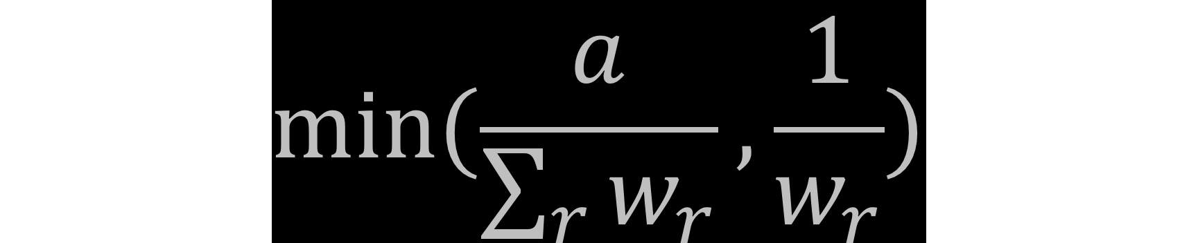
How does MPTCP congestion control work?
Maintain a congestion window w_{r}, one window for each path, where r ∊ R ranges over the set of available paths.
Increase w_{r} for each ACK on path r, by
Decrease w_{r} for each drop on path r, by w_{r} /2
Notes:
MPTCP works pretty much like TCP, i.e. window increases and window decreases on each path. The decrease is the same as TCP. When there is only one path available, this formula reduces to the TCP formula.
We derived a throughput formula for this congestion control algorithm, and checked that it satisfies the design goals.

Slide 30
Discussion

Slide 31
What You Said
Ravi: “An interesting point in the MPTCP paper is that they target a 'sweet spot' where there is a fair amount of traffic but the core is neither overloaded nor underloaded.”

Slide 32
What You Said
Hongzi: “The paper talked a bit of `probing’ to see if a link has high load and pick some other links, and there are some specific ways of assigning randomized assignment of subflows on links. I was wondering does the `power of 2 choices’ have some roles to play here?”

Slide 33
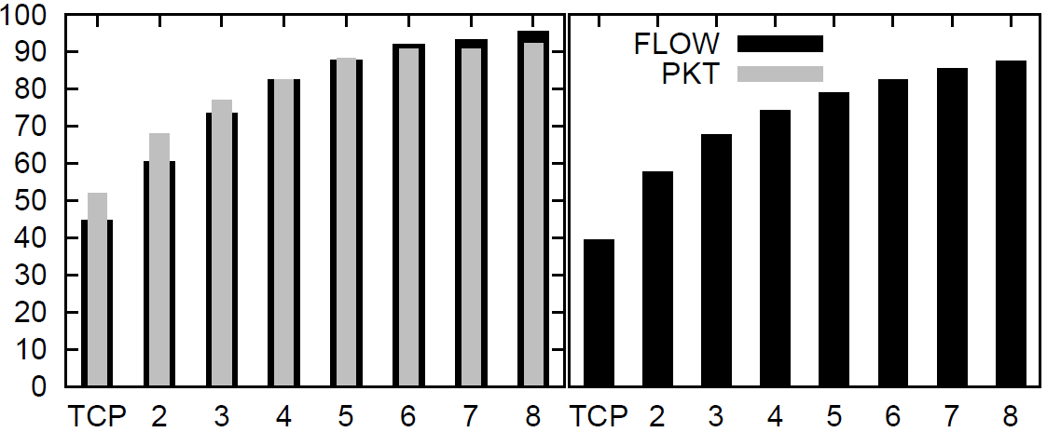
MPTCP discovers available capacity, and it doesn’t need much path choice.
Throughput
(% of optimal)
FatTree, 128 nodes
FatTree, 8192 nodes
Num. paths
Simulations of FatTree, 100Mb/s links, permutation traffic matrix,
one flow per host, TCP+ECMP versus MPTCP.
If each node-pair balances its traffic over 8 paths, chosen at random, then utilization is around 90% of optimal.

Slide 34
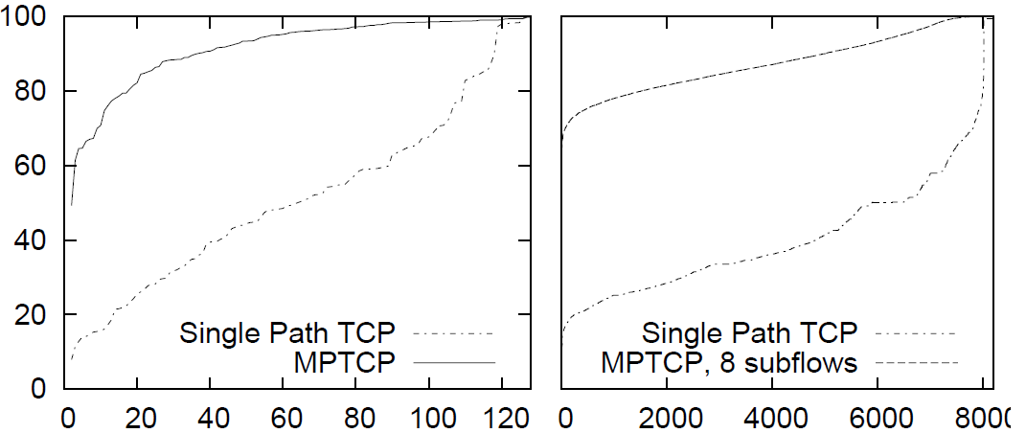
MPTCP discovers available capacity, and it shares it out more fairly than TCP+ECMP.
Throughput
(% of optimal)
FatTree, 128 nodes
FatTree, 8192 nodes
Flow rank
Simulations of FatTree, 100Mb/s links, permutation traffic matrix,
one flow per host, TCP+ECMP versus MPTCP.

Slide 35
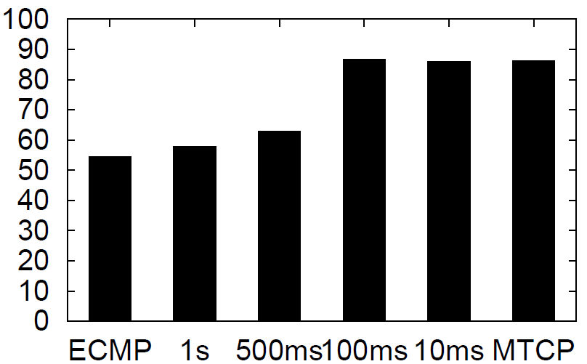
MPTCP can make good path choices, as good as a very fast centralized scheduler.
Throughput [% of optimal]
Simulation of FatTree with 128 hosts.
Permutation traffic matrix
Closed-loop flow arrivals (one flow finishes, another starts)
Flow size distributions from VL2 dataset
MPTCP
Hedera first-fit heuristic

Slide 36
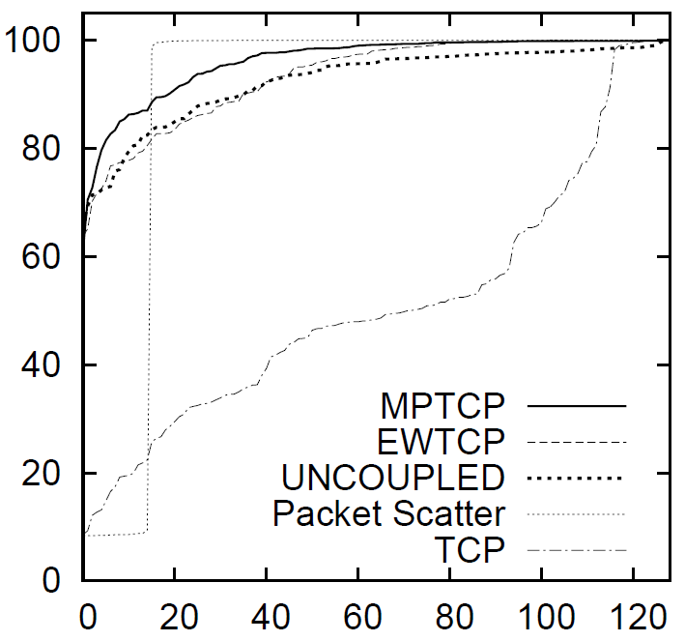
MPTCP permits flexible topologies
Average throughput
[% of optimal]
Simulation of 128-node FatTree, when one of the 1Gb/s core links is cut to 100Mb/s
Rank of flow
Because an MPTCP flow shifts its traffic onto its least congested paths, congestion hotspots are made to “diffuse” throughout the network. Non-adaptive congestion control, on the other hand, does not cope well with non-homogenous topologies.
Notes:
This is a very plausible sort of failure!

Slide 37
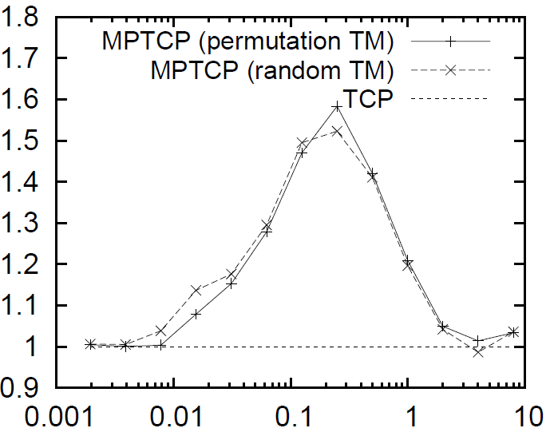
MPTCP permits flexible topologies
Ratio of throughputs, MPTCP/TCP
Simulation of a FatTree-like topology with 512 nodes, but with 4 hosts for every up-link from a top-of-rack switch, i.e. the core is oversubscribed 4:1.
Permutation TM: each host sends to one other, each host receives from one other
Random TM: each host sends to one other, each host may receive from any number
Connections per host
At low loads, there are few collisions, and NICs are saturated, so TCP ≈ MPTCP
At high loads, the core is severely congested, and TCP can fully exploit all the core links, so TCP ≈ MPTCP
When the core is “right-provisioned”, i.e. just saturated, MPTCP > TCP

Slide 38
MPTCP permits flexible topologies
FatTree
(5 ports per host in total,
1Gb/s bisection bandwidth)
Dual-homed FatTree
(5 ports per host in total,
1Gb/s bisection bandwidth)
1Gb/s
1Gb/s
If only 50% of hosts are active, you’d like each host to be able to send at 2Gb/s, faster than one NIC can support.

Slide 39
Presto
Adapted from slides by Keqiang He (Wisconsin)

Slide 40
Solution Landscape
Centralized
Distributed
[Hedera, Planck, Fastpass, …]
In-Network
Host-Based
Cong. Oblivious
Cong. Aware
Cong. Oblivious
Cong. Aware
[ECMP, WCMP,
packet-spray, …]
[Flare, TeXCP, CONGA,
HULA, DeTail…]
[Presto]
[MPTCP, FlowBender…]
Is congestion-aware load balancing overkill for datacenters?

Slide 41
We’ve already seen a congestion-oblivious load balancing scheme
ECMP
Presto is fine-grained congestion-oblivious
load balancing
Key challenge is making this practical

Slide 42
Key Design Decisions
Use software edge
  No changes to transport (e.g., inside VMs) or switches
LB granularity flowcells [e.g. 64KB of data]
  Works with TSO (TSC Segmentation Offload) hardware offload
  No reordering for mice
  Makes dealing with reordering simpler (Why?)
“Fix” reordering at GRO (Generic Receive Offloading) layer
  Avoid high per-packet processing (esp. at 10Gb/s and above)
End-to-end path control

Slide 43

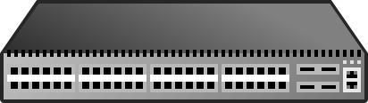
Presto at a High Level
Spine
Leaf
Near uniform-sized data units
NIC
NIC
vSwitch
vSwitch
TCP/IP
TCP/IP
Notes:
Now let’s see how Presto works at high level.
First Presto load balances on near uniform-sized small data units.

Slide 44
Presto at a High Level
Spine
Leaf
Near uniform-sized data units
NIC
Proactively distributed evenly over symmetric network by vSwitch sender
NIC
vSwitch
vSwitch
TCP/IP
TCP/IP
Notes:
These near uniform-sized data units are proactively distributed evenly over the symmetric network by the virtual switches on the hosts.
Please note that today’s data center networks are commonly constructed by symmetric Clos networks.

Slide 45
Presto at a High Level
Spine
Leaf
Near uniform-sized data units
NIC
Proactively distributed evenly over symmetric network by vSwitch sender
NIC
vSwitch
vSwitch
TCP/IP
TCP/IP
Notes:
This slide illustrates how the uniform-sized data units are distributed evenly over the symmetric network.

Slide 46
Presto at a High Level
Spine
Leaf
Near uniform-sized data units
NIC
Proactively distributed evenly over symmetric network by vSwitch sender
NIC
vSwitch
vSwitch
TCP/IP
Receiver masks packet reordering due to multipathing below transport layer
TCP/IP
Notes:
This kind of fine-grained load balancing scheme can cause packet reordering at the receiver side, therefore, at the receiver side,
Presto masks packet reordering due to multipathing below the transport layer.

Slide 47
Discussion

Slide 48
What You Said
Arman: “From an (information) theoretic perspective, order should not be such a troubling phenomenon, yet in real networks ordering is so important. How practical are “rateless codes” (network coding, raptor codes, etc.) in alleviating this problem?”
Amy: “The main complexities in the paper stem from the requirement that servers use TSO and GRO to achieve high throughput. It is surprising to me that people still rely so heavily on TSO and GRO. Why doesn't someone build a multi-core TCP stack that can process individual packets at line rate in software?”

Slide 49
Presto LB Granularity
Presto: load-balance on flowcells
What is flowcell?
  A set of TCP segments with bounded byte count
  Bound is maximal TCP Segmentation Offload (TSO) size
    Maximize the benefit of TSO for high speed
    64KB in implementation
What’s TSO?
TCP/IP
Large Segment
NIC
Segmentation & Checksum Offload
MTU-sized Ethernet Frames
Notes:
Instead, Presto load balances on flowcells.
Flowcell essentially is a set of TCP segments with bounded byte count. The bound is the maximal TCP Segmentation Offload (TSO) size
because we want to maximize the benefit of TSO for high speed.
It was 64KB in our implementation.
So, what’s TSO? When a system needs to send large chunks of data, TCP/IP stack operates on large segments and passes
those large segments down to the NIC. Then NIC TSO helps perform segmentation and checksumming.
TSO technique can help reduce processing overhead of the end host stack.

Slide 50
Presto LB Granularity
Presto: load-balance on flowcells
What is flowcell?
  A set of TCP segments with bounded byte count
  Bound is maximal TCP Segmentation Offload (TSO) size
    Maximize the benefit of TSO for high speed
    64KB in implementation
Examples
TCP segments
25KB
30KB
30KB
Flowcell: 55KB
Start
Notes:
To better understand the concept of flowcell, here we show a few examples.
The first example, we show the first three segments of a TCP flow, whose size is 25KB, 30KB and 30KB respectively.
In this case, the first two TCP segments belong to 1 flowcell.

Slide 51
Intro to GRO
Generic Receive Offload (GRO)
  The reverse process of TSO
Notes:
First, we need to introduce a technique called Generic Receiver Offload, or GRO.
GRO is the reverse process of TSO.

Slide 52
Intro to GRO
TCP/IP
OS
GRO
NIC
Hardware
Notes:
GRO logic is located below the TCP/IP stack in the OS and above the NIC.

Slide 53
Intro to GRO
TCP/IP
GRO
MTU-sized
Packets
P1
P2
P3
P4
P5
NIC
Queue head
Notes:
Now let’s see how GRO logic works.
Let’s say a bunch of MTU-sized small packets arrive at the NIC’s queue.

Slide 54
Intro to GRO
TCP/IP
GRO
Merge
MTU-sized
Packets
P1
P2
P3
P4
P5
NIC
Queue head
Notes:
Then GRO logic tries to merge those MTU-sized packet into large TCP segments.

Slide 55
Intro to GRO
TCP/IP
P1
GRO
Merge
MTU-sized
Packets
P2
P3
P4
P5
NIC
Queue head

Slide 56
Intro to GRO
TCP/IP
P1 – P2
GRO
Merge
MTU-sized
Packets
P3
P4
P5
NIC
Queue head

Slide 57
Intro to GRO
TCP/IP
P1 – P3
GRO
Merge
MTU-sized
Packets
P4
P5
NIC
Queue head

Slide 58
Intro to GRO
TCP/IP
P1 – P4
GRO
Merge
MTU-sized
Packets
P5
NIC
Queue head

Slide 59
Intro to GRO
TCP/IP
P1 – P5
GRO
Push-up
MTU-sized
Packets
NIC
Large TCP segments are pushed-up at the end of a batched IO event
(i.e., a polling event)
Notes:
The merged large TCP segments are pushed-up to TCP/IP at the end of a batched IO event, or a polling event.

Slide 60
Intro to GRO
TCP/IP
P1 – P5
GRO
Push-up
MTU-sized
Packets
NIC
Merging pkts in GRO creates less segments & avoids using substantially more cycles at TCP/IP and above [Menon, ATC’08]
If GRO is disabled, ~6Gbps with 100% CPU usage of one core
Notes:
The basic idea behind is GRO is that spending a few cycles to aggregate packets
within GRO creates less segments for TCP and prevents
having to use substantially more cycles at higher layers in the networking stack.
If GRO is disabled, we can only get ~6Gbps throughput with 100% CPU usage of one core.

Slide 61
Reordering Challenges
TCP/IP
GRO
NIC
P1
P2
P3
P6
P4
P7
P5
P8
P9
Out of order packets
Notes:
Now we will show “how GRO logic is broken in face of massive packet reordering”.
Here we show an example that packets arrive at the NIC our of order.

Slide 62
Reordering Challenges
TCP/IP
P1
GRO
NIC
P2
P3
P6
P4
P7
P5
P8
P9
Notes:
GRO still tries to merge packets into segments.
It first process P1.

Slide 63
Reordering Challenges
TCP/IP
P1 – P2
GRO
NIC
P3
P6
P4
P7
P5
P8
P9
Notes:
P2 is merged with P1.

Slide 64
Reordering Challenges
TCP/IP
P1 – P3
GRO
NIC
P6
P4
P7
P5
P8
P9
Notes:
P3 is merged into the existing segment too.

Slide 65
Reordering Challenges
TCP/IP
P1 – P3
P6
GRO
NIC
P4
P7
P5
P8
P9
GRO is designed to be fast and simple; it pushes-up the existing segment immediately when 1) there is a gap in sequence number, 2) MSS reached or 3) timeout fired
Notes:
When GRO processes P6, we meet an issue –
GRO logic is designed to be fast and simple; it pushes-up the existing segment immediately when
1)There is a gap in TCP sequence number, or 2)Maximum Segment Size is reached or 3)timeout is fired.
In this case, there is a TCP sequence number gap between “P1-P3” and “P6”.

Slide 66
Reordering Challenges
P1 – P3
TCP/IP
P6
GRO
NIC
P4
P7
P5
P8
P9
Notes:
So “P1-P3” is pushed-up immediately and P6 becomes the existing segment.

Slide 67
Reordering Challenges
P1 – P3
P6
TCP/IP
P4
GRO
NIC
P7
P5
P8
P9
Notes:
When GRO processes P4, it meets similar problem – there is a sequence number gap.
Therefore, P6 is pushed-up and P4 becomes the existing segment.

Slide 68
Reordering Challenges
P1 – P3
P6
P4
TCP/IP
P7
GRO
NIC
P5
P8
P9
Notes:
This process continues…

Slide 69
Reordering Challenges
P1 – P3
P6
P4
P7
TCP/IP
P5
GRO
NIC
P8
P9
Notes:
This process continues…

Slide 70
Reordering Challenges
P1 – P3
P6
P4
P7
P5
TCP/IP
P8
GRO
NIC
P9
Notes:
This process continues…

Slide 71
Reordering Challenges
P1 – P3
P6
P4
P7
P5
TCP/IP
P8 – P9
GRO
NIC
Notes:
P9 can be merged with P8.

Slide 72
Reordering Challenges
P1 – P3
P6
P4
P7
P5
P8 – P9
TCP/IP
GRO
NIC
Notes:
Finally, all the packets are pushed-up to TCP/IP.

Slide 73
Reordering Challenges
GRO is effectively disabled
Lots of small packets are pushed up to TCP/IP
Huge CPU processing overhead
Poor TCP performance due to massive reordering
Notes:
We can see that, in case of massive packet oredering, GRO is effectively disabled.
Lots of small packets are pushed-up to TCP/IP.
This has two unfortunate consequences:1) There is huge CPU processing overhead on the end-host because
the networking stack needs to process those small packets 2)TCP performance is poor due to massive packet reordering.

Slide 74

Handling Asymmetry
Handling asymmetry optimally needs traffic awareness
40G
40G
40G
40G
40G
40G

Slide 75
Handling Asymmetry
Handling asymmetry optimally needs traffic awareness
30G
(UDP)
40G
30G
40G
5G
40G
40G
35G
40G
(TCP)
40G

