Slide 1



Bahan Ajar
Materi Pembelajaran
Matakuliah :
INTERFACING PERIPHERAL
Kode Matakuliah : SKO 21416
Prodi : SISTEM KOMPUTER
Dosen Pengampu Matakuliah:
Bayu Nugroho, S.Kom., M.Eng

Slide 2
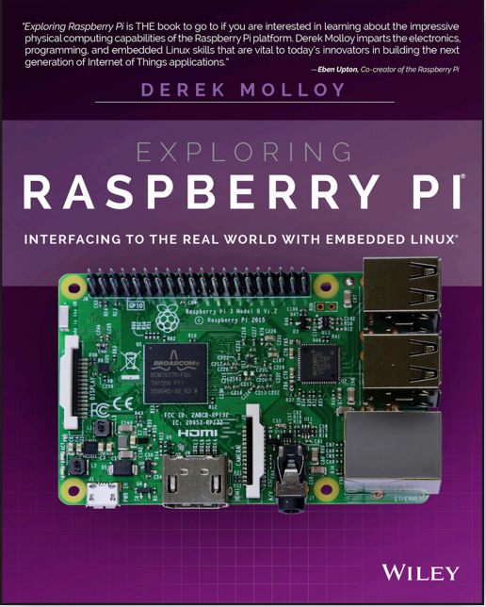
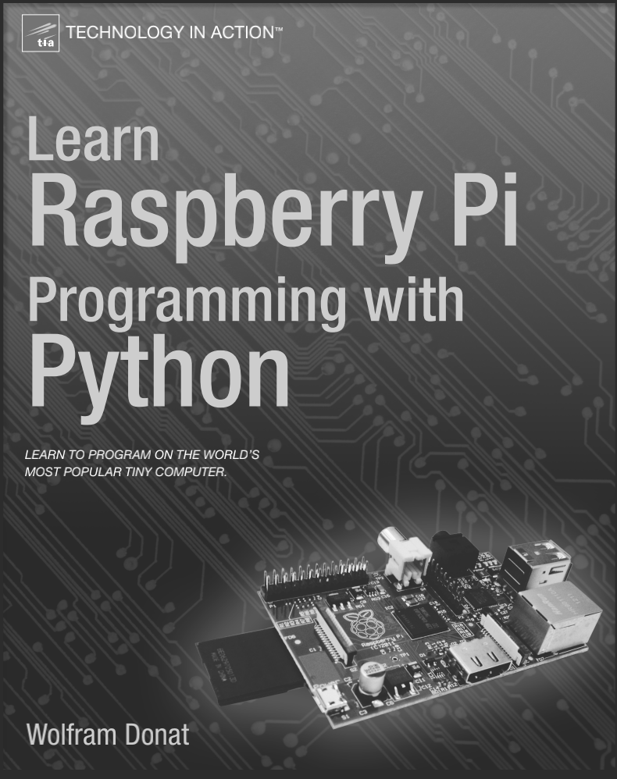
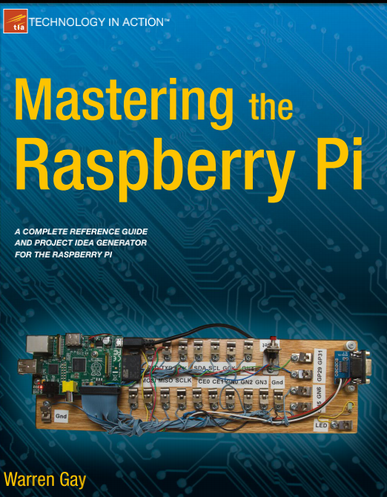

INTERFACING PERIPHERAL
Introduction
- Kontrak Perkuliahan & Instrument Assesment
- Rencana Pembelajaran Semester (RPS)
- Tugas Mandiri (Teori & Praktikum)
- Buku Acuan :

Slide 3
Tables of Content
Chapter 1
Interfacing with Raspberry Pi
- Konsep Interfacing
- What is a Raspberry Pi?
- Model Variants
- Specifications Overview
- Pipeline Flow for Multiplication Operations
- GPU Overview
Tugas Mandiri

Slide 4
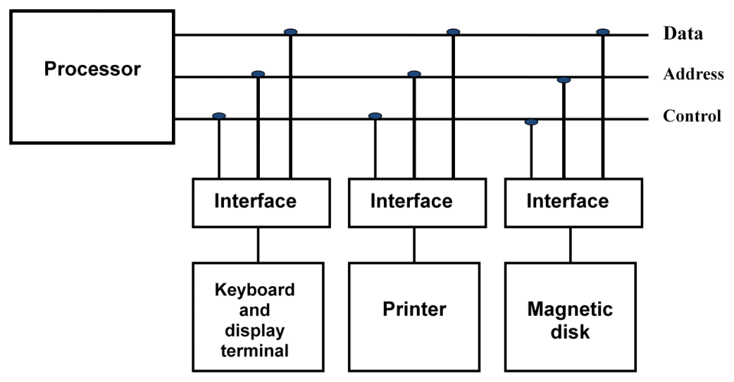
Chapter 1
Konsep Interfacing

Slide 5

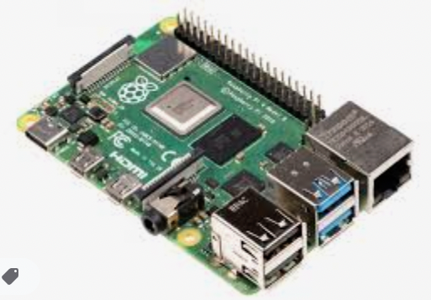
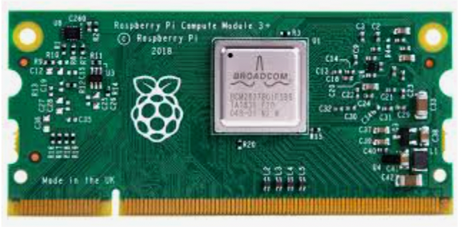
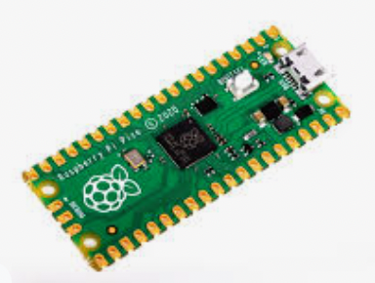
Chapter 1
What is a Raspberry Pi?

Slide 6
Chapter 1
What is a Raspberry Pi?
Raspberry Pi is a credit-card sized single-board computer designed and manufactured by the Raspberry Pi foundation in the United Kingdom.
Raspberry Pi has an ARMv6 700 MHz single-core processor, a VideoCore IV GPU and 512MB of RAM. it uses an SD card for its operating system and data storage.
The Raspberry Pi officially supports Raspbian, a lightweight linux OS based on Debian.

Slide 7
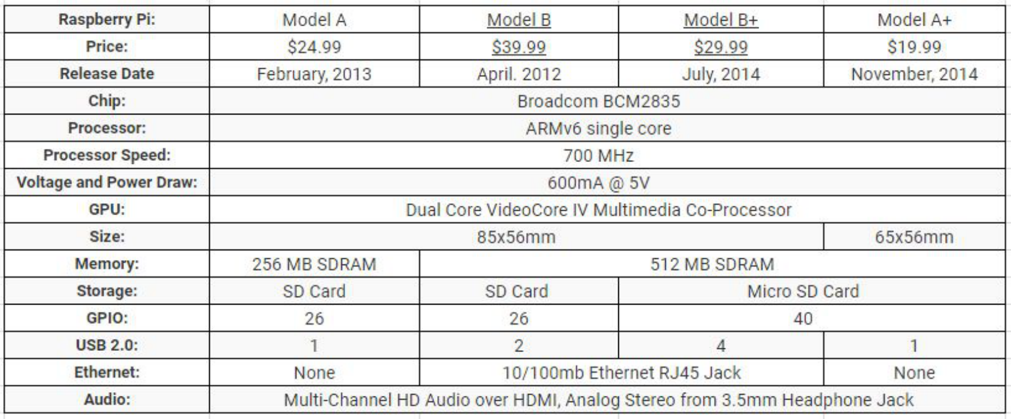
Chapter 1
Model Variants

Slide 8
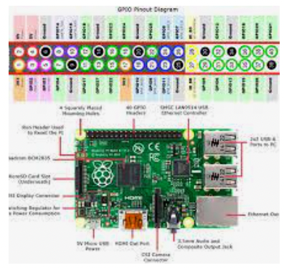
Chapter 1
Specifications Overview
Model B
○ Processor: Broadcom BCM2835
○ CPU: ARM 1176JZFS (ARM 11 w/ v6
core, floating pt @ 700MHz)
○ GPU: Videocore IV GPU
○ RAM: 512 MB
○ USB: 2 USB 2.0
○ Network: Ethernet
○ Video out: HDMI
○ Audio out: 3.5 mm jack
○ SD Card Storage (Up to 32GB)
○ Micro USB power
○ Display Serial Interface Port (DSI)
○ Camera Serial Interface Port (CSI)

Slide 9
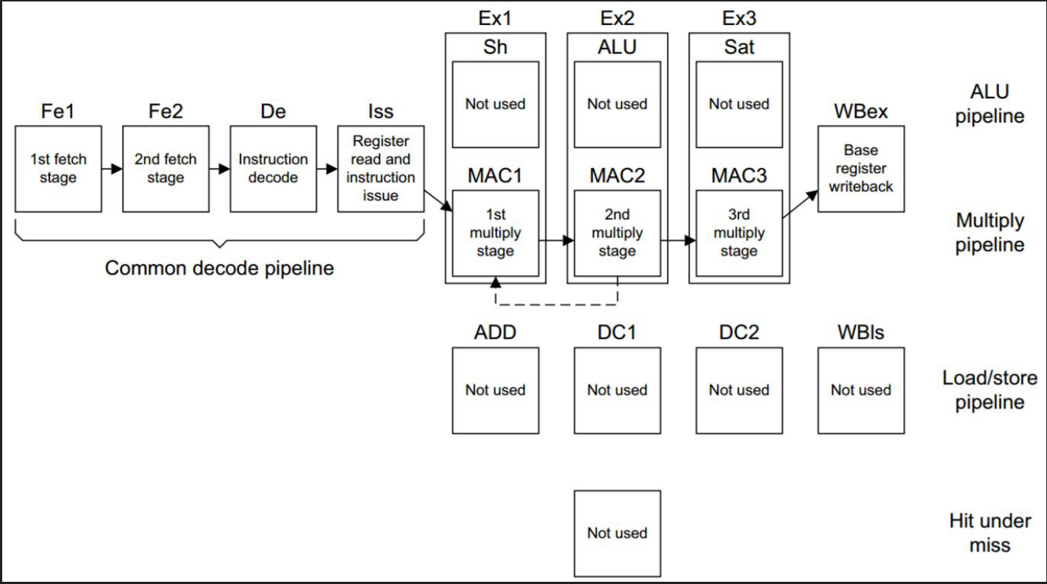
Chapter 1
Pipeline Flow for Multiplication Operations

Slide 10
Chapter 1
GPU Overview
● Broadcom Videocore IV GPU
○ Tile-based renderer (TBR) that use up to four cores
○ 40 nm technology
○ Integrated graphics card so shared memory
● Capable of Blu-Ray quality of 1080p with
H.264 at 40Mb/s
● Graphics performance is similar to the Xbox 1
● 24 GFLOPS of general purpose
computational power
● Has texture filtering and DMA infrastructure
● OpenGL ES 1.1, OpenGL ES 2.0, hardware
accelerated OpenVG 1.1, Open EGL, and
OpenMAX

Slide 11
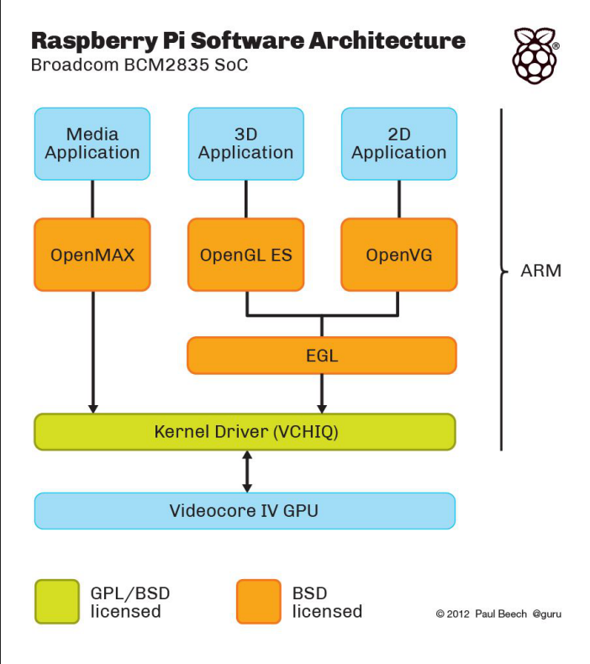
Chapter 1
GPU Overview

Slide 12
Chapter 1
Tugas Mandiri (teori):
Apa perbedaaan Mikrokontroller, Mikroprosesor, dan Minimum System?
Sebutkan Jenis dan macam-macam Single Board Computer (sertakan gambar alat)
Tugas Mandiri (prakt):
Installasi simulator software Raspberri Pi di Proteus. Jelaskan tahapan installasi.

Slide 13
end

