Slide 1


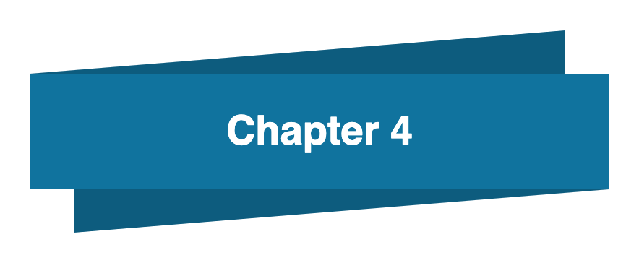
Bahan Ajar
Materi Pembelajaran
Matakuliah :
INTERFACING PERIPHERAL
Kode Matakuliah : SKO 21416
Prodi : SISTEM KOMPUTER
Dosen Pengampu Matakuliah:
Bayu Nugroho, S.Kom., M.Eng

Slide 2
Tables of Content
Chapter 4
Python Data Types
- Built-in Data Types
- Getting the Data Type
- Setting the Data Type
- Python Numbers
- Python Strings
- Escape Characters
Tugas Mandiri

Slide 3
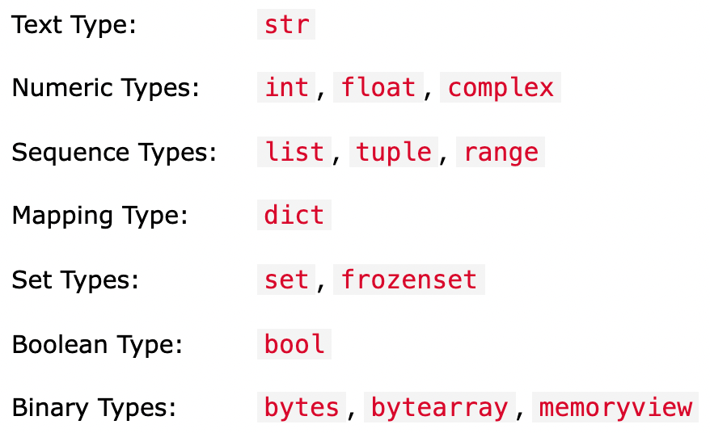
Chapter 4
Built-in Data Types
In programming, data type is an important concept.
Variables can store data of different types, and different types can do different things. Python has the following data types built-in by default, in these categories:

Slide 4
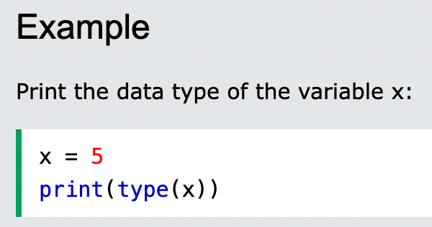
Chapter 4
Getting the Data Type
You can get the data type of any object by using the type() function:

Slide 5
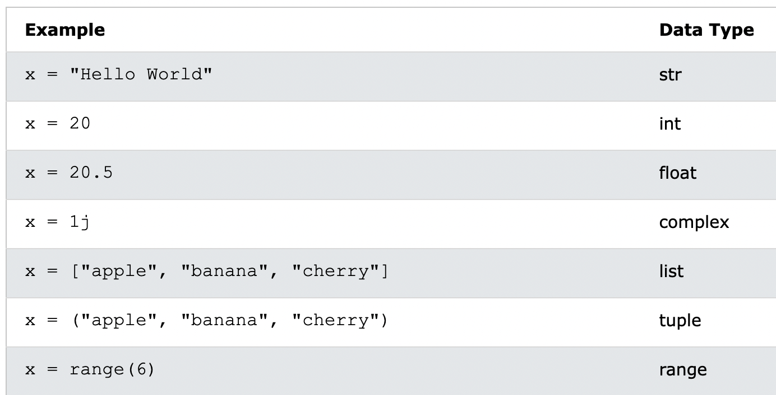
Chapter 4
Setting the Data Type
In Python, the data type is set when you assign a value to a variable:

Slide 6
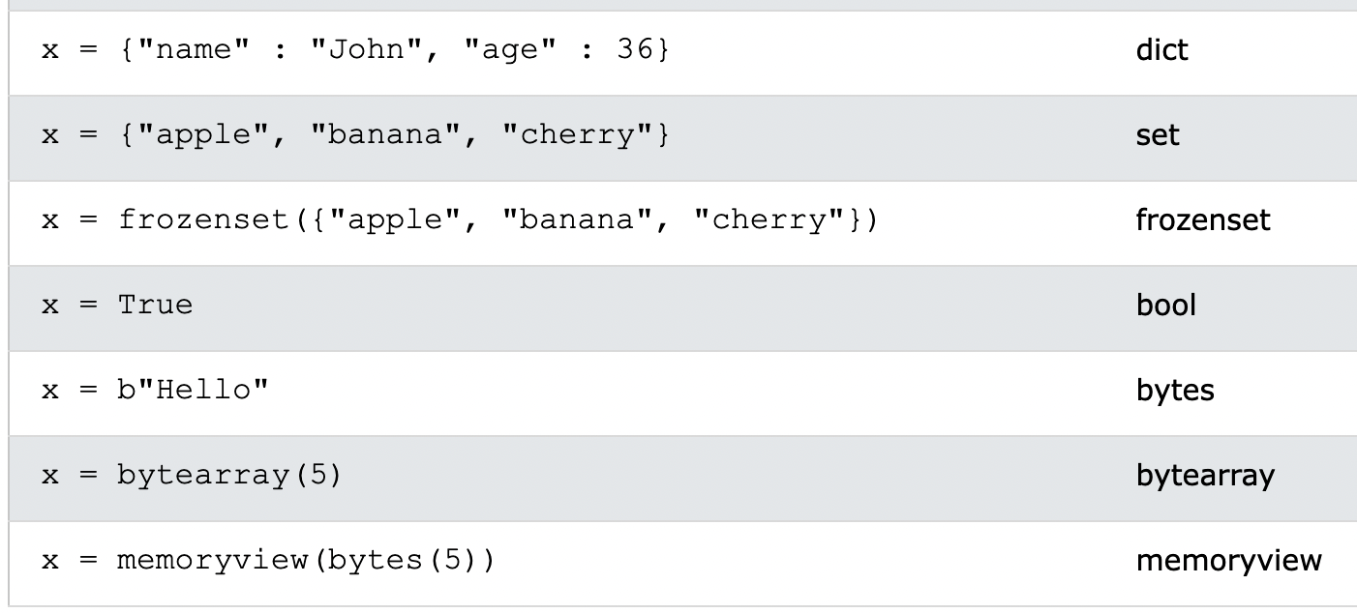
Chapter 4
Setting the Data Type
In Python, the data type is set when you assign a value to a variable:

Slide 7
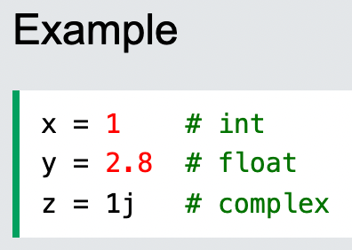
Chapter 4
Python Numbers
There are three numeric types in Python:
int
float
complex
Variables of numeric types are created when you assign a value to them:

Slide 8
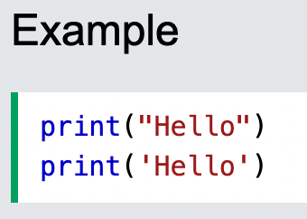
Chapter 4
Python Strings
Strings in python are surrounded by either single quotation marks, or double quotation marks.
'hello' is the same as "hello".
You can display a string literal with the print() function:

Slide 9
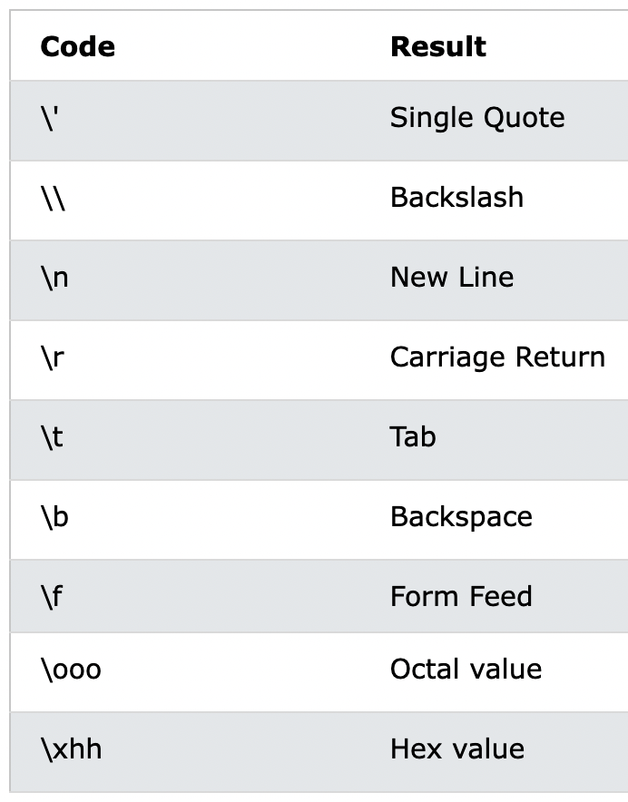
Chapter 4
Escape Characters

Slide 10
Chapter 4
Tugas Mandiri (teori):
Apa perbedaan bahasa pemrograman dan bahasa scripting?
Jelaskan tipe data dalam bahasa pemrograman Python di bawah ini:
Numbers, Strings, Escape Characters.
Tugas Mandiri (prakt):
Tuliskan dan jelaskan script program python untuk menuliskan identitas anda di terminal Raspberry Pi.

Slide 11
end

