Slide 1



Bahan Ajar
Materi Pembelajaran
Matakuliah :
INTERFACING PERIPHERAL
Kode Matakuliah : SKO 21416
Prodi : SISTEM KOMPUTER
Dosen Pengampu Matakuliah:
Bayu Nugroho, S.Kom., M.Eng

Slide 2
Tables of Content
Chapter 5
Python Decission Making
- Python Math Operators
- Built-in Math Functions
- The Math Module
- Math Constants
Tugas Mandiri
https://www.w3schools.com/python/default.asp

Slide 3
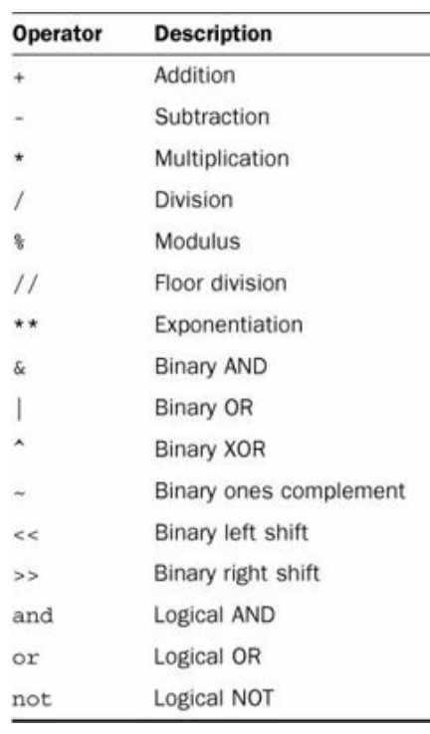
Chapter 5
Python Math Operators
all the Python mathematical operators available for you to use in your scripts.

Slide 4
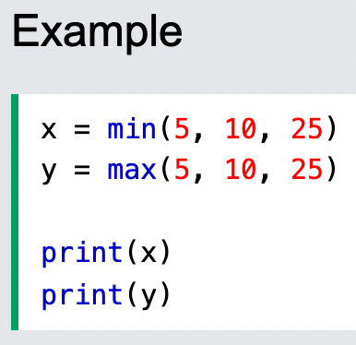
Chapter 5
Built-in Math Functions
The min() and max() functions can be used to find the lowest or highest value in an iterable:

Slide 5
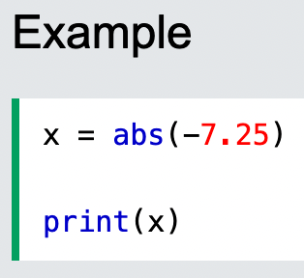
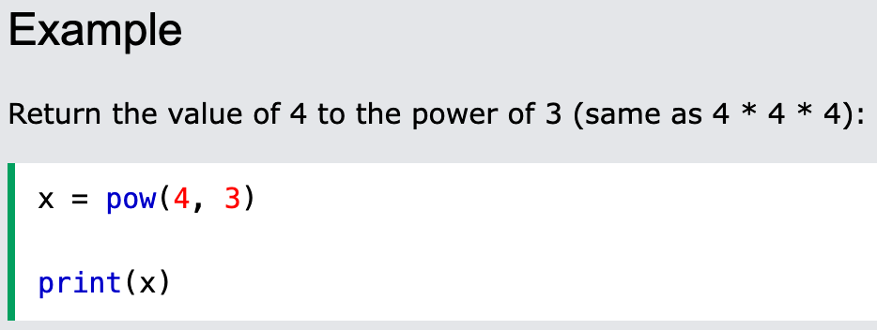
Chapter 5
Built-in Math Functions
The abs() function returns the absolute (positive) value of the specified number:
The pow(x, y) function returns the value of x to the power of y (xy).

Slide 6
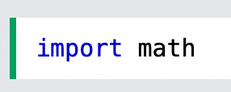
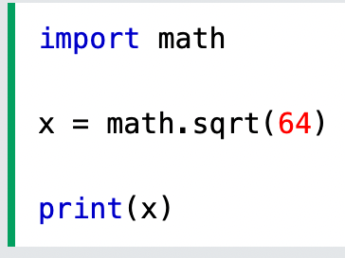
Chapter 5
The Math Module
Python has also a built-in module called math, which extends the list of mathematical functions.
To use it, you must import the math module:
When you have imported the math module, you can start using methods and constants of the module.
The math.sqrt() method for example, returns the square root of a number:

Slide 7
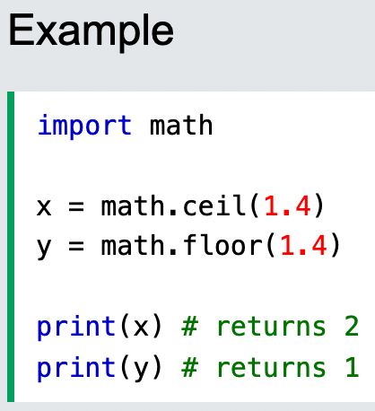
Chapter 5
The Math Module
The math.ceil() method rounds a number upwards to its nearest integer, and the math.floor() method rounds a number downwards to its nearest integer, and returns the result:

Slide 8
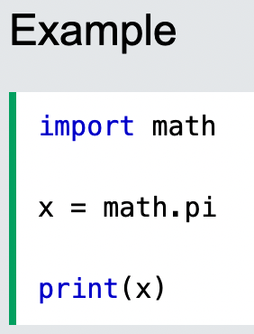
Chapter 5
The Math Module
The math.pi constant, returns the value of PI (3.14...):

Slide 9
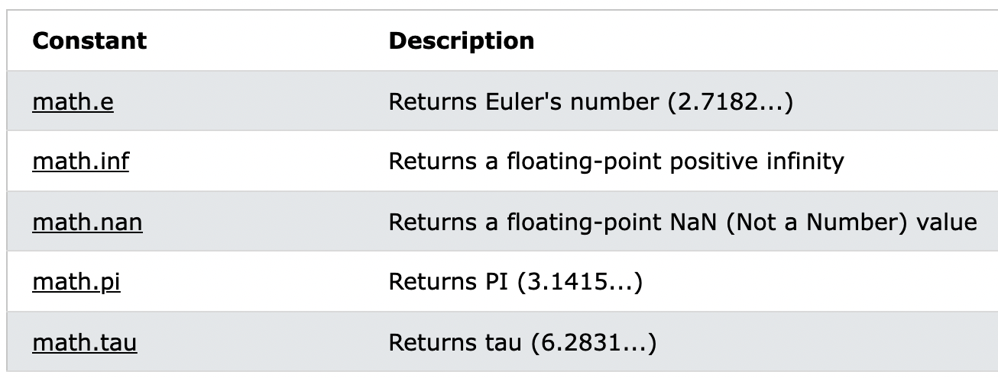
Chapter 5
Math Constants

Slide 10
Chapter 5
Tugas Mandiri (teori):
You must import the Python math library in order to use the Python trigonometric functions. True or false? explained.
What data type should you use to store monetary values in Python?
Tugas Mandiri (prakt):
Tuliskan dan jelaskan script program python untuk menuliskan operasi matematika di terminal Raspberry Pi.

Slide 11
end

