Slide 1



Bahan Ajar
Materi Pembelajaran
Matakuliah :
INTERFACING PERIPHERAL
Kode Matakuliah : SKO 21416
Prodi : SISTEM KOMPUTER
Dosen Pengampu Matakuliah:
Bayu Nugroho, S.Kom., M.Eng

Slide 2
Tables of Content
Chapter 7
Python Conditions and If statements
- Python Logical Conditions
- Elif
- Else
- Short Hand If
- And, Or
- Nested If
Tugas Mandiri

Slide 3
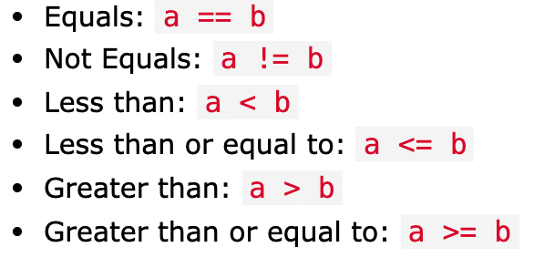
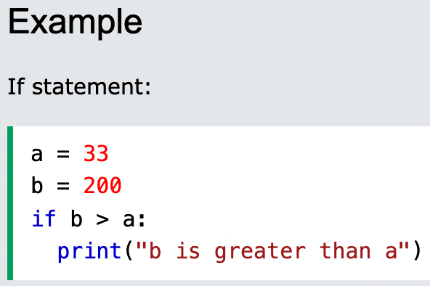
Chapter 7
Python Logical Conditions
Python supports the usual logical conditions from mathematics:

Slide 4
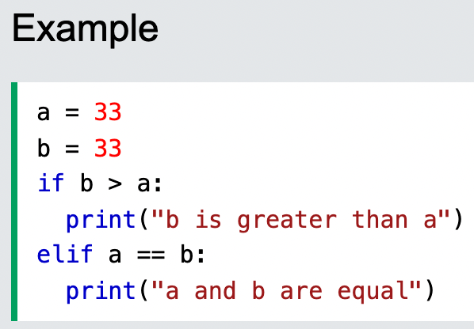
Chapter 7
Elif
The elif keyword is pythons way of saying "if the previous conditions were not true, then try this condition".

Slide 5
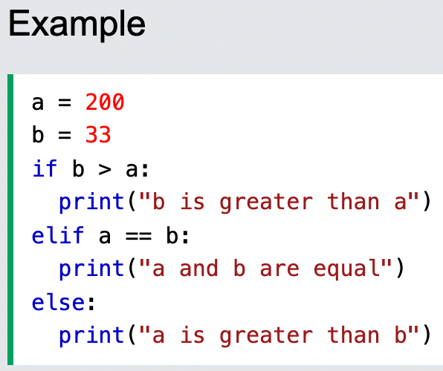
Chapter 7
Else
The else keyword catches anything which isn't caught by the preceding conditions

Slide 6
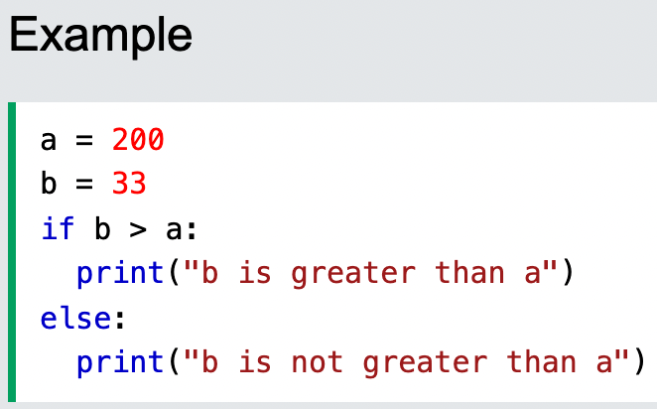
Chapter 7
Else
You can also have an else without the elif:

Slide 7
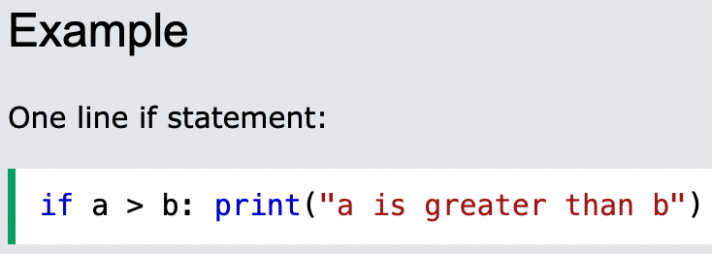
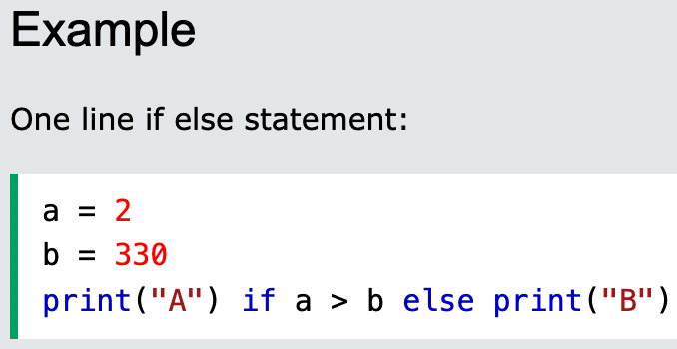
Chapter 7
Short Hand If
If you have only one statement to execute, you can put it on the same line as the if statement
Short Hand If ... Else

Slide 8
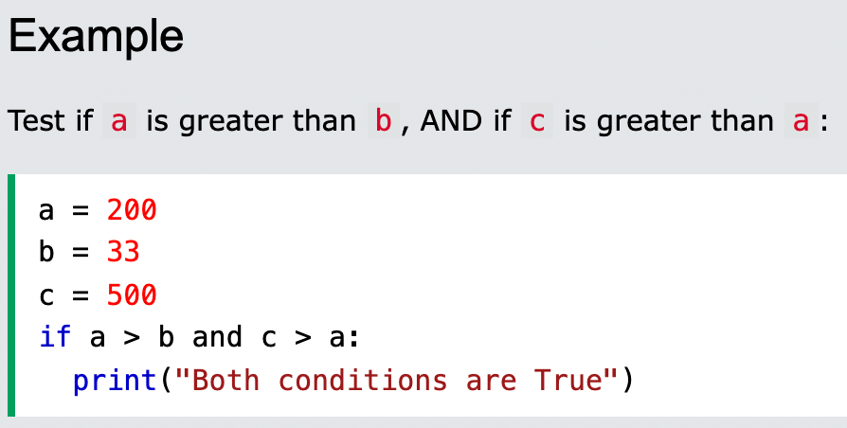
Chapter 7
And
The and keyword is a logical operator, and is used to combine conditional statements:

Slide 9
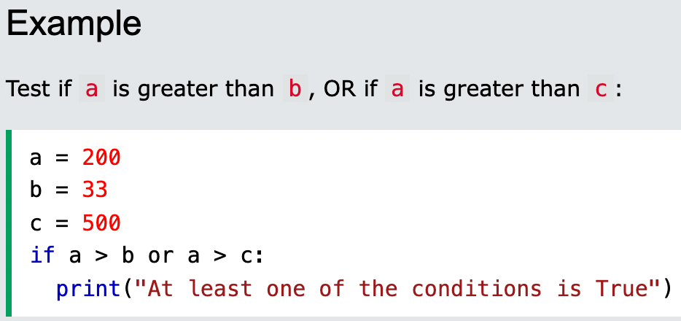
Chapter 7
Or
The or keyword is a logical operator, and is used to combine conditional statements:

Slide 10
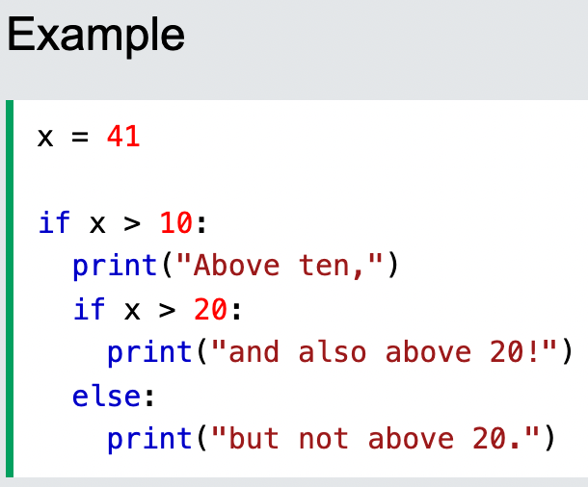
Chapter 7
Nested If
You can have if statements inside if statements, this is called nested if statements.

Slide 11
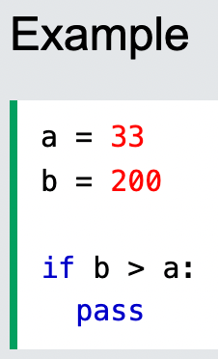
Chapter 7
The pass Statement
if statements cannot be empty, but if you for some reason have an if statement with no content, put in the pass statement to avoid getting an error.

Slide 12
Chapter 7
Tugas Mandiri (teori):
Is there a limit on how many statements I can place in an if or else code block?.
Is there a limit on how many elif statements I can place in an if statement?
How would you write the if statement to display a message only if the value stored in the z variable is between 10 and 20 (not including those values)?
Tugas Mandiri (prakt):
Tuliskan script program python IF-ELSE untuk menghidupkan 6 buah LED secara bergantian di Raspberry Pi.

Slide 13
end

