Slide 1



Bahan Ajar
Materi Pembelajaran
Matakuliah :
PEMROGRAMAN TERSTRUKTUR
Kode Matakuliah : SKO 21411
Prodi : SISTEM KOMPUTER
Dosen Pengampu Matakuliah:
Bayu Nugroho, S.Kom., M.Eng

Slide 2
Tables of Content
Chapter 6
- The Increment and Decrement Operators
- Two Flavors of the Decrement Operator (--)
- Precedence of Operators
- The switch Statement
- The C Preprocessor

Slide 3
Chapter 6
The Increment and Decrement Operators
This statement simply takes the rvalue of counter, increments it by 1, and assigns the new value back
into the rvalue of counter.
counter = counter + 1;

Slide 4
Chapter 6
The Increment and Decrement Operators
Two Types of Increment Operator (++)
There are two flavors for the increment operator:
• pre-increment
• post-increment
++counter; // pre-increment
counter++; // post-increment

Slide 5
Chapter 6
Two Flavors of the Decrement Operator (--)
counter = counter – 1;
could be written :
counter--;
k = --c;
k = c--;
c++;
++k;

Slide 6
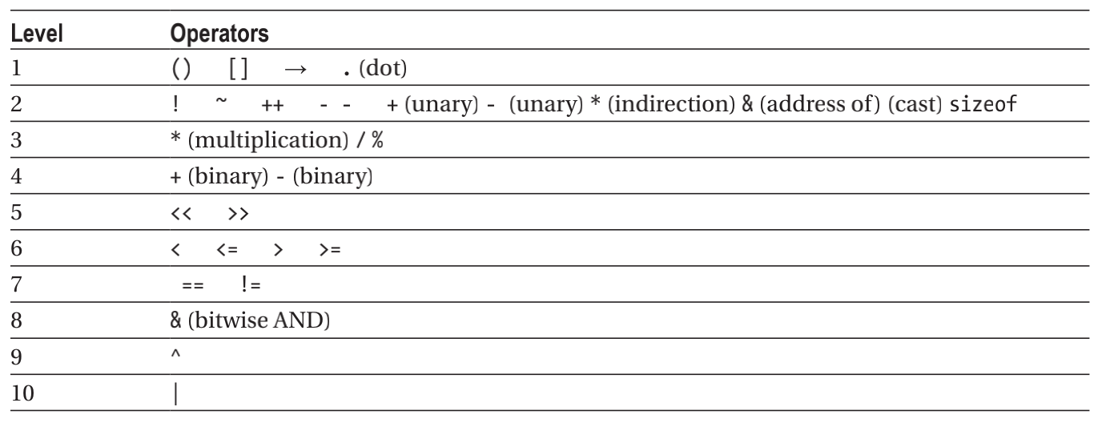
Chapter 6
Precedence of Operators

Slide 7
Chapter 6
The switch Statement
switch (expression1) { // opening brace for switch statement block
case 1:
// statements to execute when expression1 is 1
break;
case 2:
// statements to execute when expression1 is 2
break;
case 3:
// statements to execute when expression1 is 3
break;
// more case statements as needed
default:
// statements to execute if expression1 doesn't have a "case value"
break;
} // close brace for switch statement block
// This is the next statement after the switch

Slide 8
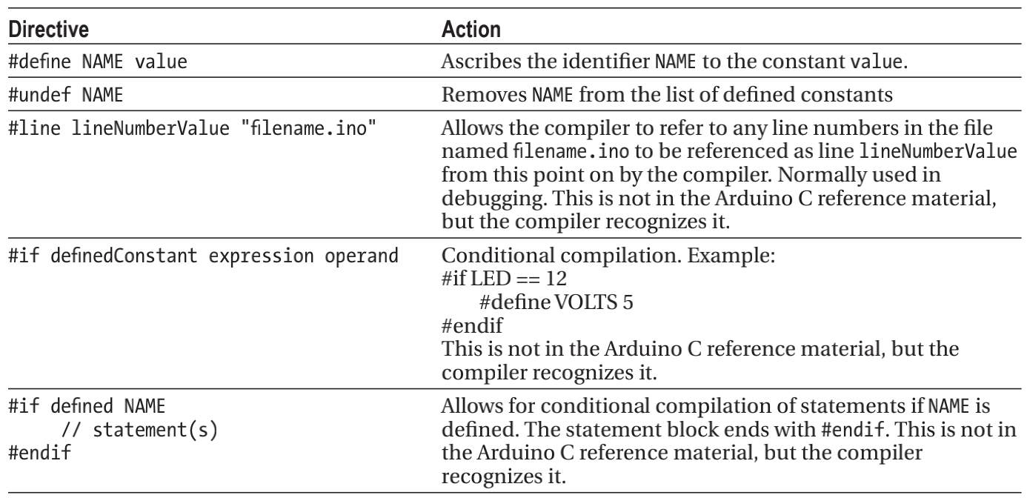
Chapter 6
The C Preprocessor

Slide 9
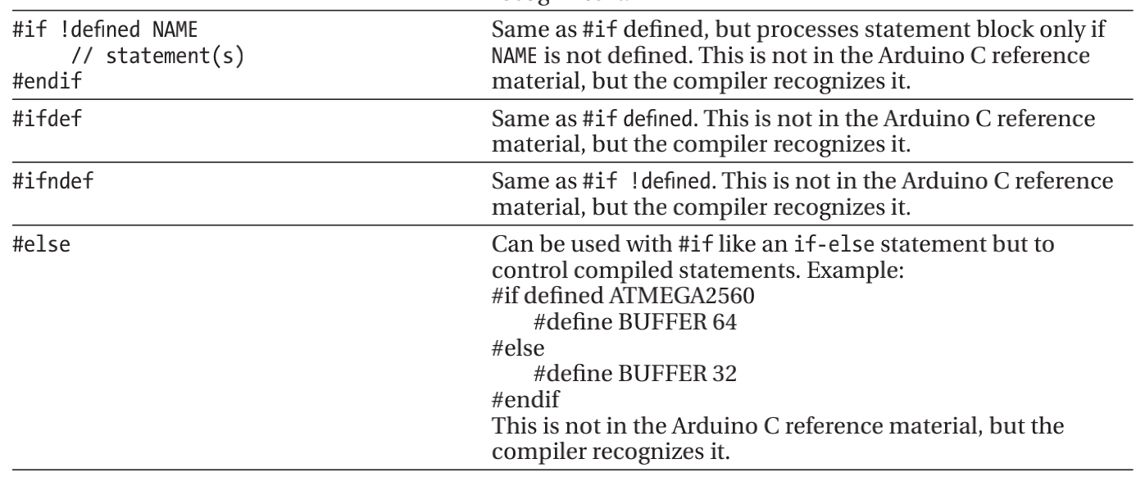
Chapter 6
The C Preprocessor

Slide 10
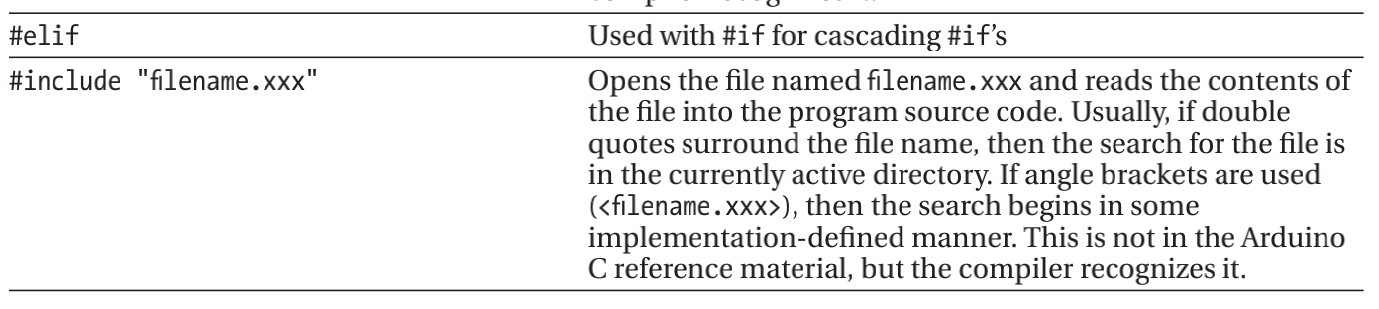
Chapter 6
The C Preprocessor

Slide 11
Chapter 6
Tugas Mandiri (teori):
Dimana letak perbedaan antara tipe data, variabel dan konstanta? jelaskan.
Tugas Mandiri (prakt):
Lakukan perakitan skema rangkaian LED di proteus untuk sketch Program IF-ELSE, Increment, dan Decrement dalam bahasa C Arduino.

Slide 12
end

