Slide 1



Bahan Ajar
Materi Pembelajaran
Matakuliah :
PEMROGRAMAN TERSTRUKTUR
Kode Matakuliah : SKO 21411
Prodi : SISTEM KOMPUTER
Dosen Pengampu Matakuliah:
Bayu Nugroho, S.Kom., M.Eng

Slide 2
Tables of Content
Chapter 8
Functions in C Arduino
- The Anatomy of a Function
- Function Type Specifier
- Function Arguments
- Function Body
- Function Signature
Functions Should Avoid Coupling
- Argument List

Slide 3
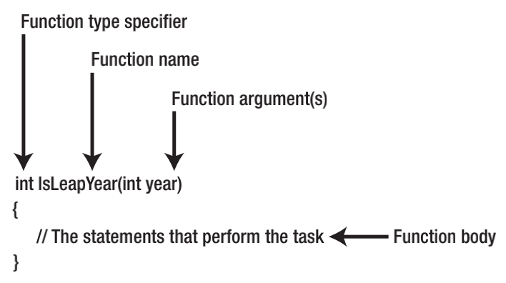
Chapter 8
The Anatomy of a Function
The general structure of a C function as shown

Slide 4
Chapter 8
Function Type Specifier
int FindListItem(int list[], int target)
{
ShellSort(list); // Sort the data
return FindItem(list, target); // Find the item
}
In this case, you have wrapped the details of how the sort is done in a function that says what is to be
done. If you decide later that some other algorithm works better, then it is very easy to make the change.

Slide 5
Chapter 8
Function Arguments
int buyNails;
int nailsPerFoot;
int numberOfFeet;
// some more code...
buyNails = NailsNeeded(nailsPerFoot, numberOfFeet);

Slide 6
Chapter 8
Function Body
If the function type specifier is anything other than void, then at least one of the statements in the
function body must contain the keyword return. For example:
int VolumeOfCube(int width, int length, int height)
{
int volume;
volume = width * length * height;
return volume;
}

Slide 7
Chapter 8
Function Signature
Sometimes you may hear the term function signature when discussing functions. A function signature is comprised of everything following the type specifier through the closing parenthesis of the argument list. For example, for the VolumeOfCube() function, the function signature is:
VolumeOfCube(int width, int length, int height)

Slide 8
Chapter 8
Functions Should Avoid Coupling
Coupling refers to the need for one function to depend on the results of another function to perform its task. For example, earlier we mentioned a function named FindListItem() and suggested:
int FindListItem(int list[], int target)
{
ShellSort(list); // Sort the data
return FindItem(list, target); // Find the item
}
This is really not a good function because it has two tasks:
1. Sorting the data
2. Finding the item in the sorted list

Slide 9
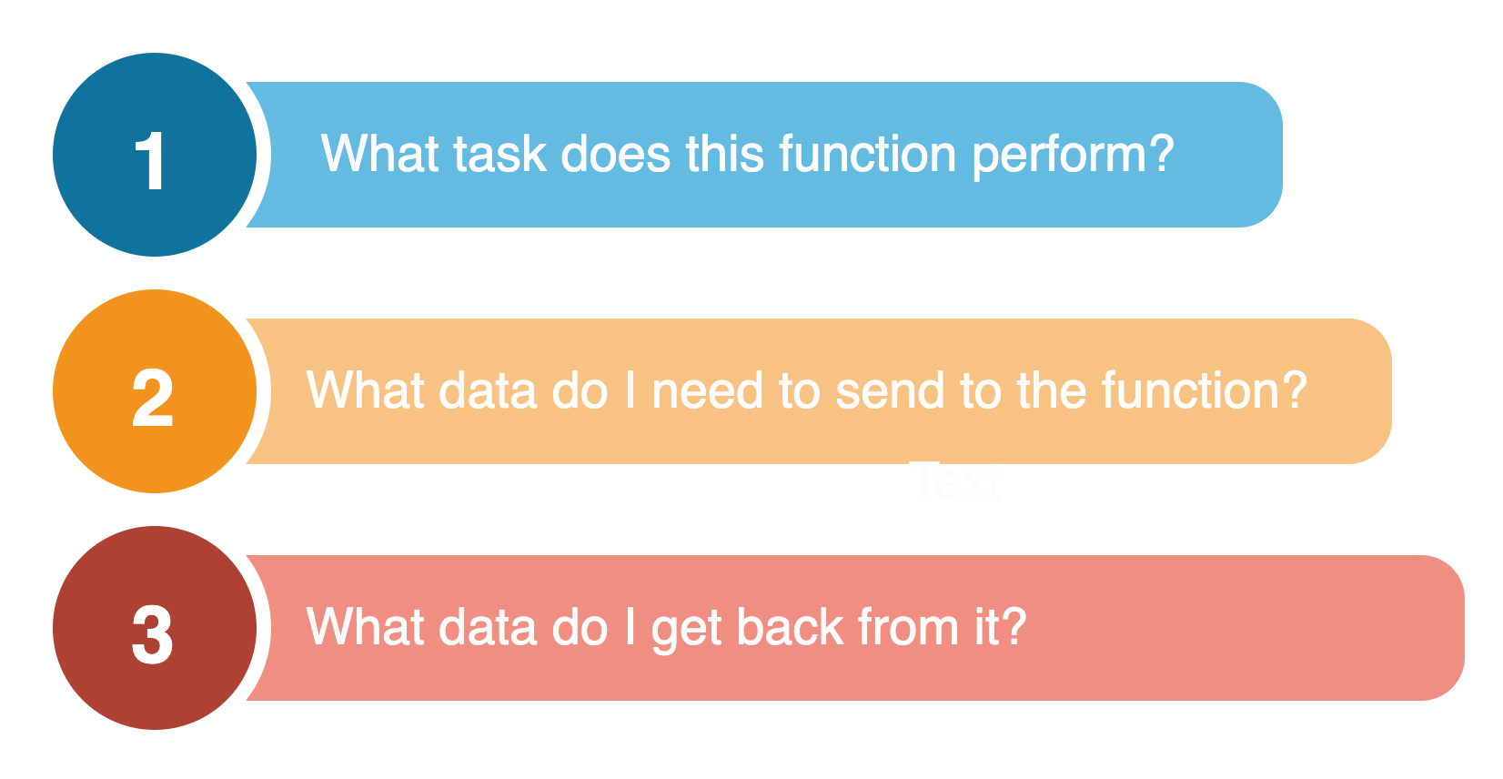
Chapter 8
Argument List
After you write this function, handing the function to another programmer for use of your function should prompt only three questions from them:

Slide 10
Chapter 8
Tugas Mandiri (teori):
Jelaskan bebrapa fungsi (FUNCTION) dalam pemrograman C Arduino?. berikan contohnya.
Tugas Mandiri (prakt):
Lakukan perakitan skema rangkaian LED di proteus untuk sketch FUNCTION dalam bahasa C Arduino.

Slide 11
end

