Slide 1



Bahan Ajar
Materi Pembelajaran
Matakuliah :
PEMROGRAMAN TERSTRUKTUR
Kode Matakuliah : SKO 21411
Prodi : SISTEM KOMPUTER
Dosen Pengampu Matakuliah:
Bayu Nugroho, S.Kom., M.Eng

Slide 2
Tables of Content
Chapter 9
Logical Operators
- Logical AND Operator (&&)
- Logical OR (||)
- Logical NOT (!)

Slide 3
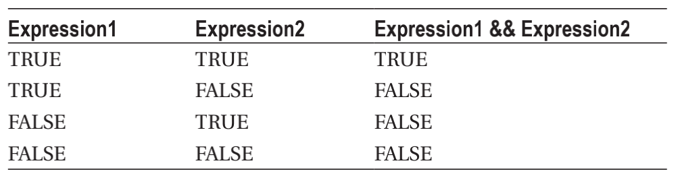
Chapter 9
Logical AND Operator (&&)
The AND operator is formed by placing two ‘&’ characters back-to-back with no space between them (&&). Consider the truth table for the logical AND operator as shown

Slide 4
Chapter 9
Logical AND Operator (&&)
Suppose you have variables k and j and k equals 2 and j equals 3, then the statement:
if (k == 2 && j == 3)
finds expression1 is true and expression2 is also true. You can see that the result of the && operation within the if statement must therefore be true. However, using the same values for k and j, the following statement:
if (k == 9 && j == 3)

Slide 5
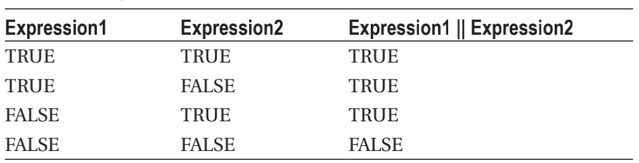
Chapter 9
Logical OR (||)
The logical OR operator is formed by placing two vertical bar ‘|’ (also called pipe) characters back-to-back with no space between them (||). The truth table for the logical OR operator is shown

Slide 6
Chapter 9
Logical OR (||)
Once again, suppose you have variables k and j and k equals 2 and j equals 3, then the OR expression
in the following:
if (k == 2 || j == 3)
is logic true. However, it is also true that
if (k == 9 || j == 3)

Slide 7
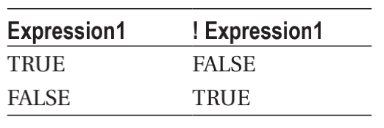
Chapter 9
Logical NOT (!)
The logical NOT operator is the exclamation point (!). Because the logical NOT operator is a unary
operator, its truth table is a little simpler, as shown

Slide 8
Chapter 9
Logical NOT (!)
NOT operator does is invert the logic of the expression. For example, suppose k equals 2 again. Then:
if (! k == 2)
is logic false. Because expression1 is true (k does equal 2), Table 6-4 shows that the result of the logical NOT operator is logic false. I surround the expression in a NOT operation with parentheses, as in:
if (! (k == 2) )

Slide 9
Chapter 9
Tugas Mandiri (teori):
Jelaskan fungsi Gerbang logika
-AND - XOR
-NOT - NAND
-OR - NOR
Buat tabel kebenaran tiap gerbang logika...
Tugas Mandiri (prakt):
Lakukan perakitan skema rangkaian LED di proteus untuk sketch gerbang logika dalam bahasa C Arduino.

Slide 10
end

