Slide 1



Bahan Ajar
Materi Pembelajaran
Matakuliah :
PEMROGRAMAN TERSTRUKTUR
Kode Matakuliah : SKO 21411
Prodi : SISTEM KOMPUTER
Dosen Pengampu Matakuliah:
Bayu Nugroho, S.Kom., M.Eng

Slide 2
Tables of Content
Chapter 10
Storage Classes and Scope
- Local Scope
- Global Scope
- Scope and Storage Classes

Slide 3
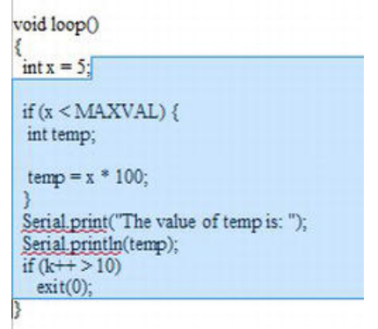
Chapter 10
Local Scope
A variable that has local scope has life and visibility from the point of its definition to the end of the
function in which it is defined. The shaded illustrates local scope for variable x.

Slide 4
Chapter 10
Local Scope
What would happen if you moved the definition of x as shown in the code fragment below?
(Note how we have
void loop()
{
if (x < MAXVAL) {
int temp;
temp = x * 100;
}
if (k++ > 10)
exit(0);
int x = 5;
}

Slide 5
Chapter 10
Global Scope
The global scope for k is the shaded
area in Figure next. This means that any statement that appears after the definition of k has access to k; k is “globally” accessible to all functions and statement blocks within the source file.

Slide 6
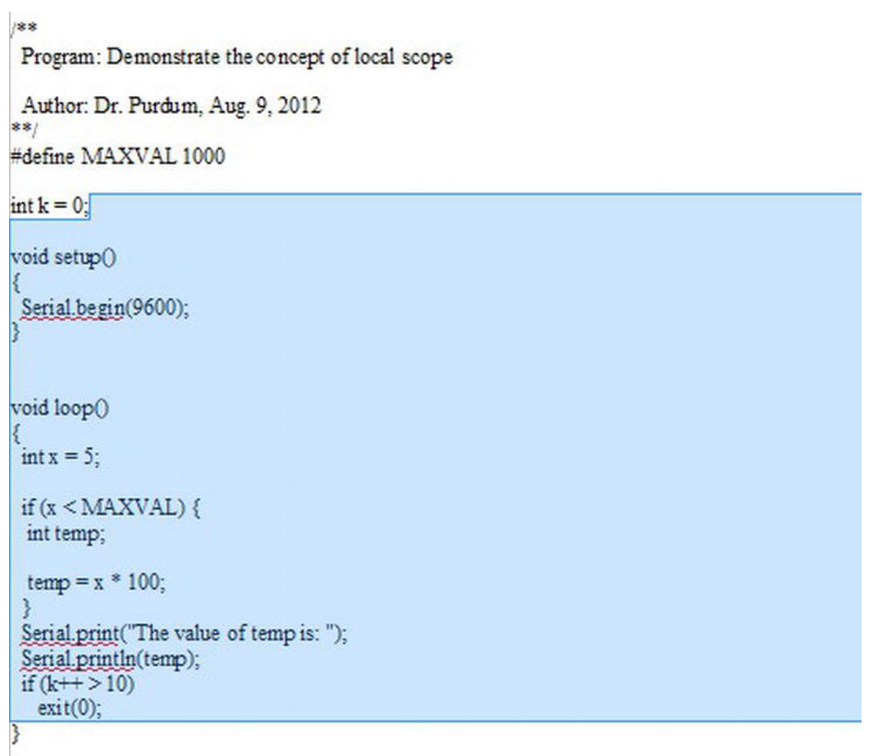
Chapter 10

Slide 7
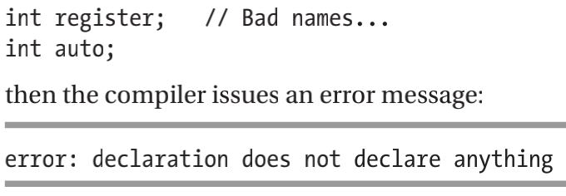
Chapter 10
Scope and Storage Classes
Arduino C recognizes four storage classes: auto, register, static, and extern. All four are keywords in
Arduino C and cannot be used as variable names. If you try to define variables named:
Clearly, the compiler does recognize both as keywords and will not let you use them as a variable
name

Slide 8
Chapter 10
Scope and Storage Classes
The static Storage Class
Consider the following code fragment:
int MyCounter()
{
static int counter = 0;
// do some stuff...
return ++counter;
}

Slide 9
Chapter 10
Tugas Mandiri (teori):
1. What are the scope levels in C?
2. What is the default scope level for a function?
3. What is the default storage class for a function.
4. What are the C storage classes?

Slide 10
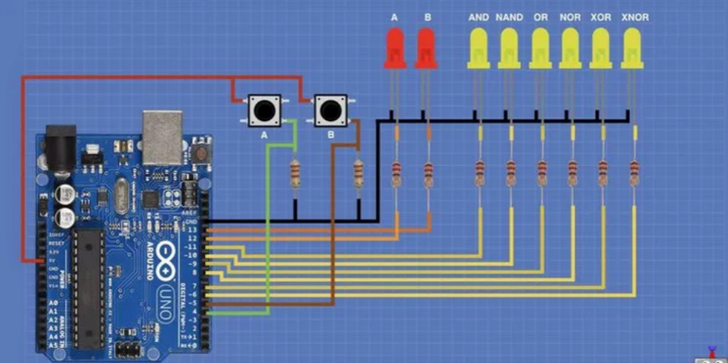
Chapter 10
Tugas Mandiri (prakt):
Lakukan perakitan skema rangkaian LED di proteus seperti gambar berikut dan gunakan switch button untuk menghidupkan LED.

Slide 11
end

