Slide 1



Bahan Ajar
Materi Pembelajaran
Matakuliah :
PEMROGRAMAN TERSTRUKTUR
Kode Matakuliah : SKO 21411
Prodi : SISTEM KOMPUTER
Dosen Pengampu Matakuliah:
Bayu Nugroho, S.Kom., M.Eng

Slide 2
Tables of Content
Chapter 11
Pointers
- Pointer Type Specifiers and Pointer Scalars
Using a Pointer
- The Indirection Operator (*)
Pointers and Arrays

Slide 3
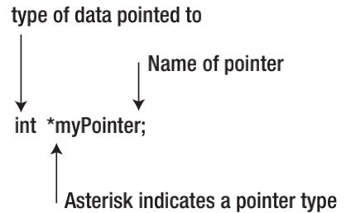
Chapter 11
Pointers
One of the most powerful features of C is pointers. Although many of the features of any programming
language have the power for you to shoot yourself in the foot, pointers give you the power to blow your
entire leg off.

Slide 4
Chapter 11
Pointers
Some sample pointer names might be:
ptrMyQuizScores
ptrName
ptrStateCapital
ptrSisters

Slide 5
Chapter 11
Pointer Type Specifiers and Pointer Scalars
For example, all of the following are valid pointer definitions:
int *ptrSheepCount;
char *ptrFirstName;
long *ptrBigVal;
float *ptrYardsOfCloth;

Slide 6
Chapter 11
Pointer Scalars
Consider the following two pointer definitions:
char *ptrLetter;
int *ptrNumber;

Slide 7
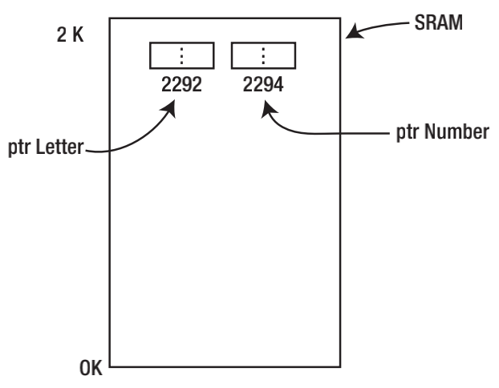
Chapter 11
Pointer Scalars
Whenever we defined data types before, a char data type used 1 byte and an int used 2 bytes. Yet, the pointer definition shows that each pointer requires the same amount of storage: 2 bytes. Why?

Slide 8
Chapter 11
Pointer Initialization
The instant after you define a pointer, you should think of it as being unusable. That is, after the compiler processes the following statement:
int *ptrNumber;
you have an int pointer that has a garbage rvalue. Suppose the compiler ends up placing the pointer at memory address 2294.

Slide 9
Chapter 11
Using a Pointer
suppose you have the following three statements in a program:
int a;
int b = 5;
a = b;
int number = 5;
int *ptrNumber;
ptrNumber = &number;
The purpose of the address of operator (&) is to tell the compiler

Slide 10
Chapter 11
The Indirection Operator (*)
If you wish to use a pointer to change the rvalue of the variable it points to, then you use the indirection
operator. The syntax is:
*variableID = expression1;
For example:
*ptrNumber = 10;

Slide 11
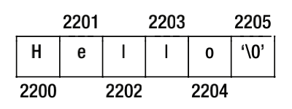
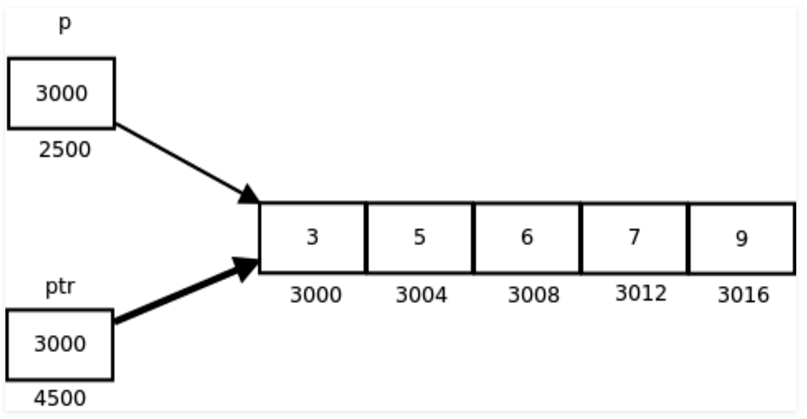
Chapter 11
Pointers and Arrays

Slide 12
Chapter 11
Tugas Mandiri (teori):
What does the address of operator do? Give an example
What is the indirection operator (*) and what is its purpose? Give an example of how it might be used
Suppose you needed to pass the value of the fifth element of an int array named values to a function named func(). How would you write the code?

Slide 13
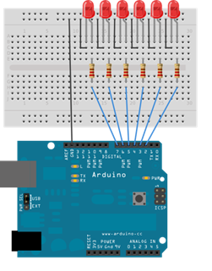
Chapter 11
Tugas Mandiri (prakt):
Lakukan perakitan skema rangkaian LED di proteus seperti gambar berikut dan perintah Array untuk menghidupkan LED.

Slide 14
end

