Slide 1



Bahan Ajar
Materi Pembelajaran
Matakuliah :
PEMROGRAMAN TERSTRUKTUR
Kode Matakuliah : SKO 21411
Prodi : SISTEM KOMPUTER
Dosen Pengampu Matakuliah:
Bayu Nugroho, S.Kom., M.Eng

Slide 2
Tables of Content
Chapter 12
Pointer Arithmetic
Array
Array Multi Dimensional
Pointers to Functions
enum
Pointers to Functions

Slide 3
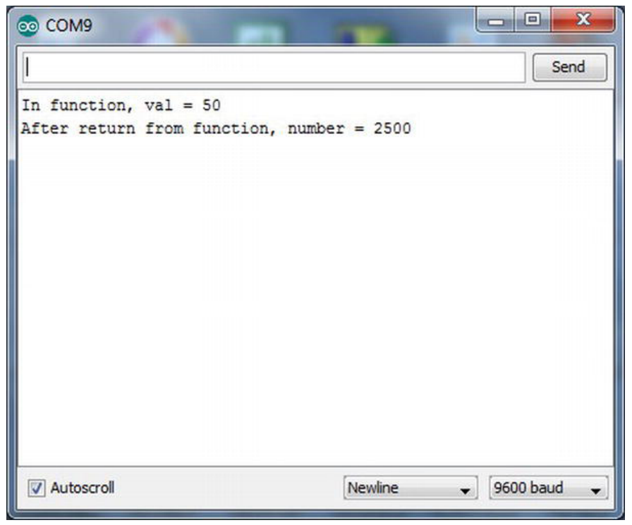
Chapter 12
Pointer Arithmetic
Sample run of pointer to function program.

Slide 4
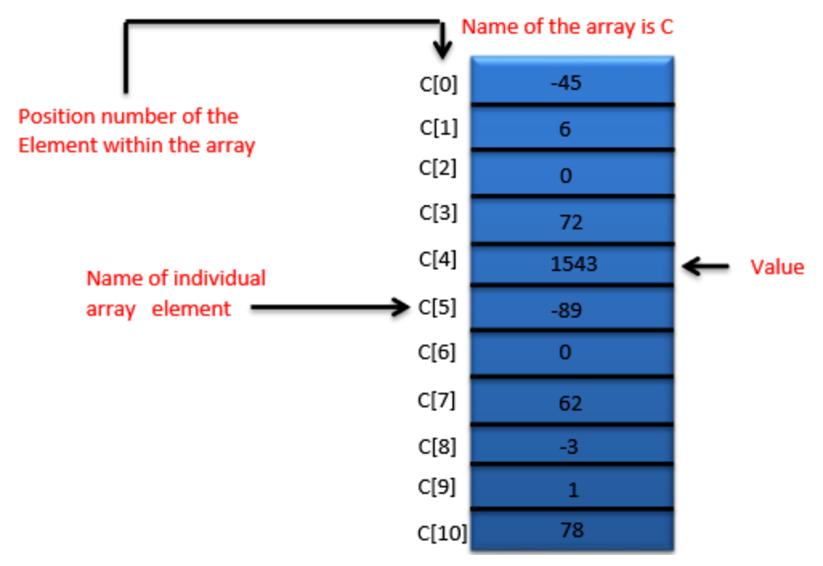
Chapter 12
Array

Slide 5
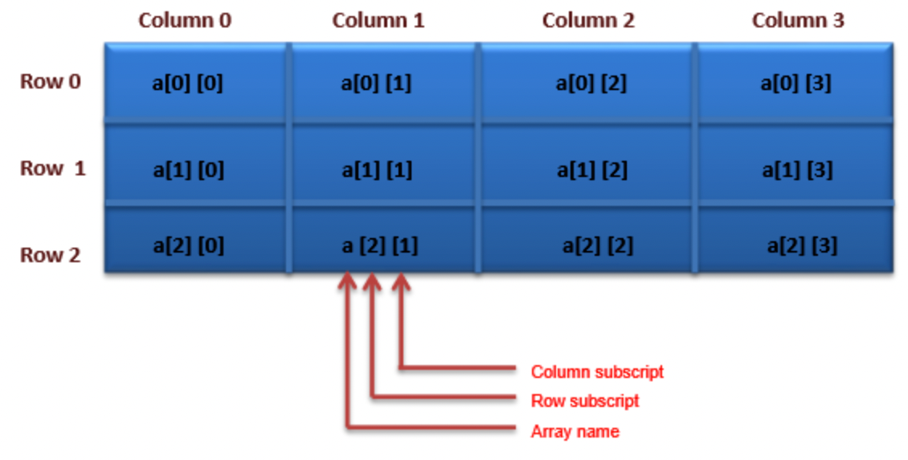
Chapter 12
Array Multidimensional

Slide 6
Chapter 12
enum
The enum syntax is:
enum NameOfEnum {enumMember List};
By default, the list is assigned values starting with 0 and is incremented by 1 for each member. For
example:
enum days {SUNDAY, MONDAY, TUESDAY, WEDNESDAY, THURSDAY, FRIDAY, SATURDAY};

Slide 7
Chapter 12
would associate 0 with SUNDAY, 1 for MONDAY, and 6 for SATURDAY. You can override the default numbering by using explicit assignments, such as:
enum speeds {RESIDENTIAL = 35, STATEROAD = 55, FEDERALHIGHWAY = 70};
To define an enumerated variable, you may use either of the following syntax forms:
enum days myDay;
enum speeds {RESIDENTIAL = 35, STATEROAD = 55, FEDERALHIGHWAY = 70} mySpeed;

Slide 8
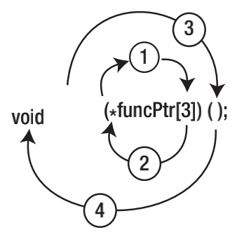
Chapter 12
The Right-Left Rule

Slide 9
Chapter 12
Pointers to Functions
void setup() {
Serial.begin(9600); // Serial link to PC
}
void loop() {
int number = 50;
int (*funcPtr)(int n); // This defines a pointer to function
funcPtr = DisplayValue; // This copies the lvalue of DisplayValue
number = (*funcPtr)(number);

Slide 10
Chapter 12
Pointers to Functions
Serial.print("After return from function, number = ");
Serial.println(number);
Serial.flush();
exit(0);
}
int DisplayValue(int val)
{
Serial.print("In function, val = ");
Serial.println(val);
return val * val;
}

Slide 11
Chapter 12
Tugas Mandiri (teori):
When can you use two pointers in an arithmetic expression?
If you define a pointer to a function, what is the rvalue of a properly initialized pointer to function?
What is the purpose of the Right-Left Rule?

Slide 12
Chapter 12
Tugas Mandiri (prakt):
Lakukan perakitan skema rangkaian LED di proteus dengan perintah Array 1 dimensi dan 2 dimensi untuk menghidupkan LED.

Slide 13
end

