Slide 1



Bahan Ajar
Materi Pembelajaran
Matakuliah :
PEMROGRAMAN TERSTRUKTUR
Kode Matakuliah : SKO 21411
Prodi : SISTEM KOMPUTER
Dosen Pengampu Matakuliah:
Bayu Nugroho, S.Kom., M.Eng

Slide 2
Tables of Content
Chapter 13
Structures, Unions, and Data Storage
- Declaring a Structure
- Defining a Structure
- Initializing a Structure
Unions

Slide 3
Chapter 13
Structures, Unions, and Data Storage
Declaring a Structure
An example will help you to see how a structure is declared in C. Sticking with our service people example, you might declare the associated structure as follows:
struct servicePeople {
int ID;
char Name[20];
char PW[10];
long Phone;
};

Slide 4
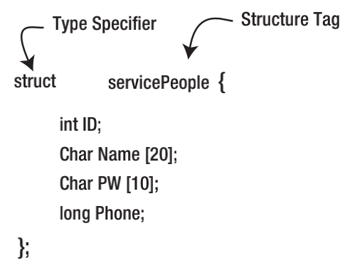
Chapter 13
Declaring a Structure

Slide 5
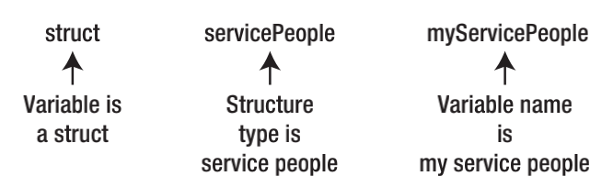
Chapter 13
Defining a Structure
An alternative way to define a structure is:
struct servicePeople {
int ID;
char Name[20];
char PW[10];
long Phone;
} myServicePeople;

Slide 6
Chapter 13
Defining a Structure
You can, however, also define a structure variable without a structure tag, as in:
struct {
int ID;
char Name[20];
char PW[10];
long Phone;
} myServicePeople, yourServicePeople;

Slide 7
Chapter 13
Initializing a Structure
If you wish, you can initialize a structure at its point of definition, as in:
servicePeople myServicePeople = {
101, // ID number
"Kack's Lawn Service", // Company name
"Clowder", // Password
2345678, // Phone number
},

Slide 8
Chapter 13
Unions
You could define temporary working variables, such as:
char tempChar;
int tempInt;
float tempFloat;
And then assign the sensor readings into the appropriate variable.

Slide 9
Chapter 13
Unions
You could also use the following union:
union {
char tempChar;
int tempInt;
float tempFloat;
} sensorReading;

Slide 10
Chapter 13
Unions
The union defined as sensorReading is big enough to hold any one of the three sensor types, but only
one at a time. In other words, you can place a float into the union and then read it back using the code:
float currentFloatSensorReading = 51.25;
sensorReading.tempFloat = currentFloatSensorReading; //move data into the union
// some more code...
currentFloatSensorReading = sensorReading.tempFloat; // get the data back from the union

Slide 11
Chapter 13
Tugas Mandiri (teori):
Apa Fungsi ARRAY dalam pemrograman?
Jelaskan kapan fungsi ARRAY efektif digunakan dalam pemrograman?

Slide 12
Chapter 13
Tugas Mandiri (prakt):
// Inisialisasi Pin LED
const int pinLED1 = 10;
const int pinLED2 = 11;
const int pinLED3 = 12;
const int pinLED4 = 13;
void setup() {
// pin LED sebagai output
pinMode(pinLED1,OUTPUT);
pinMode(pinLED2,OUTPUT);
pinMode(pinLED3,OUTPUT);
pinMode(pinLED4,OUTPUT);
}
void loop() {
digitalWrite(pinLED1,LOW);
digitalWrite(pinLED2,LOW);
digitalWrite(pinLED3,LOW);
digitalWrite(pinLED4,LOW);
delay(1000);
digitalWrite(pinLED1,HIGH);
delay(1000);
digitalWrite(pinLED2,HIGH);
delay(1000);
digitalWrite(pinLED3,HIGH);
delay(1000);
digitalWrite(pinLED4,HIGH);
delay(1000);
}.
// Inisialisasi Jumlah LED
const int numLED = 4;
// LED 1,2,3,&4 jadi 1 varibel
// dengaan alamat index 0,1,2,3
const int pinLED[numLED] = {10,11,12,13};
void setup() {
// Inisialisasi semua pin LED sebagai OUTPUT
for(int i=0; i<4; i++){
pinMode(pinLED[i],OUTPUT);
}
}
void loop() {
// Matikan semua LED
for(int i=0; i<4; i++){
digitalWrite(pinLED[i],LOW);
}
delay(1000);
// Hidupkan semua LED bertahap dg jeda 1 detik
for(int i=0; i<4; i++){
digitalWrite(pinLED[i],HIGH);
delay(1000);
}
}

Slide 13
Chapter 13
Tugas Mandiri (prakt):
Apa perbedaan metode kedua Sketch Program di atas?
Bagaimana kondisi Led saat Sketch Program tersebut di jalankan?

Slide 14
end

