Slide 1



Bahan Ajar
Chapter 15
Materi Pembelajaran
Matakuliah :
PEMROGRAMAN TERSTRUKTUR
Kode Matakuliah : SKO 21411
Prodi : SISTEM KOMPUTER
Dosen Pengampu Matakuliah:
Bayu Nugroho, S.Kom., M.Eng

Slide 2
Tables of Content
Chapter 14
The C Preprocessor and Bitwise Operations
- Preprocessor Directives
- Parameterized Macros

Slide 3
Chapter 14
Preprocessor Directives
The ANSI C specification details the duties of the C preprocessor. It is the function of the C preprocessor to process the defined directives supported by the C compiler. Table lists the preprocessor directives that Arduino C can translate.

Slide 4
Chapter 14
Arduino C Preprocessor Directives
Directive | Action
#define NAME value | Ascribes the identifier NAME to the constant value.
#undef NAME | Removes NAME from the list of defined constants
#line lineNumberValue "filename.ino" | Allows the compiler to refer to any line numbers in the file named filename.ino to be referenced as line lineNumberValue from this point on by the compiler. Normally used in debugging. This is not in the Arduino C reference material, but the compiler recognizes it

Slide 5
Chapter 14
Arduino C Preprocessor Directives
Directive | Action
#if definedConstant expression operand | Conditional compilation. Example: #if LED == 12 #define VOLTS 5 #endif This is not in the Arduino C reference material, but the compiler recognizes it..
#if defined NAME // statement(s) #endif | Allows for conditional compilation of statements if NAME is defined. The statement block ends with #endif. This is not in the Arduino C reference material, but the compiler recognizes it
#if !defined NAME // statement(s) #endif | Same as #if defined, but processes statement block only if NAME is not defined. This is not in the Arduino C reference material, but the compiler recognizes it.

Slide 6
Chapter 14
Arduino C Preprocessor Directives
Directive | Action
#ifdef | Same as #if defined. This is not in the Arduino C reference material, but the compiler recognizes it.
#if defined NAME // statement(s) #endif | Allows for conditional compilation of statements if NAME is defined. The statement block ends with #endif. This is not in the Arduino C reference material, but the compiler recognizes it
#ifndef | Same as #if !defined. This is not in the Arduino C reference material, but the compiler recognizes it.
#else | Can be used with #if like an if-else statement but to control compiled statements. Example: #if defined ATMEGA2560 #define BUFFER 64 #else #define BUFFER 32 #endif

Slide 7
Chapter 14
Arduino C Preprocessor Directives
Directive | Action
#elif | Used with #if for cascading #if’s
#include "filename.xxx" | Opens the file named filename.xxx and reads the contents of the file into the program source code. Usually, if double quotes surround the file name, then the search for the file is in the currently active directory. If angle brackets are used (<filename.xxx>), then the search begins in some implementation-defined manner. This is not in the Arduino C reference material, but the compiler recognizes it.

Slide 8
Chapter 14
#undef
The #undef is used to turn off a previously-defined #define preprocessor directive. For example:
#ifdef DEBUG
Serial.print("The counter value is: ");
Serial.println(myCounter);
#endif
This is a technique (called scaffolding) that you have used before to toggle debugging code into the program. If the source contains:
#define DEBUG 1

Slide 9
Chapter 14
#undef
#define DEBUG 1
// A whole bunch of program lines
// that still need to be debugged
#undef DEBUG
ReadSensorCounter() {
// code for the debugged function
}
When the preprocessor sees the #undef directive, it removes DEBUG from its list of #defines. This has the
effect of removing the Serial() calls from the (now debugged) ReadSensorCounter() function.

Slide 10
Chapter 14
#line
The #line directive is used most often while debugging a program. The syntax is:
#line lineNumberValue "filename.ino"
where lineNumberValue is the line number you want to the compiler to use from that point on in the source
code file name filename.ino. Therefore:
#line 100 "C:\Temp\myCode.ino"

Slide 11
Chapter 14
#if, Conditional Directives
There are a number of conditional directives, and they are very similar, so we can discuss them as a group.
First, the expression:
#if definedConstant expression operand
// Statement(s)
#endif
might be written as:
#if BOARD == ATMEGA168
#define MAXEEPROM 1024
#endif

Slide 12
Chapter 14
Bitwise Operators
Arduino C provides you with four bitwise logic operators: AND, OR, XOR, and NOT. The first three
operators are binary operators and, hence, require two operands in the expression. The bitwise NOT
operator is a unary operator and uses only a single operand. Bitwise operations can only be performed on integer data (i.e., no floating point data).

Slide 13
Chapter 14
Bitwise AND
In code, the bitwise AND might look like:
byte a = 10; // 00001010
byte b = 6; // 00000110
byte c = a & b; // 00000010 = c
Bitwise OR
In code, a bitwise OR fragment might be written as:
byte a = 10; // 00001010
byte b = 6; // 00000110
byte c = a | b; // 00001110

Slide 14
Chapter 14
Bitwise Exclusive OR (XOR)
Using our code fragment:
byte a = 10; // 00001010
byte b = 6; // 00000110
byte c = a ^ b; // 00001100
Bitwise NOT (~)
That is, all 0 bits become 1s and all 1 bits become 0s. For example:
byte a = 1; // 00000001
byte c = ~a ; // 11111110

Slide 15
Chapter 14
Tugas Mandiri (teori):
If you have an integer value k and wish to multiply it by 2 and assign the result into variable j, then what statement would you use?
What types of data would you consider using for bitwise operations?

Slide 16
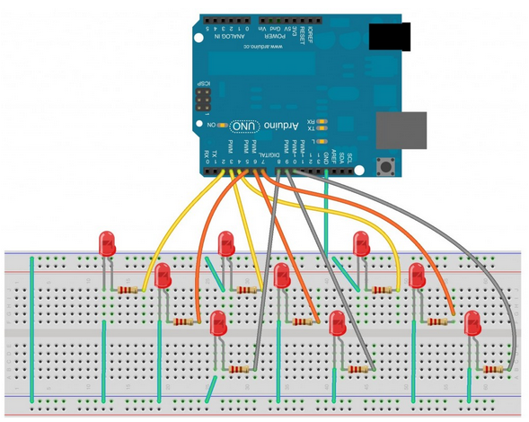
Chapter 14
Tugas Mandiri (prakt):

Slide 17
Chapter 14
Tugas Mandiri (prakt):
//the matrix will hold the pin assignments for the led
int pinMatrix[3][3] = {
{2, 3, 4 },
{5, 6, 7 },
{8, 9, 10 }
};
void setup() {
//use a nested for loop to initialize all the pins
for (int i = 0; i < 3; i++) {
for (int j = 0; j < 3; j++) {
pinMode(pinMatrix[i][j], OUTPUT);
}//close for i
}//close for j
} //close setup()
void loop() {
//this nested for loop will turn each LED on and off in sequence
for (int i = 0; i < 3; i++) {
for (int j = 0; j < 3; j++) {
digitalWrite(pinMatrix[i][j], HIGH);
delay(100);
digitalWrite(pinMatrix[i][j], LOW);
}//close for i
}//close for j
} //close loop()
Analisa kondisi Led saat Sketch Program ini di jalankan

Slide 18
end

