Slide 1



Bahan Ajar
Materi Pembelajaran
Matakuliah :
INTERFACING PERIPHERAL
Kode Matakuliah : SKO 20416
Prodi : SISTEM KOMPUTER
Dosen Pengampu Matakuliah:
Bayu Nugroho, S.Kom., M.Eng

Slide 2
Tables of Content
Chapter 9
Python Loops
- The while Loop
- The break Statement
- The continue Statement
- The else Statement
Python For Loops
- Looping Through a String
- The break Statement
- The continue Statement
Tugas Mandiri

Slide 3
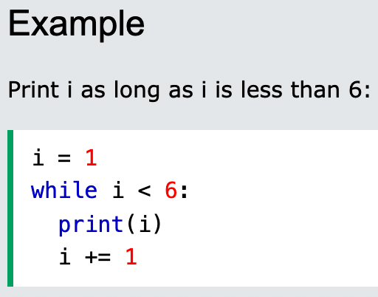
Chapter 9
The while Loop
With the while loop we can execute a set of statements as long as a condition is true

Slide 4
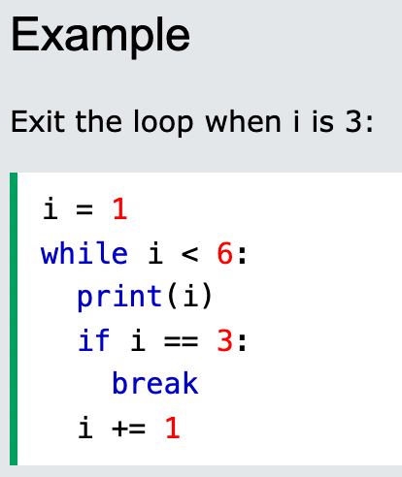
Chapter 9
The break Statement
With the break statement we can stop the loop even if the while condition is true:

Slide 5
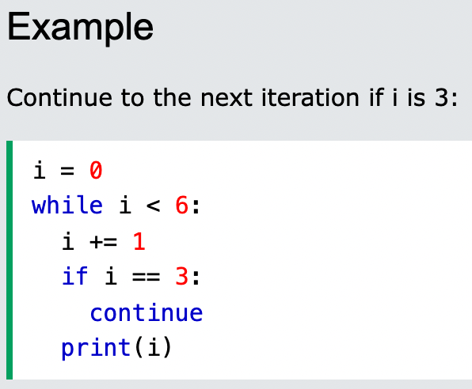
Chapter 9
The continue Statement
With the continue statement we can stop the current iteration, and continue with the next:

Slide 6
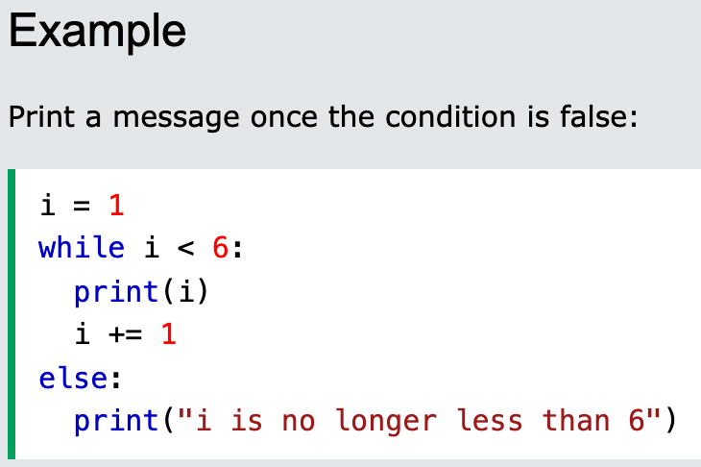
Chapter 9
The else Statement
With the else statement we can run a block of code once when the condition no longer is true:

Slide 7
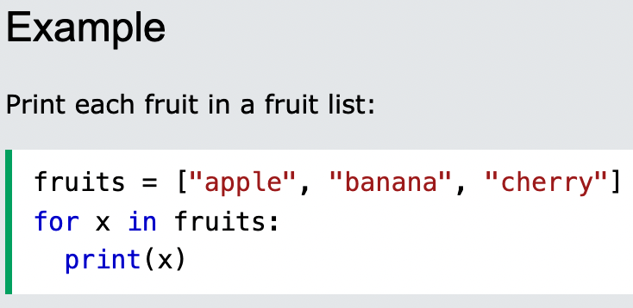
Chapter 9
Python For Loops
A for loop is used for iterating over a sequence (that is either a list, a tuple, a dictionary, a set, or a string).This is less like the for keyword in other programming languages, and works more like an iterator method as found in other object-orientated programming languages.
With the for loop we can execute a set of statements, once for each item in a list, tuple, set etc.

Slide 8
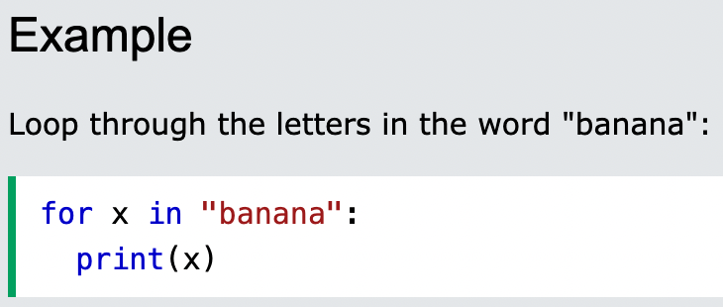
Chapter 9
Looping Through a String
Even strings are iterable objects, they contain a sequence of characters:

Slide 9
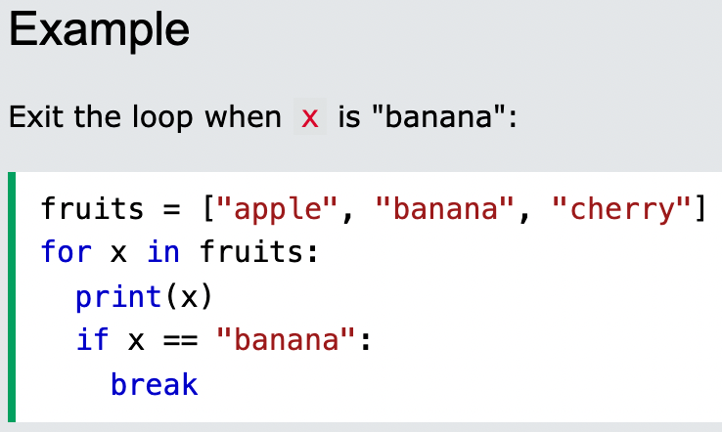
Chapter 9
The break Statement
With the break statement we can stop the loop before it has looped through all the items:

Slide 10
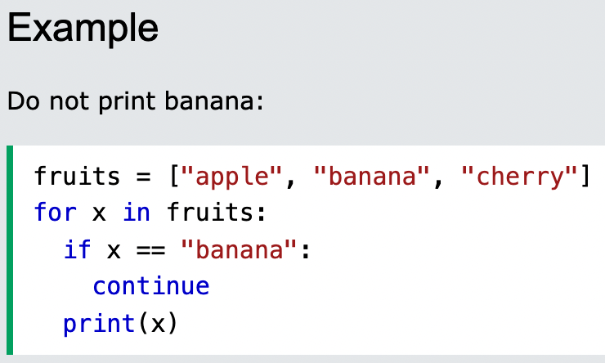
Chapter 9
The continue Statement
With the continue statement we can stop the current iteration of the loop, and continue with the next:

Slide 11
Chapter 9
Tugas Mandiri (teori):
A for loop is a count-controlled loop, and a while loop is a condition-controlled loop. True or false? Explained.
I am running my Python script, and it is stuck in an infinite loop! What do I do?
Tugas Mandiri (prakt):
Lakukan perakitan komponen pada Jobsheet 9 dan gunakan script program Python untuk menghidupkan LED dengan Ketentuan:
LED hidup bergantian random masing-masing selama 3 detik.
LED hidup berurutan masing-masing selama 2 detik

Slide 12
end

