Slide 1



Bahan Ajar
Materi Pembelajaran
Matakuliah :
INTERFACING PERIPHERAL
Kode Matakuliah : SKO 20416
Prodi : SISTEM KOMPUTER
Dosen Pengampu Matakuliah:
Bayu Nugroho, S.Kom., M.Eng

Slide 2
Tables of Content
Chapter 10
Python Functions
- Creating a Functions
- Calling a Function
- Arguments
- Number of Arguments
- Arbitrary Arguments, *args
- Keyword Arguments
- Default Parameter Value
- The pass Statement
Tugas Mandiri

Slide 3
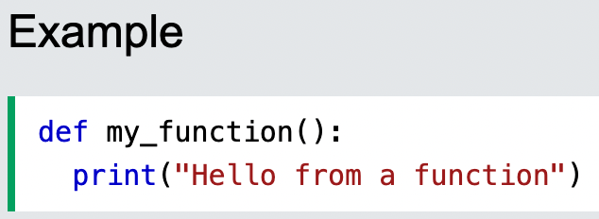
Chapter 10
Python Functions
A function is a block of code which only runs when it is called.
You can pass data, known as parameters, into a function.
A function can return data as a result
Creating a Function
In Python a function is defined using the def keyword:

Slide 4
Chapter 10
Calling a Function
To call a function, use the function name followed by parenthesis:

Slide 5
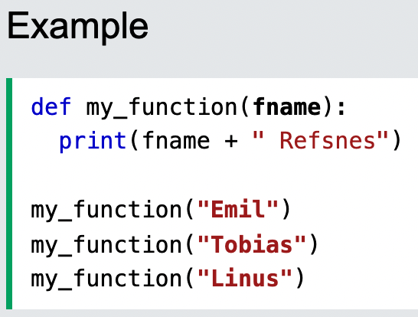
Chapter 10
Arguments
Information can be passed into functions as arguments.
Arguments are specified after the function name, inside the parentheses. You can add as many arguments as you want, just separate them with a comma.
The following example has a function with one argument (fname). When the function is called, we pass along a first name, which is used inside the function to print the full name:

Slide 6
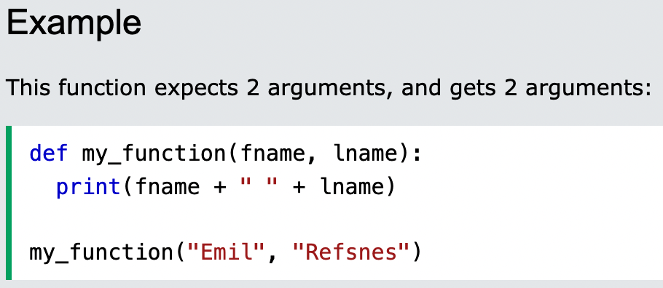
Chapter 10
Number of Arguments
By default, a function must be called with the correct number of arguments. Meaning that if your function expects 2 arguments, you have to call the function with 2 arguments, not more, and not less

Slide 7
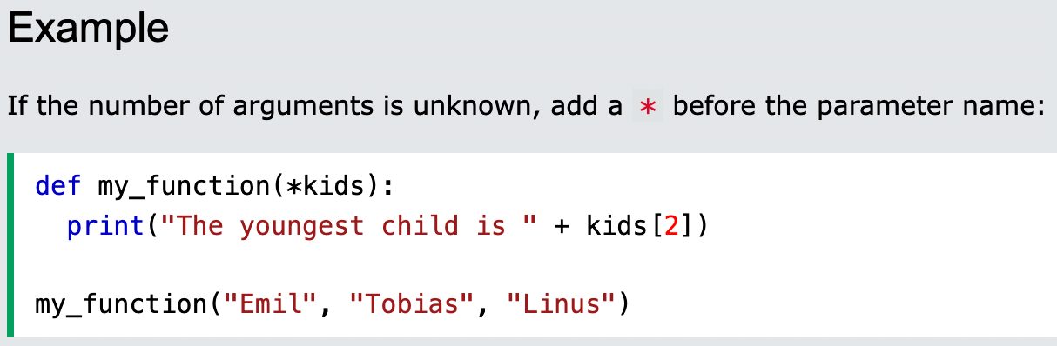
Chapter 10
Arbitrary Arguments, *args
If you do not know how many arguments that will be passed into your function, add a * before the parameter name in the function definition.
This way the function will receive a tuple of arguments, and can access the items accordingly:

Slide 8
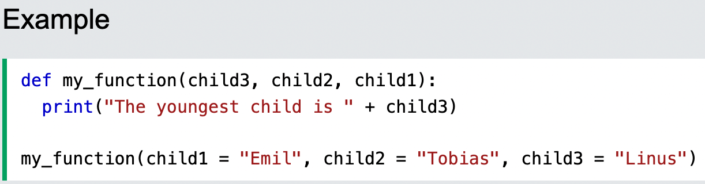
Chapter 10
Keyword Arguments
You can also send arguments with the key = value syntax.
This way the order of the arguments does not matter.

Slide 9
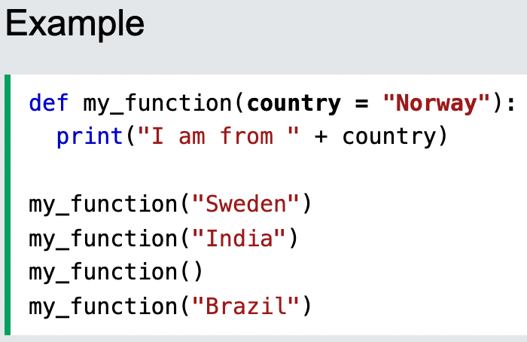
Chapter 10
Default Parameter Value
The following example shows how to use a default parameter value.
If we call the function without argument, it uses the default value:

Slide 10
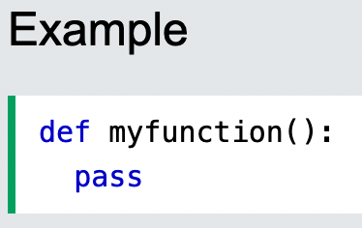
Chapter 10
The pass Statement
function definitions cannot be empty, but if you for some reason have a function definition with no content, put in the pass statement to avoid getting an error.

Slide 11
Chapter 10
Tugas Mandiri (teori):
If both the function and the main program can read and process global variables, why do I need to pass parameters to a function? Can’t I just use global variables? Explained.
You must define a function before you can use it in your Python script. True or false? Explained
Tugas Mandiri (prakt):
Lakukan perakitan komponen pada gambar Jobsheet 10 dan gunakan script program Python untuk menghidupkan LED dengan Ketentuan LED akan hidup jika sensor mendeteksi gerakan.

Slide 12
end

