Slide 1



Bahan Ajar
Materi Pembelajaran
Matakuliah :
INTERFACING PERIPHERAL
Kode Matakuliah : SKO 20416
Prodi : SISTEM KOMPUTER
Dosen Pengampu Matakuliah:
Bayu Nugroho, S.Kom., M.Eng

Slide 2
Tables of Content
Chapter 11
Python Lambda
- Lambda Functions
- Why Use Lambda Functions?
Python Casting
- Specify a Variable Type
- Python Casting
Tugas Mandiri

Slide 3
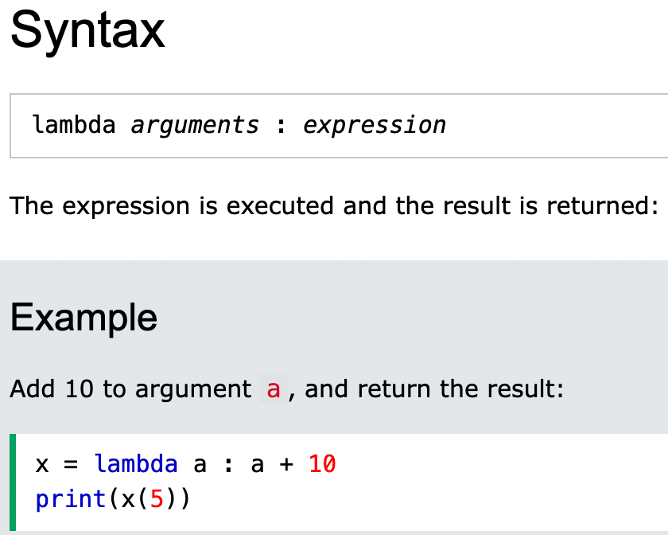
Chapter 11
Python Lambda
A lambda function is a small anonymous function.
A lambda function can take any number of arguments, but can only have one expression.

Slide 4
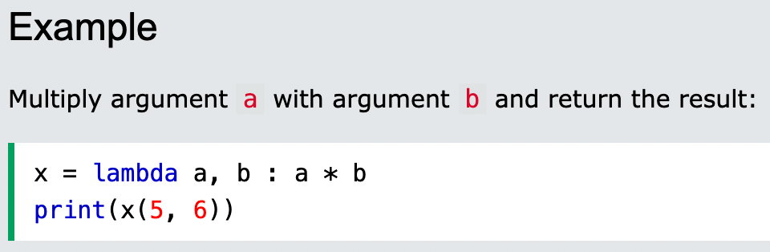
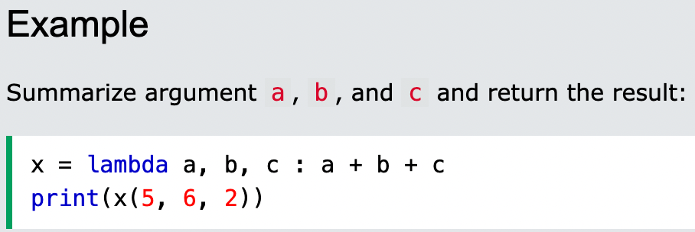
Chapter 11
Python Lambda
Lambda functions can take any number of arguments:

Slide 5
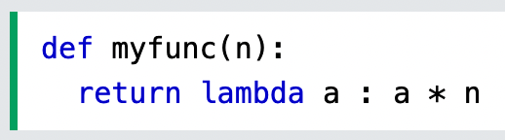
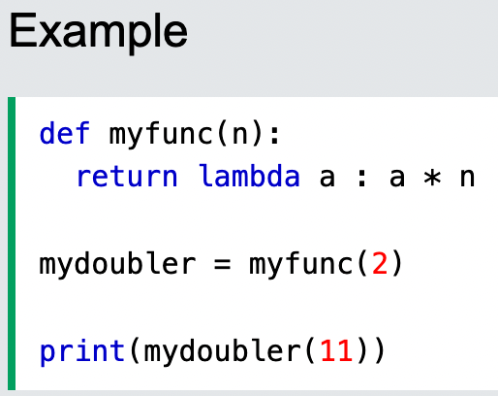
Chapter 11
Why Use Lambda Functions?
The power of lambda is better shown when you use them as an anonymous function inside another function.
Say you have a function definition that takes one argument, and that argument will be multiplied with an unknown number:
Use that function definition to make a function that always doubles the number you send in:

Slide 6
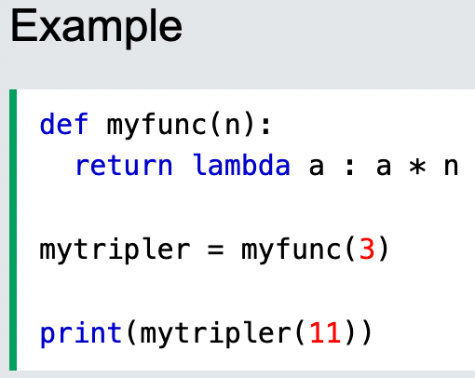
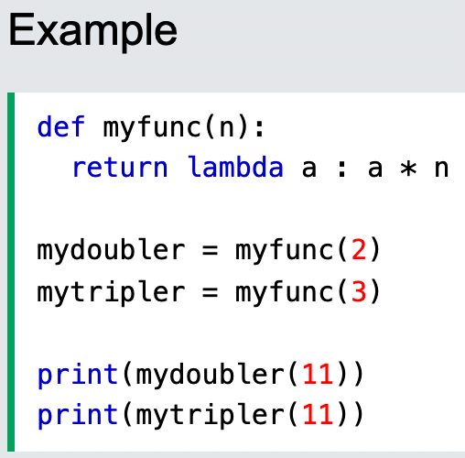
Chapter 11
Why Use Lambda Functions?
Or, use the same function definition to make a function that always triples the number you send in:
Or, use the same function definition to make both functions, in the same program:

Slide 7
Chapter 11
Python Casting
Casting in python is therefore done using constructor functions:
int() - constructs an integer number from an integer literal, a float literal (by removing all decimals), or a string literal (providing the string represents a whole number)
float() - constructs a float number from an integer literal, a float literal or a string literal (providing the string represents a float or an integer)
str() - constructs a string from a wide variety of data types, including strings, integer literals and float literals

Slide 8
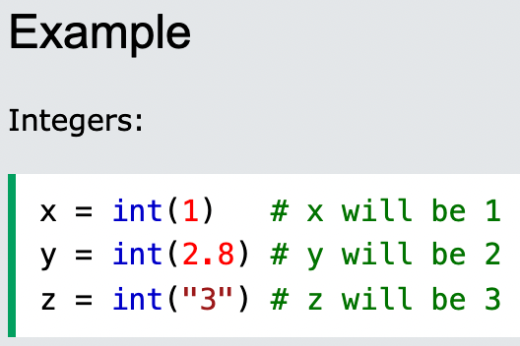
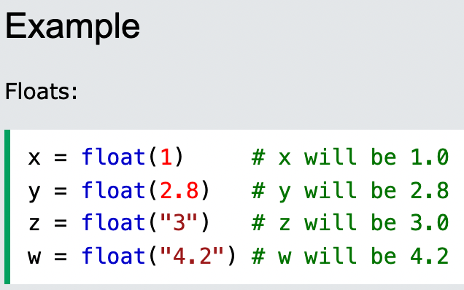
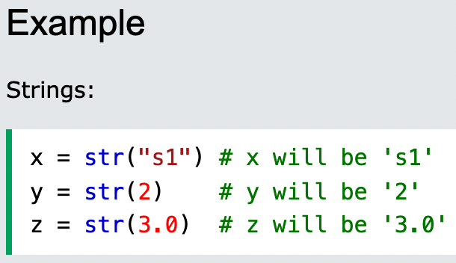
Chapter 11
Python Casting

Slide 9
Chapter 11
Tugas Mandiri (teori):
How can I add some sort of help to my custom module?
The Raspberry Pi can use different operating systems. Which one is recommended for those who are new to the Raspberry Pi? Explained
Tugas Mandiri (prakt):
Lakukan perakitan komponen pada gambar di Modul Jobsheet 11 dan gunakan script program Python untuk menghidupkan LED dengan Ketentuan LED akan hidup jika sensor tidak terkena cahaya.

Slide 10
end

