Slide 1


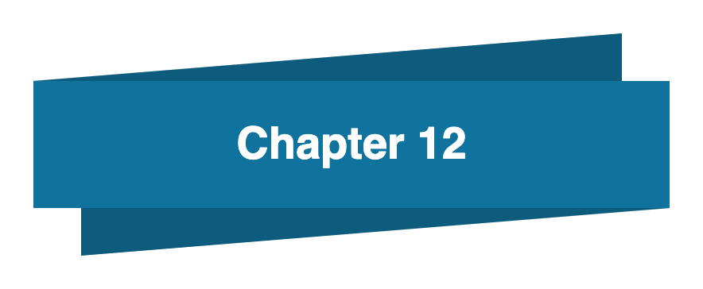
Bahan Ajar
Materi Pembelajaran
Matakuliah :
INTERFACING PERIPHERAL
Kode Matakuliah : SKO 20416
Prodi : SISTEM KOMPUTER
Dosen Pengampu Matakuliah:
Bayu Nugroho, S.Kom., M.Eng

Slide 2
Tables of Content
Chapter 12
Python Arrays
- Access the Elements of an Array
- The Length of an Array
- Looping Array Elements
- Adding, Removing Array Elements
- Array Methods
Tugas Mandiri

Slide 3
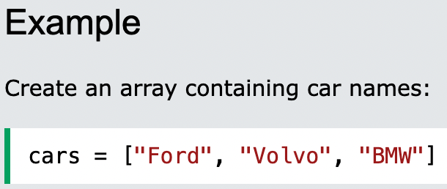
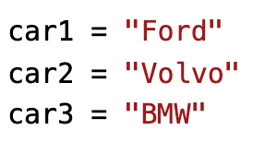
Chapter 12
Python Arrays
Arrays are used to store multiple values in one single variable:
An array is a special variable, which can hold more than one value at a time.
If you have a list of items (a list of car names, for example), storing the cars in single variables could look like this:

Slide 4
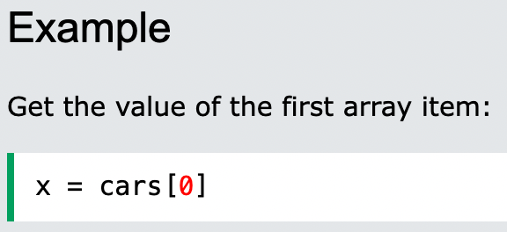
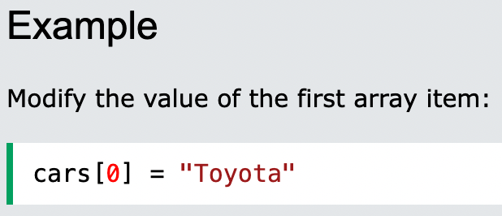
Chapter 12
Access the Elements of an Array
You refer to an array element by referring to the index number.

Slide 5
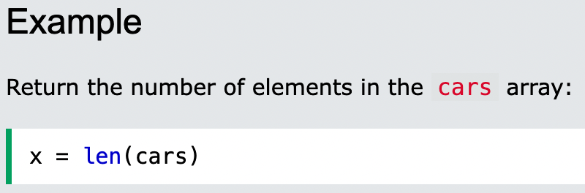
Chapter 12
The Length of an Array
Use the len() method to return the length of an array (the number of elements in an array).

Slide 6
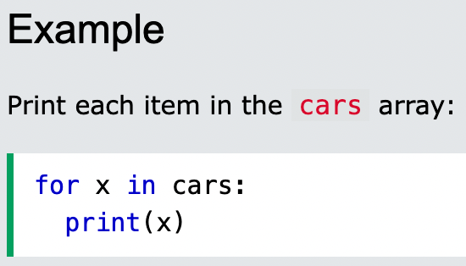
Chapter 12
Looping Array Elements
You can use the for in loop to loop through all the elements of an array.

Slide 7
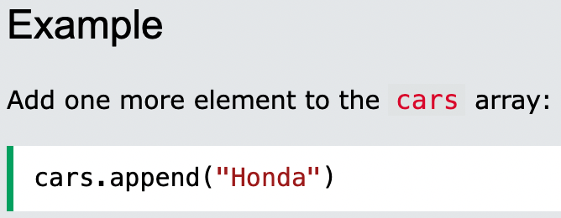
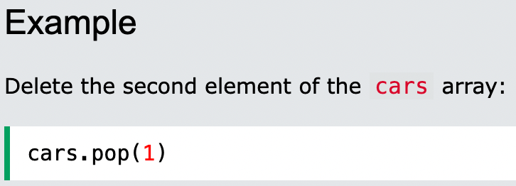
Chapter 12
Adding Array Elements
You can use the append() method to add an element to an array.
Removing Array Elements
You can use the pop() method to remove an element from the array.

Slide 8
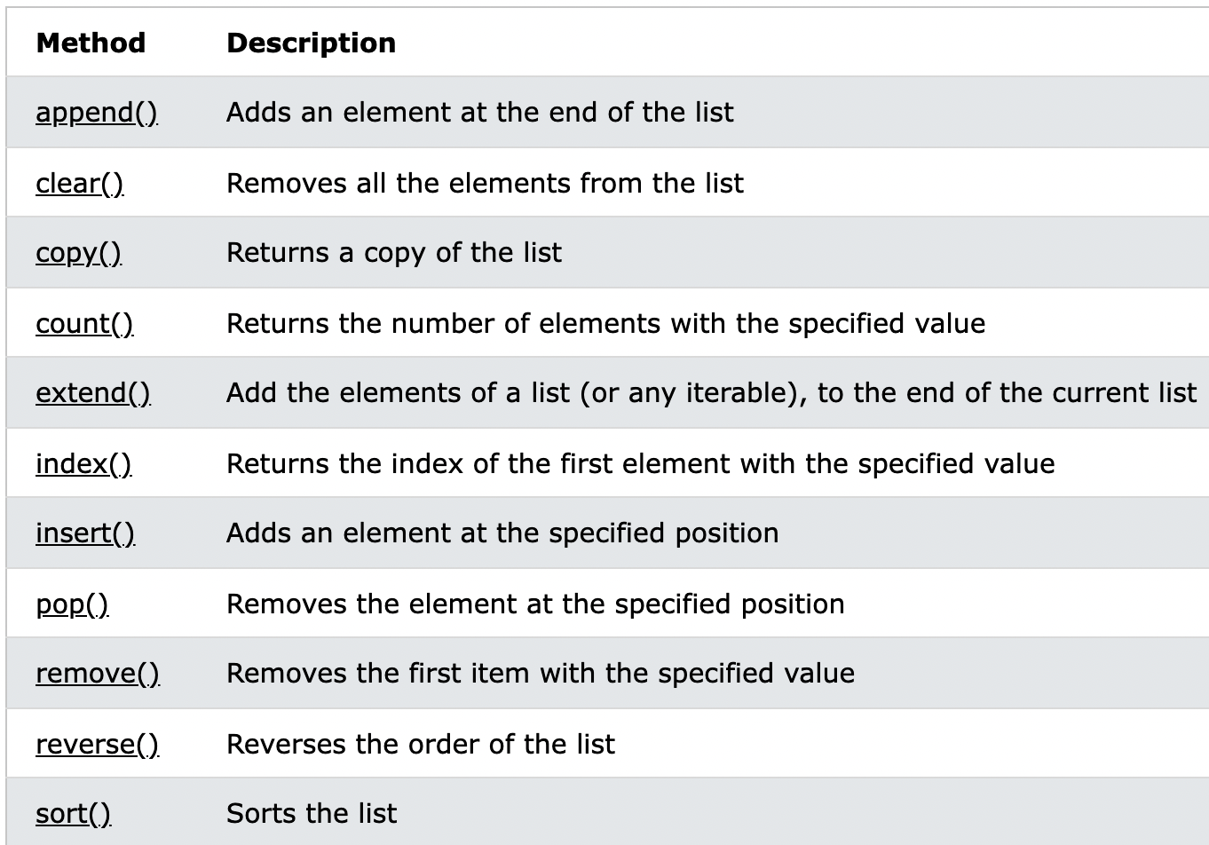
Chapter 12
Array Methods

Slide 9
Chapter 12
Tugas Mandiri (teori):
Most programming languages support associative arrays, matching a key to a value in an array. Do lists or tuples support this feature?
You can change a data value in a tuple, but not in a list. True or False? Explained
Tugas Mandiri (prakt):
Lakukan perakitan komponen pada gambar di Modul Jobsheet 12 dan gunakan script program Python untuk jarak antara sensor dengan benda.

Slide 10
end

