Slide 1



Bahan Ajar
Materi Pembelajaran
Matakuliah :
INTERFACING PERIPHERAL
Kode Matakuliah : SKO 20416
Prodi : SISTEM KOMPUTER
Dosen Pengampu Matakuliah:
Bayu Nugroho, S.Kom., M.Eng

Slide 2
Tables of Content
Chapter 13
Python Classes and Objects
- Create a Class
- Create Object
- The __init__() Function
- Object Methods
- Modify, Delete Object Properties
- The pass Statement
Tugas Mandiri

Slide 3
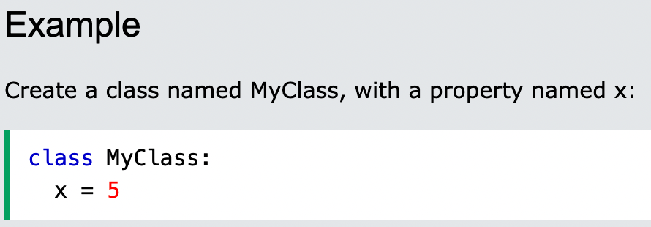
Chapter 13
Python Classes and Objects
Python is an object oriented programming language.
Almost everything in Python is an object, with its properties and methods. A Class is like an object constructor, or a "blueprint" for creating objects.
Create a Class
To create a class, use the keyword class:

Slide 4
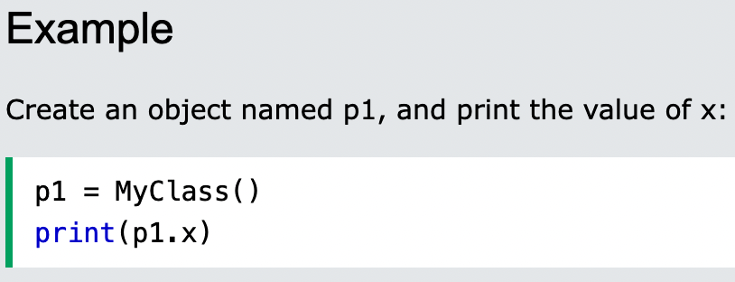
Chapter 13
Create Object
Now we can use the class named MyClass to create objects:

Slide 5
Chapter 13
The __init__() Function
The examples above are classes and objects in their simplest form, and are not really useful in real life applications.
To understand the meaning of classes we have to understand the built-in __init__() function.
All classes have a function called __init__(), which is always executed when the class is being initiated.
Use the __init__() function to assign values to object properties, or other operations that are necessary to do when the object is being created:

Slide 6
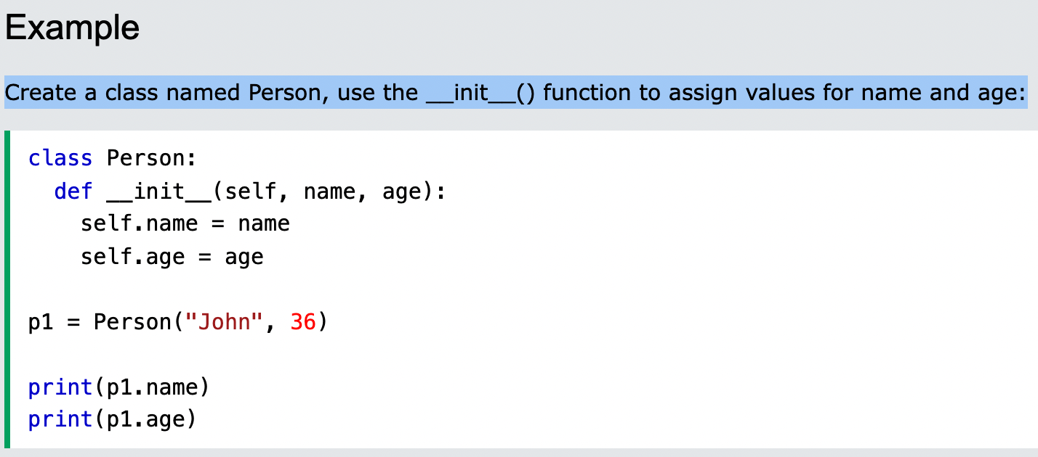
Chapter 13
The __init__() Function
Create a class named Person, use the __init__() function to assign values for name and age:

Slide 7
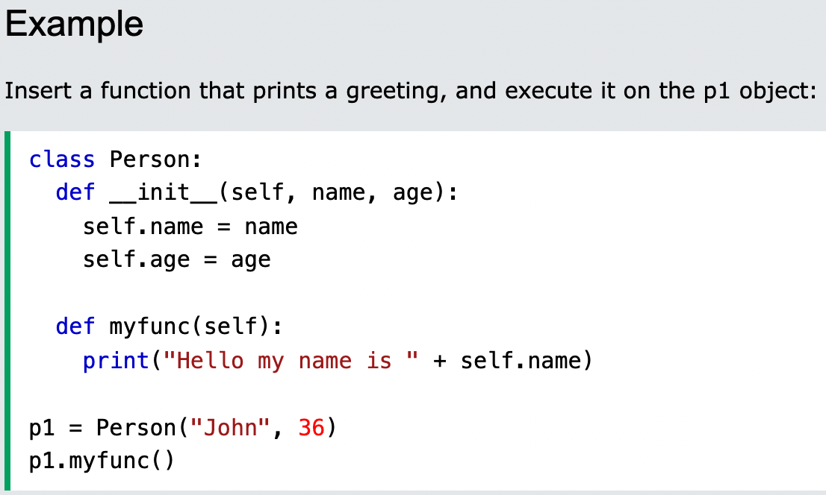
Chapter 13
Object Methods
Objects can also contain methods. Methods in objects are functions that belong to the object.
Let us create a method in the Person class:

Slide 8
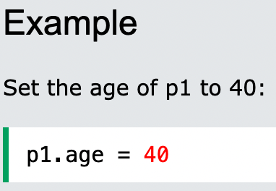
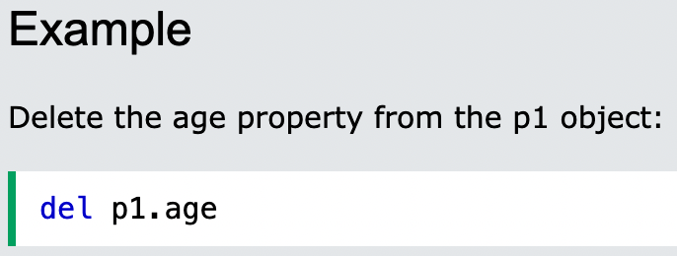
Chapter 13
Modify Object Properties
You can modify properties on objects like this:
Delete Object Properties
You can delete properties on objects by using the del keyword:

Slide 9
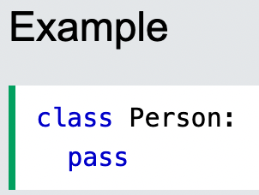
Chapter 13
The pass Statement
class definitions cannot be empty, but if you for some reason have a class definition with no content, put in the pass statement to avoid getting an error.

Slide 10
Chapter 13
Tugas Mandiri (teori):
Does Python support class inheritance? Explained
Which method should you define to create default values in a class constructor?
a. __del__()
b. __init__()
c. init() d. set_init()
Tugas Mandiri (prakt):
Lakukan perakitan komponen pada gambar di Modul Jobsheet 13 dan gunakan script program Python untuk menggerakkan motor Servo

Slide 11
end

