Slide 1


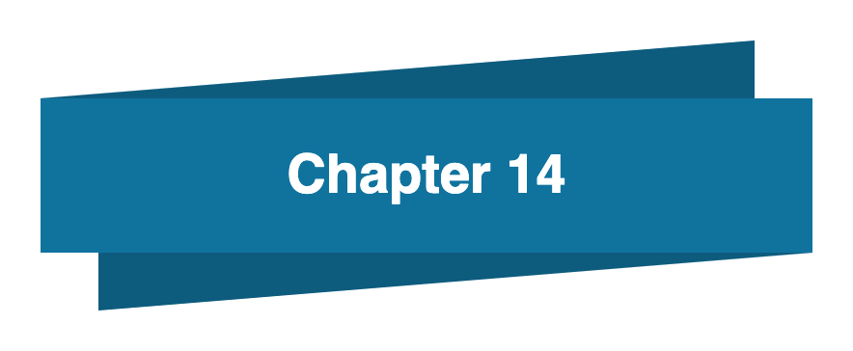
Bahan Ajar
Materi Pembelajaran
Matakuliah :
INTERFACING PERIPHERAL
Kode Matakuliah : SKO 20416
Prodi : SISTEM KOMPUTER
Dosen Pengampu Matakuliah:
Bayu Nugroho, S.Kom., M.Eng

Slide 2
Tables of Content
Chapter 14
Python Try Except
- Many Exceptions
- Else
- Finally
- Raise an exception
Tugas Mandiri

Slide 3
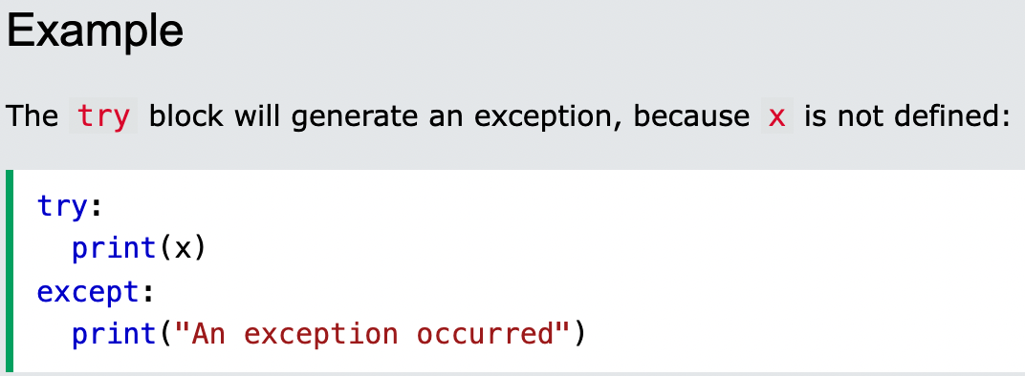
Chapter 14
Python Try Except
The try block lets you test a block of code for errors.
The except block lets you handle the error.
The else block lets you execute code when there is no error.
The finally block lets you execute code, regardless of the result of the try- and except blocks.
When an error occurs, or exception as we call it, Python will normally stop and generate an error message. These exceptions can be handled using the try statement:

Slide 4
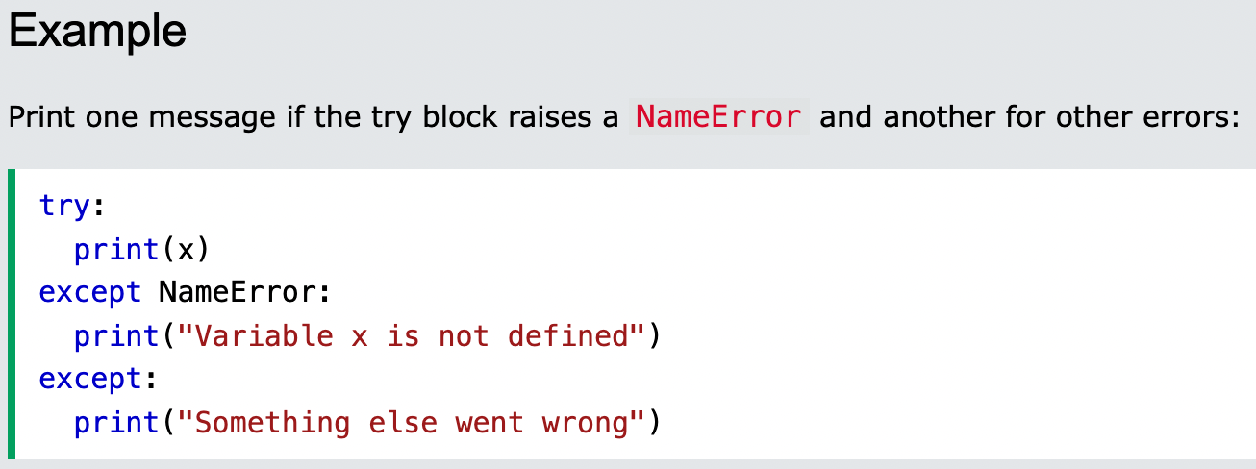
Chapter 14
Many Exceptions
You can define as many exception blocks as you want, e.g. if you want to execute a special block of code for a special kind of error:

Slide 5
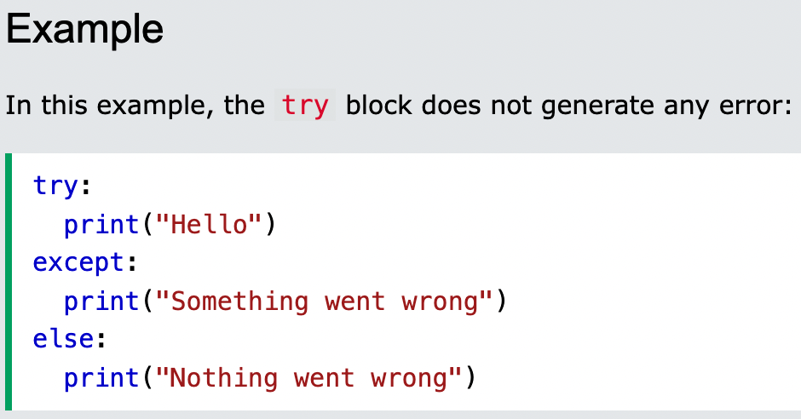
Chapter 14
Else
You can use the else keyword to define a block of code to be executed if no errors were raised:

Slide 6
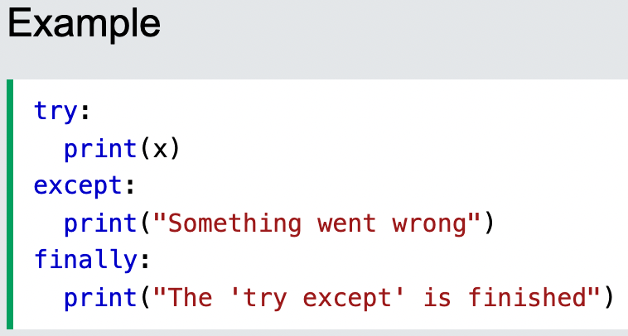
Chapter 14
Finally
The finally block, if specified, will be executed regardless if the try block raises an error or not.

Slide 7
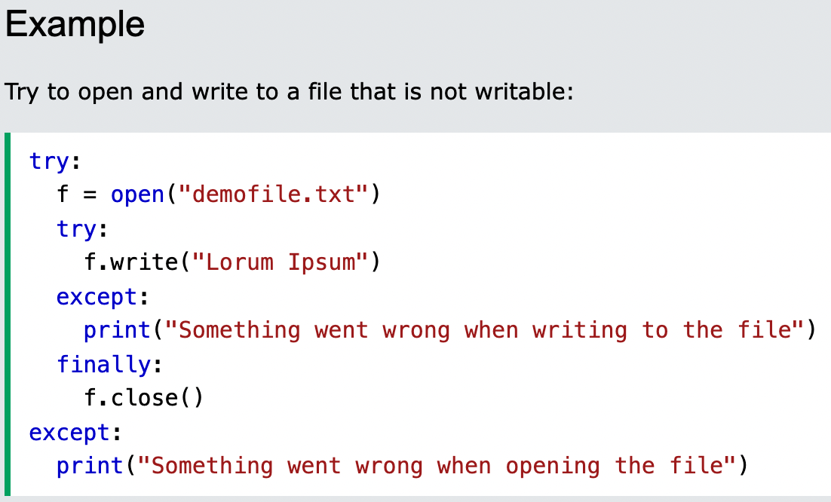
Chapter 14
Finally
This can be useful to close objects and clean up resources:

Slide 8
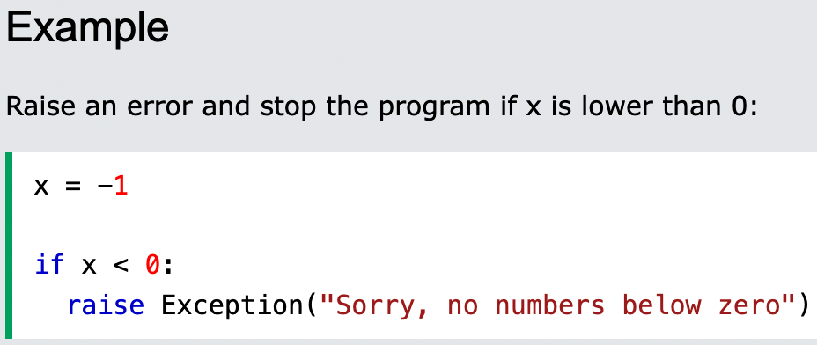
Chapter 14
Raise an exception
As a Python developer you can choose to throw an exception if a condition occurs.
To throw (or raise) an exception, use the raise keyword.

Slide 9
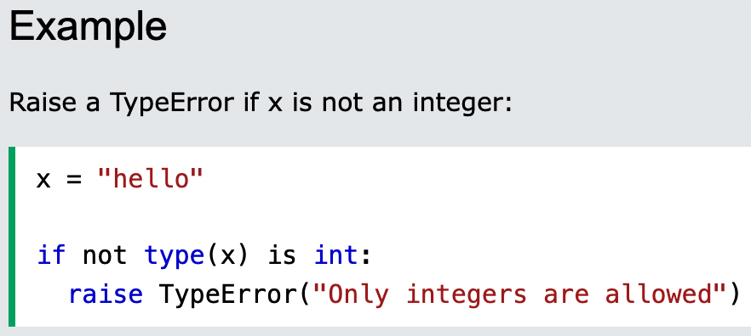
Chapter 14
Raise an exception
The raise keyword is used to raise an exception.
You can define what kind of error to raise, and the text to print to the user.

Slide 10
Chapter 14
Tugas Mandiri (teori):
Can you wrap your mainline function within a try except statement? Explained
I’ve heard I can raise my own exceptions. Is that true? Explained
Tugas Mandiri (prakt):
Lakukan perakitan komponen pada gambar di Modul Jobsheet 14 dan gunakan script program Python untuk menghidupkan lampu LED menggunakan Potensiometer.

Slide 11
end

