Slide 1


Bahan Ajar
Materi Pembelajaran
Matakuliah :
INTERFACING PERIPHERAL
Kode Matakuliah : SKO 20416
Prodi : SISTEM KOMPUTER
Dosen Pengampu Matakuliah:
Bayu Nugroho, S.Kom., M.Eng

Slide 2
Tables of Content
Chapter 15
Python File Handling
- Python File Open
- Open a File on the Server
- Read Only Parts of the File
- Read Lines
- Close Files
Tugas Mandiri

Slide 3
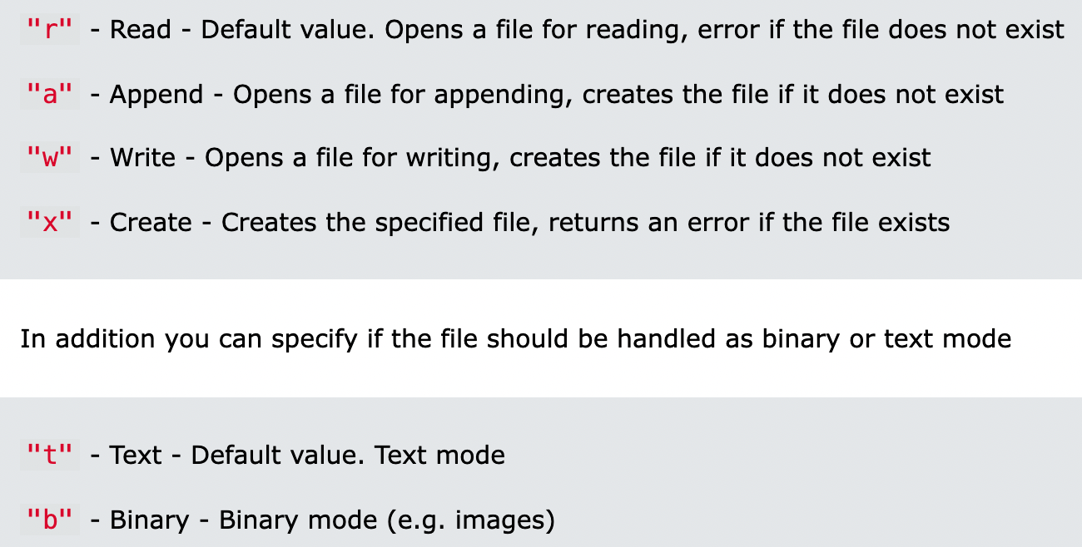
Chapter 15
Python File Open
The key function for working with files in Python is the open() function. The open() function takes two parameters; filename, and mode. There are four different methods (modes) for opening a file:

Slide 4
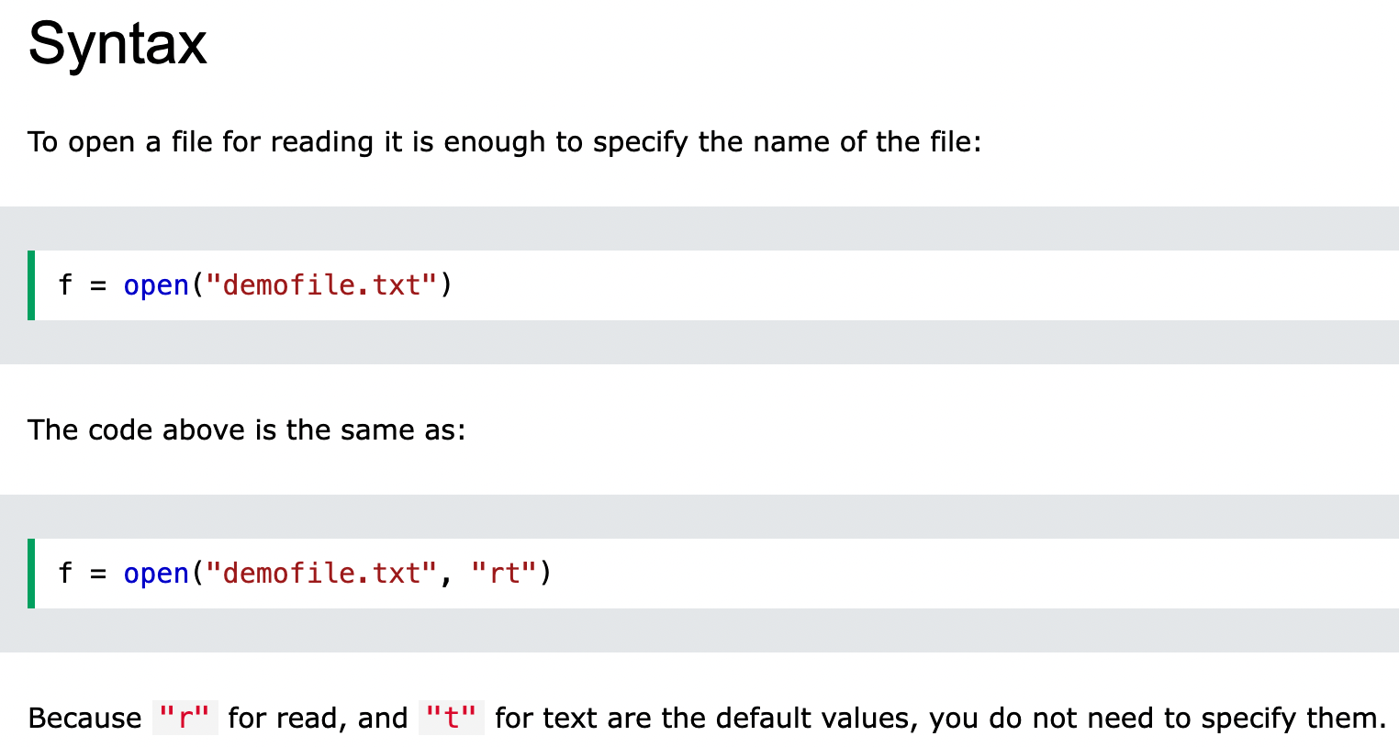
Chapter 15
Python File Open

Slide 5
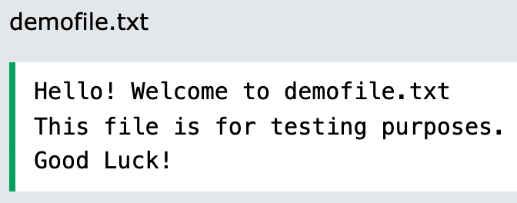
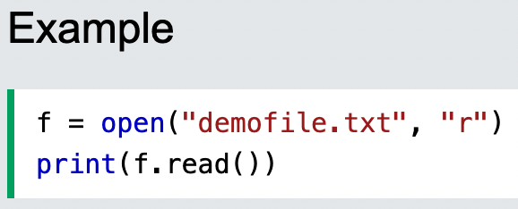
Chapter 15
Open a File on the Server
Assume we have the following file, located in the same folder as Python:
To open the file, use the built-in open() function.
The open() function returns a file object, which has a read() method for reading the content of the file:

Slide 6
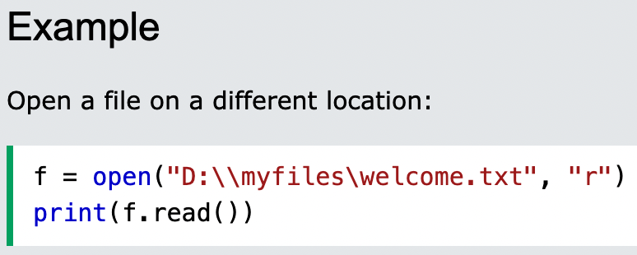
Chapter 15
Open a File on the Server
If the file is located in a different location, you will have to specify the file path, like this:

Slide 7
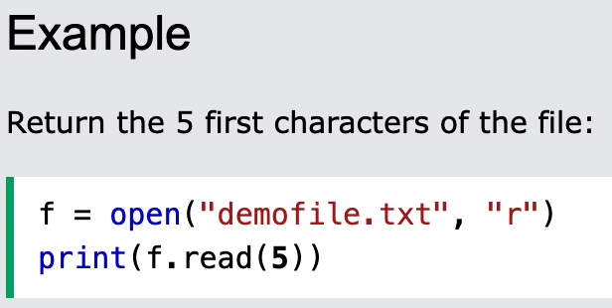
Chapter 15
Read Only Parts of the File
By default the read() method returns the whole text, but you can also specify how many characters you want to return:

Slide 8
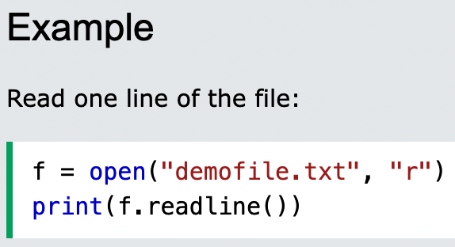
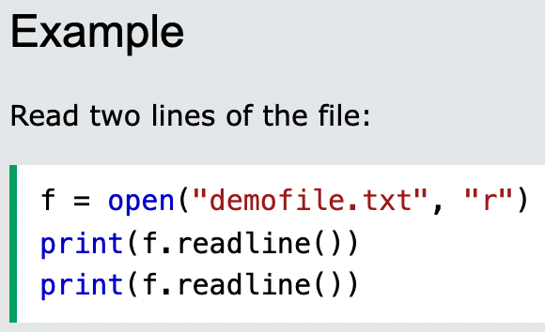
Chapter 15
Read Lines
You can return one line by using the readline() method:
By calling readline() two times, you can read the two first lines:

Slide 9
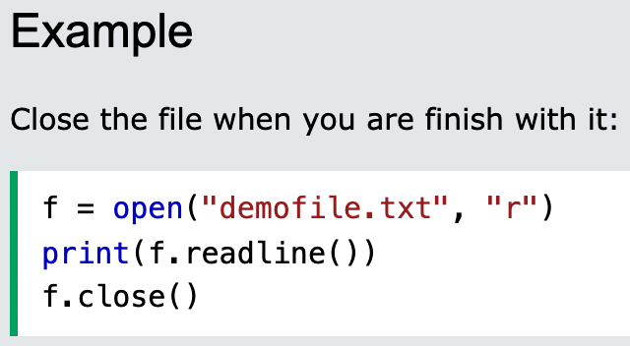
Chapter 15
Close Files
It is a good practice to always close the file when you are done with it.

Slide 10
Chapter 15
Tugas Mandiri (teori):
How can I keep the .write method from displaying the number of characters it has written during the running of a Python script?
To open a file to be both read and written, which mode should be used in the open function statement?
a. w+
b. r&w
c. r+
Tugas Mandiri (prakt):
Lakukan perakitan komponen pada gambar di Modul Jobsheet 15 dan gunakan script program Python untuk mendeteksi suhu ruangan yang ditampilkan ke LCD Display

Slide 11
end

