Slide 1
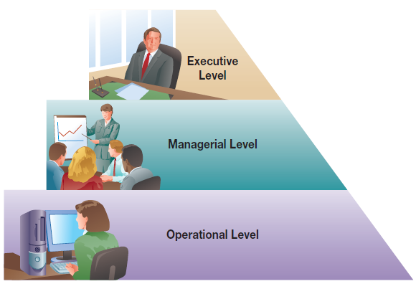
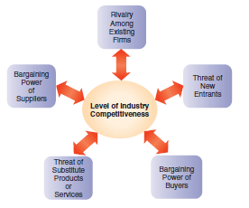
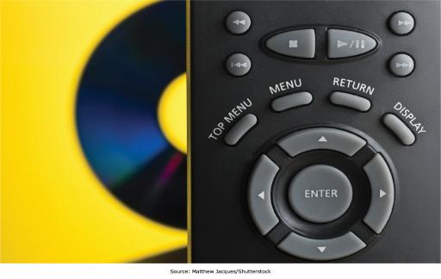
Chapter 2: Gaining Competitive Advantage Through Information Systems
A firm has competitive
advantage over rival firms when it
can do something better, faster,
more economically, or uniquely

Slide 2
Chapter 2 Learning Objectives
Enabling Organizational Strategy Through Information Systems
Business Models in the Digital World
Describe how information systems support business models used by companies operating in the digital world.
Valuing Innovations
Explain why and how companies are continually looking for innovative ways to use information systems for competitive advantage.
Discuss how information systems can be used for automation, organizational learning, and strategic advantage.

Slide 3
Enabling Organizational Strategy Through Information Systems
Enabling Organizational Strategy Through Information Systems
Discuss how information systems can be used for automation, organizational learning, and strategic advantage.
Business Models in the Digital World
Describe how information systems support business models used by companies operating in the digital world.
Valuing Innovations
Explain why and how companies are continually looking for innovative ways to use information systems for competitive advantage.

Slide 4
Organizational Decision-Making Levels
Executive/Strategic Level
  Upper Management
Managerial/Tactical Level
  Middle Management
Operational Level
  Operational Employees, Foremen, Supervisors
Notes:
Most businesses have three levels of management, with one or more layers of managers in each level.
The executive management includes top-tier management focused on long-term strategic business decisions such as how to compete, price versus quality, and what countries to do business in.
Middle or tactical management is focused on running the organization to meet the strategic goals, and typically has a management time frame of 3 to 12 months. Typical decisions might include where additional stores in existing markets should be opened.
Operational employees and management perform the day-to-day work of the organization, making decisions on a day-by-day basis.
A shift manager at a Walmart would be operational management, whereas a store manager at a Walmart would be at the lowest level of middle or tactical management.

Slide 5
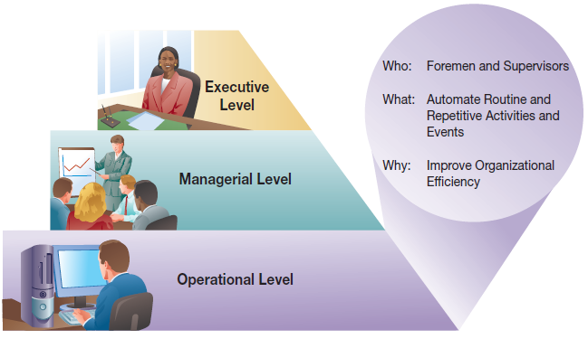
Organizational Decision-Making Levels:
Operational Level
Notes:
Operational information systems primarily focus on process automation. This can include automating routine activities as well as automating and optimizing structured decisions (such as employee scheduling).

Slide 6
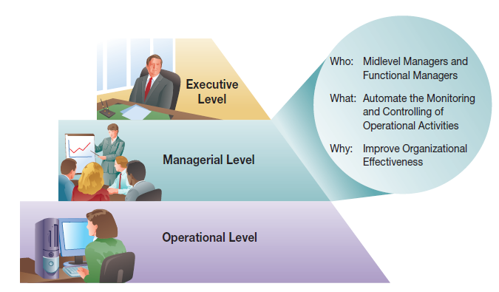
Organizational Decision-Making Levels:
Managerial/Tactical Level
Notes:
Information systems at the managerial, or tactical, level are focused on helping middle management exercise control more efficiently and effectively and on helping them make semi-structured decisions with better input and resources.

Slide 7
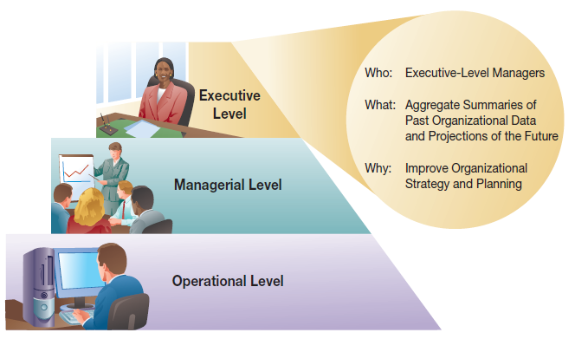
Organizational Decision-Making Levels:
Executive/Strategic Level
Notes:
Information systems at the executive level are focused on helping executing managers understand the current business status through:
executive information systems that often show aggregate business performance data, and
through tools to support executing decision making, such as forecasting and planning tools.

Slide 8
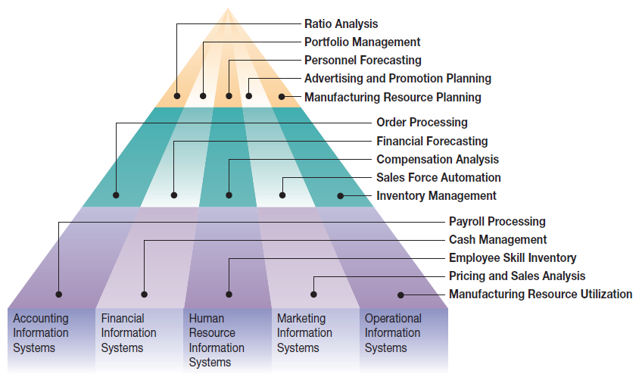
Organizational Functions and Functional Levels
Notes:
Organizations are organized along functional boundaries as well as along managerial levels, and managers within each function at each organizational level have unique information system needs.

Slide 9
Information Systems for Automating: Doing Things Faster (Table 2.2)
Primary Activities of Loan Processing | Manual Loan Process | Technology-Supported | Fully Automated
Complete and submit application | Completed at home (1.5 days) | Completed at home (1.5 days) | Completed online (15 minutes)
Check application for errors | Done in batches (2.5 days) | Done in batches (2.5 days) | Computerized (1 sec)
Input data into the information system | NA some paper handling (1 hr) | Done in batches (2.5 days) | NA (already done)
Assess loan apps under $250K | Done by hand (15 days) | Computer assisted (1 hr) | Computer processed (1 sec)
Committee decides if loan over $250K | (15 days) | (15 days) | (15 days)
Applicant notified | Batches (1 week) | (1 day) | E-mail (1 sec)
Total time | 25 to 40 days | 5 to 20 days | 15 min to 15 days
Notes:
Computers can automate existing business processes to varying degrees. Depending on the process, this may or may not be significant. In the above example, going from a manual process to a fully automated process changed the total time for loans under $250K from 25 days to 15 minutes.

Slide 10
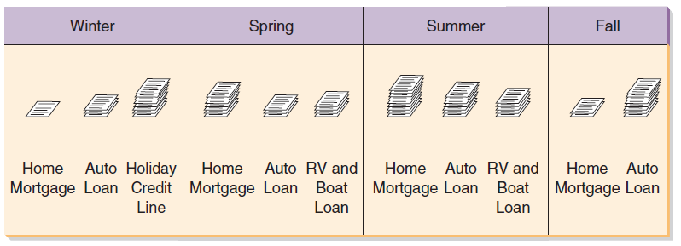
Information Systems for Organizational Learning: Doing Things Better
Information systems can track and identify trends and seasonality
Managers can use this to plan staffing levels and cross-training
Notes:
Information systems can track information and identify how the business is functioning in general and at different times of the year.
Managers can learn from this information and utilize it to run the business more efficiently, planning in advance how they handle seasonal demand fluctuations, or change business processes that are flawed and generating problems, such as approving loans that will be defaulted.

Slide 11
Information Systems for Supporting Strategy: Doing Things Smarter
Firms have a competitive strategy
Information systems should be implemented that support that strategy
  Low-cost strategy implies information systems to minimize expenses
  High-quality strategy implies information systems to support ensuring excellent quality and minimal defects
Notes:
Although automating and learning are good approaches to information systems, ensuring that expenditures are for systems that match the corporate strategy is also critical.
It wouldn’t make sense for a low-cost car manufacturer to implement a highly sophisticated and very expensive quality control system that rivaled the quality control systems of Mercedes, because that isn’t why customers are buying their cars and the system wouldn’t generate an appropriate return in investment.

Slide 12
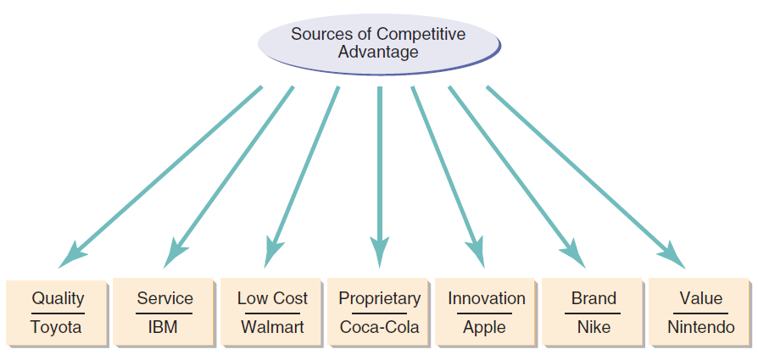
Sources of Competitive Advantage
Notes:
When a company does or is perceived by customers to do something distinctively better then the competition, it has a competitive advantage based on that distinctive feature.
Many firms seek unique positioning to increase the marketability of their products. Information systems that help a firm achieve a distinct position can help create competitive advantage.

Slide 13
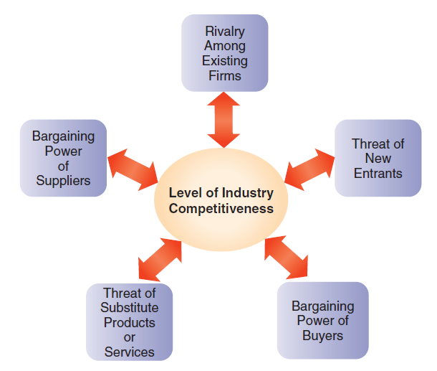
Identifying Where to Compete: Analyzing Competitive Forces
Notes:
Companies need to understand the forces acting within the industry and on their organization. Michael Porter created a framework for this in 1979 that is still widely used to this day.

Slide 14
Influence of the Internet on Competitive Forces (Table 2.3)
Competitive Force | Implication for Firm | Internet Influence on Competitive Force
Rivals within your industry | Competition in price, product distribution, and service | Geographic reach, ease of product comparison, price competition
New entrants | Increased capacity in industry, reduced prices and market share | Reduced entry barriers and eased critical resource access
Customers’ bargaining power | Reduced prices, demand for better quality and service | Wider customer choices, lower switching costs, higher customer bargaining power
Suppliers’ bargaining power | Increased costs and reduced quality | Equalized access to suppliers
Threat of substitute products | Potential returns on product, decreased market share, customer loss | New substitutes created by Internet and IT
Notes:
Information systems can help offset many competitive forces, such as computer-aided design and manufacturing, to help firms meet customer demands when customers have a high degree of bargaining power.

Slide 15
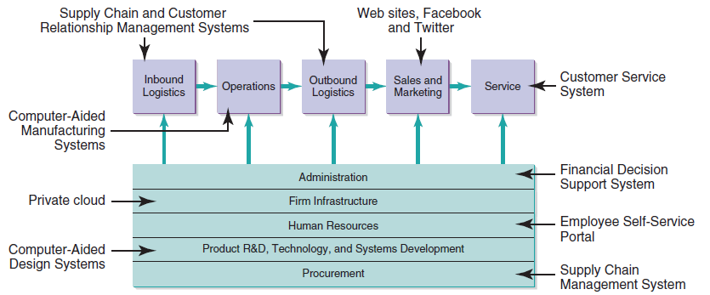
Identifying How to Compete: Role of IS in the Value Chain
Notes:
Value chain analysis can highlight opportunities in which information systems implementation can make an organization more effective and efficient, and secure a competitive advantage.
By identifying your cost structure at each level of the value chain and benchmarking against your competitors, you can identify changes that will enhance your performance.

Slide 16
The Technology/Strategy Fit
There are never enough resources to implement every possible IS improvement
Therefore, organizations try to maximize business/IT alignment
This means matching the IT investment to the company’s strategy
  e.g., don’t invest in IS that maximizes product differentiation if your company’s strategic focus is on being a low-cost leader
Companies that focus on the improvements and business process management that help their value creation strategy the most will see the greatest competitive benefit
Notes:
It is important that when firms are choosing technologies to implement they make sure the technologies support the business strategies already in place.
Although many projects may appear to be justified, limited resources require careful selection.
By making sure that the projects selected are focused on helping the company meet its core business objectives, a company can help ensure that the projects are adding value.

Slide 17
Assessing Value for the IS Infrastructure
Economic Value
  Direct financial impact
Architectural Value
  Extending business capabilities today and in the future
Operational Value
  Enhancing ability to meet business requirements
Regulatory and Compliance Value
  Complying with regulatory requirements
Notes:
Information systems add value to companies in several ways.
There are both direct financial impacts and indirect impacts, such as enabling an organization to make changes in the future or strengthening the business processes so organizations are readily able to meet business requirements without having to constantly make exceptional efforts. Finally, there is the value of meeting current and future regulatory requirements.

Slide 18
Business Models in the Digital World
Enabling Organizational Strategy Through Information Systems
Discuss how information systems can be used for automation, organizational learning, and strategic advantage.
Business Models in the Digital World
Describe how information systems support business models used by companies operating in the digital world.
Valuing Innovations
Explain why and how companies are continually looking for innovative ways to use information systems for competitive advantage.

Slide 19
Business Models in the Digital World
A business model reflects the following:
  What does a company do?
  How does a company uniquely do it?
  In what way (or ways) does the company get paid for doing it?
  What are the key resources and activities needed?
  What are the costs involved?
Notes:
How a company answers these questions dictates:
what industry the company is competing in,
how competitive it is in that industry,
what if any competitive advantage the company enjoys, and
how profitable the company is or can be.

Slide 20
Components and E-business Revenue of a Business Model
Components (Table 2.4)
  Customer segments
  Value proposition
  Channels
  Customer relationships
  Revenue streams
  Key resources
  Key activities
  Key partners
  Cost structure
Revenue Model (Table 2.5)
  Affiliate marketing
  Subscription
  Licensing
  Transaction fees and Brokerage
  Traditional sales
  Web advertising
Notes:
A business model is a summary of a business’s strategic direction that outlines how the objectives will be achieved; a business model specifies the value proposition, as well as how a
company will create, deliver, and capture value. Each component plays a critical role in shaping all aspects of the business.
The most important ingredient for any organization is determining how to generate revenue. A revenue model describes how the firm will earn revenue, generate profits, and produce
a superior return on invested capital.

Slide 21
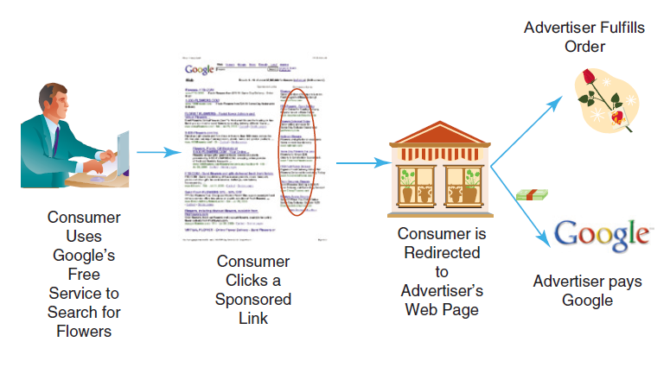
Freeconomics: Free Products Are the Future
Yahoo! makes millions from its free Web-based e-mail service—
reduced storage cost ➔ increased revenue per user
Notes:
As the market for digital goods and services increases, the total and marginal per-user costs decrease. Competition forces companies to pass these reduced costs on to customers to maintain competitiveness. Over time these constantly decreasing costs approach “free,” and offering them to the consumer for free may be the only way to get the consumer to take advantage of them as compared to a competitor’s offerings.

Slide 22
The Freeconomics Value Proposition
Free doesn’t mean no profit
  Google gives away search
  Users give Google search results their attention
    This can include attention to sponsored links
    Google sells space for sponsored links
  Advertisers pay Google for that attention to sponsored links
    Some users convert into customers
    Customers pay advertising firms for their products
Notes:
Someone gets something for free in freeconomics, but that doesn’t mean no one is paying for anything. There are multiple approaches to making freeconomics work, many of which result in significant profits for successful companies. The classic example is online search engines. The functionality of the search engines is given to users for free, but the use of the search engine Web site gives the search engine companies the opportunity to sell advertising to companies. The sale of advertising by the search engine can be particularly valuable because the advertising shown can be targeted based on the content of the desired search, making it more relevant for the user exposed to it.

Slide 23
Applying Freeconomics to Various Industries
Approach | What it Means | Examples
Advertising | Free services are provided to customers and paid for by a third party | ▪ Yahoo!’s banner ads ▪ Google’s pay-per-click
Freemium | Basic services are free; a premium is charged for special features | ▪ Skype ▪ Dropbox.com
Cross subsidies | Sale price of one item is reduced in order to sell something else of value | ▪Comcast DVR ▪Free cell phone with two-year contract
Zero Marginal Cost | Products are distributed to customers without an appreciable cost to anyone | ▪ iTunes music distribution ▪ Software distribution ▪ YouTube Video content
Labor Exchange | The act of customers using free services creates value | ▪ Yahoo! Answers ▪ Answers.com
Gift Economy | People participate and collaborate to create value for everyone | ▪ Open source software ▪ Wikipedia
Notes:
There are multiple ways companies implement freeconomics, many of which still drive revenue.
Advertising is very common, such as the search engine example from the previous slide.
Cross subsidies allow one item to be given away or sold at a reduced price to drive sales of another item.
Some items have no additional cost to duplicate, such as digital music, allowing companies to give them away without incurring expense.
There are also freeconomics at play in the gift economies and labor exchanges, where people participate for various reasons that are not monetarily based.

Slide 24
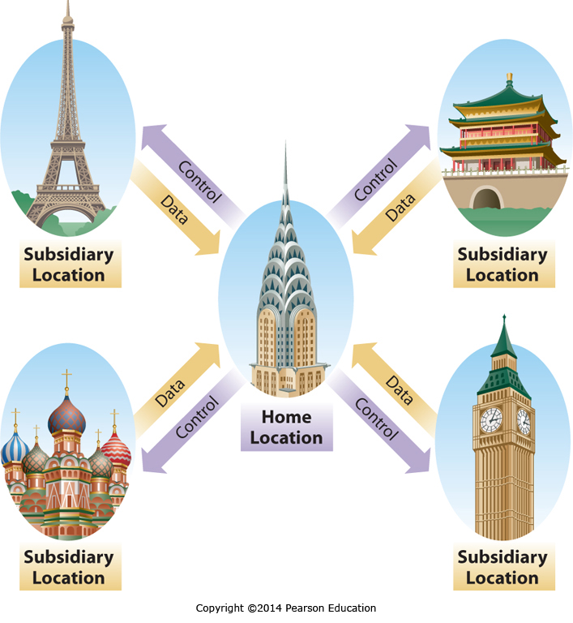
International Business Strategies
There are four international business strategies
  Home replication
  Global
  Multidomestic
  Transnational
Each has pros and cons in terms of complexity, cost benefits, local responsiveness, and control
Notes:
The four international business strategies are designed to address different needs for local responsiveness, simplicity, and cost minimization. We will discuss each of them in depth in the next four slides.

Slide 25
Home-Replication Strategy
Focused domestically, homogenous markets
International business an extension of home business
Focus on core home market competencies
Inability to react to local market conditions
Domestic systems, limited communication, local databases
Notes:
The home replication strategy is essentially focused on making products for the domestic market, and then selling them as exports to anyone who wants to buy them internationally, regardless of how the products may or may not be suited for that different market.

Slide 26
Global Business Strategy
Central organization, standardized offerings across markets, homogenous markets
Standardized products, economies of scale
Inability to react to local market conditions
Centralized systems, networks and data sharing between home office and subsidiaries
Notes:
When companies are pursuing a global business strategy, their products are deliberately developed for a global market.
This is differs from the home-replication strategy, where products are developed for the home market then offered up for export.
In the global strategy the product is intended for a global audience and designed to appeal across the global audience.
This requires subsidiaries providing extensive feedback to the home office to ensure an understanding of how the product is being received.
This strategy doesn’t allow for localization of the product to appeal to specific markets; the focus is rather a global product appealing across many markets.

Slide 27
Multidomestic Business Strategy
Decentralized federation, heterogeneous markets
Quick reaction to changing local market conditions
Differing products, lack of economies of scale, limited communication and knowledge sharing
Decentralized systems, bidirectional communications, local databases
Notes:
Multidomestic companies take a decentralized approach to running different subsidiary locations. Each location typically has a great deal of latitude in meeting local market needs. Although multidomestic companies can successfully operate in very different cultures, there tends to be little sharing of lessons learned and best practices throughout the company, resulting in inefficiencies. The information systems of multidomestic companies also tend to be run by individual IS departments within each subsidiary.

Slide 28
Transnational Business Strategy
Both centralized and decentralized components, integrated network and market
Benefits of both multi-domestic and global strategies
Highly complex, difficult to manage
Distributed/shared systems, enterprise-wide linkages, common global data resources
Notes:
In transnational companies, some aspects of the company are centralized, whereas other aspects are decentralized. What portions of the company are centralized and which are decentralized is based on what approach is necessary to maximize the return on shareholder investment, with products requiring significant localization to be successful often being decentralized, and products or business functions that gain efficiencies from economies of scale and standardization being centralized. Different parts of the company may even be centralized in different countries to take advantage of cost savings. The transnational strategy is sophisticated and complex, requiring extensive information sharing between different subsidiaries as well as between each subsidiary and the home location or locations. This communication is facilitated by information systems and the Internet.

Slide 29
Valuing Innovations
Enabling Organizational Strategy Through Information Systems
Discuss how information systems can be used for automation, organizational learning, and strategic advantage.
Business Models in the Digital World
Describe how information systems support business models used by companies operating in the digital world.
Valuing Innovations
Explain why and how companies are continually looking for innovative ways to use information systems for competitive advantage.
Notes:
To differentiate itself, an organization often must deploy new, state-of-the-art technologies to do things even better, faster, and more cheaply than rivals that are using older technologies.

Slide 30
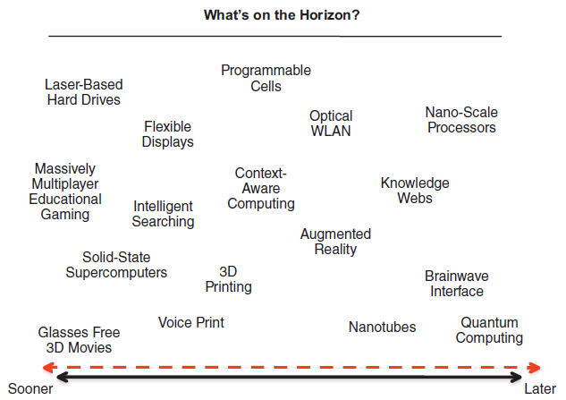
Some Enabling Technologies on the Horizon
Notes:
With the plethora of new information technologies and systems available, how can you possibly choose winners? Indeed, how can you even keep track of all the new breakthroughs,
new products, new versions, and new ways of using technologies? Which of these new technologies is important for you? Which one will make or break your business?

Slide 31
The Need for Constant IS Innovation
“The most important discoveries of the next 50 years are likely to be ones of which we cannot now even conceive” John Maddox
Transformation technologies are difficult or even impossible to see coming
  Think of the Internet in 1999
  Many of the critical discoveries in the next 50 years will be in areas we don’t see coming
Notes:
If a company wants to stay ahead of the competition, it needs to stay on top of the changing environment.
This can require constant innovation, as the technologies in the world we live in keep changing in new and unexpected ways.
Just as many companies in 1999 couldn’t conceive of the Internet as it is today, we may be unable to conceive of how the Internet will look in 2020 or 2025.

Slide 32
Successful Innovation Is Difficult
Innovation Is Often Fleeting
  The pace of change is fast
  Smart rivals quickly adopt any advantage
Innovation Is Often Risky
  Competing technologies result in a winner and a loser (e.g., Blu-Ray and HD DVD)
Innovation Choices Are Often Difficult
  It is impossible to pursue all opportunities
  It is hard to predict which opportunities will lead to success
Notes:
Innovation can bring great rewards, but it typically isn’t easy. Some innovations only give a short-term advantage; they are readily copied by competitors once they see it works. And when there are competing technologies, there is no guarantee that the one a company chooses to embrace will become the market standard, making large investments risky. Finally, companies often have to choose a limited set of options to pursue out of a wealth of opportunities. Resources are constrained, time is limited, and the information about the different options is imperfect.

Slide 33
Organizational Requirements for Innovation
Process Requirements
  Focus on success over other objectives
Resource Requirements
  Employees with knowledge, skill, time, and resources
  Partner with appropriate requirements
Risk Tolerance Requirements
  Tolerance for risk
  Tolerance for failure
Notes:
Innovation isn’t something every company can do. The company has to have an organization and process that allows innovation to move forward and not get caught up in office politics and competing agendas. If a company decides to pursue innovation, it either needs the resources in-house or needs to contract with a partner that has the appropriate resources. Finally, a company that doesn’t allow risk taking and the occasional failure will punish people who try to take risks and innovate, and will soon stifle any possibility of innovation.

Slide 34
Predicting the Next New Thing
Many innovations can be copied
  Limited time span of any advantage
  May become a requirement for staying competitive
Some innovations deliver longer advantages
  Unique customer service based on customer data
  High levels of customer investment in proprietary systems; high switching costs
  Technologies that are very difficult to copy
Notes:
It is difficult to predict the next innovation that will provide a long-term competitive advantage, but there are a few things to keep in mind. Innovations based on a purchased technology can often be purchased by competitors, and those based on a developed technology can be imitated or copied. To provide long-term advantage the innovation needs to form the basis for or incorporate something that competitors can’t readily acquire or develop. This could be something based on customer data that competitors can’t readily acquire, such as unique customer service. Sometimes a company can develop a technology that customers buy into and then are locked into with high switching costs. Although this can be effective, some customers will view it as a trap and avoid it. Finally, companies can develop sophisticated technologies that are very difficult to copy or have a very high cost to duplicate. All of these can result in a company having a long-term competitive advantage.

Slide 35
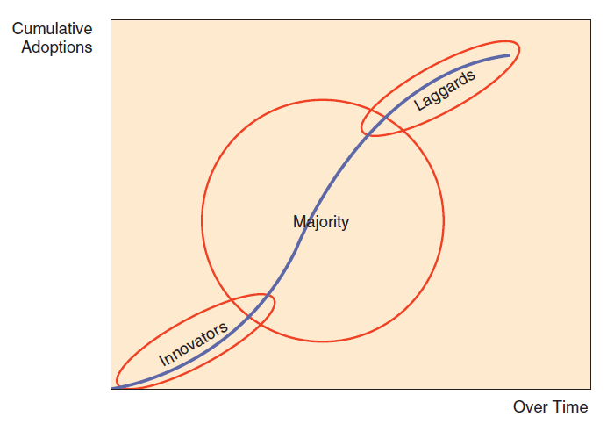
The Diffusion of Innovations
Source: Based on Rogers (2003).
Notes:
Typical innovations are often slow to take off, then are rapidly adopted, and finally there is a long tail of late adopters who slowly change over. The innovators may be adopting technology just to see if it’s beneficial, while the majority are adopting it to take advantage of its benefits, and the laggards are slow to adopt despite the benefits they would see. Although many technologies go through this cycle, disrupting innovations, discussed next, are different.

Slide 36
Disruptive Innovations
Examples from Table 2.9
Disruptive Innovation | Displaced or Marginalized Technology
Digital photography | Chemical photography
Online stock brokerage | Full-service stock brokerages
Online retailing | Brick-and-mortar retailing
Distance education | Classroom education
Unmanned aircraft | Manned aircraft
Semiconductors | Vacuum tubes
MP3 players and music downloading | Compact discs and music stores
Smartphones | MP3 players, dedicated GPS navigation
Tablets | Notebook computers
Xbox, PlayStation, Smartphones | Desktop computers
Notes:
Disruptive innovations can completely replace the technology they are disrupting, and a failure to recognize that a disruptive innovation is changing the market can easily lead to a company’s demise. With a disruptive innovation, companies may not be given the opportunity to be laggards.

Slide 37
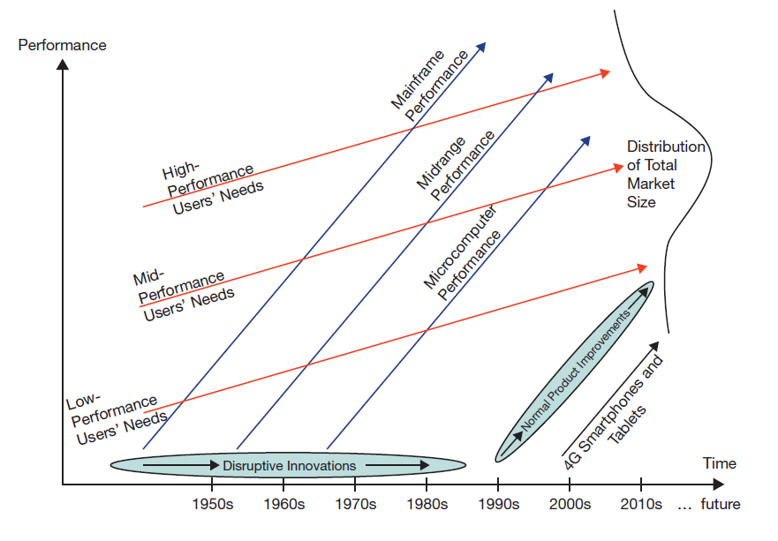
The Innovator’s Dilemma
Notes:
In many different industries the capabilities of the lowest-performing category of the market improve faster then the needs of the lowest-need users. This is especially true in the computing industry, where the capabilities of computer systems continue to increase at a breakneck pace. When the lowest-performing technology that is useful becomes powerful enough, it starts to meet the needs of additional users, and can often replace higher-cost technology options. Thus microcomputers pushed midrange computers out of the workplace, but some midrange computers pushed high-end computers out as well. The lowest-performing technology that is useful may now itself be threatened by other technologies that couldn’t meet the needs of users in a segment before, but now can. Cell phones and tablet computers are now powerful enough to be a disruptive technology threatening microprocessor-based computers.

Slide 38
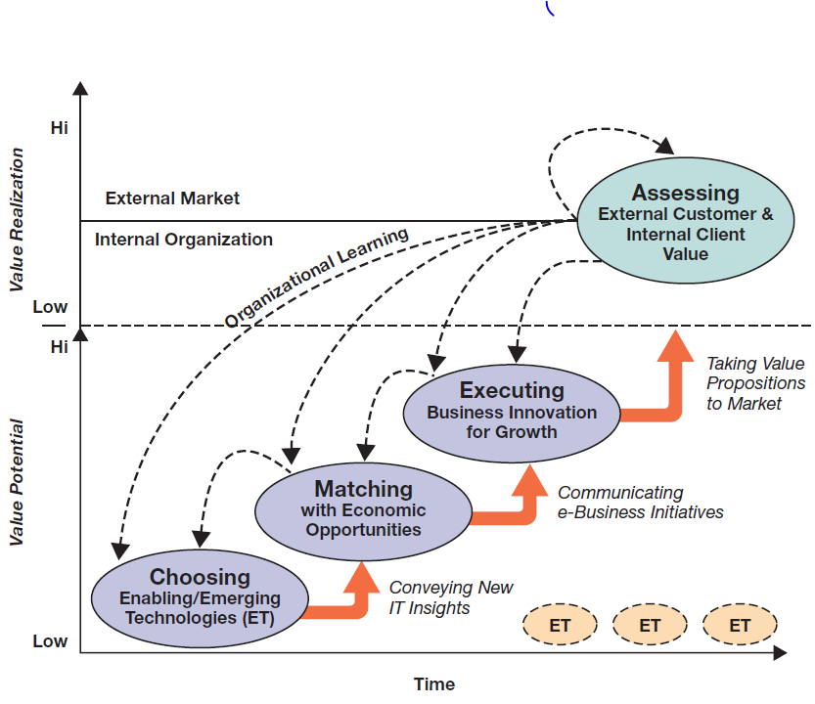
Implementing the Innovation Process
Notes:
The e-business innovation cycle is based on choosing technologies, matching them to opportunities, and executing against the opportunity. After each execution there is an assessment phase where learning occurs, and then the process starts again.
The most difficult part of the cycle is in choosing the enabling/emerging technologies, which can be exceptionally difficult. Matching the selection with business opportunities is the next most difficult phase.

Slide 39
End of Chapter Content

Slide 40
Managing in the Digital World: The Business of Merging “Groups” and “Coupons”
Groupon created a new business model
  Heavily discounted deals for grouped buyers
  Advertising value for sellers
Groupon’s business model is easily duplicated, and has been, repeatedly
  Groupon does have a first-mover head start
  Groupon has purchased many competitors
  However, Groupon has no sustainable competitive advantage as currently positioned

Slide 41
Brief Case: Wi-Fi in the Sky
Airline passengers don’t want to be deprived of Wi-Fi-enabled digital devices
So, airlines are rushing to comply
  Aircell’s cellular ground-based “GoGo” service has been installed on over 2,000 aircraft
  Row 44’s satellite service is installed in Southwest’s entire fleet
Some airlines offer Internet access for free, others charge customers
In 2013, the FCC lifted a ban on cell-phone use, allowing Airplane mode throughout the duration of flight
Voice calls are still banned, due to annoyance, not danger of signal interference

Slide 42
Who’s Going Mobile: Mobile Platforms
Mobile devices are redefining the way we access information and communicate
Like computers, smartphones run on specific operating systems
  Apple: iOS
  Samsung: Android
People choose smartphones phones based more on manufacturer, OS, and apps than on carrier

Slide 43
When Things Go Wrong: The Pains of Miscalculating Groupon
Groupon sales are heavily discounted, and can cost companies more then they bring in
  Groupon takes 40% of the discounted sale
  Groupon sales are unprofitable unless they grow the repeat business customer base
  Some sales are one-time (eye laser surgery)
  Businesses forget to cap the number of sales
  A large number of unprofitable sales can lead to large losses for small companies

Slide 44
Ethical Dilemma:
Underground Gaming Economy
Massively multiplayer online role-playing games (MMORPGs)
  Players are now buying and selling virtual goods with real money
  Some companies hire people to “farm gold,” which they sell
    Estimated 400,000 gold farmers world wide
    90% in China, often work 12 hour days
    Is this a human rights violation?
  Buying assets in a game creates advantages over players who can’t or won’t, changing the game
  Some companies ban gold farmers for life to protect the integrity of the game for other players

Slide 45
Coming Attractions:
Google’s Project Glass: A Pair of Glasses
Project Glass: an embedded display in eyeglasses
Augments reality
  Displays information about wearer’s environment
  Take photos, listen to music, play videos
  GPS
Went public in May 2014 for $1500
Leads to privacy concerns, resentment from others (refer to wearers as “glassholes”)

Slide 46
Key Players:
The Global Elite
Who are the technology giants in the global marketplace?
  U.S.-based firms include: Hewlett-Packard, AT&T, Apple, IBM, Verizon, Microsoft, and Dell
  Non-U.S. firms include: Huawei Technologies, Nokia, Motorola, Siemens, Foxconn, and ZTE

Slide 47
Industry Analysis: Education
Cost of higher education in the United States has steadily increased (16% every five years)
Average college graduate owes $30,000 in student loans
Trend in globalization—increased collaboration in research and curriculum
Trend in online delivery—leads to cost savings, but may be less engaging to students
Massively open online courses (MOOCs)—free to students

