Slide 1
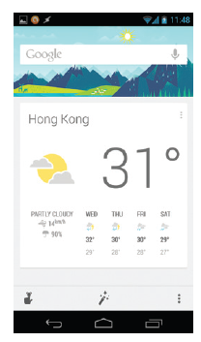
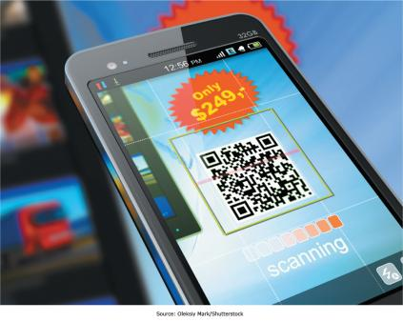

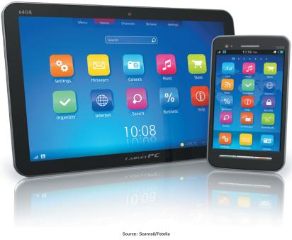
Chapter 4: Enabling Business-to-Consumer Electronic Commerce
The Internet and World Wide Web are extremely well suited for conducting business electronically on a global basis

Slide 2
Chapter 4 Learning Objectives
After this chapter, you will be able to:
Electronic Business: E-Commerce and E-Government
Describe different business models used to compete in cyberspace as well as different forms of electronic government.
Business-to-Consumer E-Commerce
Describe business-to-consumer electronic commerce strategies.
Understand the keys to successful electronic commerce Web sites, and explain the different forms of Internet marketing.
Electronic Commerce Websites and Internet Marketing
Mobile Commerce, Consumer-to-Consumer EC, and Consumer-to-Business EC
Describe mobile commerce, consumer-to-consumer electronic commerce, and consumer-to-business electronic commerce.
Managing Finances and Navigating Legal Issues in EC
Describe how to conduct financial transactions and navigate the legal issues of electronic commerce.

Slide 3
Electronic Business:
E-Commerce and E-Government
Electronic Business: E-Commerce and E-Government
Describe different business models used to compete in cyberspace as well as different forms of electronic government.
Business-to-Consumer E-Commerce
Describe business-to-consumer electronic commerce strategies.
Understand the keys to successful electronic commerce Web sites, and explain the different forms of Internet marketing.
Electronic Commerce Websites and Internet Marketing
Mobile Commerce, Consumer-to-Consumer EC, and Consumer-to-Business EC
Describe mobile commerce, consumer-to-consumer electronic commerce, and consumer-to-business electronic commerce.
Managing Finances and Navigating Legal Issues in EC
Describe how to conduct financial transactions and navigate the legal issues of electronic commerce.

Slide 4
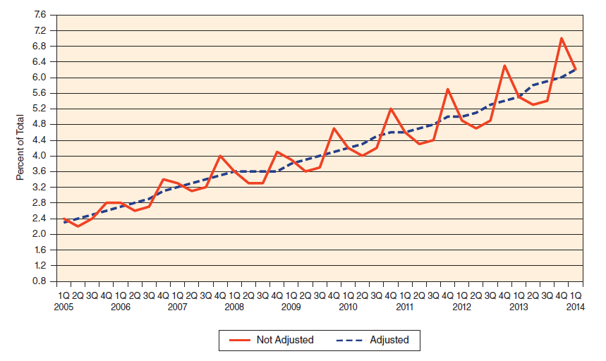
E-Commerce (EC) Defined
  “The exchange of goods, services, and money among firms, between firms and their customers, and between customers, supported by communication technologies and, in particular, the Internet”
Notes:
Electronic commerce occurs when any aspect of the transaction is facilitated by electronic communication technologies.
We typically think of the Internet, which is where the vast majority of electronic commerce takes place.
Exchanges can involve consumer, businesses, and the government, where any of these can be the buyer, the seller, or both.

Slide 5
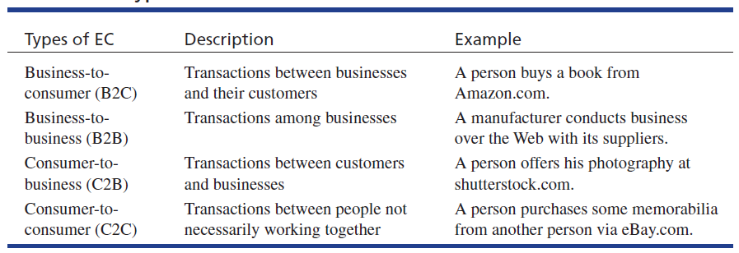
Electronic Commerce Defined:
EC Business Models
All of the above types of EC are in the private sector.
Notes:
There are many types of EC, based on who is interacting with, or selling to, whom.
Business-to-consumer is businesses selling to consumers; consumer-to-business is consumers selling to businesses.
As a consumer, you mostly make use of B2C. Perhaps you also use eBay to auction off items you no longer need, which is a form of C2C. Has anyone ever sold something to a business (C2B)?

Slide 6
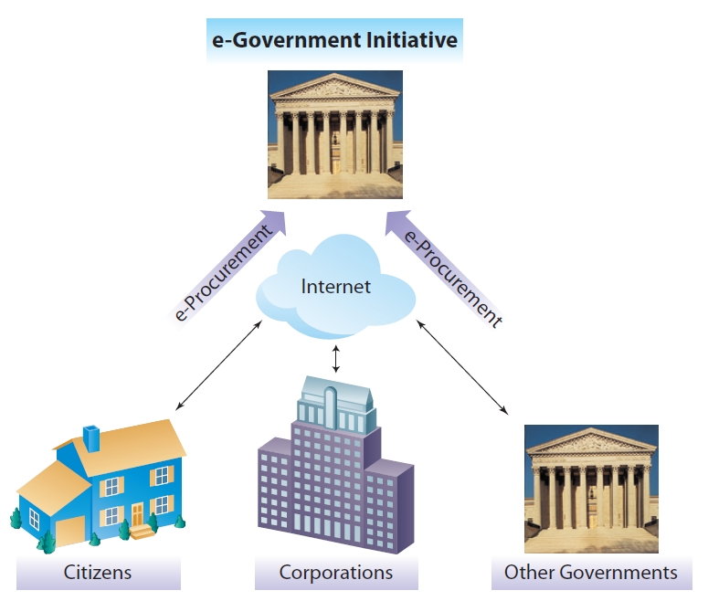
E-Government
Government-to-Citizens (G2C)
Government-to-Business (G2B)
Government-to-Government (G2G)
Notes:
Governments use e-government to increase efficiency and effectiveness, much like businesses do.
By reducing paperwork and allowing for the electronic dissemination of information and the automated processing of transactions, governments can significantly reduce operating costs while increasing services.
Examples of this might include the electronic filing of income tax returns, the online filing of business license applications, or the ability to share data electronically between different law enforcement agencies.

Slide 7
Business-to-Consumer E-Commerce
Electronic Business: E-Commerce and E-Government
Describe different business models used to compete in cyberspace as well as different forms of electronic government.
Business-to-Consumer E-Commerce
Describe business-to-consumer electronic commerce strategies.
Understand the keys to successful electronic commerce Web sites, and explain the different forms of Internet marketing.
Electronic Commerce Websites and Internet Marketing
Mobile Commerce, Consumer-to-Consumer EC, and Consumer-to-Business EC
Describe mobile commerce, consumer-to-consumer electronic commerce, and consumer-to-business electronic commerce.
Managing Finances and Navigating Legal Issues in EC
Describe how to conduct financial transactions and navigate the legal issues of electronic commerce.

Slide 8
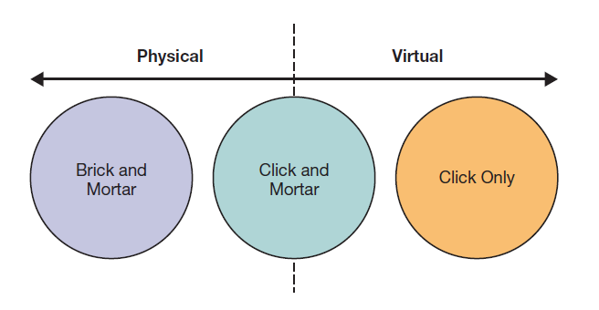
EC Business Strategies
Notes:
Companies can ignore e-commerce and just sell through physical outlets, can be virtual companies that only sell through online store fronts, or can combine them using a “click-and-mortar” approach that allows both online transactions and physical store sales.
The physical, store-only company has a limited product reach as well as limited sales and support hours.
The online company can sell anywhere in the world 24/7, but customers must wait for their product to be shipped and some products require physical inspection and testing to verify suitability.
Click-and-mortar stores often combine the best of both worlds, but retailers must overcome the pricing differences inherent between online and physical locations as well as the complexity of two sales channels.

Slide 9
e-Tailing: Capabilities and Benefits
Mass Customization
  Firms can tailor their products and services to meet a customer’s particular needs
Disintermediation
  Cutting out the “middleman” and reaching customers more directly and efficiently
Group Buying
  If many people agree to purchase the product or service, they get significant discounts
Notes:
Powerful Web technologies have given rise to a global platform where firms from across the world can effectively compete for customers and gain access to new markets.
Web sites that are linked to corporate databases provide real-time access to personalized information.

Slide 10
e-Tailing: Capabilities and Benefits (cont.)
New Revenue and Pricing Models
  Companies can earn revenues not only through traditional sales, but also through subscription, licensing, or transaction fees
  Companies and individuals can earn money through Web advertising or affiliate marketing
Social Commerce
  Utilizing social networks to build lasting relationships and advertise products
Notes:
The Web has opened new avenues for communication between companies and their customers, including Web-based support, electronic mail, online text or video chat applications, and social media.
This facilitates all stages of a transaction, allowing companies to conduct business online without human assistance, greatly reducing transaction costs while enhancing operational efficiency.

Slide 11
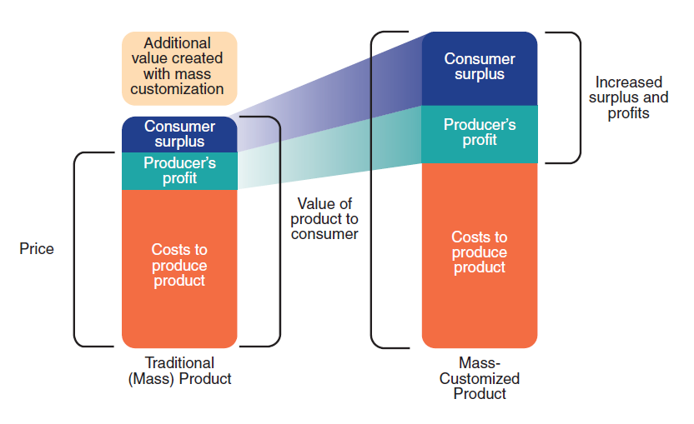
Mass Customization
Mass customization generates additional value for customers and profits for producers.
Notes:
Mass customization, which caters to individualized customer preferences while maintaining economies of scale, helps firms tailor their products and services to meet a customer’s particular needs on a large scale.
Linking online product configuration systems with just-in-time production allows companies to assemble each individual product based on the customers’ specifications.
Dell and Nike are two examples of firms that have successfully implemented mass customization into their e-commerce strategy.

Slide 12
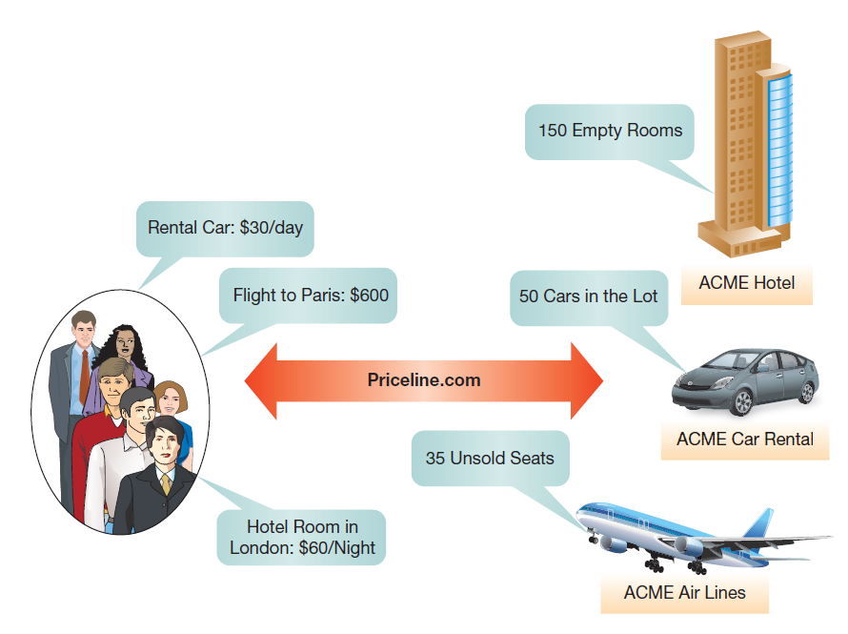
New Revenue and Pricing Models
Priceline.com lets consumers name their own price for travel-related services.
Reverse pricing
“Name your own price”
Notes:
Customers specify the product they are looking for and how much they are willing to pay for it and Priceline.com matches the customers’ bids with offers from companies like airlines, hotels, and car rental agencies.
This helps these companies get rid of excess inventory, so it is a win-win.

Slide 13
Benefits of e-Tailing
Product Benefits: With no store size and shelf space restrictions, companies can sell a far wider variety of goods
Place Benefits: Internet storefronts are available on almost every computer connected to the Internet
Price Benefits: Online retailers are efficient, with high volumes and low overhead allow for very competitive pricing
The Long Tail (see next slide)
Notes:
When companies are selling online, they can take advantage of the elimination of the retail market space, selling a much wider variety of products, targeting unique market segments on a global basis, and undercutting competitors’ pricing.

Slide 14
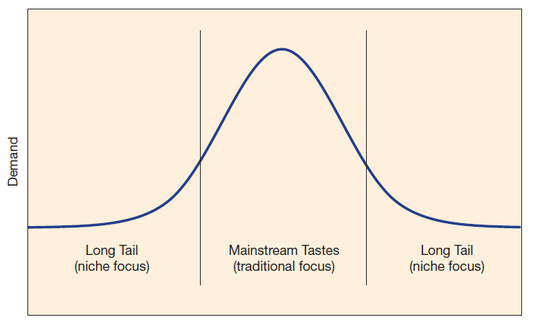
Benefits of e-Tailing: The Long Tail
Notes:
Online retailers can cater to the “Long Tail,” or niche markets in addition to (or instead of) purely selling mainstream products.
Although customers with unusual wants or needs may not be able to support a local storefront, there are often enough individuals in larger geographic regions to support an online merchant.

Slide 15
Drawbacks of e-Tailing
Trust
  This is especially a concern for new online businesses without a proven track record
Direct Product Experience
  E-tailing doesn’t provide sensory information
Product Delivery and Returns
  Except for direct downloads, e-tailing requires additional delivery time for products
  Returns may also be a hassle, compared to just going to the store
Notes:
There are challenges to e-tailing, especially for certain product and service types.
Often, trust becomes an issue due to the customer’s inability to adequately experience the capabilities and characteristics of a product prior to purchase, as well as due to uncertainties surrounding product delivery and returns.

Slide 16
Electronic Commerce Websites and
Internet Marketing
Electronic Business: E-Commerce and E-Government
Describe different business models used to compete in cyberspace as well as different forms of electronic government.
Business-to-Consumer E-Commerce
Describe business-to-consumer electronic commerce strategies.
Electronic Commerce Websites and Internet Marketing
Understand the keys to successful electronic commerce Web sites, and explain the different forms of Internet marketing.
Mobile Commerce, Consumer-to-Consumer EC, and Consumer-to-Business EC
Describe mobile commerce, consumer-to-consumer electronic commerce, and consumer-to-business electronic commerce.
Managing Finances and Navigating Legal Issues in EC
Describe how to conduct financial transactions and navigate the legal issues of electronic commerce.

Slide 17
EC Web Sites: Attracting and Retaining Online Customers—Four Key Recommendations
The Web site should offer something unique
The Web site must motivate people to visit, to stay, and to return
You must advertise your presence on the Web
You should learn from your Web site
Notes:
Online customers have many choices, but if you can provide customers with something they can find nowhere else, then they will have to come to you to get that benefit.
You can compete for customers on price, but if you also offer them service, support, community, or other benefits, you can build a relationship to draw customers to you instead.
Customers have to find you to buy from you.
If you have features on your Web site that are prompting customers to buy, or to leave, you should know what they are. By tracking how customers navigate through your site you can learn what is working and what isn’t, and make adjustments accordingly.

Slide 18
Designing Web Sites to Meet Online Consumers’ Needs
Structural Firmness
  No bad links, understandable error messages, privacy/security, speed
Functional Convenience
  Ease of use, simple navigation, user feedback, help features, one-click ordering, flexible payment, order tracking
Representational Delight
  Aesthetically pleasing, professional look and feel, color/font/images, consistent layout, no clutter
Notes:
Successful companies design their Web sites to enhance their online customers’ experience when interacting with the Web site.
The site has to work correctly, be easy to use, and look good.
There is a hierarchy of these needs. Most important is structural firmness, followed by functional convenience, and finally representational delight.

Slide 19
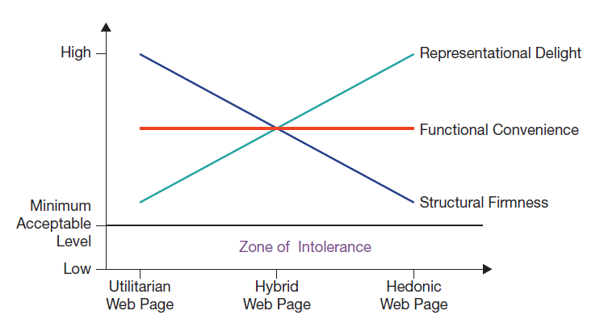
Different Web Sites Focus on Different Needs
Notes:
Consumers need Web sites to meet their basic needs, which vary depending on why they are using the site.
If a site can’t reliably process transactions, is difficult to use, and is off-putting in its design, consumers are unlikely to use it.

Slide 20
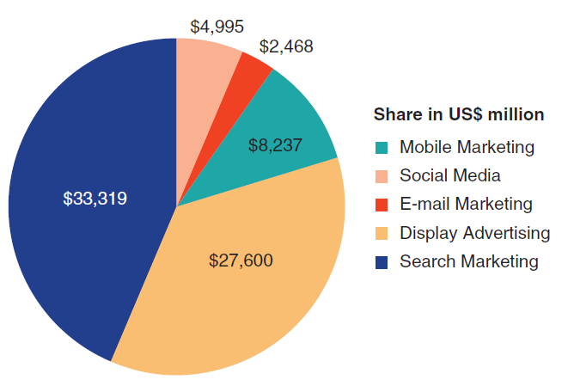
Internet Marketing
If you build it, they won’t come unless you market it
Search engine optimization (SEO) can be critical to a Web site’s success
Notes:
Historically, companies’ advertising budgets were mostly spent on noninteractive advertising campaigns, such as billboards, newspaper, radio, or television ads. However, by 2013, 42 percent of U.S. online adults were accessing the Internet multiple times a day from multiple devices and locations. In response to these changes, companies are reallocating their advertising budgets; in 2011, organizations spent 19 percent of their advertising budgets on Internet marketing; research firm Forrester estimates that by 2016, companies will spend 35 percent of their advertising budgets on Internet marketing, including search marketing, display ads, e-mail marketing, social media, and mobile marketing.

Slide 21
Internet Marketing Methods
Search Marketing | Includes paid search, placing ads on search Web sites based on search terms, and SEO, optimizing a Web site and its relative search engine ranking
Display Ads | Simple banner ads, but now often contextualized to what the person is viewing
E-Mail Marketing | Extremely low cost, less than a penny an e-mail, and hence very popular; effectiveness also easy to track
Social Media Marketing | Increasingly used for interactive communication and relationship building with customers
Mobile Marketing | If ads can be tailored to a user’s location, then highly targeted marketing opportunities open up
Performance Assessment | Impression, pay-per-click/click-through, and conversion models (but beware of click fraud)
Notes:
Advertisers continually look for ways to deliver targeted information at the time and place where it will be most likely to stimulate a purchase or build a relationship that increases the lifetime value of the customer base. Internet marketing is no exception, and these approaches all seek to address these needs.
As with many aspects of business, there is a potential for fraud in advertising if aspects of the transaction can’t be monitored, and click fraud by the ad seller trying to drive up revenue or a competitor (or disgruntled employee) trying to drive up business costs can readily occur.

Slide 22
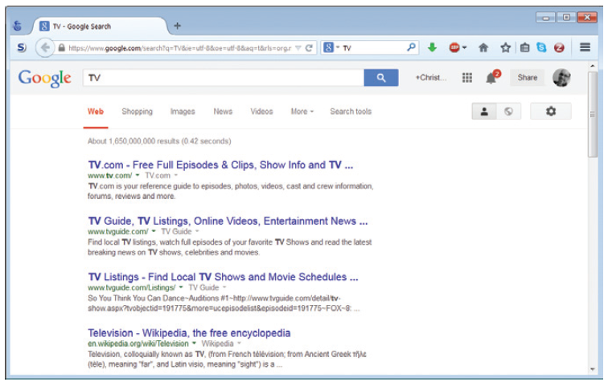
Search Engine Optimization (SEO)
SEO attempts to improve a page’s ranking in search engines like Google.
Techniques include having other pages link to the page,
keeping content updated, and including key words.
Source: Courtesy of Google, Inc.
Notes:
It is hard to influence the ranking of your company’s page in the organic search results. Users will typically only click on the first few items of their search. Search engines’ algorithms are usually proprietary and are frequently changed, and there can be hundreds of factors influencing a page’s rank. They also check for “cheating,” such as hidden keywords.

Slide 23
Mobile Commerce, Consumer-to-Consumer EC, and Consumer-to-Business EC
Electronic Business: E-Commerce and E-Government
Describe different business models used to compete in cyberspace as well as different forms of electronic government.
Business-to-Consumer E-Commerce
Describe business-to-consumer electronic commerce strategies.
Understand the keys to successful electronic commerce Web sites, and explain the different forms of Internet marketing.
Electronic Commerce Websites and Internet Marketing
Mobile Commerce, Consumer-to-Consumer EC, and Consumer-to-Business EC
Describe mobile commerce, consumer-to-consumer electronic commerce, and consumer-to-business electronic commerce.
Managing Finances and Navigating Legal Issues in EC
Describe how to conduct financial transactions and navigate the legal issues of electronic commerce.

Slide 24
Mobile EC
Location-Based M-Commerce
  Services can be offered tailored to a person’s needs based on their current location
Information on the Go
  Customers can get further information about a product wherever they are, including in the store, but this can lead to “showrooming”
Product and Content Sales
  Consumers use mobile apps to make purchases while on the go
Notes:
Mobile commerce has seen tremendous growth in the past few years.
M-commerce is any electronic transaction or information interaction conducted using a wireless, mobile device and mobile networks.
Powerful mobile devices, such as Apple’s iPhone and iPad or Samsung’s Galaxy, support high-speed data transfer and “always-on” connectivity.
The increasing use of tablets is seen as a major driver of mobile commerce.

Slide 25
GPS-Enabled Location-Based Services
Service | Example
Location | Determining the basic geographic position of the cell phone
Mapping | Capturing specific locations to be viewed on the phone
Navigation | The ability to give route directions from one point to another
Tracking | The ability to see another person’s location
GPS = global positioning system
Notes:
Location-based services are highly personalized mobile services based on a user’s location. Location-based services are implemented via the cellular network, Wi-Fi networks, and global positioning system (GPS) functionality, now built into most modern cell phones.
Via GPS, search engines can provide specific information about attractions or restaurants located in the user’s vicinity, retail stores can enhance store locators with navigation instructions, or users can receive real-time traffic or public transport information.

Slide 26
C2C EC
E-Auctions
  Individual sellers can sell or barter items at online auctions
  Consumers place bids
  Examples: eBay.com and swap.com
  Revenue model based on small transaction fees, highly profitable
Online Classifieds
  Just advertising, no online transactions
  Freecycling
  Example: craigslist.com
Notes:
Consumer-to-consumer e-commerce allows consumers to achieve a fair price for goods, which they otherwise might not be able to achieve.
E-auctions allow consumers to sell rare and unusual items to a world market.
Online classifieds allow consumers to sell and search for products locally, reaching a wider audience but still facilitating what is often a local face-to-face transaction.
There is, however, a danger of fraud.

Slide 27
C2C Opportunities and Threats
Opportunities | Threats
Consumers can buy and sell to broader markets | No quality control
Eliminates the middleman that increases the final price of products and services | Higher possibility of fraud
Always available for consumers, 24/7/365 | Harder to use traditional payment methods (checks, cash, ATM cards)
Market demand is an efficient mechanism for setting prices in the electronic environment
Increases the numbers of buyers and sellers who can find each other
Notes:
C2C is a very open medium of exchange, so provides both opportunities and threats.

Slide 28
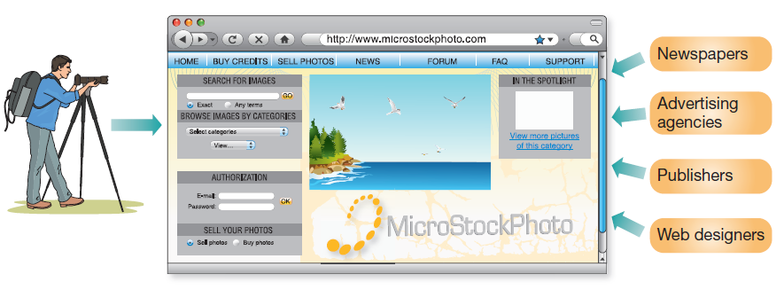
C2B EC
Relatively new phenomenon, consumers can sell small pieces of work (e.g., photos) or services to businesses
It might be argued that anyone who made a living doing this is actually in business for themselves, so may be B2B
Notes:
A relatively new phenomenon is C2B e-commerce. This involves consumers selling what is typically small slices of work to businesses.
A good example is businesses that buy photos from amateur photographers to sell online to interested parties. Each photo is a small piece of work, but when they sell the photographer gets a small commission.

Slide 29
Managing Finances and Navigating Legal Issues in EC
Electronic Business: E-Commerce and E-Government
Describe different business models used to compete in cyberspace as well as different forms of electronic government.
Business-to-Consumer E-Commerce
Describe business-to-consumer electronic commerce strategies.
Understand the keys to successful electronic commerce Web sites, and explain the different forms of Internet marketing.
Electronic Commerce Websites and Internet Marketing
Mobile Commerce, Consumer-to-Consumer EC, and Consumer-to-Business EC
Describe mobile commerce, consumer-to-consumer electronic commerce, and consumer-to-business electronic commerce.
Managing Finances and Navigating Legal Issues in EC
Describe how to conduct financial transactions and navigate the legal issues of electronic commerce.

Slide 30
E-Banking
Online Banking and Electronic Bill Services
  Convenience
  Security concerns
  Mobile banking
Online Investing
  Increased access to financial information and analytical tools
  Online investing
  Mobile investing
Notes:
Online banking has become widely accepted, although many people are still worried about the security aspect.
An emerging trend is mobile banking apps allowing anytime, anywhere banking.
Online investing has also taken off, with a variety of sites offering financial information, investment advice, and online brokerage accounts.

Slide 31
Securing Payments in the Digital World
Credit and Debit Cards
  Credit cards are a simple mechanism
  Consumers have to transfer a lot of personal information to the seller
  Risk of identity theft
Managing Risk
  Businesses are financially liable for fraudulent transactions
  Businesses have to look for fraud indicators and sometimes reject risky transactions
Payment Services
  Examples: PayPal, Google Checkout
Notes:
Online payments are readily made using credit cards, which offer consumers some protection against fraud by the seller, which typically still requires a significant amount of personal information to complete the sale.
At the same time, the merchant is at significant risk of fraud from buyers, and unlike “card-present” sales in traditional stores, when a sale is made online the merchant is financially liable if the sale is fraudulent.
Merchants now employ additional safeguards to flag and reject sales that have warning signs indicating they may not be legitimate.

Slide 32
Ways to Protect Yourself When Shopping Online
Use a secure browser
Check the site’s privacy policy
Read and understand the refund and shipping policies
Keep your personal information private
Give payment information only to businesses you know and trust
Keep records of your online transactions and check your e-mail
Review your monthly credit card and bank statements
Source: Based on Federal Trade Commission (2010).
Notes:
Make sure that your browser has the latest encryption capabilities; also, always look for the padlock icon in your browser’s status bar before transmitting sensitive information.
Make sure that the company you’re about to do business with does not share any information you would prefer not to be shared.
Make sure that you can return unwanted/defective products for a refund.
Make sure that you don’t give out information, such as your Social Security number, unless you know what the other entity is going to do with it.
Make sure that you don’t provide your payment information to fly-by-night operations.
Make sure that you don’t miss important information about your purchases.
Make sure to check for any erroneous or unauthorized transactions.

Slide 33
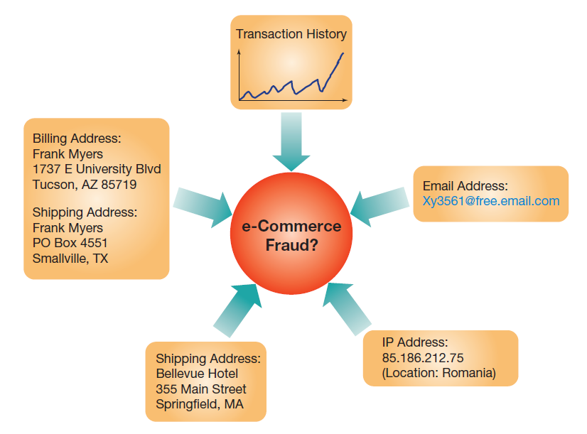
Possible Indicators of Fraud
Email addresses
Shipping and billing addresses
Transaction patterns
Notes:
In e-commerce transactions, there is no imprint of the physical card and no cardholder signature, so online merchants have to be especially careful when deciding whether or not to make a transaction.
Online merchants often use automated fraud screening services that provide the merchants with a risk score based on a number of variables such as match between shipping address, billing address, and phone number; the time of the order and the customer’s time zone; transaction volume; and the customer’s IP address and its geographic location.

Slide 34
Legal Issues in EC
Taxation
  Sales taxes
  Internet Freedom Act: Internet sales are treated like mail-order sales
Digital Rights Management
  Preventing unauthorized duplication
  Restrict which devices can play media
  Limit number of times media can be played
Net Neutrality
  Should the Internet be open? Or should Internet access come first to the highest bidder?
Notes:
Sales taxes have historically not been levied on companies selling to consumers in different states.
EC both reduces state sales tax revenues and makes local business less competitive as compared to out-of-state online retailers.
Digital Rights Management, or DRM, includes practices to limit the copying and distribution of digital goods to paying customers.

Slide 35
End of Chapter Content

Slide 36
Managing in the Digital World:
Taobao and the World of e-Commerce
Taobao is the largest digital marketplace in China
  By 2011 more registered users (370 million) than the population of the United States
  Online marketplace for multiple companies
  Online consumer-to-consumer sales, much like eBay
  Notorious for piracy and counterfeit goods
360buy new-fast growing competitor
  Not on the list of notorious markets
Sales in China pose huge logistics headaches
  Widely varying population densities
  No “overnight shipping” infrastructure

Slide 37
Ethical Dilemma:
The Ethics of Reputation Management
Online reviews can be critical to a customer’s buying decision
Biased and fake reviews can affect a business’s profitability, or even survival
Owners are tempted to post fake positive reviews
Competitors are tempted to post fake negative reviews
Reputation management can help offset negative biased reviews, but poses ethical dilemmas

Slide 38
Key Players: Behind the Online Storefront: How e-Commerce Giants Help Small Businesses Flourish
Starting an online business can be complex
  Commercial giants such as eBay and Amazon allow small retailers to sell through their sites
  Large hosting companies such as GoDaddy provide hosting and online shopping carts
  Payment services such as Intuit and PayPal offer credit card services
  Fulfillment centers, such as Amazon, handle packaging and shipping individual orders
These simplify small business implementations

Slide 39
When Things Go Wrong:
Buying Likes
Many businesses entice users to “like” their business page on Facebook, Twitter, or other sites for some reward
Campaigns and contests can be deeply biased by automated “likes” and votes, giving unfair advantage to users who game the system
Social media platforms try to suppress this type of devious behavior, but it can be a cat-and-mouse game

Slide 40
Coming Attractions:
Carbon Nanocomputers
Despite rapid advancements in computer power, processors constantly battle the limits of silicon
Enter the carbon nanotube
  Hollow cylinders composed of a single sheet of carbon atoms
  Relatively little energy required to power a nanotube transistor
  Small size makes them easy to pack into small places
  Heat efficient
Stanford University recently created the first functioning nanotube-based computer

Slide 41
Brief Case: CrowdSpring—The Graphic Designers’ Marketplace
CrowdSpring: a large marketplace for connecting businesses with creative professionals in mutually beneficial relationships
Businesses create a description of the design project
Designers submit design ideas
Such marketplaces provide tremendous value for all parties involved

Slide 42
Who’s Going Mobile:
Mobile Payments
Electronic funds transfer (EFT) technologies are paving the way for cashless societies
The smartphone is becoming a natural payment companion
Near field communication (NFC) allows for simply waving an NFC-enabled phone in front of a reading device to make a payment
Potential problems: merchant costs, privacy concerns

Slide 43
Industry Analysis:
Retailing
Retailing has embraced new technologies
  Bar code scanning for price, inventory management, self-checkout
  RFID functions like a barcode but uses wireless technologies, and can be integrated with other information technologies
  New forms of electronic payment, whether by pin, phone barcode, near-field communication (NFC) technologies, or fingerprint, are gaining traction

