Slide 1



Chapter 5: Enhancing Organizational Communication and Collaboration Using Social Media
Social media introduce unprecedented ways to connect to friends, share knowledge with your colleagues, or collaborate with a team of engineers 5,000 miles away

Slide 2
Chapter 5 Learning Objectives
The Need for Communication and Collaboration
Explain organizations’ needs for communication and collaboration.
The Evolving Web
Explain social media and evolving Web capabilities.
Managing the Enterprise 2.0 Strategy
Describe how companies can manage their Enterprise 2.0 strategy and deal with potential pitfalls associated with social media.
Social Media and the Enterprise
Describe various social media applications, and explain their role in enhancing communication, collaboration, cooperation, and connection.
Notes:
This chapter focuses on social media in and around the context of the business organization.

Slide 3
The Need for Communication and Collaboration
The Need for Communication and Collaboration
Explain organizations’ needs for communication and collaboration.
The Evolving Web
Explain social media and evolving Web capabilities.
Managing the Enterprise 2.0 Strategy
Describe how companies can manage their Enterprise 2.0 strategy and deal with potential pitfalls associated with social media.
Social Media and the Enterprise
Describe various social media applications, and explain their role in enhancing communication, collaboration, cooperation, and connection.

Slide 4

Virtual Teams
Notes:
Organizations typically strive to put together the right members of a team or task force to solve challenging business problems, regardless of where they are located geographically within the organization.
When team members are located at different physical locations, they are a “virtual team.”
Virtual teams face the challenge of communicating and collaborating at a distance, and use modern technologies such as teleconferencing and online Web technologies to interact and share documents and information.

Slide 5
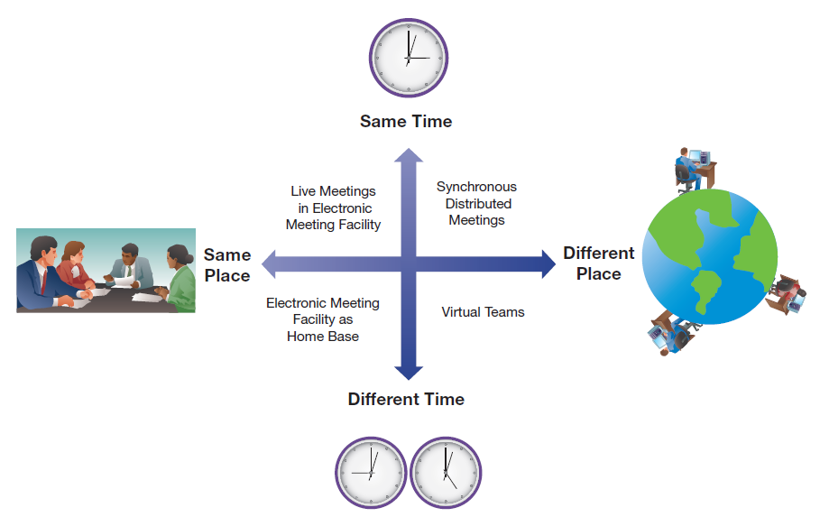
Groupware
Notes:
Groupware can be divided into synchronous and asynchronous tools, as well as into tools that enhance working at the same location or across different locations.
Synchronous means at the same time, such as when two people are talking on the telephone.
Asynchronous means disconnected in time, such as when someone reads an email a day after it was sent.
Asynchronous groupware tools include e-mail, mailing lists, workflow automation systems, intranets, group calendars, collaborative writing tools, and discussion forums.
Synchronous groupware tools include shared whiteboards, online chat, electronic meeting systems, and video communication systems.

Slide 6

Electronic Meeting System (EMS)
An electronic meeting system utilizes networked computers and sophisticated software to support various group tasks.
Source: Konstantinos Kokkinis/Shutterstock
Notes:
Electronic meeting systems provide a synchronous and structured meeting process. The process includes electronic idea generation, idea evaluation, and voting. In this way, EMS helps groups stay on track and avoid costly diversions that can often occur in less structured meetings.

Slide 7
Videoconferencing
Desktop Videoconferencing
  Simple and low cost
  Internet based
Dedicated Videoconferencing
  Organizational conference rooms
  Multiple people and/or locations
  Highly realistic/excellent video and audio quality
  Can be extremely expensive, up to $500K
Notes:
Videoconferencing is a simple solution to the problem of people needing to talk who are in different locations.
Desktop videoconferencing solutions are both low cost and functional, but only support one individual at each site.
Dedicated videoconferencing rooms support larger groups meeting in real time as if in the same room. They have excellent audio and video quality, and can eliminate the need for groups to travel, but can cost up to $500K per dedicated installation.

Slide 8
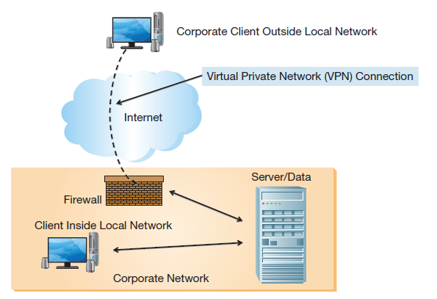
Intranets and Employee Portals
Real-Time Access to Information
  Updated information instantly available throughout the organization
Enterprise Search
  Company focused, including corporate databases
Collaboration
  Document sharing and co-editing
Employee Portals
  Employee benefits self-service
Notes:
Companies create intranets to share documents and information within the organization.
Employee portals are often set up so employees can access self-service benefits.

Slide 9
The Evolving Web
The Need for Communication and Collaboration
Explain organizations’ needs for communication and collaboration.
The Evolving Web
Explain social media and evolving Web capabilities.
Managing the Enterprise 2.0 Strategy
Describe how companies can manage their Enterprise 2.0 strategy and deal with potential pitfalls associated with social media.
Social Media and the Enterprise
Describe various social media applications, and explain their role in enhancing communication, collaboration, cooperation, and connection.

Slide 10
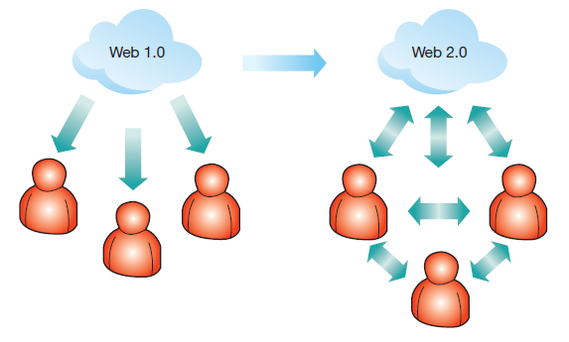
Evolving Web Capabilities
mashups
Web 2.0 applications shift a Web user’s role from a passive consumer of content to its creator.
network effect
Notes:
The network effect refers to the notion that the value of a network (or tool or application based on a network) increases with the number of other users. The more users, the higher the value.
A mashup is an application or Web site that uses data from one or more service providers. For example, a mashup could combine mapping data, photos, reference information, hotel prices, and weather information to provide a comprehensive overview of travel destinations.

Slide 11
Evolving Social Interaction
Web 2.0 technologies change how people interact and enable social media
  Online information at our fingertips
  Personal expression available 24/7
Individuals often post very private information
  About themselves
  About others
  Without thinking about the consequences
Notes:
Now that users can readily share information as well as consume it, social media have changed dramatically to take advantage of these capabilities.
Users now have information, and the ability to express their opinion on it, at their fingertips literally 24/7.
This has led to an explosion in the sharing of personal information, sometimes very private, and often without taking into account the consequences.

Slide 12
Evolving Collaboration Through Collective Intelligence: Shifting Perspectives
Web 1.0 | Web 2.0
Me | Me and you
Read | Read and write
Connect ideas | Connect ideas and people
Search | Receive and give recommendations to friends and others
Find | Share
Techies rule | Users rule
Organizations | Individuals
Notes:
As we transition from the Web 1.0 model to the interactive Web 2.0 model, the Web experience changes to become both more individual and more interactive.
In this table we can see specific examples of this evolution, such as the transition from just reading information to also writing.

Slide 13
The Evolving Workspace
A generation of social media users
  Millenniums, “Generation Y”
  Different workplace expectations
  Portfolio careers, not cradle-to-grave
  State-of-the-art technology valued
  55% use instant messaging as a work tool
  45% use social media for work-related activities
  29% of college students would not work for a company that bans social media in the workplace
Notes:
The current generation of workers grew up in an Internet-enabled world and expect an Internet-enabled workplace.
They expect to have multiple jobs with multiple companies throughout their lives and value a workplace where they can leverage modern technologies versus being banned form utilizing and accessing them.

Slide 14
Future Web Capabilities
The Semantic Web
  Machine-readable Web pages
  Enhanced search results
  Web 3.0, or “What comes next?”
  Mobility?
  The contextual Web?
Enterprise 2.0
  Leverage social media to support business processes
Notes:
Innovation continues to abound and future Web technologies may go in may different directions.
The semantic Web is an effort to make the abundance of Web pages readable by machines as well as people so they can process them more accurately and greatly enhance our ability to search for and find information.
Although no one knows what Web 3.0 will entail, some speculate that it will revolve around mobility and mobile computing, whereas others believe it will entail contextual filtering, so users will see information based on what they are doing, where they are, what time it is, or a combination thereof.
Even as we race toward Web 3.0, enterprises seek to leverage social media within their boundaries and with their customers to become social enterprises.

Slide 15
Social Media and the Enterprise
The Need for Communication and Collaboration
Explain organizations’ needs for communication and collaboration.
The Evolving Web
Explain social media and evolving Web capabilities.
Managing the Enterprise 2.0 Strategy
Describe how companies can manage their Enterprise 2.0 strategy and deal with potential pitfalls associated with social media.
Social Media and the Enterprise
Describe various social media applications, and explain their role in enhancing communication, collaboration, cooperation, and connection.

Slide 16
Enhancing Communication Using Social Media
Blogs
  Topical blogs of interest to customers
  Critics call blogs “amateurization of journalism”
Microblogging Tools (like Twitter)
  Post news to customers
  Example: Coca-Cola’s official Twitter account
Instant Messaging
  Within the company
  With customers
Virtual Worlds
  Product showcases
Notes:
Companies can enhance their communication through the effective use of social media.
Depending on the objectives, many different tools can be implemented.
For example, a company may have experts write blogs on topics that customers find interesting and would like to know more about.

Slide 17
Enhancing Cooperation with Social Media
Media Sharing
  Via Flickr, Instagram, Vimeo, YouTube, SlideShare
  Webcasting, podcasting
Social Bookmarking
  Share Internet bookmarks, folksonomies
  Reddit, StumbleUpon, Delicious, Pinterest
Social Cataloging
Tagging
  Manually adding metadata to content
Geotagging
Notes:
Cooperation between users can be increased through the use of cooperative tools, where everybody gets to take advantage of each user’s contributions.
This can include cooperative efforts to find, tag, bookmark, or catalog Web content. This builds a repository of useful information references that can be accessed by other participants, who are also contributing to the pool for the greater good.

Slide 18
Enhancing Collaboration with Social Media
Cloud-Based Collaboration Tools
Content Management Systems
  Learning management systems
Collective Intelligence
  Open source software
  Wikis
Human-Based Computing (Crowdsourcing)
Notes:
Collaboration can also benefit from social media. There are multiple different ways people can work together, and collaboration tools facilitate that process.
Content management systems allow multiple users to coordinate working on documents, without accidently overwriting or deleting each other’s work, and often saving multiple prior versions in case the need to access them arises.
The concept of collective intelligence is based on the notion that distributed groups of people with a divergent range of information and expertise will be able to outperform the capabilities of individual experts.
Crowdsourcing uses everyday people from all over the world as a cheap labor force.

Slide 19
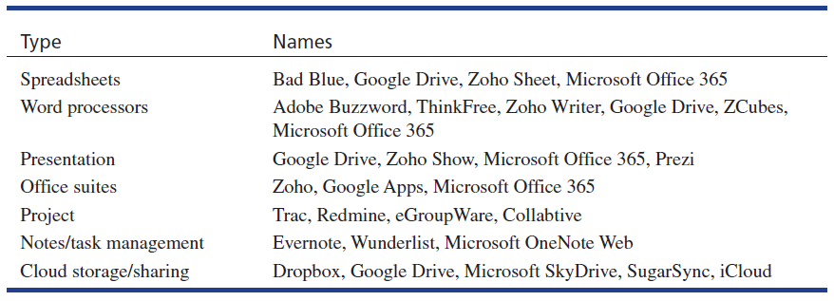
Cloud-Based Collaboration Tools
Notes:
Many types of applications that have been traditionally desktop are now housed in the cloud, enabling multiple users to access them at the same time.

Slide 20

Crowdsourcing
Notes:
Crowdsourcing takes advantage of individuals from all over the world sharing their knowledge, expertise, or resources.
Sometimes this can be done at a fraction of the cost of normal businesses, such as when amateur photographers share their photos online for a small fee.
Pearson Prentice Hal makes use of crowdsourcing for obtaining photographs and images for textbooks, for example.
Open innovation is a crowdsourcing approach involving the process of integrating external stakeholders into the innovation process.
Amazon.com’s Mechanical Turk microtasking marketplace is a crowdsourcing environment that allows individuals to make a little money by performing small tasks.

Slide 21
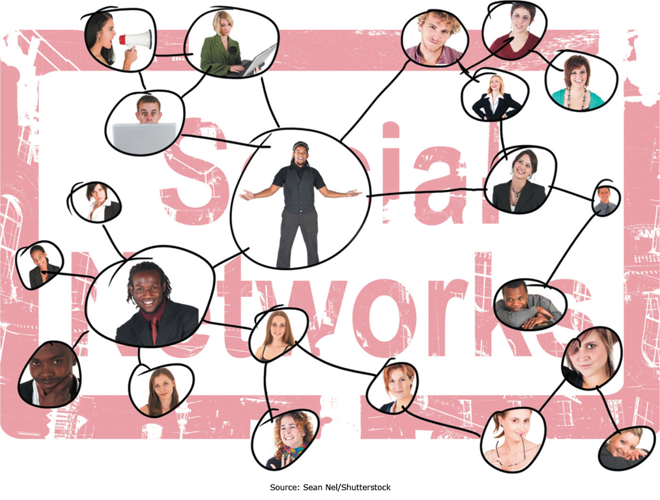
Enhancing Connection with Social Media
Notes:
Social networks allow individuals to meet and collaborate online, drawing together individuals with specific interests and giving them a communications platform.

Slide 22
Enhancing Connection with Social Media
Social Networking
  Social online communities
  Facebook has 1.28 billion users as of May 2014
Social Search
  Increase the relevance of search results
  Including content from social networks, blogs, or microblogging services
Viral Marketing
  Word-of-mouth or person-to-person communication
Notes:
Social networking involves letting people communicate and network online, but social search takes that one step further.
LinkedIn has more than 300 million members, and Xing (which is widely popular in Europe) has around 12 million members.
Viral marketing is based on users promoting content they find interesting or engaging to their friends; in effect, users are “infecting” other users. This can be a very powerful and effective marketing strategy.
Critical factors in a successful viral marketing campaign are to do the unexpected, make people feel something, make sequels, allow sharing and easy distribution, and make the viral content unrestricted.

Slide 23
Managing the Enterprise 2.0 Strategy
The Need for Communication and Collaboration
Explain organizations’ needs for communication and collaboration.
The Evolving Web
Explain social media and evolving Web capabilities.
Managing the Enterprise 2.0 Strategy
Describe how companies can manage their Enterprise 2.0 strategy and deal with potential pitfalls associated with social media.
Social Media and the Enterprise
Describe various social media applications, and explain their role in enhancing communication, collaboration, cooperation, and connection.

Slide 24
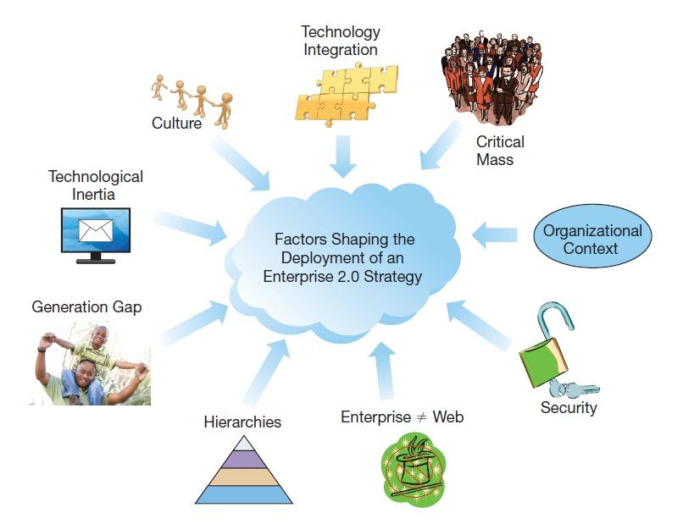
Organizational Issues
Various factors have to be taken into account for successful Enterprise 2.0 applications
Notes:
Enterprise 2.0 is not like the Web, and what dictates Internet success doesn’t necessarily translate directly to Enterprise 2.0 success.
Corporate culture plays a critical role, as does corporate context.
When corporations have an open culture based on sharing, then employees will be more supportive of initiatives requiring sharing.
The Web 2.0 tool deployed should be tailored to the organizational context; for example, wikis and blogs fulfill different needs.
Focused departmental initiatives can be more readily successful than enterprise-wide initiatives, which typically require cultural changes and senior management championship.
Not everyone will participate in contributing content, so there needs to be enough support from those who will contribute to achieve critical mass.
Employees unused to Web 2.0 technologies may be slow to adopt them or learn them unless they see tangible benefits.
Once deployed, these applications need to be integrated into the overarching technological framework and have appropriate security controls just like any other enterprise application.

Slide 25
Pitfalls of Web 2.0 Marketing
Online Product Reviews
  Negative reviews from competitors
  Companies paying for positive reviews
Microblogging
  Easy to “cross a line” and offend
  Negative publicity can come quickly
Social Networks
  Fine line between maintaining control and offending customers
  Individuals sharing too much personal information
Notes:
Web 2.0 provides many opportunities, but also poses many threats to organizations.
Not all competitors are scrupulous, and it is easy for companies to post negative reviews of competitors or arrange for positive reviews of themselves.
Even activities under a company’s control, such as its Twitter account or social network site, can pose a risk, as it is easy to release a tweet or exert controls that customers find offensive and overbearing.

Slide 26
More Pitfalls of Web 2.0 Marketing
Bad Vibes Going Viral
  Negative publicity can spread like wildfire
  Videos can easily go viral
Lessons Learned
  News travels fast
  Have a crisis team and a plan
  Prepare for your worst social media nightmare
  Monitor the environment
  Respond within 24 hours
Notes:
Once negative information is online about a company, it can easily go viral and spiral out of control.
This is particularly true of videos and other engaging content that can easily be shared through a link.
Companies should be prepared for this type of negative publicity, continuously monitoring the social environment and being ready to respond within 24 hours with a suitable crisis team and management plan.

Slide 27
End of Chapter Content

Slide 28
Managing in the Digital World:
Facebook.com
Facebook had 1.28 billion users in 2014, valued at $163 billion
Many companies now have Facebook pages
  When users “like” a company, they can receive updates from the company
  Consumers can leave comments for companies
  Companies can interact with customers and track customer loyalty
  Future demand is predicted based on customers’ “likes”

Slide 29
Brief Case:
Crowdfunding
Problem: starting a new business or building a new product takes lots of money
Possible solution: crowdfunding
Kickstarter is a company that facilitates crowdfunding
  Funding campaign centers on a product
  Individual “backers” pledge money to support
  Backers are charged only if pledges reach goal
  135,000 projects, $1 billion in pledges
Could be risky to backers, but also a good opportunity

Slide 30
Coming Attractions:
Dissolvable Electronics
Pharmaceutical industry fighting bacteria that evolve to resist antibiotics
  Antibiotics take years to develop, and can lose effectiveness quickly
Possible solution: electronic devices that generate heat to kill the bacteria
  Developed by researchers at University of Illinois
  After surgery, the devices are placed in the wound
  The devices are “biocompatible” and dissolve after doing their job
Still in research phase

Slide 31
Key Players:
The “Other” Social Networking Giants
Everyone knows the big U.S.-based players in social networking:
  Facebook, Google+, Twitter, LinkedIn
But there are others popular internationally:
  Tencent Holdings (from China) produces QQ (instant messaging), QZone (social networking and blogging), WeChat (mobile messaging and networking), and Weibo (microblogging)
    Very popular in Asia
  WhatsApp messaging platform is popular in India, Russia, Brazil, and Australia

Slide 32
Who’s Going Mobile:
Going SoLoMo: Yelp
SoLoMo = the intersection of social, local, and mobile services
Example: Yelp.com
  A review and rating platform providing information on local businesses from previous customers
  Started in 2004
  Integrated with iOS 6 mapping and directions app
  Incorporates local business advertising

Slide 33
Ethical Dilemma:
Negative Impacts of Social Media Use
Almost every aspect of our lives has become intertwined with Facebook
Is Facebook robbing our innocence?
Shift in identity from the “real world” to the “virtual world”
Is a person’s sense of self governed by how many “friends” he or she has on Facebook?
Vicious cycle: self-broadcasting leads to emptier life, leading to more need for self-broadcasting
Facebook parents: documenting every aspect of their children’s lives
Possible loss of privacy for young people

Slide 34
When Things Go Wrong:
Social Media Meltdown
Many businesses have embraced social media to connect with their customers. But sometimes this can backfire.
Example: JP Morgan Chase
  In late 2013, JP Morgan Chase announced that it would host a live Q&A session on Twitter
  Users could sign up via #AskJPM hashtag
  Things quickly got out of hand on Twitter
  Disgruntled customers and others complained about business practices, unfair mortgage foreclosures, and posted rude jokes.
  JP Morgan cancelled the Q&A, but by then it was too late
  Social media marketing can be a double-edged sword

Slide 35
Industry Analysis:
Online Travel
The first wave (1.0) of online travel involved major online travel agencies (OTAs)
  Expedia, Orbitz, Priceline, Travelocity
Online Travel 2.0 is in the works, allowing individuals to profit
  Example: Airbnb
    Allows travelers to offer their homes for rent
    Airbnb value as of April 2014 is $USD 10 billion
  Example: Uber
    Social taxi service
    Individuals can provide rides and make some money
  Both use ratings and reviews to ensure quality

