Slide 1
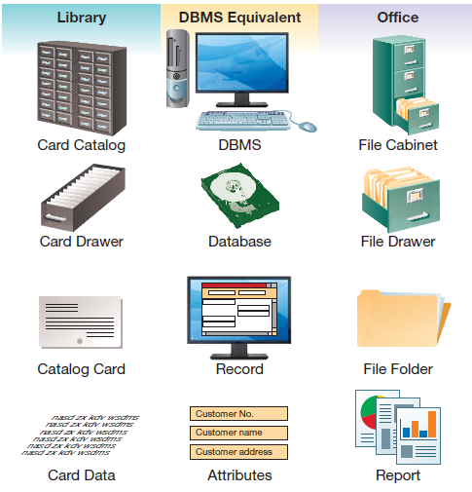
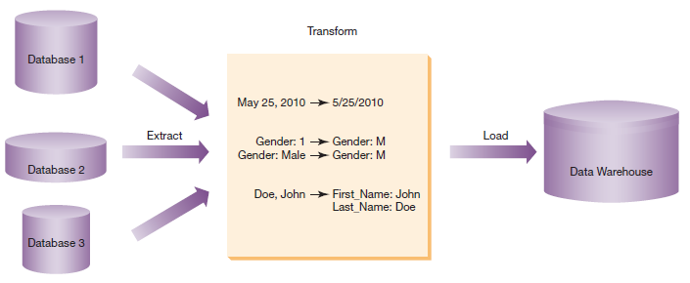
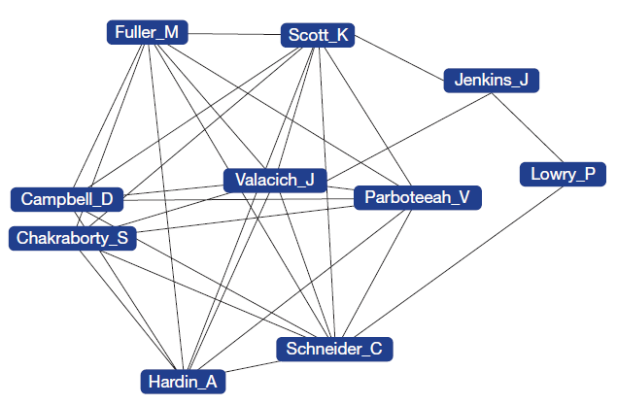
Chapter 6: Enhancing Business Intelligence Using Information Systems
A key to effective management is
high-quality and timely information to support decision making

Slide 2
Chapter 6 Learning Objectives
Business Intelligence
Describe the concept of business intelligence and how databases serve as a foundation for gaining business intelligence.
Business Intelligence Components
Explain the three components of business intelligence: information and knowledge discovery, business analytics, and information visualization.

Slide 3
Business Intelligence
Business Intelligence
Describe the concept of business intelligence and how databases serve as a foundation for gaining business intelligence.
Business Intelligence Components
Explain the three components of business intelligence: information and knowledge discovery, business analytics, and information visualization.

Slide 4
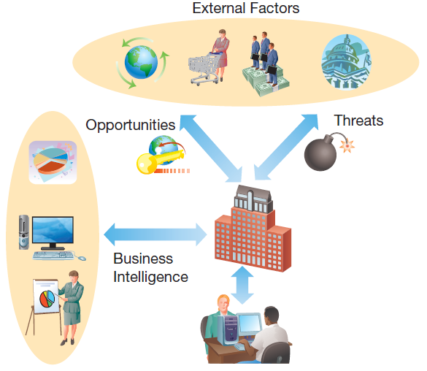
Why Organizations Need Business Intelligence: Threats and Opportunities
Notes:
External factors in the business environment, such as changes in consumer demand, competitive pressures, and changing regulations, can create both threats and opportunities businesses need to respond to.
The more rapidly businesses can recognize changes and move to account for them, the more competitive they will be in today’s ever-changing business environment.

Slide 5
Why Organizations Need Business Intelligence: Understanding Big Data
Businesses are dealing with the challenge of “Big Data”
  High Volume
    Unprecedented amounts of data
  High Variety
    Structured data
    Unstructured data
  High Velocity
    Rapid processing to maximize value
Notes:
Organizations face unprecedented volumes of information, both structured and unstructured, which require rapid processing and analysis to maximize its value.

Slide 6
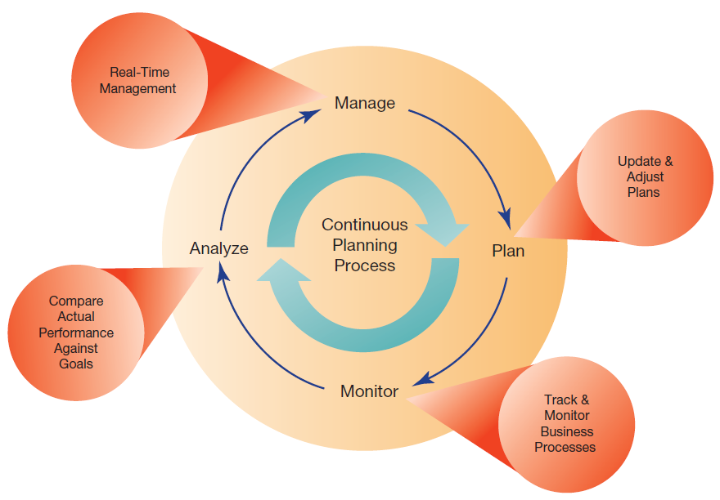
Why Organizations Need Business Intelligence: Continuous Planning
Notes:
Businesses were used to planning and executing in an annual cycle.
Now businesses are changing to a continuous planning/execution model.
This requires continuous monitoring to ensure organizations have the information to make ongoing, forward-looking adjustments and updates to business plans.

Slide 7
Databases: Providing Inputs into Business Intelligence Applications
Data and knowledge are an organization’s most valuable resource
Enabling interactive Web sites using databases:
  E-commerce makes extensive use of databases
  Product catalog data are stored in databases and available to users
  Customer billing and shipping
  E-commerce applications process millions of transactions per day
Notes:
Databases are essential for all elements of a business: maintaining customer records, supporting business processes, sales transactions, inventory management, and marketing.
E-commerce applications store their transaction information in databases. This can be later used in business intelligence (BI) applications to help analyze sales trends, customer satisfaction, and other key performance indicators of company health.

Slide 8
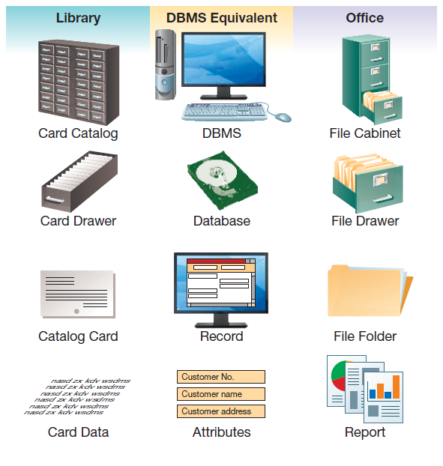
Databases: Foundation Concepts
Notes:
Databases are the digital equivalent of hierarchical paper-based filing systems.
Like an office filing system where file cabinets hold drawers, drawers hold folders, and folders hold individual items, databases are comprised of a database management system (DBMS) that equates to the paper filing system. The DBMS manages the database, which is a store of data, much like a file drawer may contain all the files on a specific topic.

Slide 9
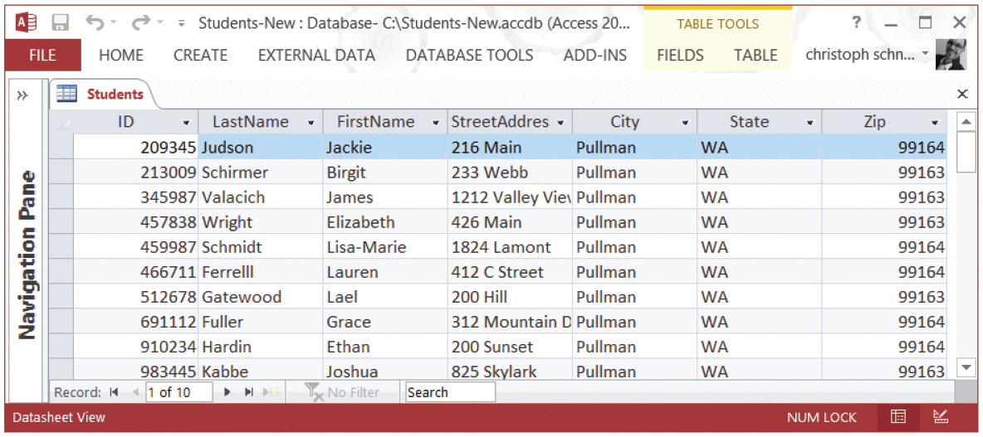
Databases: Tables and Records
This sample data table for the entity Student includes 7 attributes and 10 records.
Source: Microsoft Access
Notes:
Databases are made up of one or more tables, where each table contains multiple records. The records are all of the same type; for example, they may be records of students. Typically we show each record on one row of the table, and each column in the table represents a different attribute, such as the student’s street address. We generally assign a unique identifier to each record so we can readily reference it; in this case the identifier is ID Number.

Slide 10
Databases: Advantages
Advantage | Description
Program-data independence | Programs and data are separated by the DBMS
Minimal data redundancy | There is a single copy of the data
Improved data consistency | Eliminating redundancy improves consistency
Improved data sharing | The DBMS allows sharing between programs
Application development | Data standards simplify program development
Standards enforcement | Centralized data management standardizes rules
Increased security | Simplifies enforcement of access restrictions
Improved data quality | Centralized control, minimized redundancy, and improved data consistency enhance data quality
Improved data accessibility | Centralized, standardized access
Reduced program maintenance | Changes in data replicate seamlessly
Notes:
Databases provide many advantages stemming from the centralized, standardized approach and the elimination of data redundancies.

Slide 11
Databases: Costs and Risks
Cost or Risk | Description
Need for new, specialized personnel | Conversion to the database approach may require hiring additional personnel.
Installation and management cost and complexity | The database approach has higher up-front costs and complexity in order to gain long-term benefits.
Conversion costs | Extensive costs are common when converting existing systems, often referred to as legacy systems, to the database approach.
Need for explicit backup and recovery | A shared corporate data resource must be accurate and available at all times.
Organizational conflict | Ownership—creation, naming, modification, and deletion—of data can cause organizational conflict.
Notes:
Migrating from a legacy system composed of independent files to a centralized common data store is not easy. The up-front conversions will be very costly and require people with expertise. Sharing data raises potential political problems, and there is always the need to ensure that data are current and safe.

Slide 12
Databases: Effective Management
The Data Model
  What data will be captured
  How the data will be represented
The Data Dictionary
  Document of database metadata
    Attribute name
    Type of data
    Valid values
    Business rules
Notes:
When designing a database, it is important to first create a data model.
The data model specifies what data will be in the database, and how they will be represented. This might include the length of name fields, for example.
After the data model is complete a data dictionary is developed. The data dictionary specifies how the data will be implemented in the database.
It also includes any business rules affecting the data, such as how the data will be validated to ensure consistency.

Slide 13
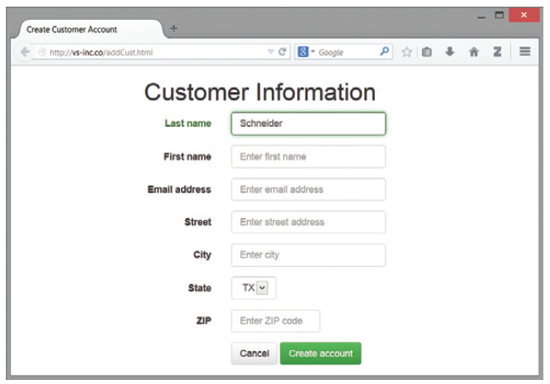
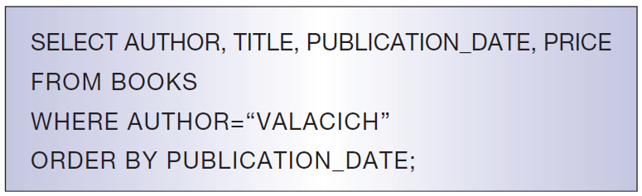
Databases: Entering and Querying Data
Notes:
Data in information systems and their underlying databases are typically managed through the use of forms.
Form can be used to enter new data, update or delete existing data, or create reports.
The systems interact with the database by sending SQL commands to the DMBS, which then executes those commands to make the change or return the requested information.

Slide 14
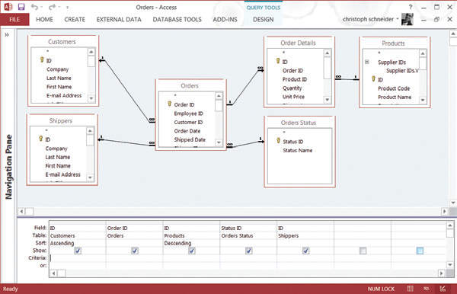
Databases:
Query via Graphical User Interface
Source: Courtesy of Microsoft Corporation
Notes:
Many desktop DBMS packages provide graphical user interfaces, where the user can pick the desired data from the database, to create queries quickly and easily.

Slide 15
Databases:
Operational Systems and BI
Online Transaction Processing (OLTP)
  Systems that interact with customers and run a business in real time
Master Data Management
  Data deemed most important in the operation of a business
  Shared among multiple organizational units
Data Warehouses
  Integrate data from multiple databases and other data sources
  Contain historic as well as current data
Data Marts
  Mini data warehouse, limited in scope to organizational unit
Notes:
OLTPs make the organization run. They include applications for order processing and sales, production, human resources operations such as payroll, and supply chain operations such as purchasing from vendors. All of this involves extensive updates to the database. Some of this data is particularly important for decision makers, and is integrated into a common data warehouse. The warehouse is not updated frequently, but instead is used for providing quick access to aggregated and historical information.

Slide 16
Operational vs. Informational Systems
Characteristic | Operational System | Informational System
Primary purpose | Run the business on a current basis | Support managerial decision making
Type of data | Current representation of state of the business | Historical or point-in-time (snapshot)
Primary users | Online customers, clerks, salespersons, administrators | Managers, business analysts, and customers (checking status and history)
Scope of usage | Narrow and simple updates and queries | Broad and complex queries and analyses
Design goal | Performance | Ease of access and use
Notes:
The purpose of an operational system is to make the company run. This involves transaction processing, and lots of updates to the database. Informational systems, on the other hand, involve almost no updates, but require complex queries in order to provide useful information to decision makers in the organization. The term BI refers to informational systems, whereas the term OLTP refers to operational systems.

Slide 17
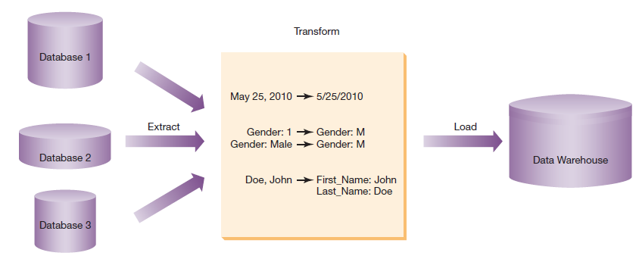
Extract, Transform, and Load
Notes:
Building a data warehouse involves integrating data from multiple sources. Extracting is the process of obtaining the necessary data. Transformation is done to ensure that the data are in a common format and are free of errors. Finally, the extracted and transformed data are loaded into the warehouse for use by decision makers.

Slide 18
Business Intelligence Components
Business Intelligence
Describe the concept of business intelligence and how databases serve as a foundation for gaining business intelligence.
Business Intelligence Components
Explain the three components of business intelligence: information and knowledge discovery, business analytics, and information visualization.

Slide 19
Information and Knowledge Discovery:
Common Reports and Queries
Report/Query | Description
Scheduled reports | Reports produced at predefined intervals—daily, weekly, or monthly—to support routine decisions
Key-indicator reports | Reports that provide a summary of critical information on a recurring schedule
Exception reports | Reports that highlight situations that are out of the normal range
Drill-down reports | Reports that provide greater detail, so as to help analyze why a key indicator is not at an appropriate level or why an exception occurred
Ad hoc queries | Queries answering unplanned information requests to support a non-routine decision; typically not saved to be run again
Notes:
There are a variety of reports and queries that managers need to have to access the information necessary to manage a company.
Some of these are routine and/or standardized, whereas sometimes unusual ad hoc reports are required to address special circumstances.
The information systems need to have the capability of serving all the different reports and queries needed.

Slide 20
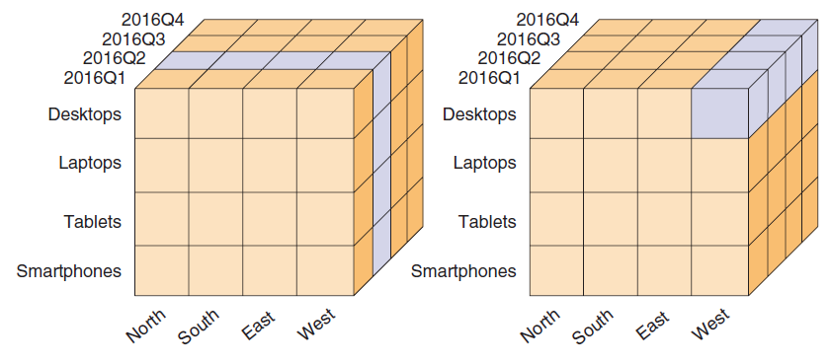
Information and Knowledge Discovery:
Online Analytical Processing (OLAP)
An OLAP cube is a multidimensional database structured to support slicing, dicing, and drill-down
Notes:
Managers often like to “drill down” to look at specific subsets of data as part of the process of understanding how the business is currently performing.
We call the different types of subsets that analysis can be narrowed on “dimensions,” and the processes of narrowing down the data “slicing and dicing.”

Slide 21
OLAP Terms and Concepts
Measures
  Facts, numerical data that can be aggregated
Dimensions
  Perspectives on which to view the facts
  Hierarchically arranged to enable drill-down and roll-up
Cubes
  Multidimensional structure of dimensions and measures
Slicing and Dicing
  Analyzing data on a subset of dimensions
Notes:
OLTP databases are structured as relational data, with tables connected in relationships via primary and foreign keys. This facilitates data integrity when there are many updates and modifications of data. But they are not ideal for complex queries. OLAP databases (cubes) are structured multidimensionally, which makes it much easier to do complex queries. Thus, BI technologies tend to utilize cubes more than relational database structures.

Slide 22
Data Mining
Discovering “hidden” predictive relationships in the data
Complicated algorithms run on large data warehouses
Types of data mining algorithms
  Association discovery
  Clustering
  Classification
  Text and web content mining
Notes:
One application of association discovery is called “market basket analysis.” This involves predicting which types of products will be likely to be bought by someone who purchased another product.
Clustering involves finding “natural” groupings of data points based on similarity metrics.
Classification involves trying to assign data into predefined categories. One application is determining high-risk versus low-risk loan applicants, based on previous experiences.
Text mining draws patterns from unstructured data such as e-mails, blogs, and other textual documents.
Web content mining uses clickstream data and Web crawlers.

Slide 23
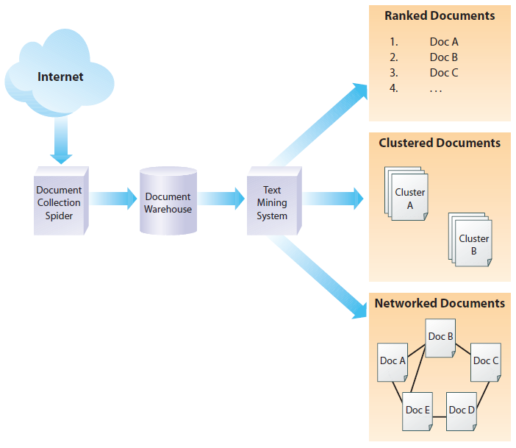
Information and Knowledge Discovery:
Unstructured Data Analysis
Notes:
The Internet contains a wealth of valuable information, such as customer product reviews, that is typically unstructured and difficult to analyze.
The process of gathering and processing this unstructured data is called “text mining the Internet,” and companies that are effective at performing it can assess customer sentiment and increase customer satisfaction.

Slide 24
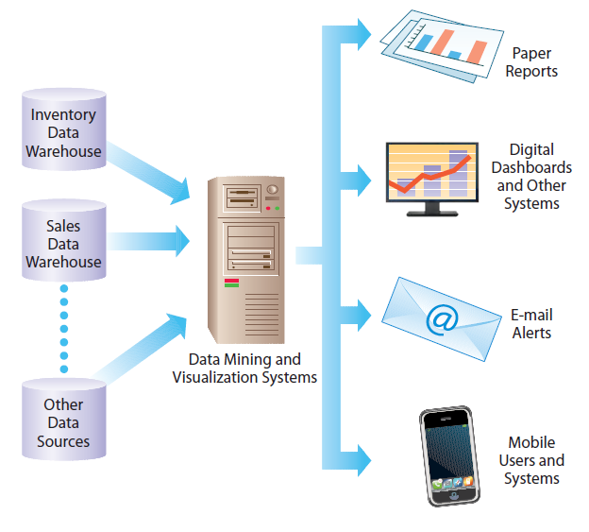
Presenting the Results of Data Mining
Data mining results can be delivered to users in a variety of ways
Notes:
The tools used for information and knowledge discovery can be embedded into a broad range of managerial, executive, and functional area information systems, as well as into decision support and intelligence systems.
Results from these analyses can be provided on digital dashboards, paper reports, Web portals, e-mail alerts (using monitoring or data mining agents), and mobile devices, as well as used by a variety of other information systems

Slide 25
Business Analytics to Support Decision Making
Business Analytics
Decision Support Systems
Intelligent Systems
  Machine learning (e.g., neural networks)
  Expert systems
  Intelligent agents
Knowledge Management Systems

Slide 26
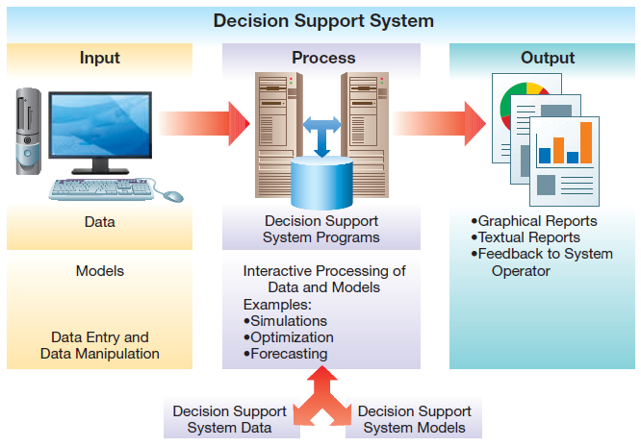
Architecture of a
Decision Support System (DSS)
Notes:
The basic systems model is composed of input, process, and output. Decision support systems are no different.
A DSS uses models to manipulate data. These models can involve simulations, forecasting, optimization, or other techniques.
One common approach is performing “what-if” analyses, which allows you to make hypothetical changes to the data associated with a problem and observe how these changes influence the results. Excel spreadsheets provide functionality for doing what-if analysis as well as optimization.

Slide 27
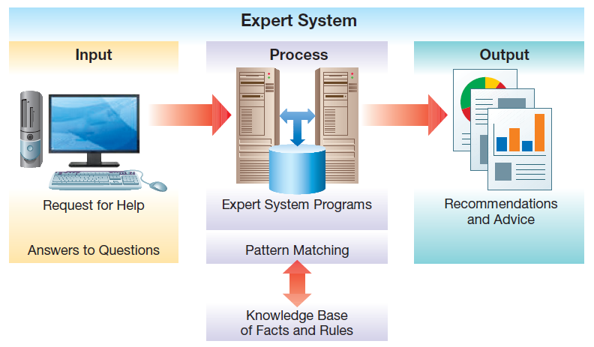
Architecture of an Expert System (ES)
Notes:
The basic systems model is composed of input, process, and output is also incorporated in the architecture of expert systems.
An expert system (ES) is a type of intelligent system that uses reasoning methods based on knowledge about a specific problem domain in order to provide advice, much like a human expert. Whereas a DSS involves use of models (mostly mathematical), an expert system makes use of a knowledge base, often composed of IF-THEN rules applied to facts.
Often expert systems make use of fuzzy logic, in which rules are represented using approximations or subjective values in order to handle situations where information about a problem is incomplete.
The processing in an ES is called inferencing, which consists of matching facts and rules, determining the sequence of questions presented to the user, and drawing a conclusion.

Slide 28
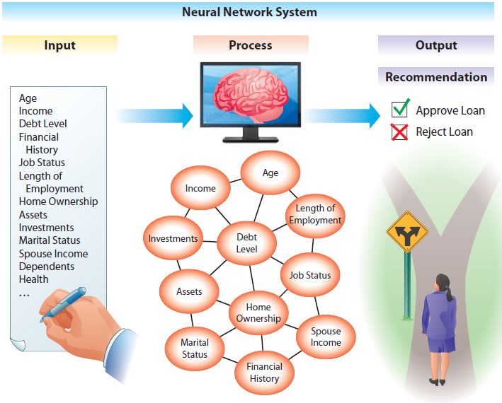
Machine Learning: Neural Networks
Neural networks approximate the functioning of the brain by creating common patterns in data and then comparing new data to learned patterns to make a recommendation
Notes:
Artificial neural network (ANN) algorithms are one type of machine learning. An ANN is a network of processing elements (i.e., artificial “neurons”) that work in parallel to complete a task, attempt to approximate the functioning of the human brain, and can learn by example. Typically, a neural network is trained by having it categorize a large database of past information (e.g., a database of handwritten digits) for common patterns, so as to infer rules.

Slide 29
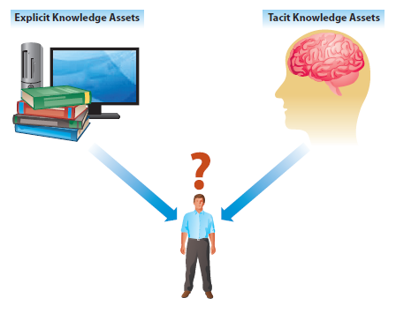
Knowledge Management Systems
Explicit knowledge
  Easily codified and documented
Tacit knowledge
  Embedded in people’s minds
  Hard to get at
  Important for best practices
Goal: gain the greatest value from knowledge assets
Notes:
Many potential benefits can come from organizations’ effectively capturing and utilizing their tacit knowledge assets:
Enhanced innovation and creativity
Improved customer service, shorter product development, and streamlined operations
Enhanced employee retention
Improved organizational performance
But, there are also challenges:
Getting employee buy-in
Focusing too much on technology
Forgetting the goal
Dealing with knowledge overload and obsolescence

Slide 30
Information Visualization
Dashboards
  Comprised of key performance indicators (KPIs)
  Visual display of summary information
  Aid in situational awareness and decision making
Visual Analytics
  Interactive graphics for complex analysis
Geographic Information Systems
  Visualizing geographic information
Notes:
Information can be visualized through digital dashboards, which are similar to a car dashboard, only in this case they display the KPIs necessary to understand how the company is operating.
Companies also use visual analytics to help with the comprehension and analysis of large data sets.
Finally, geographic information systems show information in the context of space and geography.

Slide 31
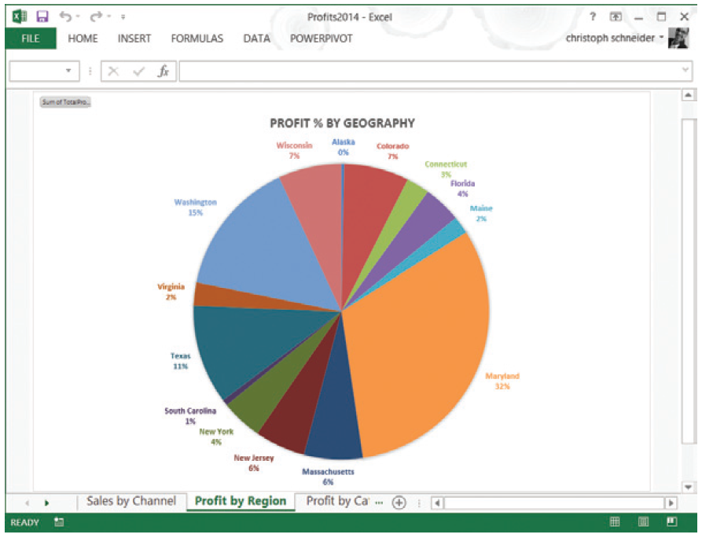
Information Visualization:
Digital Dashboard of Business Data
Notes:
This is an example of a digital dashboard showing profits by sales region. Digital dashboards often integrate analytical tools and allow users to “drill down” to more granular data by clicking on a chart or graph.

Slide 32

Information Visualization:
Geographical Data
Notes:
Geographical data are often best represented on a map, which simplifies comprehension and allows users to focus on what the data mean, rather than putting data into specific context.

Slide 33
End of Chapter Content

Slide 34
Managing in the Digital World: FBI and CIA—Gathering Intelligence Using Social Media
Social media is pervasive
  Changing perspectives on privacy, reshaping relationships, increased information sharing
Organizations monitor and digest social media information flow
Police, first responders, NSA, also tap into social media to track crises, forecast social upheavals, and predict economic changes
Analyzing the huge volume of social media interactions is a Big Data problem

Slide 35
When Things Go Wrong: Twitter Fever—Where Good Conscience Meets Bad Intelligence
Twitter allows very rapid dissemination and sharing of information
People often retweet something they find touching without verifying its accuracy first
The shortness of tweets also limits background and context, so information is easily distorted
Stories can gain rapid momentum regardless of truth or fact, and have damaging consequences

Slide 36
Coming Attractions:
Intelligence Through Drones
University of Pennsylvania is doing research on autonomous flying robots (quadcopters) that can work together in formation
Amazon.com announced work on drones that can deliver packages 30 minutes after order
University of Aberdeen is developing drone technology that gathers geographic data to help farmers find ideal planting locations

Slide 37
Brief Case:
Quality Assurance Through Call Recording
Different customer personalities relate better to different customer service approaches
E-loyalty software can classify a customer and direct a customer service representative how to handle the call
  Personality types: Spock, Princess Diana, Rush Limbaugh, Robin Williams, Donald Trump, Yoda
Algorithms use past experience and call analysis to infer patterns
E-loyalty lowers call center operating expenses by 20 percent because of more productive calls

Slide 38
Ethical Dilemma:
Are You Being Tracked?
Mobile phones emit a Temporary Mobile Subscriber Identifier (TMSI)
Software known as Footpath can triangulate this TMSI and track customers as they walk through malls
This tracking can shed light on shoppers’ individual tastes, tapping into their shopping patterns
Privacy concerns; what are the legal ramifications?

Slide 39
Key Players: SAS, MicroStrategy, and other Business Intelligence Leaders
Business intelligence is becoming big business
  Independent Pure Play analytic companies
    SAS
    MicroStrategy
  Larger integrated companies
    IBM
    SAP
    Oracle
    Microsoft
  Specialized companies also exist that focus on very specific aspects of business intelligence

Slide 40
Who’s Going Mobile:
AroundMe
Mobile devices and location are a perfect match for each other
Search engines (Google, Bing) provide users with information on nearby restaurants
AroundMe—a popular location-based service
  Uses phones GPS to find user’s location, and finds list of interesting places nearby
  Makes use of ad platform Google Dynamic Mobile Advertisement

Slide 41
Industry Analysis:
Health Care
Health care providers and insurance companies are turning to information systems
  Electronic medical records and prescriptions
  Digital imaging systems
  Telemedicine
  Robotic surgery
Consumers are turning to Web sites for health information
  Dedicated sites such as WebMD
  Social media postings related to a condition or symptoms

