Slide 1
Designing, Building and Managing a Cyber Security Program Based on the NIST Cybersecurity Framework (NIST CSF)
A Business Case

Slide 2
Agenda and Objectives
The Digital Innovation Economy
The Cyber Security Problem
The Cyber Security Solution
The UMASS Controls Factory
UMASS Cybersecurity Services
      Training & Mentoring Services
      Assessment Services
      Managed Services

Slide 3
The Digital Innovation Economy
Three things are certain in today’s business world: first, digital services are now at the center of all businesses; second, business is a moving target and third businesses are under attack from those trying to steal the critical information companies rely on for daily business operations and revenue generation.
The demand for a proactive, collaborative and balanced approach for managing and securing enterprise digital assets and services across stakeholders, supply chains, functions, markets, and geographies has never been greater.
In order to achieve the potential benefits of the digital innovation economy, an enterprise must ensure that it can build and maintain a reliable, resilient, secure and trusted digital infrastructure.

Slide 4
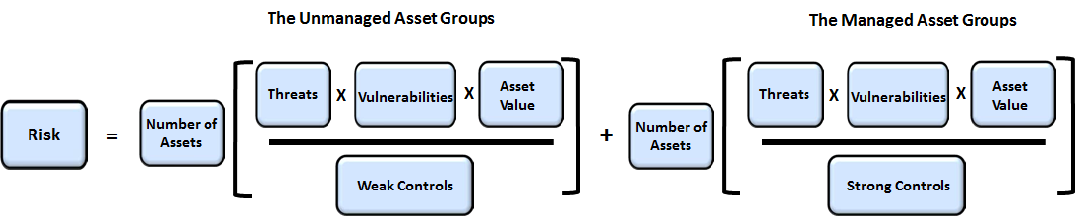
The Cyber Security Problem
Cybersecurity is all about managing risk. Before you can manage risk, you need to understand what the risk components are
Risk components include the threats, vulnerabilities, assets (and their relative value), and the controls associated with an organizations information resources
An effective cybersecurity program involves a thorough understanding these risk components and how they are secured and managed within an organization
The equation for risk, which identifies the key components of risk is shown below

Slide 5
The Cyber Security Solution
NIST Cybersecurity Framework
Recognizing the national and economic security of the United States depends on the reliable function of critical infrastructure, the President issued Executive Order (EO) 13636 in February 2013.
The Order directed NIST to work with stakeholders to develop a voluntary framework – based on existing standards, guidelines, and practices - for reducing cyber risks to critical infrastructure.
Standards, guidelines and practices include – ISO 27001, Cobit, CCS CSC, NIST 800-53, 800-171 etc.
The program focuses on the 16 critical infrastructure sectors as defined by the Department of Homeland Security but has now extended its reach across other sectors, countries and governments

Slide 6
The NIST CSF Technical Controls
The CIS Critical Security Controls (CIS Controls) are a concise, prioritized set of cyber practices created to stop today’s most pervasive and dangerous cyber-attacks
The CIS Controls are developed, refined, and validated by a community of leading experts from around the world
Organizations that apply just the first five CIS Controls can reduce their risk of cyberattack by 85 percent. Implementing all 20 CIS Controls increases the risk reduction to 94 percent

Slide 7
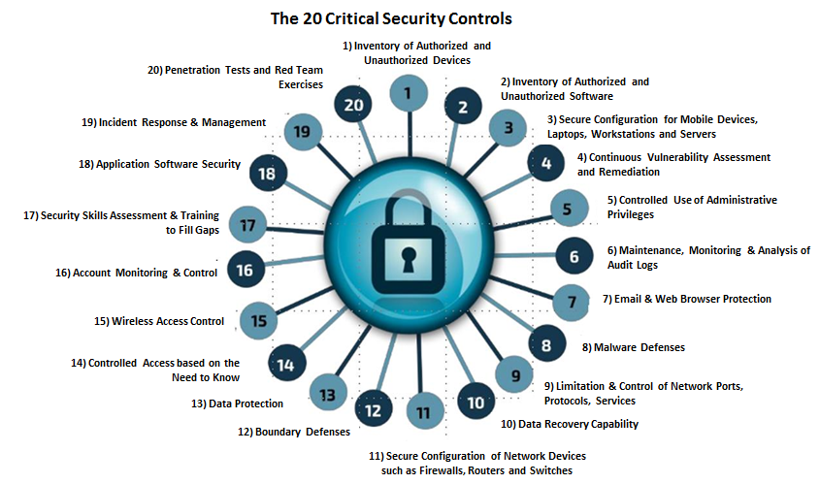
CIS Critical Security Controls

Slide 8
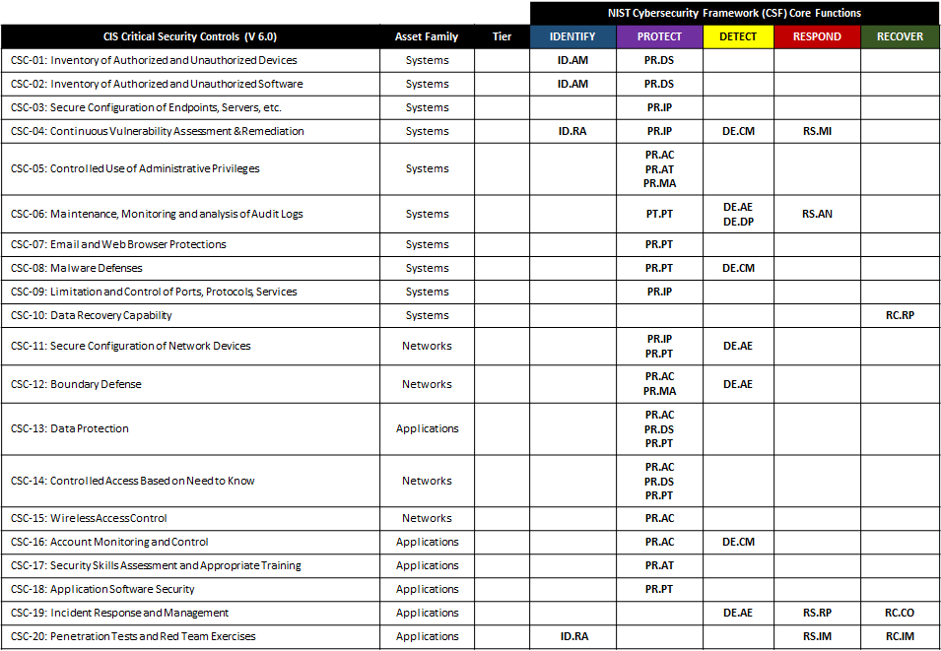
20 Critical Controls Mapping to the NIST Cybersecurity Framework

Slide 9
The NIST CSF Business Controls
Organizational assets are subject to both deliberate and accidental threats as the related processes, systems, networks and people that use and support them have inherent vulnerabilities
Changes to business processes and systems or other external changes (such as new laws and regulations) may create new information security risks
Effective information security reduces these risks by implementing a suitable set of controls, including policies, processes, procedures and organizational structures that deal with the people and process side of risk management.
ISO/IEC 27002:2013 provides guidelines for organizational information security standards and information security management practices including taking into consideration the organization's people and process risk environment(s)

Slide 10
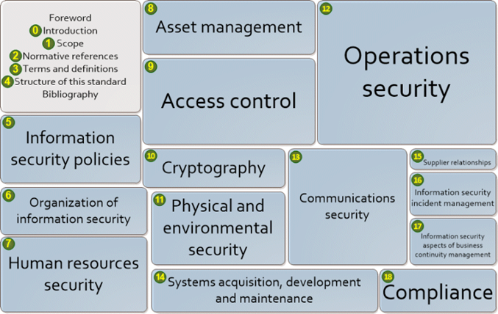
ISO 27002: 2013 Code of Practice for Information Security Management

Slide 11
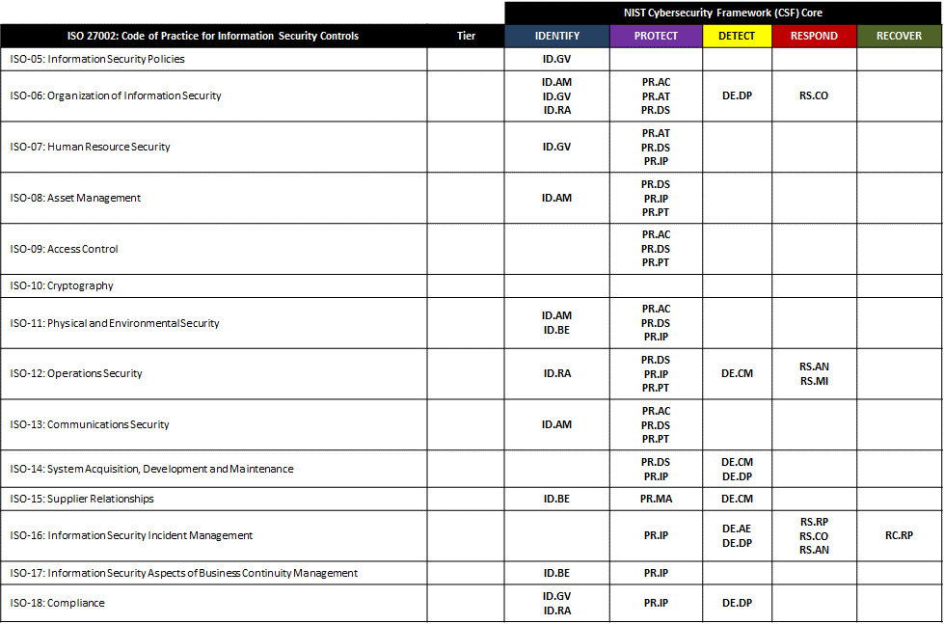
ISO 27002 Controls Mapping to the NIST Cybersecurity Framework:

Slide 12
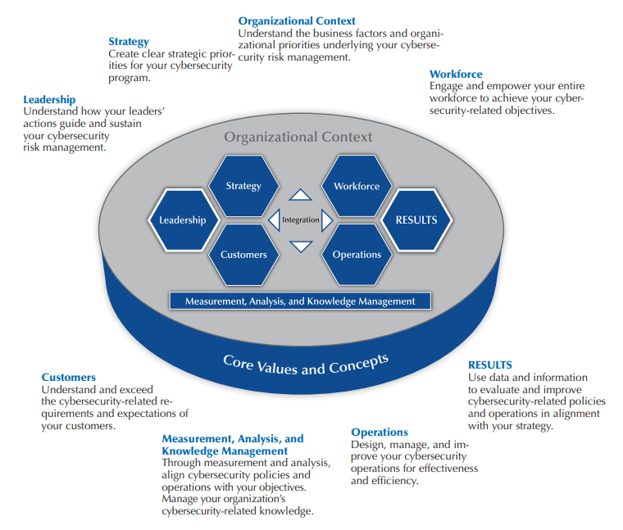
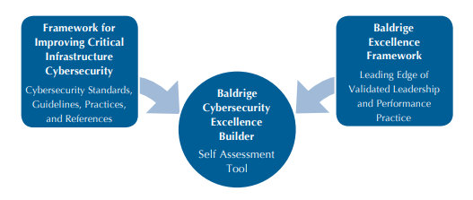
The NIST CSF Risk Management Controls
The Baldrige Cybersecurity Excellence Builder is a voluntary self-assessment tool that enables organizations to better understand the effectiveness of their cybersecurity risk management efforts.
Baldrige Excellence Framework

Slide 13
The NIST CSF Risk Management Controls
Using this self-assessment tool, organizations can
  Determine cybersecurity-related activities important to your business strategy and critical service delivery;
  Prioritize your investments in managing cybersecurity risk;
  Determine how best to enable your workforce, customers, suppliers, partners, and collaborators to be risk conscious and security aware, and to fulfill their cybersecurity roles and responsibilities;
  Assess the effectiveness and efficiency of your use of cybersecurity standards, guidelines, and practices;
  Assess the cybersecurity results you achieve; and
  Identify priorities for improvement.

Slide 14
Baldrige Cybersecurity Excellence Builder
Senior and Cybersecurity Leadership: How do your senior leaders lead cybersecurity policies and operations?
Governance and Societal Responsibilities: How do you govern cybersecurity policies and operations and fulfill your organization’s societal responsibilities?
Strategy Development: How do you develop your cybersecurity strategy?
Strategy Implementation: How do you implement your cybersecurity strategy?
Voice of the Customer: How do you obtain information from your customers?
Customer Engagement: How do you engage customers by serving their needs and building relationships?
Measurement, Analysis, and Improvement of Performance: How do you measure, analyze, and then improve cybersecurity-related performance?
Knowledge Management: How do you manage your organization's cybersecurity related knowledge assets?
Workforce Environment: How do you build an effective and supportive workforce environment to achieve your cybersecurity goals?

Slide 15
Baldrige Cybersecurity Excellence Builder (cont.)
Workforce Engagement: How do you engage your workforce to achieve a high performance work environment in support of cybersecurity policies and operations?
Work Processes: How do you design, manage, and improve your key cybersecurity work processes?
Operational Effectiveness: How do you ensure effective management of your cybersecurity operations?
Process Results: What are your cybersecurity performance and process effectiveness results?
Customer Results: What are your customer-focused cybersecurity performance results?
Workforce Results: What are your workforce-focused cybersecurity performance results?
Leadership and Governance Results: What are your cybersecurity leadership and governance results?
Financial Results: What are your financial performance results for your cybersecurity operations?

Slide 16

American Water Works Association
Process Control System Security Guidance for the Water Sector
A 29 page security guide
Recommended Security Practices for Water Sector – a list of 12 major ‘to dos’
A Cybersecurity Guidance Tool to simplify guidance landscape
Crosswalk of Framework to AWWA Guidance Control

Slide 17
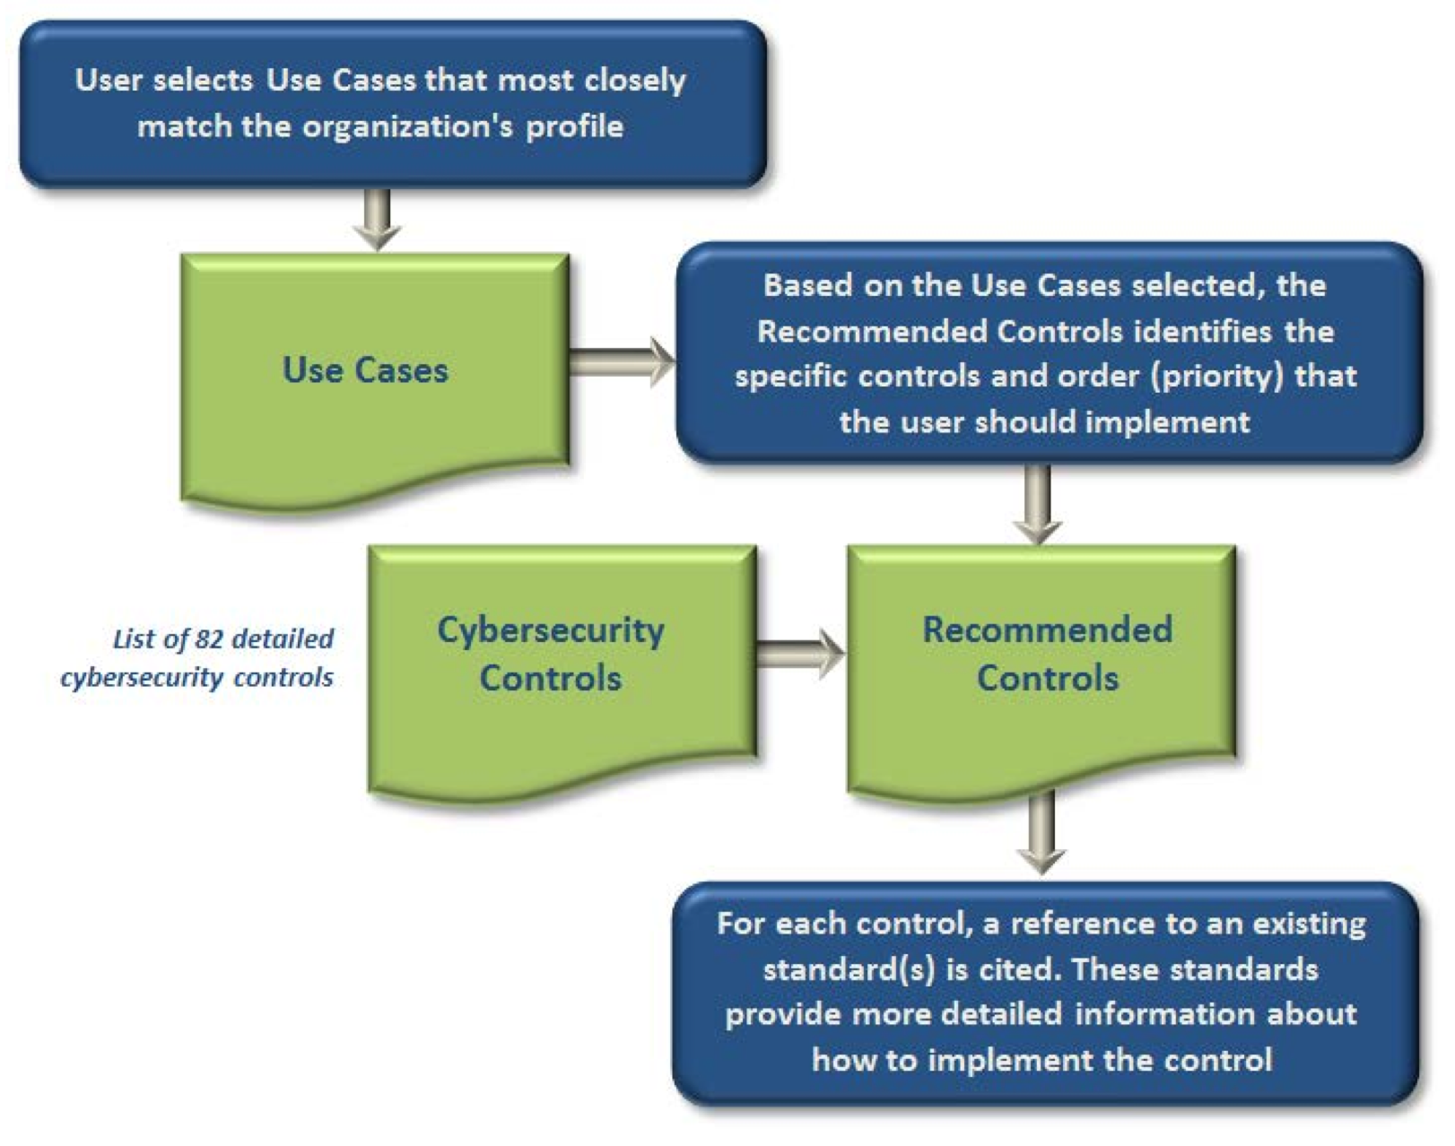
Cybersecurity Guidance ToolProcess Control System Security Guidance for the Water Sector

Slide 18
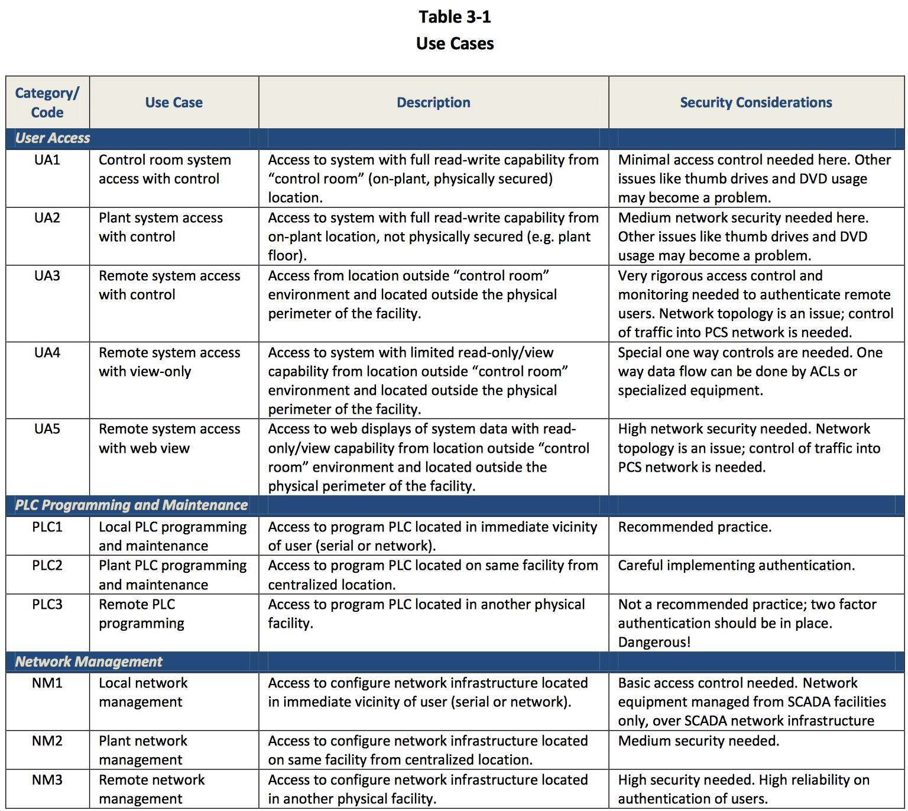
CGT Use Case Examples
Process Control System Security Guidance for the Water Sector

Slide 19
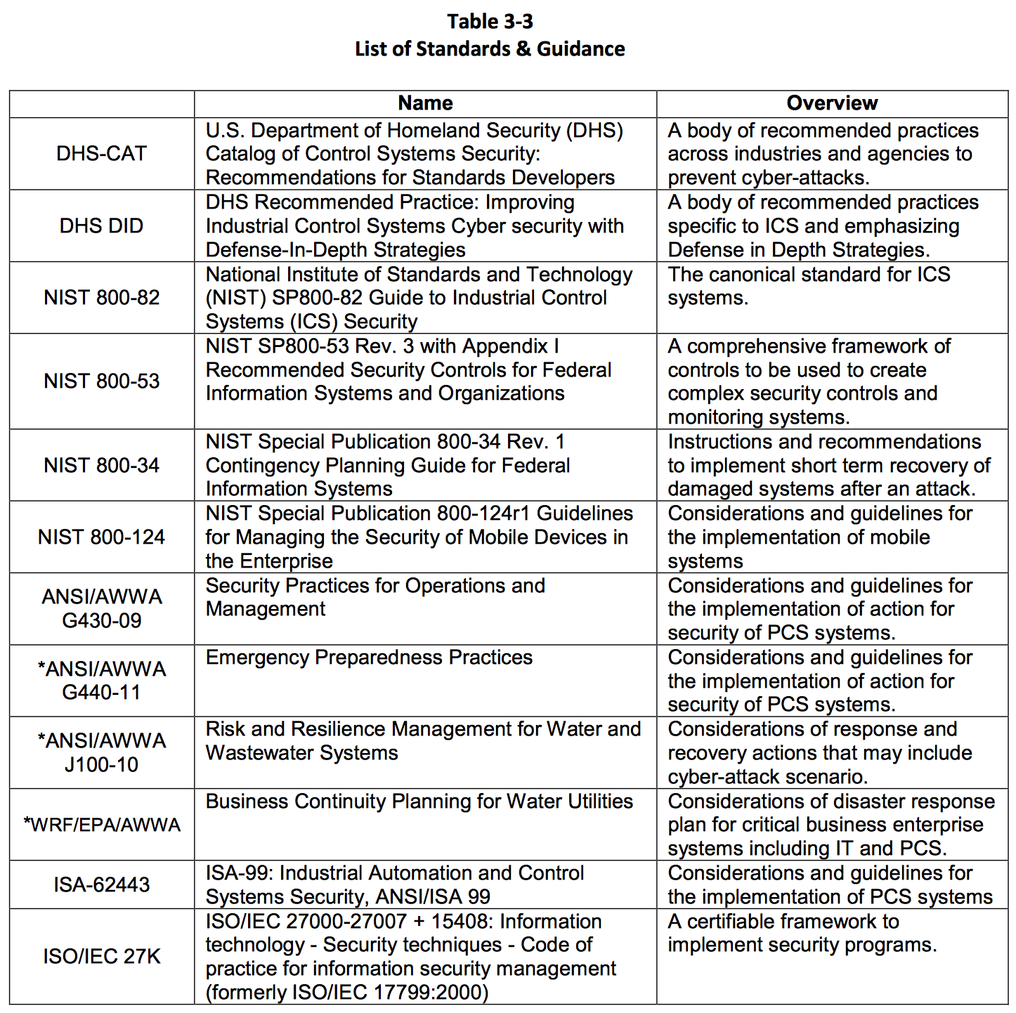
Referenced Standards
Process Control System Security Guidance for the Water Sector

Slide 20


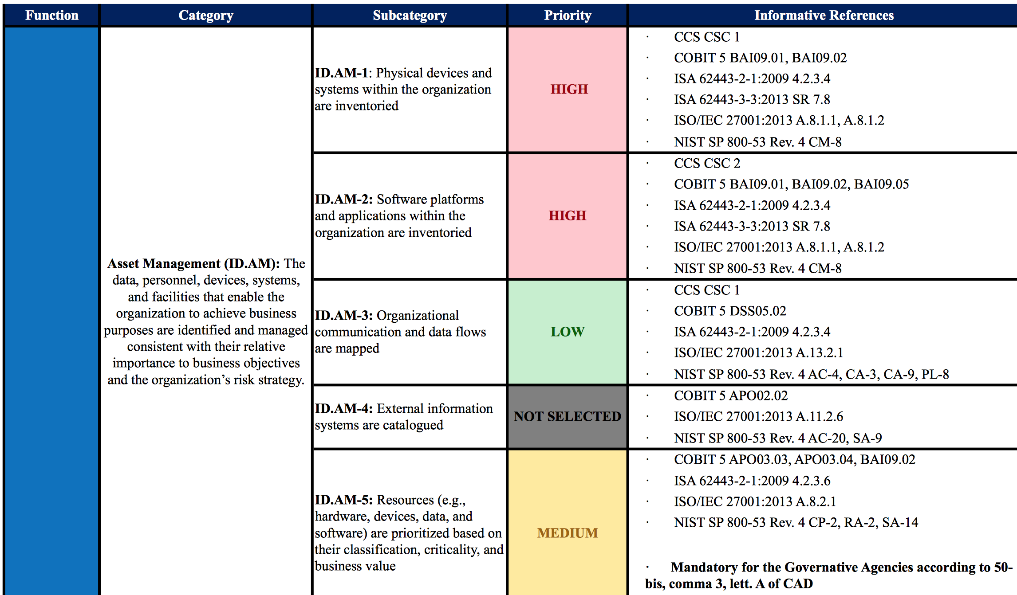
Suggested Priorities for SMEs
National Framework for Cybersecurity

Slide 21
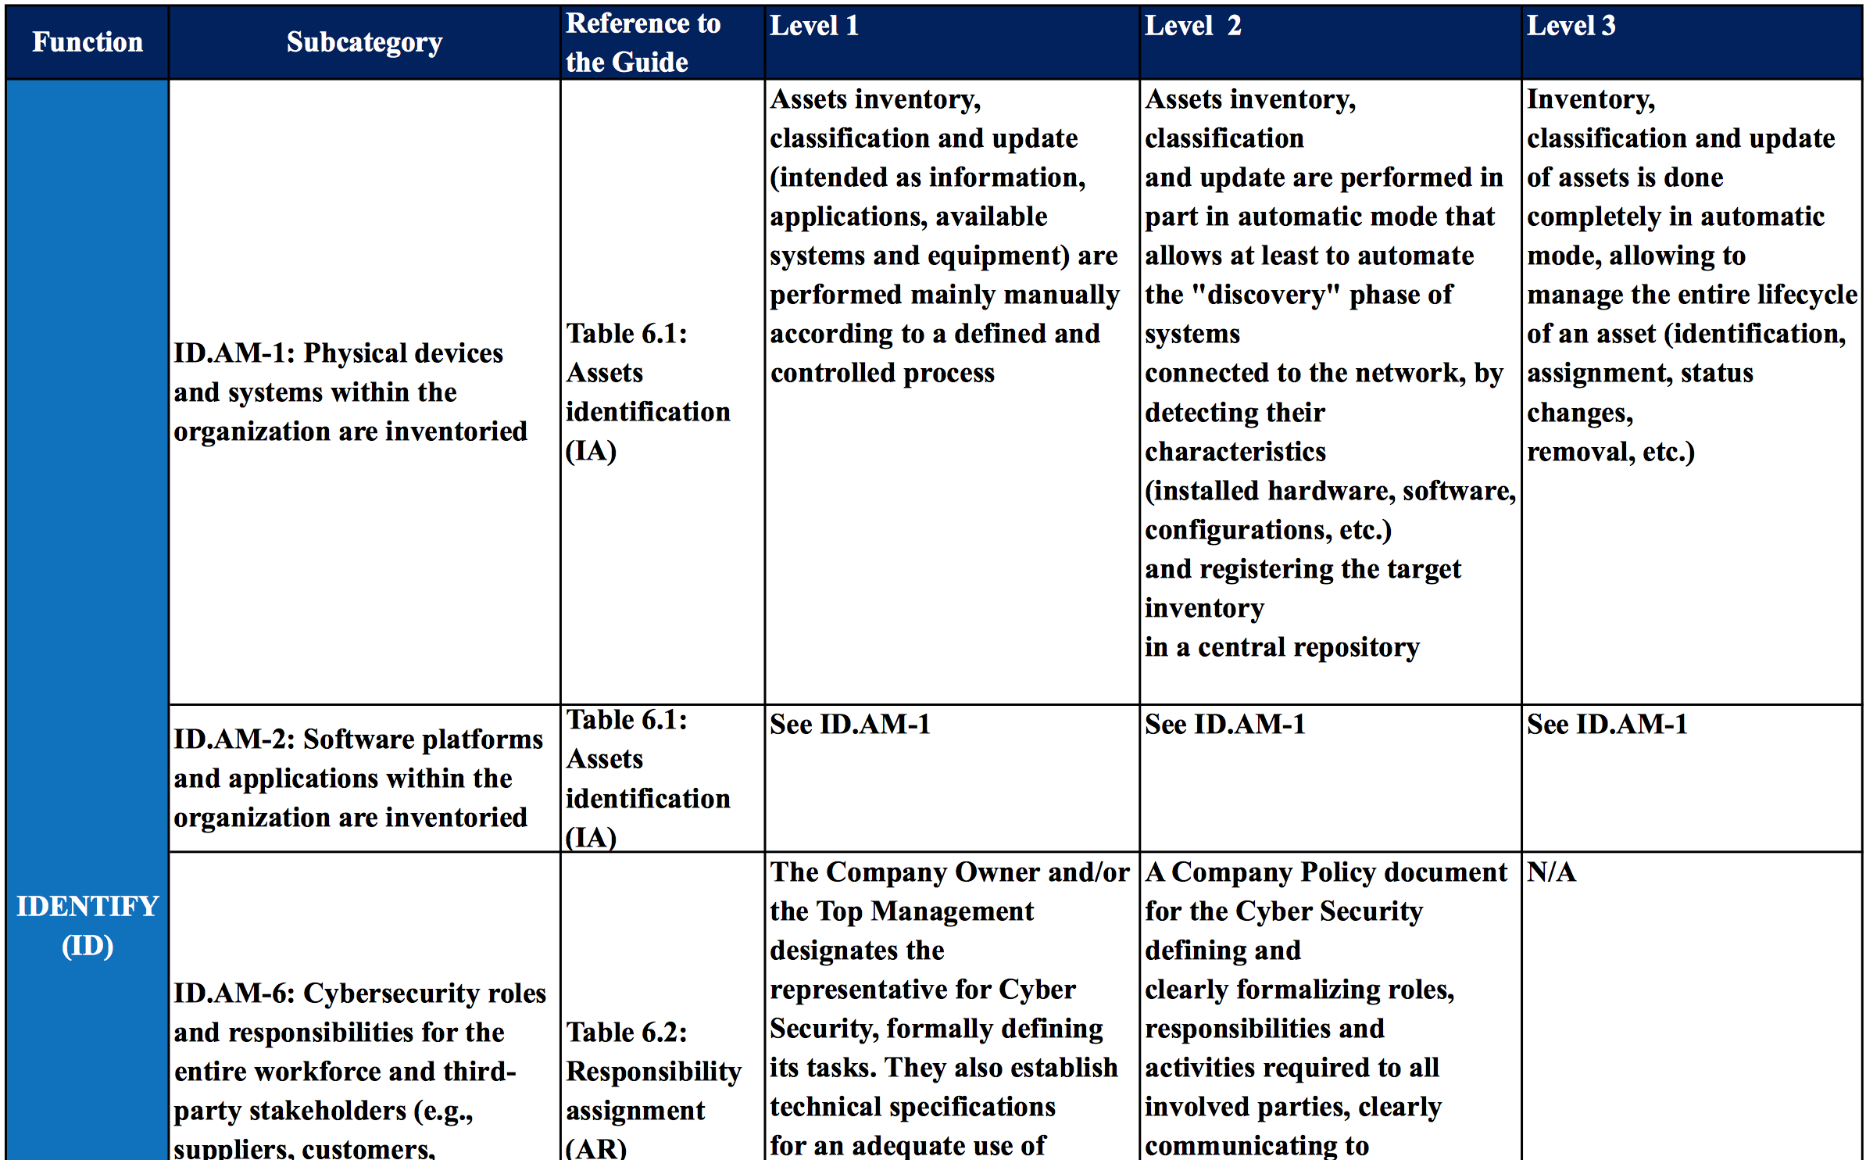
Qualitative Assessment Criteria
National Framework for Cybersecurity

Slide 22
Questions & Answers

