Slide 1


Slide 2
Chapter 13
Sampling

Slide 3
Sampling
Sampling: the process of selecting a sufficient number of elements from the population, so that results from analyzing the sample are generalizable to the population.
The reasons for using a sample are self-evident. In research involving hundreds or even thousands of elements, it would be practically impossible to collect data from every element. Even if it were possible, it would be prohibitive in terms of time, cost, and other human resources.

Slide 4
Relevant Terms - 1
Population refers to the entire group of people, events, or things of interest that the researcher wishes to investigate.
An element is a single member of the population.
A sample is a subset of the population. It comprises some members selected from it.

Slide 5
Relevant Terms - 2
Sampling unit: the element or set of elements that is available for selection in some stage of the sampling process.
A subject is a single member of the sample, just as an element is a single member of the population.

Slide 6
Relevant Terms - 3
The characteristics of the population such as µ (the population mean), σ (the population standard deviation), and σ2 (the population variance) are referred to as its parameters. The central tendencies, the dispersions, and other statistics in the sample of interest to the research are treated as approximations of the central tendencies, dispersions, and other parameters of the population.

Slide 7
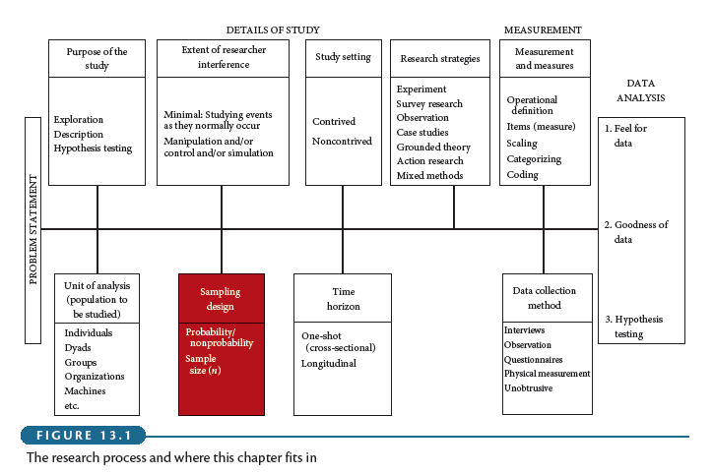
Statistics versus Parameters

Slide 8
Advantages of Sampling
Less costs
Less errors due to less fatigue
Less time
Destruction of elements avoided

Slide 9
The Sampling Process
Major steps in sampling:
  Define the population.
  Determine the sample frame
  Determine the sampling design
  Determine the appropriate sample size
  Execute the sampling process

Slide 10
Sampling Techniques
Probability versus nonprobability sampling
Probability sampling: elements in the population have a known and non-zero chance of being chosen

Slide 11
Sampling Techniques
Probability Sampling
  Simple Random Sampling
  Systematic Sampling
  Stratified Random Sampling
  Cluster Sampling
Nonprobability Sampling
  Convenience Sampling
  Judgment Sampling
  Quota Sampling

Slide 12
Simple Random Sampling
Procedure
  Each element has a known and equal chance of being selected
Characteristics
  Highly generalizable
  Easily understood
  Reliable population frame necessary

Slide 13
Systematic Sampling
Procedure
  Each n^{th} element, starting with random choice of an element between 1 and n
Characteristics
  Idem simple random sampling
  Easier than simple random sampling
  Systematic biases when elements are not randomly listed

Slide 14
Cluster Sampling
Procedure
  Divide of population in clusters
  Random selection of clusters
  Include all elements from selected clusters
Characteristics
  Intercluster homogeneity
  Intracluster heterogeneity
  Easy and cost efficient
  Low correspondence with reality

Slide 15
Stratified Sampling
Procedure
  Divide of population in strata
  Include all strata
  Random selection of elements from strata
    Proportionate
    Disproportionate
Characteristics
  Interstrata heterogeneity
  Intrastratum homogeneity
  Includes all relevant subpopulations

Slide 16
(Dis)proportionate Stratified Sampling
Number of subjects in total sample is allocated among the strata (dis)proportional to the relative number of elements in each stratum in the population
Disproportionate case:
  strata exhibiting more variability are sampled more than proportional to their relative size
  requires more knowledge of the population, not just relative sizes of strata

Slide 17
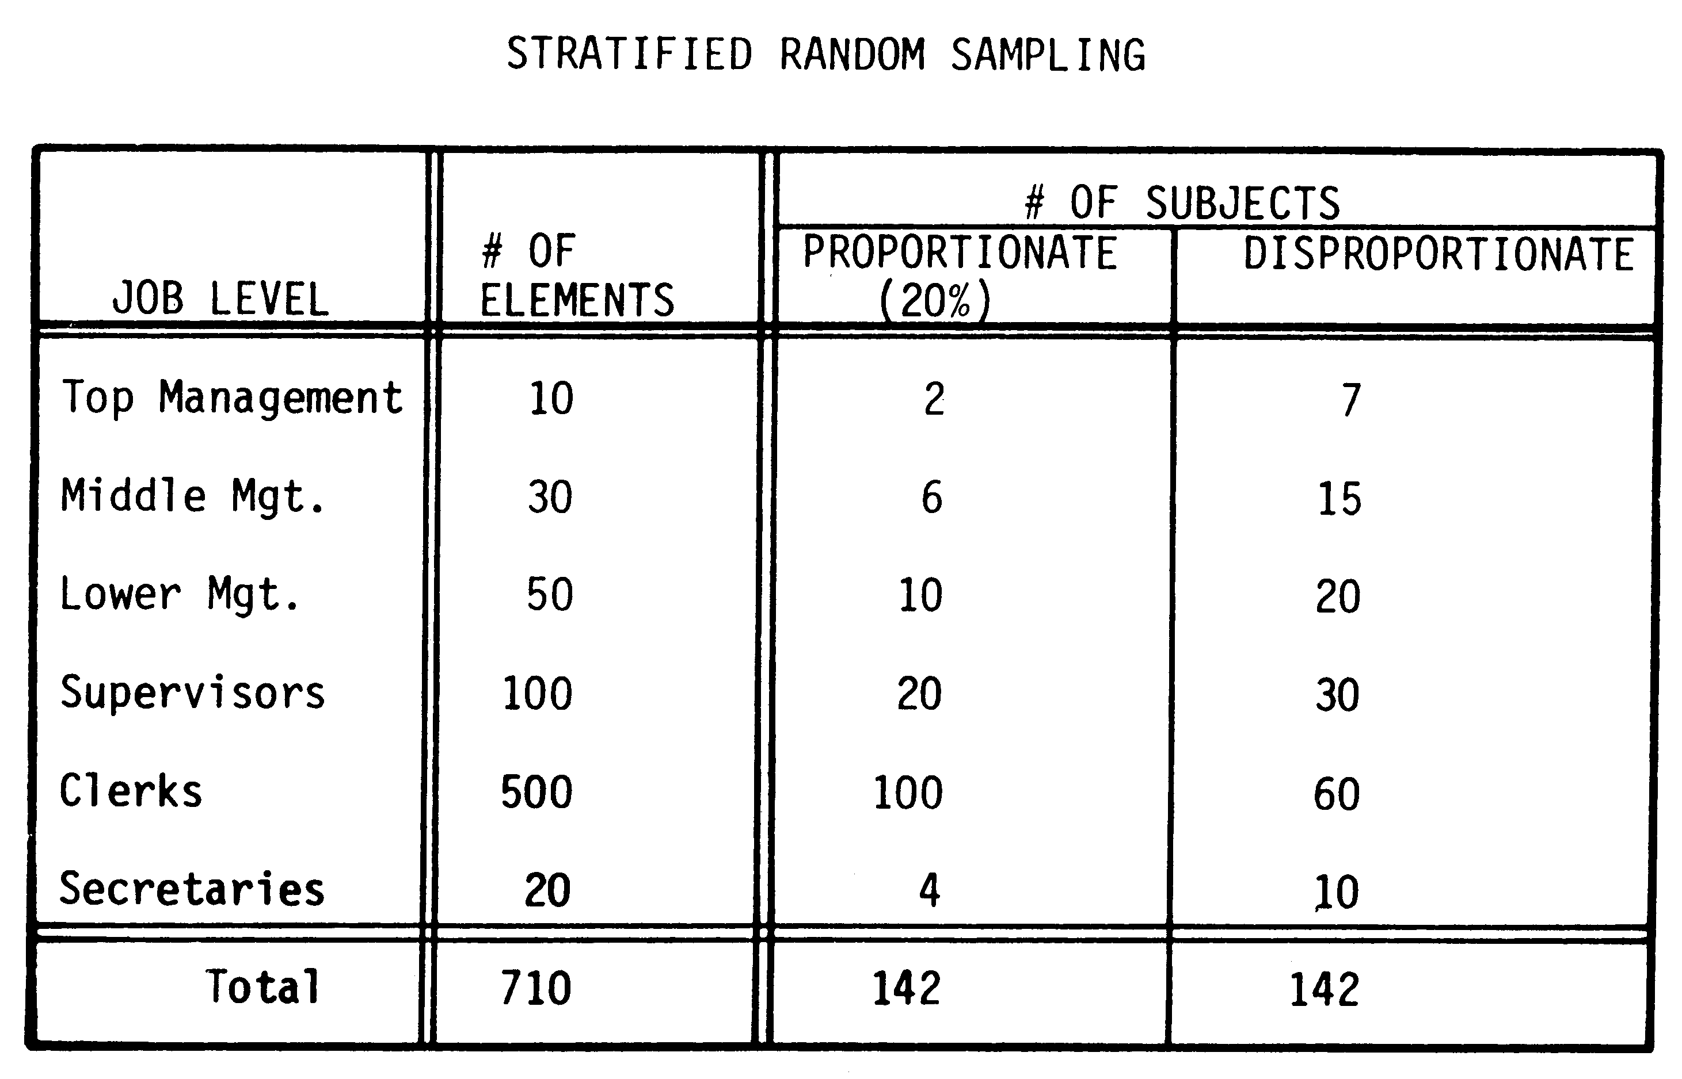
Example

Slide 18
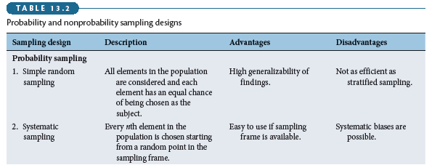
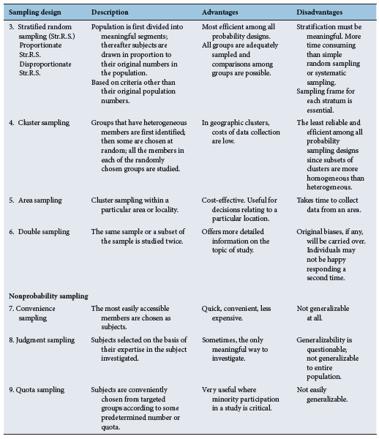
Overview

Slide 19
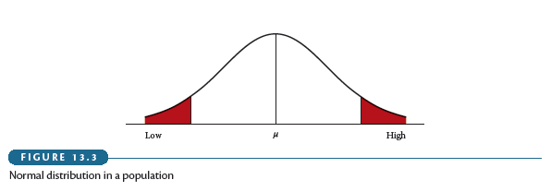
Choice Points in Sampling Design

Slide 20
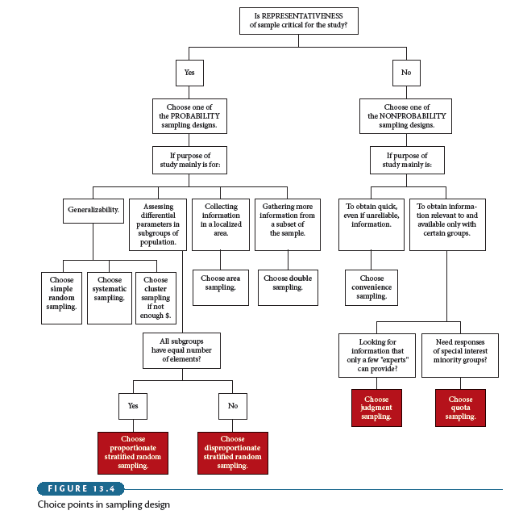
Tradeoff Between Precision and Confidence
We can increase both confidence and precision by
increasing the sample size

Slide 21
Sample Size: Guidelines
In general: 30 < n < 500
Categories: 30 per subcategory
Multivariate: 10 x number of var’s
Experiments: 15 to 20 per condition

Slide 22
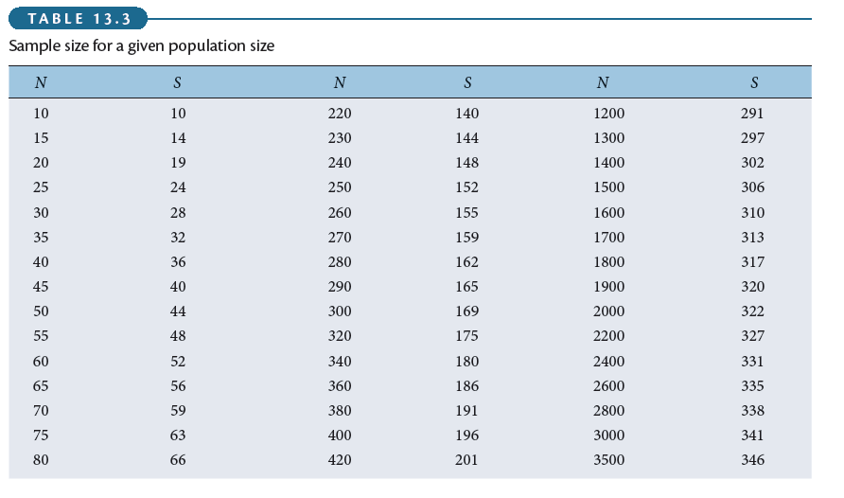
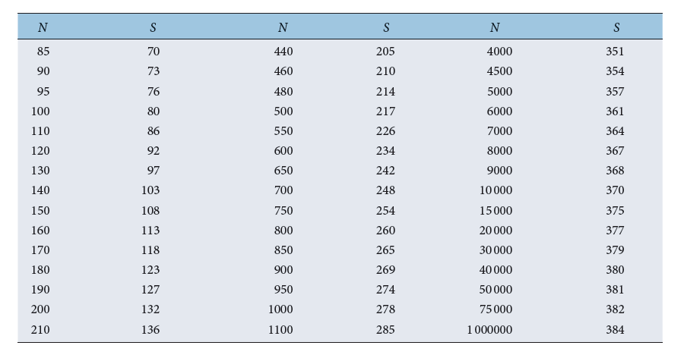
Sample Size for a Given Population Size

Slide 23
Sampling in Qualitative Research
Qualitative research generally uses nonprobability sampling as it does not aim to draw statistical inference.
Purposive sampling is one technique that is often used: subjects are selected on the basis of expertise in the subject that is being investigated.
Choose subjects in such a way that they reflect the diversity of the population.

Slide 24
Sampling in Qualitative Research
One form of purposive sampling is theoretical sampling. May or may not begin with purposive sampling. Sampling of additional subjects is directed by the emerging theoretical framework.
Impossible to determine how many subjects will need to be sampled at the beginning of study. Continue to sample until you are not getting any new information or are no longer gaining new insights. Sample size will, therefore (partly) depend on heterogeneity of the population.

