Slide 1


Slide 2
Chapter 12
Measurement of Variables: Scaling, Reliability, Validity

Slide 3
Scale
Measurement means gathering data in the form of numbers.
To be able to assign numbers to attributes of objects we need a scale: a tool or mechanism by which individuals are distinguished as to how they differ from one another on the variables of interest to our study.

Slide 4
Four Types of Scales
There are four basic types of scales: nominal, ordinal, interval, and ratio.
The degree of sophistication to which the scales are fine-tuned increases progressively as we move from the nominal to the ratio scale.

Slide 5
Nominal Scale
A nominal scale is one that allows the researcher to assign subjects to certain categories or groups.
What is your department?
O Marketing O Maintenance O Finance
O Production O Servicing O Personnel
O Sales O Public Relations O Accounting
What is your gender?
O Male
O Female

Slide 6
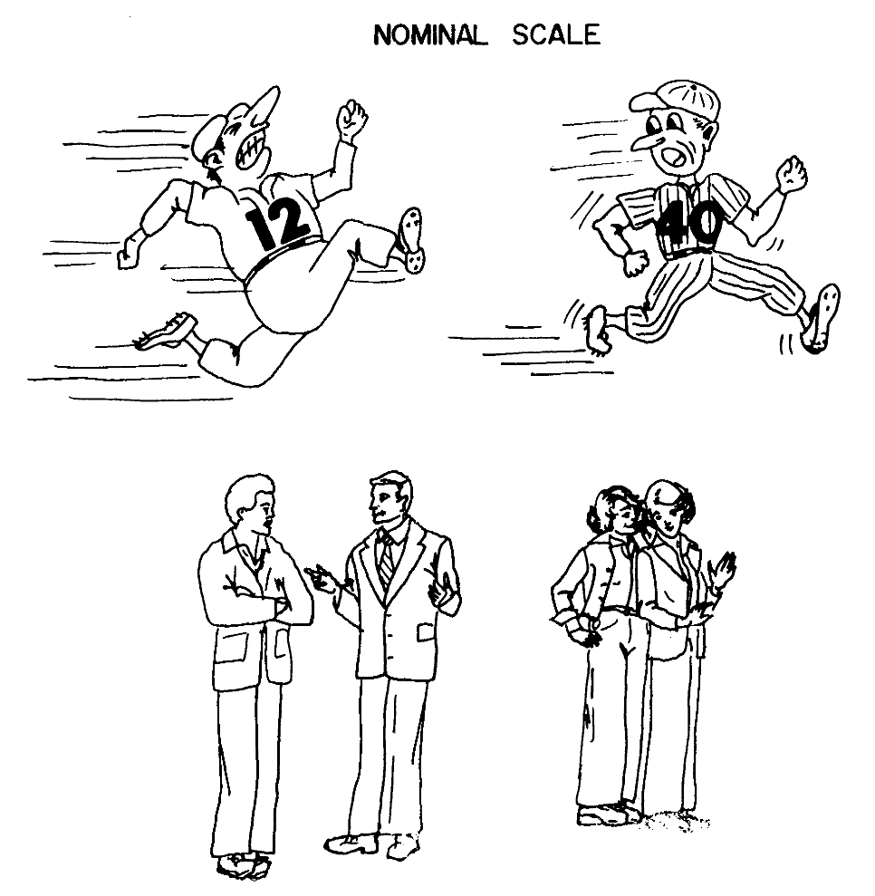
Nominal Scale

Slide 7
Ordinal Scale
Ordinal scale: not only categorizes variables in such a way as to denote differences among various categories, it also rank-orders categories in some meaningful way.
What is the highest level of education you have completed?
O Less than High School
O High School/GED Equivalent
O College Degree
O Masters Degree
O Doctoral Degree

Slide 8
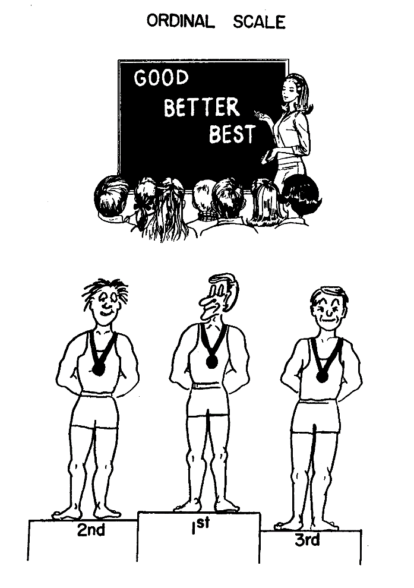
Ordinal Scale

Slide 9
Interval Scale
In an interval scale, or equal interval scale, numerically equal distances on the scale represent equal values in the characteristics being measured.
Allows us to compare differences between objects: The difference between any two values on the scale is identical to the difference between any two other neighboring values of the scale.

Slide 10
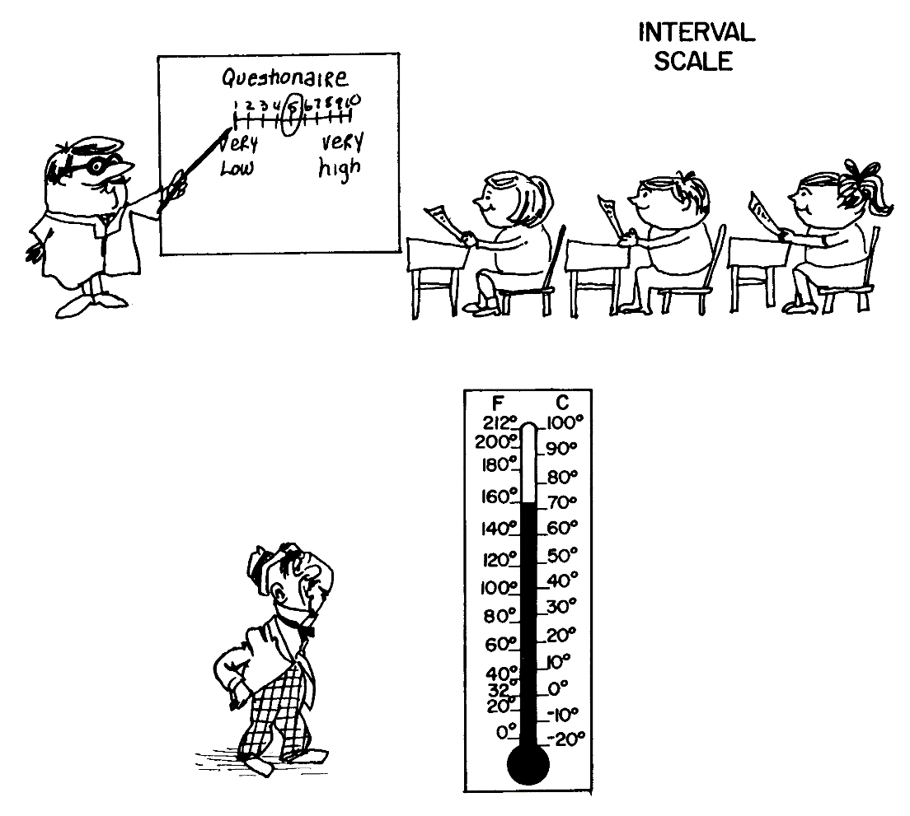
Interval Scale

Slide 11
Interval Scale
The clinical thermometer is a good example of an interval-scaled instrument; it has an arbitrary origin and the magnitude of the difference between 98.6 degrees (the normal body temperature) and 99.6 degrees is the same as the magnitude of the difference between 104 and 105 degrees.

Slide 12
Ratio Scale
Ratio scale: overcomes the disadvantage of the arbitrary origin point of the interval scale, in that it has an absolute (in contrast to an arbitrary) zero point, which is a meaningful measurement point.
What is your age?

Slide 13
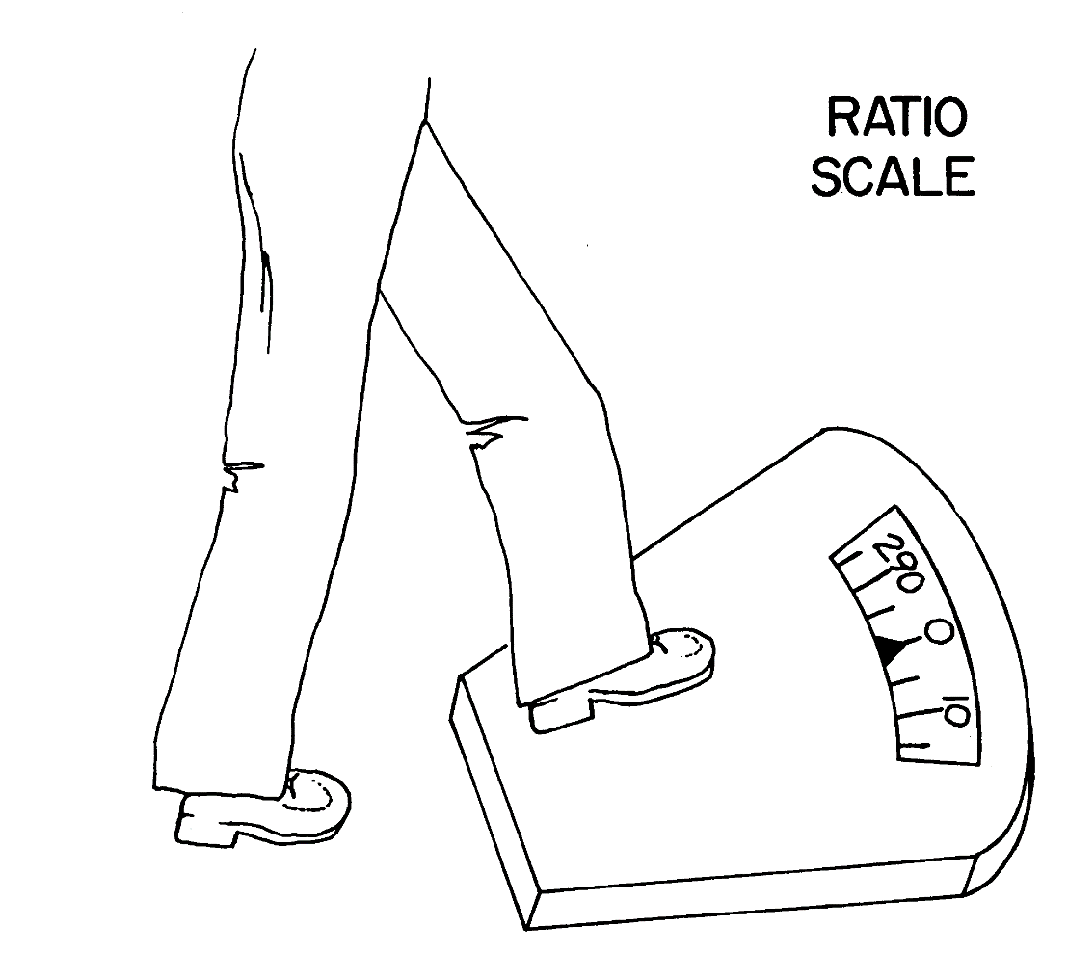
Ratio Scale

Slide 14
Ordinal Scale or Interval Scale?
Circle the number that represents your feelings at this particular moment best. There are no right or wrong answers. Please answer every question.
1. I invest more in my work than I get out of it
I disagree completely 1 2 3 4 5 I agree completely
2. I exert myself too much considering what I get back in return
I disagree completely 1 2 3 4 5 I agree completely
3. For the efforts I put into the organization, I get much in return
I disagree completely 1 2 3 4 5 I agree completely

Slide 15
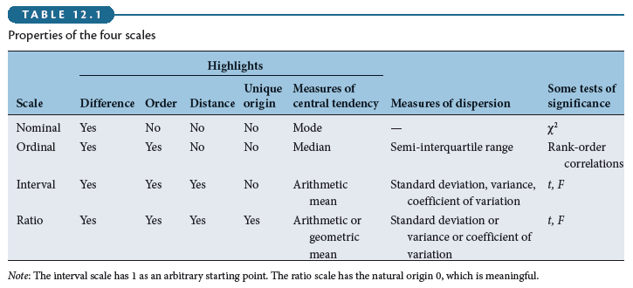
Properties of the Four Scales

Slide 16
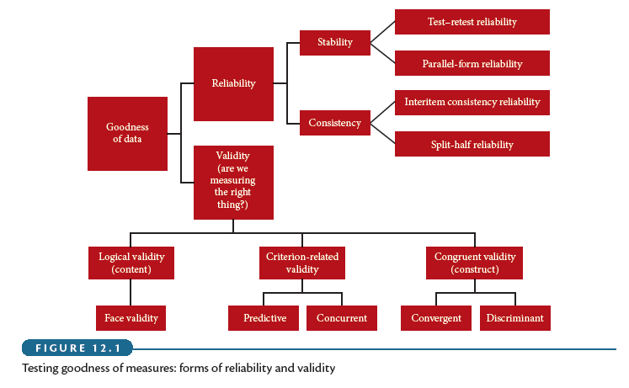
Goodness of Measures

Slide 17
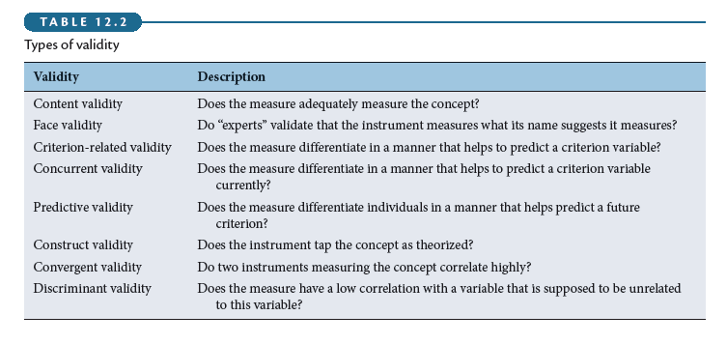
Validity

Slide 18
Reliability
Reliability of measure indicates extent to which it is without bias and hence ensures consistent measurement across time (stability) and across the various items in the instrument (internal consistency).

Slide 19
Stability
Stability: ability of a measure to remain the same over time, despite uncontrollable testing conditions or the state of the respondents themselves.
  Test–Retest Reliability: The reliability coefﬁcient obtained with a repetition of the same measure on a second occasion.
  Parallel-Form Reliability: Responses on two comparable sets of measures tapping the same construct are highly correlated.

Slide 20
Internal Consistency
Internal Consistency of Measures is indicative of the homogeneity of the items in the measure that tap the construct.
  Interitem Consistency Reliability: This is a test of the consistency of respondents’ answers to all the items in a measure. The most popular test of interitem consistency reliability is the Cronbach’s coefﬁcient alpha.
  Split-Half Reliability: Split-half reliability reflects the correlations between two halves of an instrument.

