Slide 1


Slide 2
Chapter 14
Quantitative Data Analysis

Slide 3
Getting the Data Ready for Analysis
Data coding: assigning a number to the participants’ responses so they can be entered into a database.
Data Entry: after responses have been coded, they can be entered into a database. Raw data can be entered through any software program (e.g., SPSS)

Slide 4
Editing Data
An example of an illogical response is an outlier response. An outlier is an observation that is substantially different from the other observations.
Inconsistent responses are responses that are not in harmony with other information.
Illegal codes are values that are not specified in the coding instructions.

Slide 5
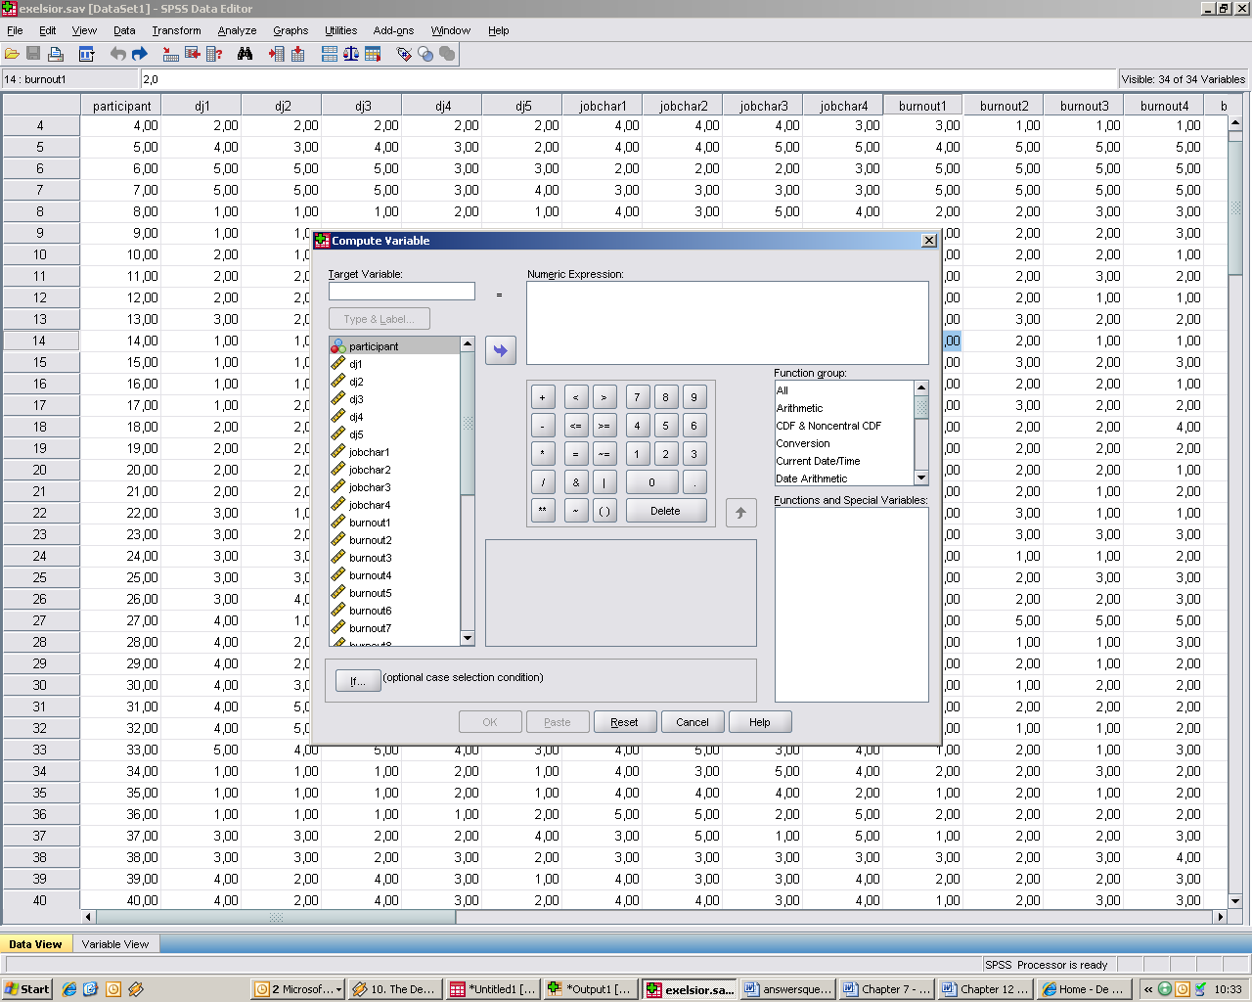
Transforming Data

Slide 6
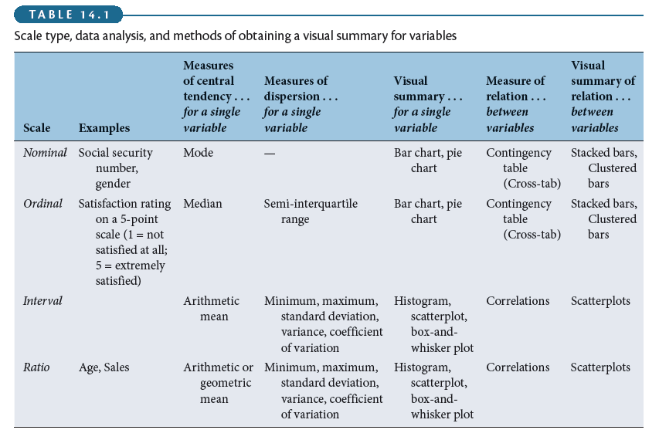
Getting a Feel for the Data

Slide 7
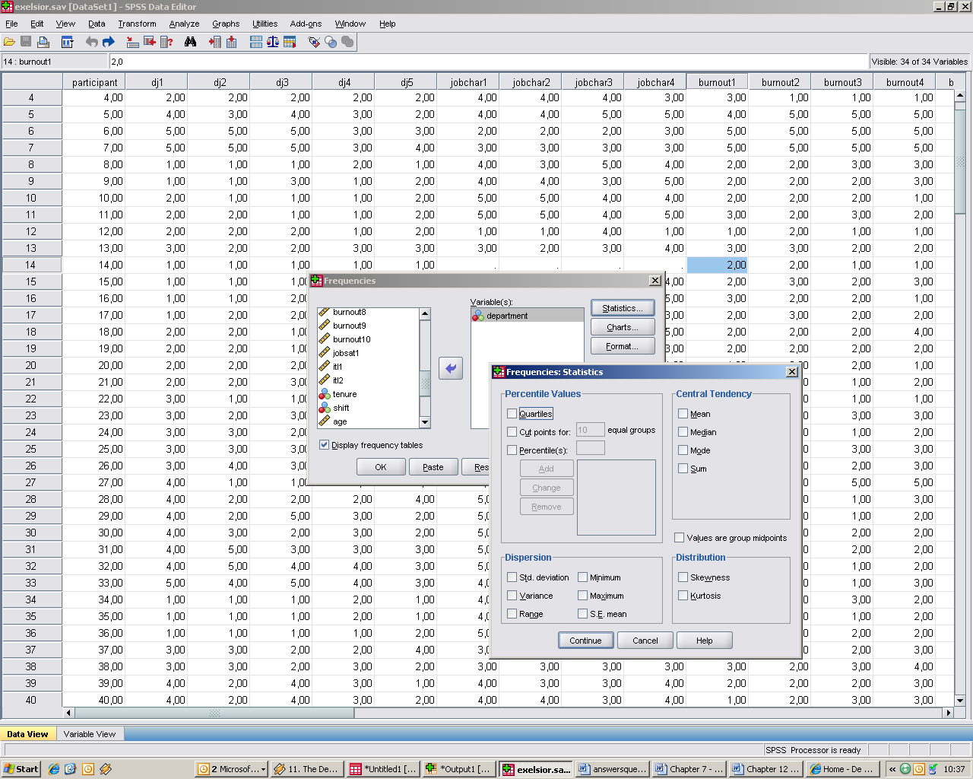
Frequencies

Slide 8
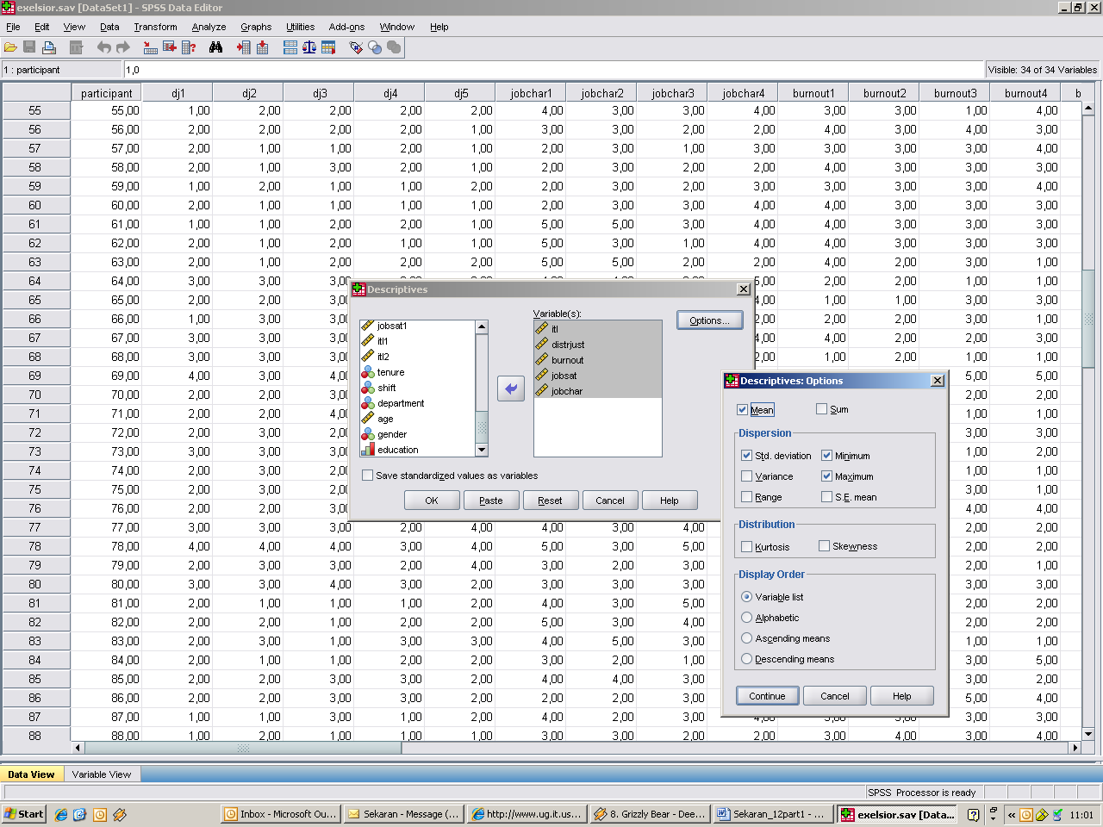
Descriptive Statistics: Central Tendencies and Dispersions

Slide 9
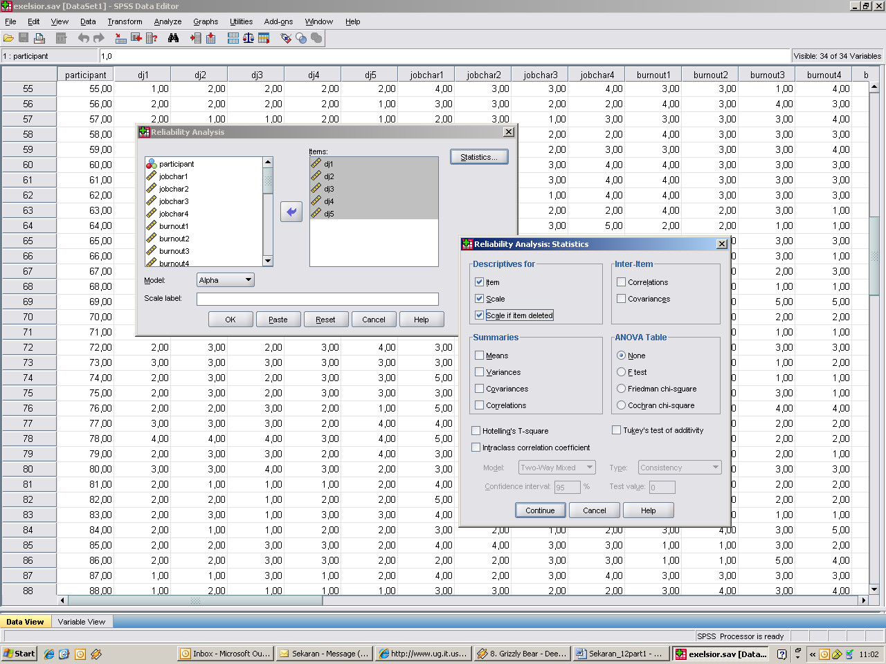
Reliability Analysis

