Slide 1
Tools Pada Adobe Ilustrator
By Dika Tondo Widakdo, S.Kom., M.T.I

Slide 2
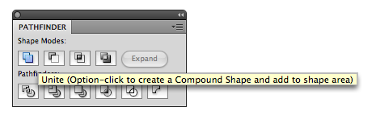
PATHFINDER
Untuk menampilkan klik menu Window → Pathfinder

Slide 3
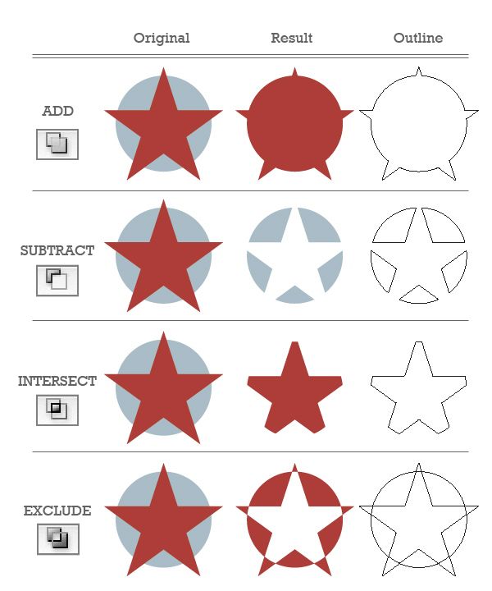

Slide 4
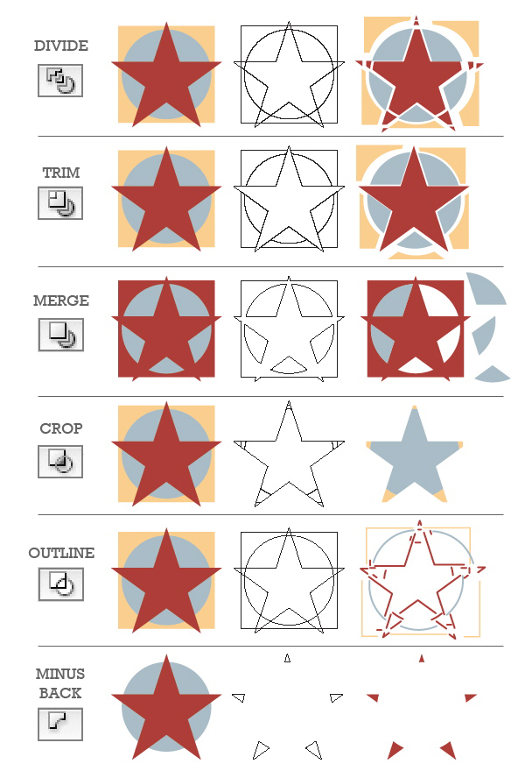

Slide 5
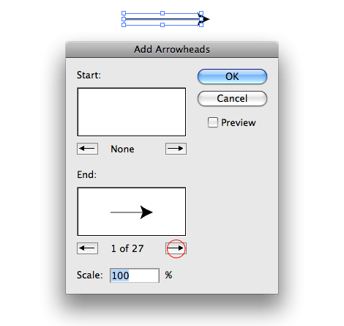
Mastering Illustrator Effects
Arrowheads
Menu Effects > Stylize > Add Arrowheads and choose a style.

Slide 6
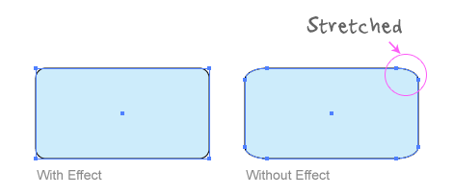
Without The Round Corners Effect?
Round Corners
Draw a rectangle shape, go to Effects > Stylize > Round Corners and enter a radius value.

Slide 7
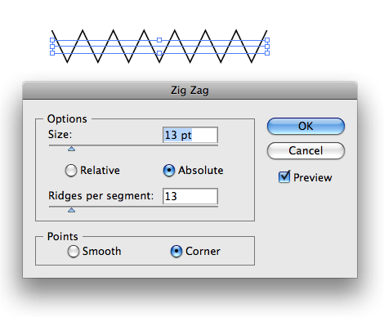
Zig Zag Effect
Effects > Distort & Transform > Zig Zag and enter a value for Size and Ridge Per Segment.

Slide 8
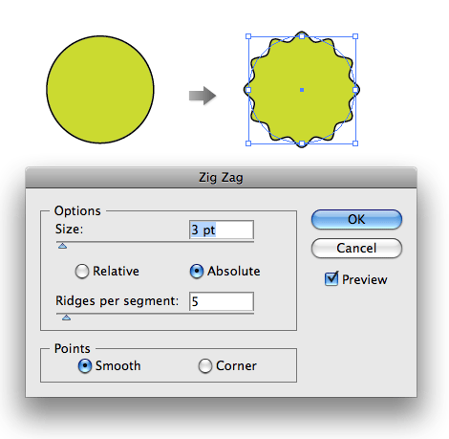
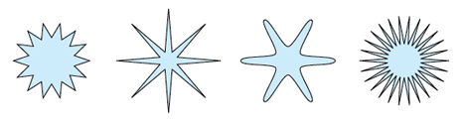
Badges
Draw a circle and apply the Zig Zag effect with the setting as shown and you will get a badge shape.

Slide 9
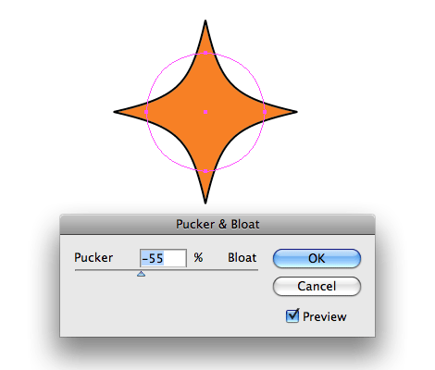
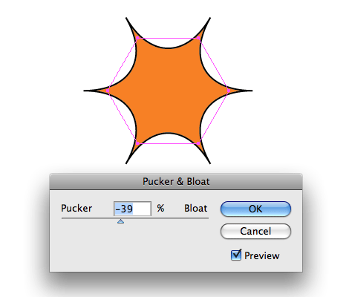
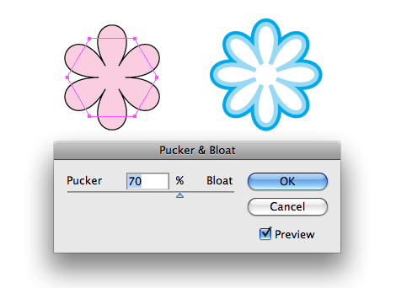
Pucker & Bloat Effect
Draw a circle, go to Effects > Distort & Transform > Pucker & Bloat, enter -55% (Pucker), and you will get a diamond shape.
With the same object, change the Pucker & Bloat option to 70%, and you will get a flower shape.

Slide 10
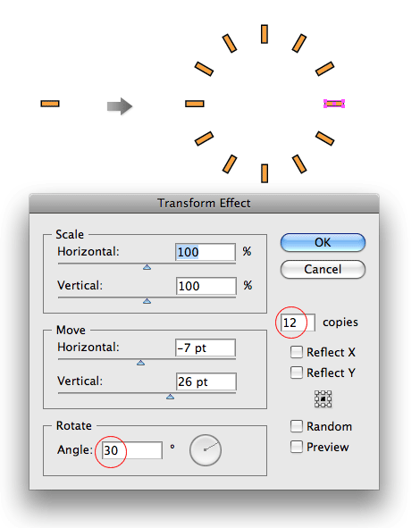

Transform Effect
The example below shows how I can duplicate 12 copies of the object (in increment of 30 degree angle) with the Transform effect.

Slide 11
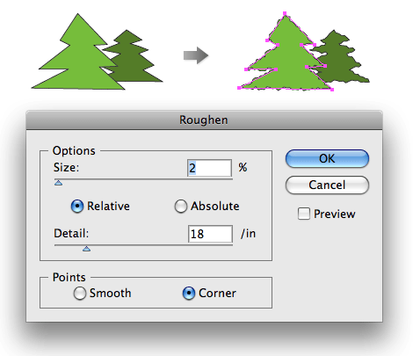
Roughen Effect
With the Roughen Effect, I can make the trees look more realistic.

Slide 12
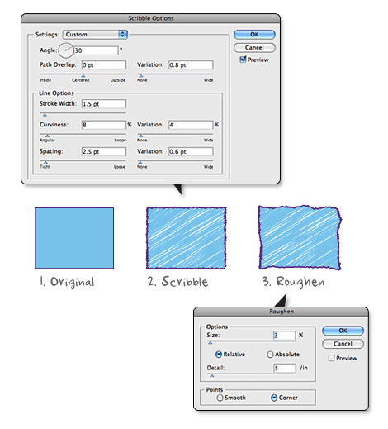
Scribble Effect
The example below shows how you can create a sketchy effect combining the Scribble and the Roughen effect. First apply the Scribble effect (Effects > Stylize > Scribble) and then apply the Roughen effect s shown.

Slide 13

Membuat RSS

Slide 14
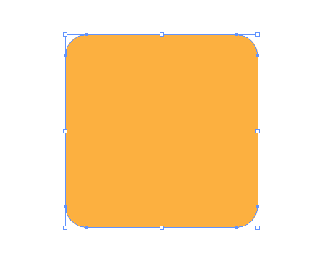
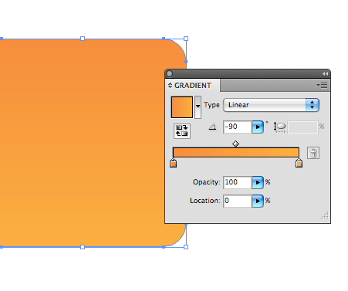
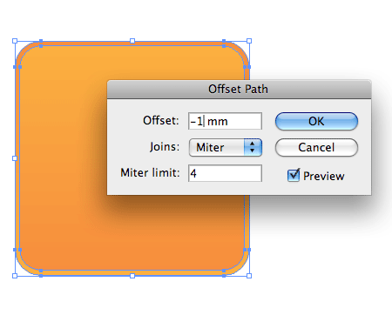
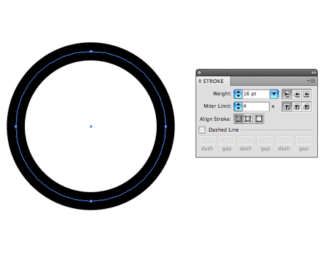
Object > Path > Offset Path.

Slide 15
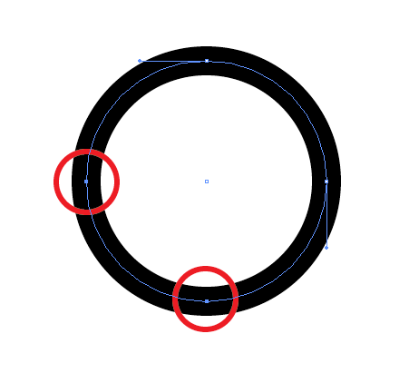
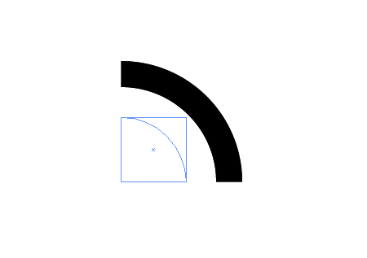
Klik dengan Direct Selection Tool dan tekan tombol Delete pada bagian yang di lingkari warna merah

Slide 16
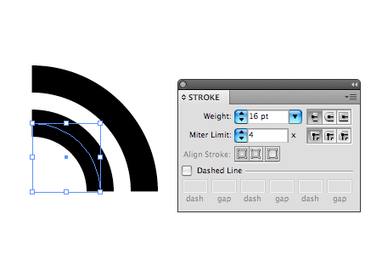
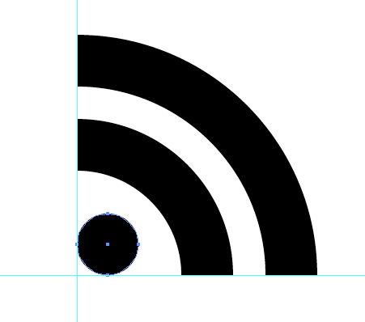
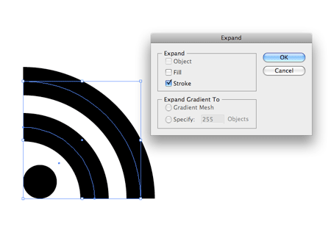
Menu Object → Expand

Slide 17
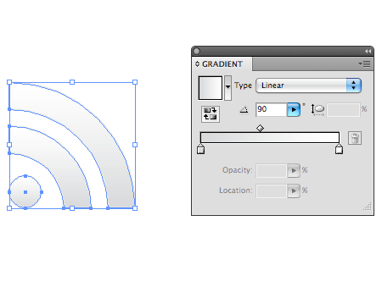


Slide 18
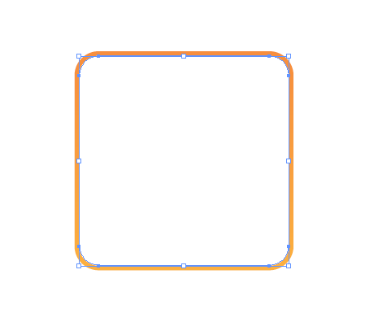
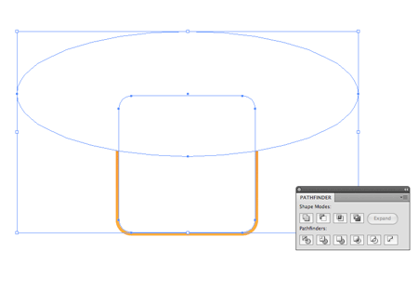
Copy kotak yg berada di luar dan beri warna putih
Gambar lingkaran ova di atas kotak putih tadi dan beri warna putih
Pilih kedua object tersebut, kemudian di intersect

Slide 19
