Slide 1


IGNITE
Pitch Deck
Milestone 3

Slide 2



Who we are
Name of your Venture:………………………..
Place your venture logo here
Why ?
Explain why do you want to pursue this Business Idea.
What ?
Your goal when answering this slide should be to create enough interest about your venture.
Provide a brief on what does your venture do.
How ?
Explain how your venture solves the problem and make its revenue.

Slide 3

Problem/Opportunity
Place your logo here
CONTEXT When does the problem occur? | PROBLEM What is the root cause of the problem? | ALTERNATIVES What do customers do now to ﬁx the problem?
CUSTOMERS Who has the problem most often? | EMOTIONAL IMPACT How does the customer feel? | ALTERNATIVE SHORTCOMINGS What are the disadvantages of the alternatives?
 | QUANTIFIABLE IMPACT What is the measurable impact (include units)?
This table helps you define the problem and existing market gaps.

Slide 4
Problem Interviews And Surveys Results
Place your logo here
How many customers did you interview?
What was the interview mode?
How many of them agree this is a problem and wants a solution?
How many of them said they don't need a new solution?
The aim of this slide is to capture the customer responses to substantiate and validate the problem your venture is solving. Present result analysis of the problem interviews conducted with your potential customers in graphical representation.

Slide 5
Market Size Estimation
Place your logo here
TAM
SAM
SOM
How to calculate market size?
1. Start with Total Addressable market- ………………………
TAM refers to the total market demand for a product or service.
If you’re entering a pre-existing space (like small business banking) you can research it and provide credible sources or reference points on how you arrived at the TAM. If you’re creating a new product or space (like Slack), you can estimate the number of customers that would want your product and approximate how much you could charge them.
2. Take your target market (SAM), within that TAM, which varies depending on geography and other logistical factors. Determine the penetration potential of your target market. This is the portion of the market you can reasonably compete with……………………………..
3.By conducting research with existing competitors, distributors etc., understand the likely penetration rate………………….
4. Multiply target market by penetration rate to find your market size…………………….
.
This slide is to provide details on Market Size and demonstrate How big is the market opportunity your venture is pursuing. Add source/reference to the data presented.
Sources: ……

Slide 6
Customer Persona
Personality trait
Personality trait
Personality trait
Motivations
Photo
Goals
Frustrations
Ethos
Age:
Occupation:
Location:
Bio
The aim is to collect the information about your ideal customer persona who are likely to buy your product or service . It will help you tailor the user experience through targeted design.
Personality
Notes:
Time: 7 mins
Get students to brainstorm on the customer persona and VPC

Slide 7
Value Proposition Canvas
Place your logo here
.
What do you offer that makes the customers happy?
I would LOVE it if:
? What would make the customer happy?
? What do the clients want when facing the problem?
This refers to the feeling/action of customers before he gets in contact with your solution.
What is the product or service that you are offering?
I would WANT:
What do the clients do (actions) when facing the problem?
This refers to the feeling/action of customers before he gets in contact with your solution.
GAIN CREATORS
FIT
GAINS
PRODUCT/
SERVICE
JOBS
PAIN KILLERS
PAINS
Which features of your offering relieve the customer's pains?
I would HATE it if:
What are the pains of the clients when facing the problem?
This refers to the feeling/action of customers before he gets in contact with your solution.
Demonstrate the fit between what you are offering and why people buy it. You must build on solution (products & service) that match their needs ( pains & gains).

Slide 8
Solution
Place your logo here
Describe your Solution:
We offer …………………………………………
The details of our offering consist of:
……………………………….
………………………………..
………………………………..
List the Benefits of Your solutions
1.
2.
3.
Notes:
Evaluation Criteria for slides 8 and 9
Check the following on the correctness of VPC:
a. Have you identified the correct pains & gains; pain relievers & gain creators (2 marks)
b. Have you identified the correct Jobs-to-be-done? (1 mark)
c. Are the pain relievers addressing the customer pains? (1 mark)
d. Have you identified the right value proposition so that the solution makes the customer's life better? (1 mark)

Slide 9
Competition Analysis
Place your logo here
Benefits | Competitor 1 | Competitor 2 | Competitor 3 | Competitor 4 | Your Venture
Product
Price
Branding channels
Packaging
Market reviews
UVP
Add more as required
Identify your competitors and examine the list of their offerings/benefits vs your product & service. Based on what the customers say as well as your research, you need to tabulate your findings. Mention your ventures USP from the competition analysis

Slide 10

Lean Canvas
Place your logo here
PROBLEM
EXISTING ALTERNATIVES
……………………………………………………………………………………………………………………………………………………………………………………………………………………
SOLUTION
……………………………………………………………………………………………………………………………………………………………………………
UNIQUE VALUE PROPOSITION
………………………………………………………………………………………………………………………………………………………………………………………………………
HIGH-LEVEL CONCEPT
………………………………………………………………………………………………………………………………………………………………………………………………………………………………………………………………………………………………………………………………………………………………………………………………………………
UNFAIR ADVANTAGE
?
?
?
?
?
CUSTOMER SEGMENTS
…………………………………………………………………………………………………………………………………………………………………………………………………………………………………………………………………………………………………………
EARLY ADOPTERS
………………………………………………………………………………………………………………………………………………………………………………………………………………………………………………………………………………………
Business Model (Explain with a process diagram)
KEY METRICS
?
?
?
?
CHANNELS
?
?
?
?
?
COST STRUCTURE
?
?
?
?
REVENUE STREAMS
?
?
?
?
This canvas explains how the venture makes money (attracts, serves and keeps customers)

Slide 11
MVP
Place your logo here
Provide Full product/service description
Insert a picture of the prototype
Provide video link of the working prototype, if any
Share screenshots of website ( Landing page, testimony etc.,). If the venture is in any online business, it must definitely showcase a functional website.
Share website link (If the venture is in any online business, it must definitely showcase a functional website.)
Share App link
Description of how the product will work and steps the customer will follow
Any other information
The slide helps to see your vision in action with a clear demonstration

Slide 12
MVP Validation
What is your MVP
Conclusion:
Test Details:
Persevere
Pivot
How long will we test this MVP?
Not conclusive
Who is our target audience for the test? How many of them?
How will we get to that audience?
Results of Test:
Realizations / Insights:
Did enough customers buy? Why or why not?
Did customers pay the price we expected? Why or why not?
Did customers come back to our product or show interest in doing so? Why or why not?
Next Steps:
Did customers recommend our product to others or evangelize about it? Why or why not?
Notes:
Evaluation Criteria for slides 12 to 14
Check the following on MVP?
1. Does it look credible and showcasable? Add a picture/video of the MVP? (3 marks)
2. Have you validated the product benefits and the price with real customers? Add the MVP interview records in a Google drive and add to the PPT. (1 + 1 marks)

Slide 13
Sales Plan
Place your logo here
Customer Sales Funnel
Customer Acquisition Plan
TARGET MARKET:
?.........................
OPPORTUNITIES/PROSPECTS:
?.........................
CUSTOMER:
?........................
LEADS:
?.........................
1 | 2 | 3 | 4 | 5
Target Customer Segment (Type) | Target Customer Segment (Number) | Channels to be used to attract the target customer segment | Estimated number of leads | Estimated cost to convert these leads to actual customers
Ensure that the target market numbers are aligned with market sizing . The sales funnel is for one year
Notes:
Evaluation Criteria for slide 20 to 22
1. Does the venture have a Sales projections sheet with monthly sales targets and customer funnel defined for the next one year? (2 marks)
2. Does the venture have an active social media presence, such as FB, Instagram, LinkedIn? (1 mark)
3. Do you have a well-thought out brand name, logo, and a Positioning statement? (1 mark)
4. Have you made an actual sale? (1 mark)

Slide 14
Go-to-Market Strategy
Place your logo here
Ensure that you have active social media presence on multiple platforms – Facebook, LinkedIn, Instagram, Twitter, and others.
Show your branding video. Ensure that it:
  Is crisp and engaging
  Clearly explains the brand, the venture, its target customers, and unique value proposition.
Show your Positioning Statement. Ensure that it clearly states what your product is and what value it brings to the customer
Action plan to reach your sales/customer target for the next one year.
Show your Sales & Distribution model, clearly listing down your channels for both sales and distribution.
Note: You may use any other template of your choice to pitch for your venture as long as you cover all information being sought here.

Slide 15
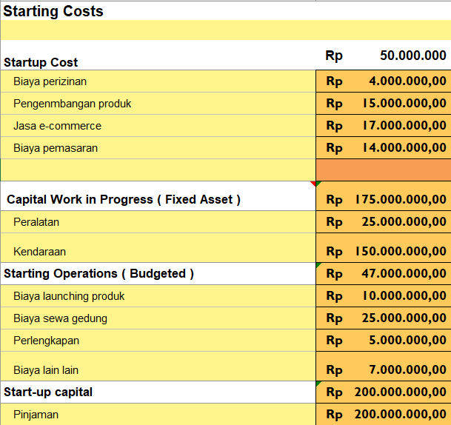
FINANCIAL PLAN
Start-up Costs
Place your logo here
Explanation:
Notes:
Evaluation Criteria for slide 24
1. Have you done their Unit Economics and come up with CAC, CLV, ARPU, Net and Gross Profit? (1 mark)
2. Do you have a plan on how to reduce their CAC and churn rate, and increase their CLV, ARPU, and Net Profit Margin? (2 marks)
3. Is the capital asked for as per the Funding plan in line with the business? (1 mark)
4. How long will it take you to return the investment? (1 mark)

Slide 16
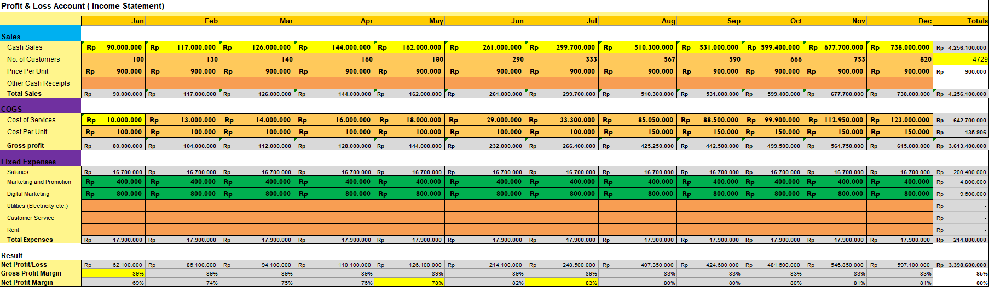
Forecast P&L
Place your logo here
Explanation:
Insert the link of your Financial template
Notes:
Evaluation Criteria for slide 24
1. Have you done their Unit Economics and come up with CAC, CLV, ARPU, Net and Gross Profit? (1 mark)
2. Do you have a plan on how to reduce their CAC and churn rate, and increase their CLV, ARPU, and Net Profit Margin? (2 marks)
3. Is the capital asked for as per the Funding plan in line with the business? (1 mark)
4. How long will it take you to return the investment? (1 mark)

Slide 17
Financial Projections
Place your logo here
Notes:
Evaluation Criteria for slide 24
1. Have you done their Unit Economics and come up with CAC, CLV, ARPU, Net and Gross Profit? (1 mark)
2. Do you have a plan on how to reduce their CAC and churn rate, and increase their CLV, ARPU, and Net Profit Margin? (2 marks)
3. Is the capital asked for as per the Funding plan in line with the business? (1 mark)
4. How long will it take you to return the investment? (1 mark)

Slide 18
Unit Economics
P & L/ unit | Year …..
Revenue
COGS
Gross Profit
Gross Profit Margin
Operating Costs
Operating Profit
Unit Economics | Year ……..
CAC
CLV
ARPU
The above is the Unit Economics for year 1 (year ……). Refer to P&L statement for year 1 in slide 16.
Assumptions (Year……..)
​Terms | Explanation (For the actual calculations, refer to the Financial Plan Excel sheet link)​
CAC​ | (Cost of Sales + Cost of Marketing ) / Number of new customers acquired (in currency terms)​
CLV | Average purchase value x Average purchase frequency x Average Customer Lifespan x Gross Margin
ARPU​ | Total revenue in specific period/Total number of customers during the same period (in currency terms)​
GROSS PROFIT​ | Total revenue – Total COGS (In currency terms)​
OPERATING COSTS | Cost of goods sold (COGS) + operating expenses (OPEX)
OPERATING PROFIT | Revenue from Core Operations – Cost of Goods Sold – Operating Expenses – Depreciation – Amortization Expenses
CHURN RATE | (Customers at the beginning of the period – customers at the end of the period) / customers at the beginning of the period

Slide 19
Team Composition
Place your logo here
Team member 1
Team member 2
Team member 3
Picture
Picture
Picture
What makes us a good team to solve the problem we chose?
Role/Position:
CEO
Role/Position:
COO/CTO
Role/Position:
CFO/CMO
Key Strengths and abilities
Key Strengths and abilities
Key Strengths and abilities :
The goal is to demonstrate teams commitment. Mention who’s on your team, why them and their extremely relevant credentials

Slide 20
Thank You!

