Slide 1
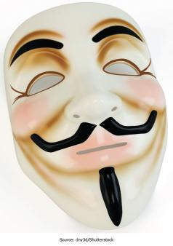
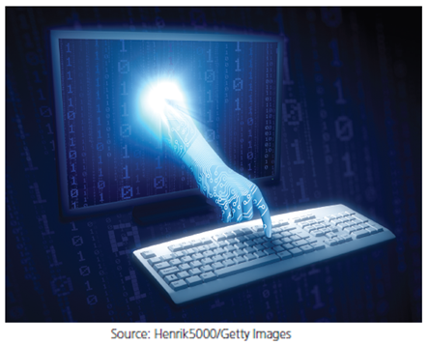
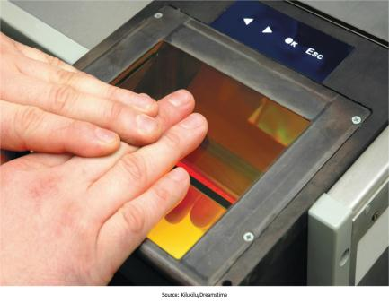
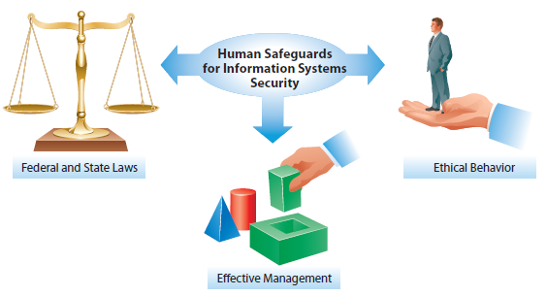
Chapter 10: Securing Information Systems
Having thorough plans and approaches for dealing with IS security attacks and natural disasters is critical for effectively managing IS resources within organizations and your personal life

Slide 2
Chapter 10 Learning Objectives
Computer Crime
Define computer crime and describe several types of computer crime.
Cyberwar and Cyberterrorism
Describe and explain the differences between cyberwar and cyberterrorism.
Managing Information Systems Security
Discuss the process of managing IS security and describe various IS controls that can help in ensuring IS security.

Slide 3
Computer Crime
Computer Crime
Cyberwar and Cyberterrorism
Describe and explain the differences between cyberwar and cyberterrorism.
Managing Information Systems Security
Discuss the process of managing IS security and describe various IS controls that can help in ensuring IS security.
Define computer crime and describe several types of computer crime.

Slide 4
What Is Computer Crime?
“Using a computer to commit an illegal act”
Targeting a computer while committing an offense
  Unauthorized access of a server to destroy data
Using a computer to commit an offense
  Using a computer to embezzle funds
Using computers to support criminal activity
  Maintaining books for illegal gambling on a computer
Notes:
Simply put, if you commit a crime against a computer, while using a computer, or even simply use a computer to support other criminal activities, it is considered computer crime.

Slide 5

Hacking and Cracking
Hackers
  Anyone who can gain unauthorized access to computers
  White hat hackers don’t intend to do harm
Crackers
  Individuals who break into computer systems with the intent to commit crime or do damage
  Also called black hat hackers
  Hacktivists: Crackers who are motivated by political or ideological goals and who use cracking to promote their interests
Malicious hackers are referred to as black hats and those not motivated to do harm are referred to as white hats
Notes:
There is a fine line between hacking and cracking, and sometimes the only difference is intent. However, hackers do not damage, deface, or steal data, whereas crackers do. Hacking originated at MIT when expert computer users would write programs, or “hacks,” that allowed them to roam through the mainframe computers and see what was there.

Slide 6
Who Commits Computer Crimes?
Computer criminals come in all shapes and sizes, in order of infractions they are:
  Current or former employees; most organizations report insider abuses as their most common crime (CSI, 2011)
  People with technical knowledge who commit business or information sabotage for personal gain
  Career criminals who use computers to assist in crimes
  Outside crackers—commit millions of intrusions per year
Studies show that only 10% of cracker attacks cause damage
Notes:
Computer criminals can no longer be stereotyped. There are many different criminals performing many different criminal acts. However, by order of infractions, the number one computer criminal is a current or former employee. The next three in descending order are people with technical knowledge who commit sabotage for personal gain, career criminals, and finally outside crackers.

Slide 7
How Do They Do It?
Technology
  Vulnerability scanners
  Packet sniffers
  Keyloggers
  Brute force
Exploiting human weaknesses
  Phishing
  Social engineering
  Shoulder surfing
  Dumpster diving
Notes:
Vulnerability scanners automatically test targeted systems for weaknesses.
Packet sniffers analyze network traffic and capture unencrypted passwords.
Social engineering involves misrepresenting oneself to trick others into revealing information.
Shoulder surfing means looking over one’s shoulder while the person is keying in access information.
Dumpster diving involves scouring wastebaskets for potentially useful information.

Slide 8
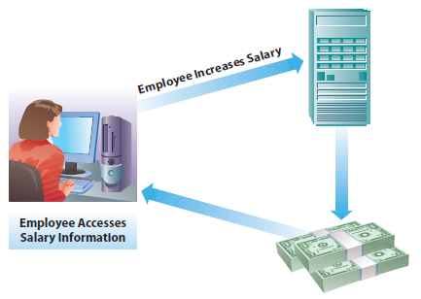
Types of Computer Crimes
Unauthorized Access
  Stealing information
  Stealing use of computer resources
  Accessing systems with the intent to commit information modification
Information Modification
  Changing data for financial gain (e.g., embezzlement)
  Defacing a Web site (e.g., hacktivists making a statement)
An information modification attack.
Notes:
Two of the most common computer crimes are unauthorized access and information modification. Unauthorized access may be a precursor to other activities such as data theft, using corporate resources for personal gain, and information modification. Information modification can involve changing data for financial benefit or other purposes, such as a hacktivist who defaces a Web site to make a political statement.

Slide 9
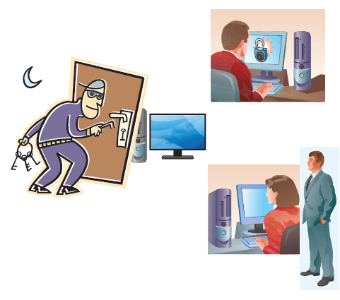
Insider Threats
Unauthorized access can occur in many ways
Some are based on insider threats
  Disgruntled employees, former employees, contractors
Edward Snowden is a recent example
Notes:
The term insider threats refers to “trusted adversaries” who operate within an organization’s boundaries and are a significant danger to both private and public sectors.
In January 2014, James R. Clapper, director of National Intelligence, cited the malicious insider as the greatest threat to the United States, exceeding terrorism.
Edward Snowden was an American computer professional who once worked for the CIA and was a contract worker for the National Security Agency (NSA). He came to international attention when he disclosed thousands of classified documents to several media outlets, which he had acquired while working for the American consulting firm Booz Allen Hamilton.

Slide 10
Other Threats
Often institutions and individuals fail to exercise proper care and implement effective controls
Passwords and access codes written down on paper, in plain sight or unsecured
Antivirus software isn’t installed or isn’t maintained
Systems left with default manufacturer passwords in place after being deployed
Information carelessly shared over the phone, or by letting unauthorized individuals see monitor screens
Company files and resources without proper access controls
Failure to install and maintain firewalls and intrusion prevention/detection systems
Poor background checks on new hires
Employees with unmonitored access to data and resources
Fired employees left unmonitored and have access to damage the system before they leave the company
Notes:
Many threats seem like common sense, but it requires constant diligence to ensure secure practices are consistently followed. Security systems and antivirus software have to be deployed and maintained on an ongoing basis. Effective security controls need to be in place ensuring people don’t have access to systems they don’t need access to, and access to critical systems is logged and monitored. Terminated employees who have access to critical resources need to be monitored or removed from a position where they could do harm if so motivated.

Slide 11
Mobile Threats
With the popularity of mobile devices like smartphones and tablets, many additional security threats have emerged
Individuals lose their mobile devices and don’t have capabilities to remotely wipe data from the device
Individuals keep sensitive data on mobile devices and do not use passcodes
Individuals “jailbreaking” their mobile phones
Individuals use poorly designed mobile applications that can have security vulnerabilities
Individuals use unsecure wireless networks, leaving their devices vulnerable to different types of attacks
Notes:
Jailbreaking involves modifying the phone’s operating system to remove manufacturer or carrier restrictions. This enables users to run applications other than those from the official app store. But jailbreaking can also allow unsecure applications to run on devices or make it difficult to upgrade devices that have been modified.

Slide 12
Computer Viruses and Other Destructive Code
Computer viruses
Worms, Trojan horses, and other sinister programs
Denial of service
Spyware, spam, and cookies
  Spyware
  Spam
  Cookies
The rise of botnets and the cyberattack supply chain
Identity theft
Notes:
Destructive code is called malware, and includes computer viruses and other types of code designed to infect computers or perform other malicious or criminal activities. Viruses, worms, and Trojan horses all fall into this category.

Slide 13
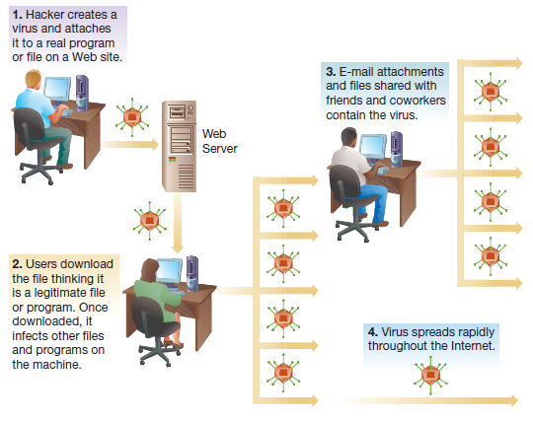
Computer Viruses and Other Destructive Code: Viruses
Notes:
Viruses infect a computer, and then spread to other computers through mechanisms such as e-mail attachments and the sharing of infected files. A virus can spread very rapidly through and across organizations.

Slide 14
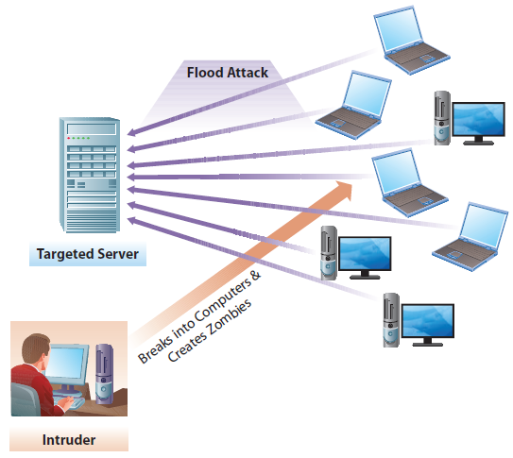
Computer Viruses and Other Destructive Code: Denial-of-Service
Notes:
When a server has too many requests to handle, it becomes overloaded and unable to serve the requests of legitimate users. A denial-of-service attack seeks to overload servers, typically using a network of hacked computers that are controlled remotely, by sending too many requests or messages to the server for it to handle.

Slide 15
Computer Viruses and Other Destructive Code: Spyware, Spam, and Cookies
Spyware, Spam, and Cookies
  Spyware: software that monitors the activity on a computer, such as the Web sites visible or even the keystrokes of the user
  Spam: Bulk unsolicited e-mail sent to millions of users at extremely low cost, typically seeking to sell a product, distribute malware, or conduct a phishing attack
  Cookies: A small file Web sites place on a user’s computer; can be legitimate (to capture items in a shopping cart) but can be abused (to track individuals’ browsing habits) and can contain sensitive information (like credit card numbers) and pose a security risk
Notes:
Spyware monitors computer use, and can have legitimate uses such as monitoring a child or employee’s activity, as well as illegitimate ones such as capturing credit card numbers.
Spam is bulk e-mail sent to large numbers of people, few of which would have interest in it, often attempting to sell products or distribute malware.
Cookies are a Web technology designed to allow Web sites to work with individual browsers by tracking such information as shopping cart contents, but they can also be used for other purposes, such as tracking a person’s browsing behaviors across multiple Web sites. If the Web site stores sensitive information in a cookie it can pose a security threat.

Slide 16
Computer Viruses and Other Destructive Code: The Rise of Botnets and the Cyberattack Supply Chain
Botnets are software robots working together with zombie computers
85% of all e-mail spam is sent by only six botnets
Example phishing attack:
  A programmer writes a phishing attack template and sells it
  A phisher purchases the template and designs the attack
  The phisher contracts with a cracker to host the phishing Web site
  The phisher contacts a bot herder to sent the botnets
  The phisher sends the information attained to a collector
  The collector works with a mule herder to withdraw funds from banks
Notes:
Each member of the supply chain has very specialized skills and can be located anywhere in the world. In fact, one of the difficulties in stopping this global crime syndicate is the difficulty of not only tracking the locations of these villains but also prosecuting criminals across international borders.

Slide 17
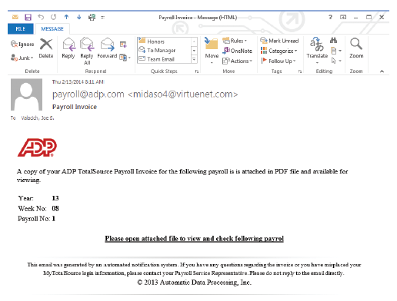
A Typical Phishing E-mail
Notes:
Phishing is the “casting” of email messages typically hoping to trick users into sending in usernames and passwords. It is a common form of spam, and some phishing attacks can be very realistic. A variation of phishing is “spear phishing,” where a single targeted e-mail message might be sent to an individual in a company seeking specific information, such as an e-mail to the COO asking about product development that is shown as coming from the office of the CEO and that references the people the COO works with by name, making it seem very plausible.

Slide 18
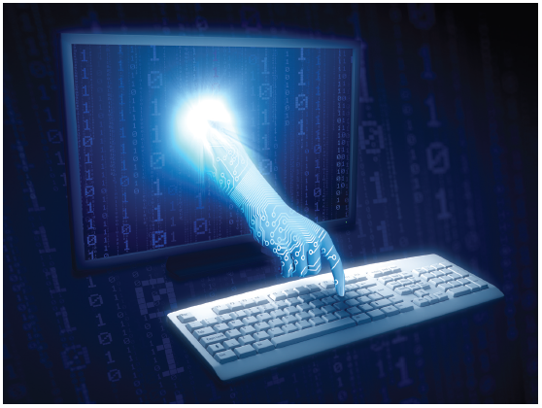
Identity Theft
Identity theft is one of the fastest growing information crimes
Stealing Social Security, credit card, bank account numbers and information
Possible solutions
  Government and private sector working together to change practices
  Use of biometrics and encryption
Notes:
In some cases, thieves even withdraw money directly from victims’ bank accounts using their stolen identities. Because many government and private organizations keep information about individuals in accessible databases, opportunities abound for thieves to retrieve it. Reclaiming one’s identity and restoring a good credit rating can be frustrating and time consuming for victims.

Slide 19
Cyberharassment, Cyberstalking, and Cyberbullying
Cyberharassment
  Use of a computer to communicate obscene, vulgar, or threatening content that causes a reasonable person to endure distress
Cyberstalking
  Tracking an individual, performing harassing acts not otherwise covered by cyberharassment, or inciting others to perform harassing acts
Cyberbullying
  Deliberately causing emotional distress
All three are closely related, a cyberstalker may be committing cyberharassment and cyberbullying
Notes:
These three concepts tend to overlap. For example, cyberbullying could be considered cyberharassment with the specific intent to bully and cause emotional distress, whereas cyberharassment may include other types of distress. Cyberstalking may be necessary to have enough information to perform cyberharassment, or it might not be. Cyberstalking isn’t always detected by the target of the stalking, and can include a wide range of acts from tracking what an individual is doing to committing acts to damage the reputation of the individual. Many states and countries have laws against one or more of these activities, although enforcement can be difficult.

Slide 20
Software Piracy
Region | Piracy Level | Dollar Loss (in US$ millions)
North America Western | 19% | 10,958
Europe | 32% | 13,749
Asia/Pacific | 60% | 20,998
Latin America | 61% | 7,459
Middle East/Africa | 58% | 4,159
Eastern Europe | 62% | 6,133
Worldwide | 42% | 63,456
Source: Based on Business Software Alliance. (2012). Extracted from unnumbered tables on pages 8–9 from http://portal.bsa.org/globalpiracy2011/downloads/study_pdf/2011_BSA_Piracy_Study-Standard.pdf.
Notes:
Software piracy is the practice of using software that isn’t properly licensed and paid for, such as by purchasing one copy of a product and then using it on multiple computers. Piracy is illegal, violating copyright and sometimes patent laws. Copyrights include creations of the mind, which typically applies to software, whereas patents refer to specific processes for doing something, which may be imbedded into a software application.
Copyright violations are a felony, and are illegal even when no profit is being made from the violation.
In some countries, such as Georgia and Zimbabwe, the percentage of software that is illegal can exceed 90%.

Slide 21
Internet Hoaxes and Cybersquatting
Internet Hoaxes
  False messages circulated about topics of interest
  Users should verify the content of e-mails before forwarding
  May be used to harvest e-mails for spam mailings
Cybersquatting
  Buying and holding a domain name with the intent to sell
  The 1999 Anti-Cybersquatting Consumer Protection Act makes it a crime if the intent is to profit from the goodwill of a trademark belonging to someone else
Notes:
Internet hoaxes often involve false messages that people are encouraged to forward to everyone they know. This wastes the time and resources of people and organizations. Some are used to gather e-mails for future spam mailings.
Cybersquatting is the practice of buying Internet domain names that might be of significant value to another company or person, then holding them for sale. However, if the individual doing so is profiting off a trademark, then it is a crime and the individual can be forced to release the domain name.

Slide 22
Federal Laws
Federal Laws
  The Computer Fraud and Abuse Act of 1986
    A crime to access government computers or communications
    A crime to extort money by damaging computer systems
    A crime to threaten the president, vice president, members of Congress, administration officials
  Electronic Communications Privacy Act of 1986
    A crime to break into any electronic communications service, including telephone services
    Prohibits the interception of any type of electronic communications
Notes:
Two critical federal laws both make it a crime to attack or threaten government agencies or officials. They also make it a crime to extort funds, break into telephone services, or even intercept electronic communications.

Slide 23
Cyberwar and Cyberterrorism
Computer Crime
Define computer crime and describe several types of computer crime.
Cyberwar and Cyberterrorism
Managing Information Systems Security
Discuss the process of managing IS security and describe various IS controls that can help in ensuring IS security.
Describe and explain the differences between cyberwar and cyberterrorism.

Slide 24
Cyberwar
Cyberwar Vulnerabilities
  Command-and-control systems
  Intelligence collection, processing, and distribution systems
  Tactical communication systems and methods
  Troop and weapon positioning systems
  Friend-or-foe identification systems
  Smart weapons systems
Notes:
Modern military systems rely on their own sophisticated networks to help the military execute its mission, and cyberwar involves protecting a military’s own infrastructure and/or disrupting an enemy’s infrastructure. As more and more governments work on developing the tools and techniques necessary to engage in cyberwarfare, a new cyber arms race has begun.

Slide 25
Cyberwar (continued)
Cyberwar strategy includes controlling Internet-based propaganda
  Web vandalism
“Patriot hackers”—governments sometimes blame independent citizens or groups for cyberwar attacks
Stuxnet—malware against an Iranian system
  Originally blamed on patriot hackers, then revealed to be developed by the U.S. and Israel
Notes:
Governments don’t want to admit that they engage in cyberwar. The Stuxnet attack was discovered by a Belarus-based computer security company in June 2010. This worm destroyed Iranian nuclear centrifuges. It wasn’t until June 2012 that it was revealed to originate from U.S. and Israeli scientists.

Slide 26
Cyberterrorism
What kinds of attacks are considered cyberterrorism?
  Attacks by individuals and organized groups
  Political, religious, or ideological goals
How the Internet is changing the business processes of terrorists
  Terrorists are leveraging the Internet to coordinate their activities, recruit, and perform fundraising
Notes:
Cyberterrorism involves cyberattacks not by government agencies, but by individuals and groups. At the same time, terrorists of all stripes are leveraging the Internet to support all their organizational needs.

Slide 27
Cyberterrorism (continued)
Assessing the cyberterrorism threat
  The Internet is generally open and accessible from anywhere in the world
  There have been many attacks, and although not significantly damaging, the will and potential exist
The globalization of terrorism
  Terrorism is now a global business
  Attacks can be launched from anywhere in the world
Notes:
Cyberterrorism is a unique problem due to the open nature of the Internet. Attacks can be launched from anywhere in the world, against any Internet-connected target in the world. Although attacks to date have had limited impact, there is the potential for significant attacks in the future.

Slide 28
Cyberterrorism (continued)
Types of Cyberterrorism
Terrorist Use of the Internet
Coordinated bomb attacks
Manipulation of financial and banking information
Manipulation of the pharmaceutical industry
Manipulation of transportation control systems
Manipulation of civilian infrastructures
Manipulation of nuclear power plants
Information dissemination
Data mining
Fundraising
Recruiting and mobilization
Networking
Information sharing
Training
Planning and coordinating
Information gathering
Location monitoring
Notes:
Although cyberterrorism obviously remains a threat to computer and network security, some experts point out that there are disadvantages to using acts of cyberterrorism as a weapon. Computer systems and networks are very complex, and security measures are always improving. Also, cyberattacks generally don’t kill people, so the “terrorism” element isn’t as strong as with bombs.

Slide 29
Managing Information Systems Security
Computer Crime
Define computer crime and describe several types of computer crime.
Cyberwar and Cyberterrorism
Describe and explain the differences between cyberwar and cyberterrorism.
Managing Information Systems Security
Discuss the process of managing IS security and describe various IS controls that can help in ensuring IS security.

Slide 30
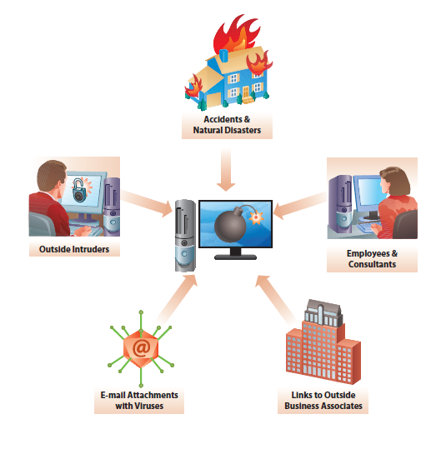
Threats to IS Security
Securing against these threats must consider these primary goals:
  Availability:
    Ensuring that legitimate users can access the system
  Integrity
    Preventing unauthorized manipulations of data and systems
  Confidentiality
    Protecting data from unauthorized access
  Accountability
    Ensuring that actions can be traced
Notes:
Threats to information security include any threat, not just intentional ones. Unintentional threats such as employee mistakes, accidents, and natural disasters can also have a huge impact on system availability and integrity.
Intentional threats, either from inside or outside the company, may come from employees, from hackers, or from malware such as viruses and Trojan horses. All of these threats need to be considered as part of a comprehensive information security plan.

Slide 31
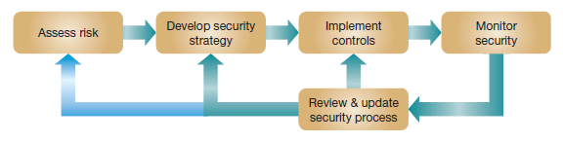
The Process of Information Security
Information systems security is an ongoing process.
Notes:
Information systems security involves four main tasks: assessing risks, developing a strategy, implementing controls, and monitoring the resulting security. This is an ongoing process that requires frequent review and update as threats evolve. Organizations should continuously watch for emerging threats, vulnerabilities, and attacks.

Slide 32
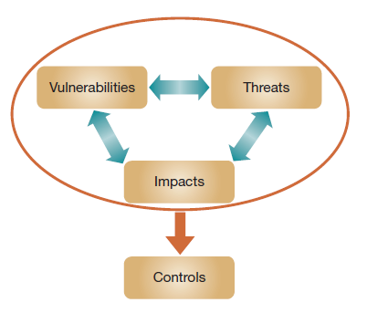
Assessing IS Risks
Options for addressing risk
  Risk Reduction
    Actively installing countermeasures
  Risk Acceptance
    Accepting any losses that occur
  Risk Transference
    Have someone else absorb the risk (insurance, outsourcing)
  Risk Avoidance
    Using alternative means, avoiding risky tasks
Interplay between threats, vulnerabilities, and impacts
Notes:
IS resources face risks, and these risks are handled by businesses using four strategies, either individually or together.
Risk reduction is when we take steps to reduce the likelihood of an event, or the consequences of it. For example, installing antivirus software reduces the chance of getting infected, whereas regular hard drive backups limit the financial loss should a hard drive fail.
Risk acceptance is understanding that some risks are better absorbed if and when they occur rather than by attempting to reduce them.
Risk transference is a good strategy when a different entity is better positioned to accept and/or reduce the risk, for example, an insurance company.
Risk avoidance may involve avoiding e-commerce, Web sites, or e-mail.

Slide 33
Developing a Security Strategy
After assessing risk, a strategy is developed detailing the information security controls
Types of controls:
  Preventive
  Detective
  Corrective
Use the principles of least permissions and least privileges
Notes:
Preventive controls involve preventing any potentially negative event from occurring, such as by preventing outside intruders from accessing a facility.
Detective controls involve recognizing when anything went wrong, such as unauthorized access attempts, and thereby limiting the resulting damage.
Corrective controls involve mitigating the impact of any problem after it has arisen, such as restoring compromised data.
Least permissions and least privileges mean that users should only be given access to the systems, data, or resources that are needed to perform their duties, and access to other resources should be restricted.

Slide 34
Developing a Security Strategy:
Policies and Procedures
Not all security measures are technical in nature. Managerial activities are important
Policies and procedures include:
  Information policy
  Security policy
  Use policy
  Backup policy
  Account management policy
  Incident handling procedures
  Disaster recovery plan
Notes:
An information policy outlines how sensitive information will be handled, stored, transmitted, and destroyed.
A security policy explains technical controls on all organizational computer systems, such as access limitations, audit-control software, firewalls, and so on.
A use policy outlines the organization’s policy regarding appropriate use of in-house computer systems; may mandate no Internet surfing, use of company computer systems only for employment-related purposes, restricted use of social networking and e-mail, and so on.
A backup policy explains requirements for backing up information, so that critical data can be restored in case of data loss.
An account management policy lists procedures for adding new users to systems and removing users who have left the organization.
Incident handling procedures list procedures to follow when handling a security breach.
A disaster recovery plan lists all the steps an organization will take to restore computer operations in case of a natural or deliberate disaster.

Slide 35
Developing a Security Strategy:
Disaster Planning
Business continuity plan—how a business continues operating after a disaster
Disaster recovery plan—detailed procedures for recovering from systems-related disasters
Questions for a disaster recovery plan:
  What events are considered a disaster?
  What should be done to prepare the backup site?
  What is the chain of command; who declares a disaster?
  What hardware and software are needed?
  Which personnel are needed?
  What is the sequence for moving back to the original location?
  Which providers can be drawn on to aid in disaster recovery?
Notes:
With a good business continuity and disaster recovery plan, even under the worst-case scenario, people will be able to replace or reconstruct critical files or data, or they will at least have a plan readily available to begin the recovery process.

Slide 36
Developing a Security Strategy:
Backups
Backup sites are critical for business continuity in the event a disaster strikes
Backup media include CD, external hard drives, and tapes
Cold backup site—an empty warehouse with all necessary connections for power and communication but nothing else
Hot backup site—fully equipped backup facility, all needed equipment and one-to-one replication of current data
Notes:
With a good business continuity and disaster recovery plan, even under the worst-case scenario, people will be able to replace or reconstruct critical files or data, or they will at least have a plan readily available to begin the recovery process.
Cold backup sites are cheap but take longer to get up and running in the case of disaster. Hot backup sites are much more expensive, but can give much faster recovery.

Slide 37
Developing a Security Strategy:
Designing the Recovery Plan
Recovery time objectives
  Specify the maximum time allowed to recover from a catastrophic event
  Minutes, hours, days?
Recovery point objectives
  Specify how current the backup data should be
  Mission-critical transaction data need to be very current
  Hot backup involves mirrored data
Notes:
Often, companies choose to replicate their data centers in multiple locations. Thinking about the location of redundant systems is an important aspect of disaster planning. Having mirrored data in a separate location reduces the likelihood that a disaster will affect the mirrored data.

Slide 38
Implementing Controls and Training
Commonly used controls:
  Physical access restrictions
  Firewalls
  Encryption
  Virus monitoring and prevention
  Secure data centers
  Systems development controls
  Human controls
Notes:
Once a comprehensive strategy has been formulated, organizations can decide which controls to implement and train personnel regarding security policies and measures. There are two broad categories of approaches for reducing risk—technological and human-based approaches—and any comprehensive security strategy will include both.

Slide 39
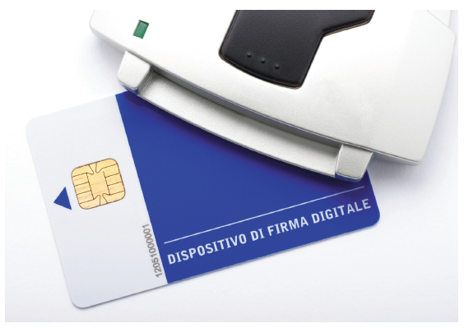
Implementing Controls and Training:
Physical Access Restrictions
Physical access controls typically focus on authentication
  Something you have
    Keys
    Smart cards
  Something you know
    Password
    PIN code
  Something you are
    Biometrics
A smart card
Source: al62/Fotolia
Notes:
Physical access restrictions typically focus on an individual identifying him- or herself, and then one or more forms of authentication being utilized to verify the stated identification. This two-step process greatly enhances security over a one-step process, such as using a fingerprint to both identify and authorize an individual.

Slide 40
Implementing Controls and Training:
Physical Access Restrictions (continued)
Methods for implementing physical access control
  Biometrics
    Identification via fingerprints, retinal patterns in the eye, facial features, or other bodily characteristics
  Access Control Software
    Allowing computer users access only to those files related to their work
    Restricting type of access (read, write, delete, etc.)
  Wireless LAN (WLAN) Controls
    Securing wireless networks prevents drive-by hacking
  Virtual Private Networks(VPN)
    Also called a secure tunnel
Notes:
Physical access restrictions typically focus on an individual identifying him- or herself, and then one or more forms of authentication being utilized to verify the stated identification. This two-step process greatly enhances security over a one-step process, such as using a fingerprint to both identify and authorize an individual.

Slide 41
Implementing Controls and Training:
Firewalls
Filter traffic
  Incoming and/or outgoing traffic
  Filter based on traffic type
  Filter based on traffic source
  Filter based on traffic destination
  Filter based on combinations of parameters
Notes:
Firewalls are a form of security based on filtering, where access is typically limited to those functions that actually need access. It is like the network equivalent of restricting people to parts of a building where they legitimately need to be.

Slide 42
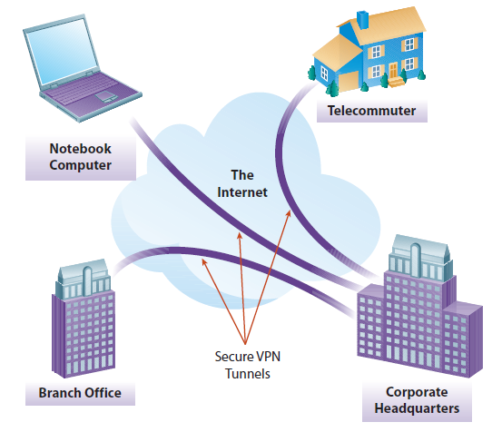
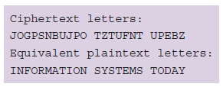
Implementing Controls and Training:
Encryption and VPN
Notes:
Encryption is the practice if safeguarding data by encrypting it so it can only be accessed by a decryption process that requires a cypher and a suitable password, key, or certificate.
Encryption can be applied to e-mail, data on hard drives, communication over the Internet, data being taken offsite for backup purposes, or other forms of communication or data storage.
This figure shows a virtual private network, which involves encrypting all traffic between two locations, where a location could be a notebook, a house, or another office of the organization.
Encryption is an effective tool for safeguarding information.

Slide 43
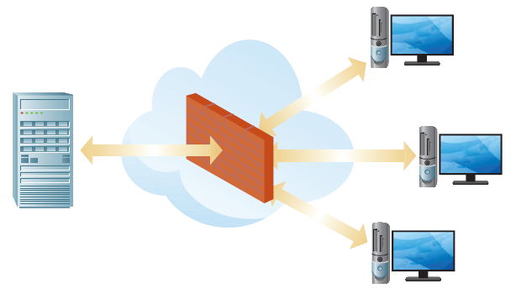
Implementing Controls and Training:
Firewalls
Firewall—part of a computer system designed to detect intrusion and prevent unauthorized access to or from a private network
A “security fence”
Notes:
Firewalls can be implemented in hardware, in software, or in a combination of both. All data packets entering or leaving the intranet pass through the firewall, which
examines each message and blocks those that do not meet the specified security criteria.

Slide 44
Implementing Controls and Training:
Virus Monitoring and Prevention
Standard precautions
  Purchase, install, and maintain antivirus software
  Do not use flash drives or shareware from unknown or suspect sources
  Use reputable sources when downloading material from the Internet
  Delete without opening any e-mail message received from an unknown source
  Do not blindly open e-mail attachments, even if they come from a known source
  If your computer system contracts a virus, report it
Notes:
Viruses and malware pose a constant threat to information systems.
A combination of antivirus software and secure practices cannot eliminate the threat, but can reduce the potential risk significantly.
Beyond antivirus software, the next most important step is to limit the potential for infection by avoiding unknown files and file sources.
If your computer is infected, prompt reporting will allow the infection to be contained and minimize the impact.

Slide 45
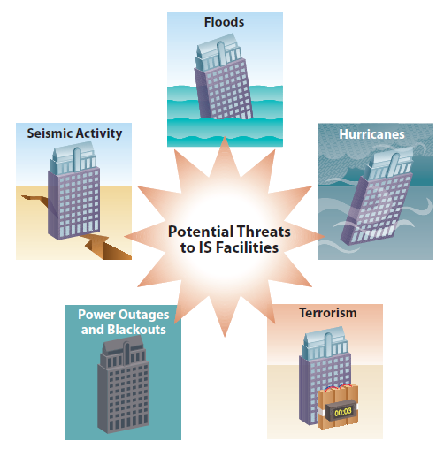
Implementing Controls and Training:
Secure Data Centers
Securing the facility’s infrastructure
  Site selection
  Physical access restrictions
  Intrusion detection
  Uninterruptible power supply
  Protection from environmental threats
Notes:
There are a surprising number of threats that can render a data center unavailable, or even destroy it and all the data it contains. Organizations should plan for the worst threats and implement appropriate risk management strategies to ensure the business isn’t threatened by the unexpected.

Slide 46
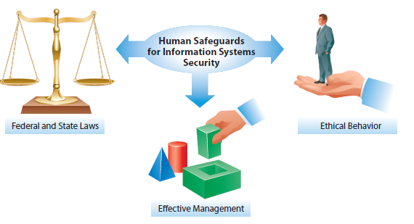
Implementing Controls and Training:
Other Controls
System development controls
Human controls
Deployment and training
Notes:
System development controls are technological controls related to ensuring that all systems (including hardware and software) are properly developed, acquired, and maintained. This is discussed in Chapter 9.
Various human safeguards can help to protect information systems, specifically ethics, laws, and effective management. Educating potential users and enacting federal laws help, but unethical users will undoubtedly always remain a problem for those wanting to maintain IS security.
Personnel throughout the organization should receive training about the security policies and plans for disaster recovery and be prepared to perform assigned tasks in that regard—both routinely on a daily basis and disaster related.

Slide 47
Monitoring Security
Monitoring external events
  Information Sharing and Analysis Centers, United States Computer Emergency Readiness Team
IS Auditing
  External entity reviews the controls to uncover any potential problems
Sarbanes-Oxley Act
  Best practices: Control Objectives for Information and related Technology (COBIT)
Responding to Security Incidents
Computer Forensics
  Examining the computers of crime victims for evidence
  Auditing computer activity logs
Notes:
To minimize risk, organizations should continuously monitor the effectiveness of the controls. The level of monitoring should be based on an assessment of the potential impact of a certain asset being compromised. The most intensive monitoring efforts should be focused on high-risk systems. Organizations should also monitor external events, in order to obtain a full view of threats and vulnerabilities

Slide 48
The Sarbanes-Oxley Act
The Sarbanes-Oxley (S-OX) Act addresses financial controls
  Companies must demonstrate that controls are in place
  Companies must preserve evidence documenting compliance
  Information systems typically used to meet compliance requirements
  Growing need for IS auditors
Notes:
Sarbanes-Oxley is an act that legally requires corporations to have suitable financial controls in place. It requires companies to meet control requirements, and document their compliance and preserve evidence. This typically means the appropriate use of information systems to ensure effective and efficient compliance. For example, capturing the evidence often means capturing all e-mails sent to or from the company in a centralized e-mail repository.

Slide 49
The State of IS Security Management
Information security is a huge management challenge
  In 2013, malware introduced into Target's point-of-sale system captured the credit card data of 40 million shoppers
2013 U.S. State of Cybercrime Security Survey
  38 percent of executives indicate lack of good security assessment methodology
  Greatest security threats from crackers, insiders, and foreign nation-states
  Insider attacks more costly than external threats
  Executives use free Internet sites for security information; not necessarily reliable
Notes:
Clearly, because malicious crackers won’t become complacent anytime soon, organizations need to guard against attacks. The lesson learned here is that we need to continue to implement vigilant approaches to better manage information systems security in the digital world.

Slide 50
End of Chapter Content

Slide 51
Managing in the Digital World: Not So “Anonymous”—Activists, Hacktivists, or Just Plain Criminals?
Anonymous
  A loose collection of hacktivists
  Practice civil disobedience by taking part in cyberattacks on Web sites (e.g., WikiLeaks)
  Politically active: launching attacks on Israeli government for Gaza Strip military actions
  Well known for Internet vigilantism
  Claiming to have good intentions, but activities are illegal
  Dilemma between pursuing ideological goals and crossing the bounds of legality

Slide 52
Ethical Dilemma:
Industrial Espionage
Industrial espionage is widespread, and critical information is always vulnerable to attacks
  Most commonly associated with industries where research and development (R&D) is a significant expense
  May be conducted by governments as well as competitors
  Employees who can be bribed, coerced, or blackmailed often targeted
  Ex-employees also an opportunistic target
  Mobile technology provides additional avenues for industrial espionage

Slide 53
When Things Go Wrong:
The Bug That Almost Killed the Internet
OpenSSL is a popular encryption framework used to secure many Internet-based transactions
Its heartbleed bug is a flaw that was created in 2011 and wasn’t fixed until 2014
Attackers can compromise encryption keys, user names and passwords, and sensitive data
The vulnerability potentially affects thousands of companies and millions of users

Slide 54
Who’s Going Mobile:
Mobile Security
With hundreds of thousands of apps in app stores, the potential for mobile malware is significant
Malware could:
  Steal user’s contacts and photos, turn on the device’s camera or send premium-rate text messages
In 2013, security firm Kaspersky reported that mobile malware poses significant security threats
  Mobile banking fraud, mobile botnets, and even access to connected PCs
Android is most vulnerable, because of open marketplace
Apple iOS is not immune

Slide 55
Brief Case:
3D Crime Scenes
3D technology is now widely used for re-creating crime scenes
  Crime scenes can be scanned and captured in minute detail
  They can then be viewed from any possible angle and vantage point
  3D maps of cities and buildings are also being stored to help foil future terrorist attacks
  CSI effect: jurors demand more forensic evidence because they see it on popular TV shows

Slide 56
Coming Attractions:
Speeding Security Screening
Airport and customs screening is time consuming and expensive
  University of Arizona researchers have constructed an embodied conversational agent called AVATAR that can interview travelers
  Multiple sensor technologies detect the traveler’s emotional state and likely deceptiveness
  As more tests are run, researchers learn more and enhance its capabilities
  One day it may take the lead in conducting travel interviews

Slide 57
Key Players:
White Knights of the Internet Age
Every computer is vulnerable to attack
Security software is big business with many players
  $19.9 billion in 2013
  Specialized security companies
    Symantec, McAfee, TrendMicro, IBM, AVG, etc.
  Offer full suites of security software, including virus and malware detection, e-mail protection, and other safeguards.
Yet, a Microsoft survey showed that in 2013, 24 percent of PCs were not protected by up-to-date antivirus software

Slide 58
Industry Analysis:
Cybercops Track Cybercriminals
Police departments have been playing catch-up with technology, but are now making great strides
  Computer Crime and Intellectual Property Section of DOD is dedicated to tackling cybercrime
  FBI has dedicated cybercrime resources in 56 field offices
  Every state has a computer crime investigation unit
  Lots of municipal computer crime investigation departments
  Software tools for law enforcement have improved significantly Examples:
    Software Forensic Tool Kit
    Statewide Network of Agency Photos (SNAP ) database
While criminals may now be using technology to commit crimes, law enforcement is using technology to catch them

