Slide 1
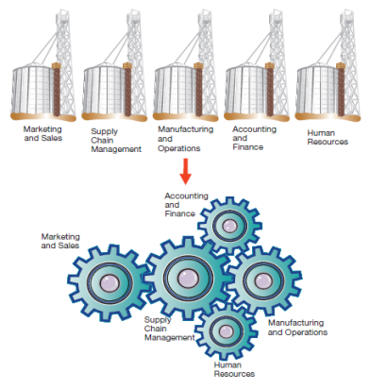
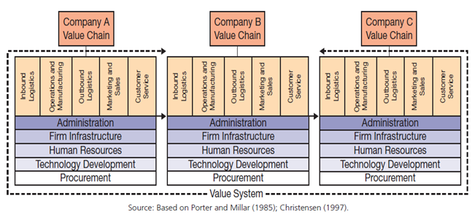
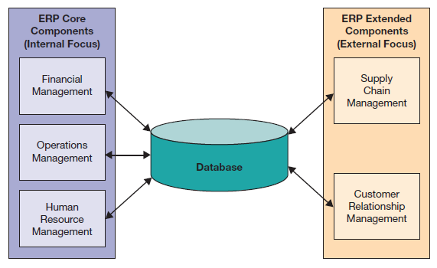
Chapter 7: Enhancing Business Processes Using Enterprise Information Systems
Enterprise systems integrate business activities across the organization and with business partners

Slide 2
Chapter 7 Learning Objectives
Core Business Processes and Organizational Value Chains
Explain core business processes that are common in organizations.
Enterprise Systems
Describe what enterprise systems are and how they have evolved.
Enterprise Resource Planning
Describe enterprise resource planning systems and how they help to improve internal business processes.
Achieving Enterprise System Success
Understand and utilize the keys to successfully implementing enterprise systems.

Slide 3
Core Business Processes and Organizational Value Chains
Core Business Processes and Organizational Value Chains
Explain core business processes that are common in organizations.
Enterprise Systems
Describe what enterprise systems are and how they have evolved.
Enterprise Resource Planning
Describe enterprise resource planning systems and how they help to improve internal business processes.
Achieving Enterprise System Success
Understand and utilize the keys to successfully implementing enterprise systems.

Slide 4

Organizations and Functions
Notes:
Corporations are made up of different functional areas.
These different functions need to work together to maximize the efficiency and effectiveness of the organization.

Slide 5
Core Business Processes
Order-to-Cash
  The process of selling goods or services and collecting revenue for them
Procure-to-Pay
  The process of ordering goods or services and paying for them
Make-to-Stock/Make-to-Order
  The process of manufacturing goods, either based on forecasts or based on orders
Notes:
There are several core business processes every company has and must execute.
These include order-to-cash and procure-to-pay.
Manufacturing companies also have the make-to-stock and make-to-order processes.

Slide 6
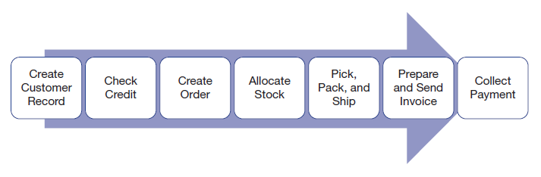
Core Business Processes:
Order-to-Cash
Functional Areas in Order-to-Cash
  Marketing and Sales
  Accounting and Finance
  Manufacturing and Operations
Notes:
The order-to-cash process includes every aspect of receiving an order, fulfilling it, and receiving payment for the same.
It involves multiple steps as well as multiple business functions to be completed successfully.

Slide 7
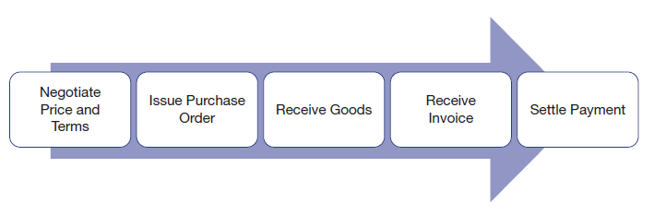
Core Business Processes:
Procure-to-Pay
Functional Areas in Procure-to-Pay
  Supply Chain Management
  Accounting and Finance
  Manufacturing and Operations
Notes:
The procure-to-pay process is the opposite of order-to-cash. It involves every step necessary to acquire the goods and materials necessary for the business to function.
It also involves multiple business functions with a need to communicate throughout the process.

Slide 8
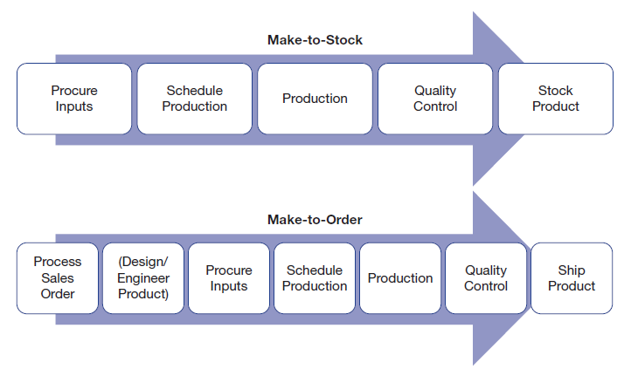
Core Business Processes:
Make-to-Stock and Make-to-Order
Notes:
The make-to-stock and make-to-order processes both involve the production of goods, but the make-to-order process is more complex, as it includes additional steps involving taking the order and then doing any design and engineering work required.
The make-to-stock process is based on forecast or budgeted sales figures.

Slide 9
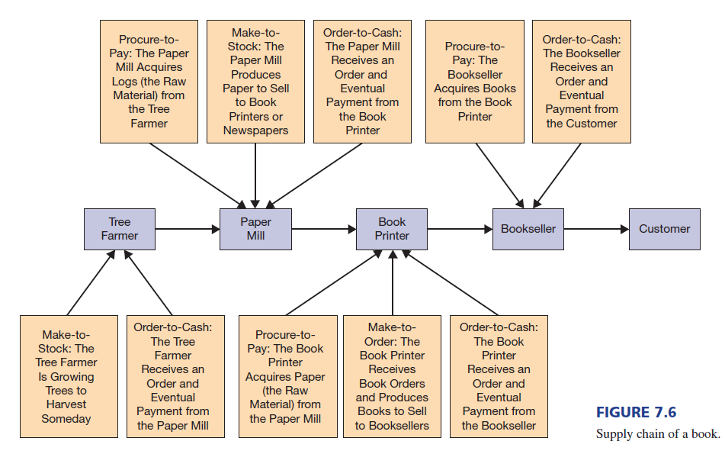

An Example Supply Chain
Notes:
This diagram shows the supply chain of a book, which is comprised of several organizational value chains feeding into each other with business processes until the book reaches the final end customer.

Slide 10
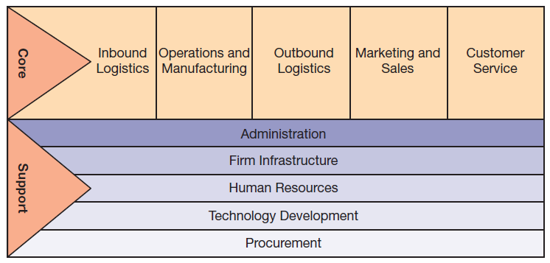
Organizational Activities Along the Value Chain
Notes:
A corporation is comprised of both core and support activities.
Core activities are focused on the actual value-creation processes within the organization, including inbound logistics, operations and manufacturing, outbound logistics, marketing and sales, and customer service.
These core activities form the organization’s “value chain.”
Different industries can have significant variance in their core activities.
Support activities are those activities that enable the core activities (and the other support activities) to function efficiently and effectively, but don’t directly create value for the customer.

Slide 11
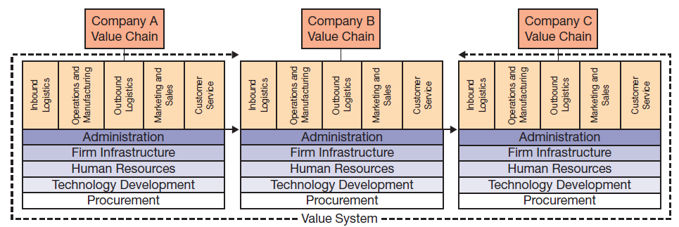
Value Systems: Connecting Multiple Organizational Value Chains
Notes:
Companies purchase goods and services from other companies, and often sell to other companies as well.
Multiple organizations working together form a value system.
It is necessary for information to flow between companies for the smooth and efficient operation of the value system.
When companies tie their information systems together, they can send and receive information with other companies up and down the value system.

Slide 12
Enterprise Systems
Core Business Processes and Organizational Value Chains
Explain core business processes that are common in organizations.
Enterprise Systems
Describe what enterprise systems are and how they have evolved.
Enterprise Resource Planning
Describe enterprise resource planning systems and how they help to improve internal business processes.
Achieving Enterprise System Success
Understand and utilize the keys to successfully implementing enterprise systems.

Slide 13
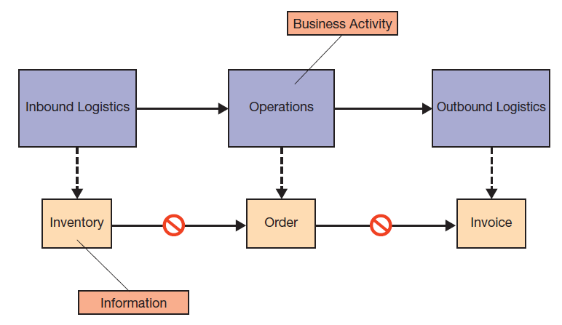
The Rise of Enterprise Systems:
Standalone Systems
Notes:
When organizations first started using information systems, they typically implemented proprietary systems from multiple vendors on a department-by-department or process-by-process basis.
This resulted in multiple information systems optimizing the practices of each department or process independent of the rest of the organization, with a marked lack of data flow between business departments or processes.
This lack of continuous data flow created large inefficiencies.
These older standalone systems are now typically referred to as legacy systems, reflecting their advancing age and lack of upgradability.

Slide 14
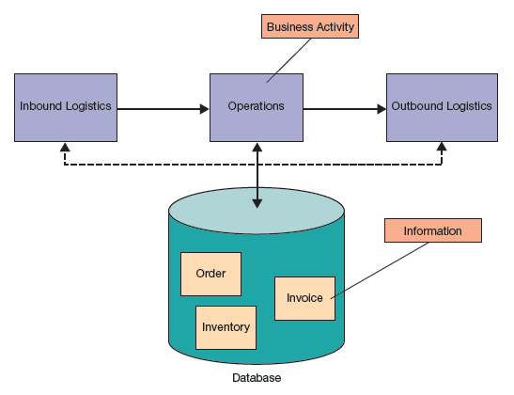
The Rise of Enterprise Systems:
Integrated Enterprise Systems
Notes:
Enterprise systems perform all the functions legacy systems used to perform, but with the added benefit of being integrated across the value chain with a consolidated database.
This ensures that all departments and processes have access to both their internal information and the information of upstream and downstream processes and functions.
This integrated approach streamlines operations across the entire value chain, eliminating road blocks and enhancing efficiency.

Slide 15
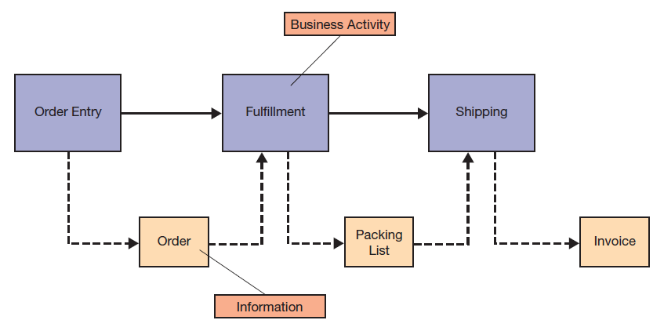
Supporting Business Processes:
Internally Focused Systems
Notes:
Internally focused systems integrate and automate information flows between departments and processes, streamlining operations and facilitating smooth business operations.

Slide 16
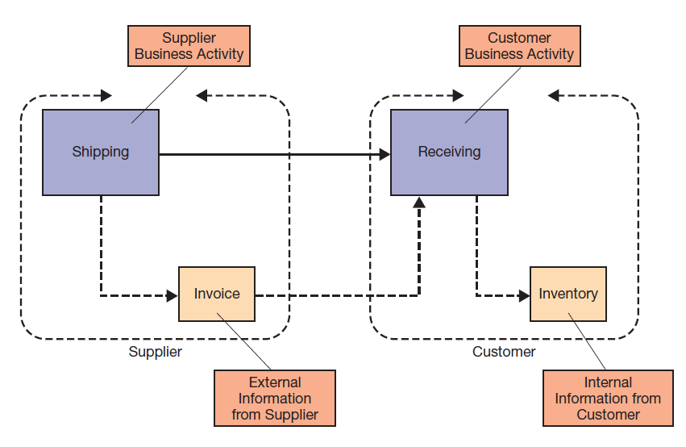
Supporting Business Processes:
Externally Focused Systems
Notes:
Externally focused systems focus on improving communication and coordination with other businesses in the overall value system.
These externally focused systems include supply chain management and customer relationship management systems, which are specifically addressed in Chapter 8.

Slide 17
Improving Business Processes Through Enterprise Systems: Software Types
Packaged Software
  Also called “off-the-shelf”
  May or may not require significant configuration
  Enterprise software often divided into modules
  Special functionality may require customizing the packaged (or vanilla) version
Custom Software
  Designed and developed exclusively for a specific organization (Chapter 9)
Notes:
Packaged software is preprogrammed software a business buys to meet business needs. It may range from simple word-processing software to very complex enterprise systems.
Simple software is typically used as-is, whereas complex or enterprise software requires configuring.
When configuring alone won’t meet a business’s unique needs, either custom software can be written from scratch or an existing module can be customized by the software vendor.
Customizing software typically entails significant cost, and often creates a version that cannot be upgraded without reprogramming the customizations.
Hence, a cost-benefit analysis needs to be performed before undertaking any customizations to ensure the value is really there.

Slide 18
Improving Business Processes Through Enterprise Systems: Best Practices
Packaged Enterprise Software
  Typically designed to operate with industry standard best practices
  May not accommodate unique organizational practices that provide a competitive advantage
  Modifying enterprise software can be a long and costly process, depending on the inherent flexibility of a given system
Notes:
Implementing enterprise software provides an opportunity for organizations to migrate under-performing processes to industry best practices, which are typically built into the software implementation.
However, if an organization has unique practices that are superior to industry standard best practices, the enterprise software may be unable to support them without significant customization.
An organization needs to understand how it is performing against industry benchmarks to know when it should adopt industry best practices and when it should keep unique business practices in place.

Slide 19
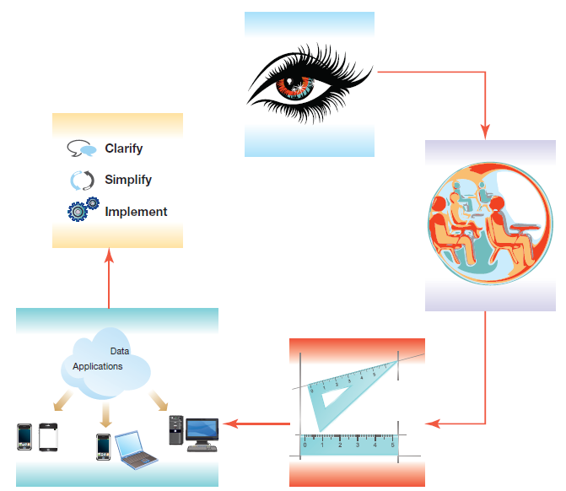
Improving Business Processes Through Enterprise Systems: BPM
Business Process Management
  Actively managing business processes
  Using a structured approach
  May be ongoing
  May include radical process reengineering
Notes:
Business process management involves actively managing a company’s business processes. This typically includes functions such as process modeling, redesign, and improvement.
BPM evolved from the concept of “business process reengineering.”
When properly supported by management with realistic expectations and clear goals, BPM can be very beneficial.
The basic steps of BPM include developing a vision, identifying the critical processes that are to be redesigned, understanding and measuring the existing processes, identifying ways that information systems can be used to improve processes, and designing and implementing the new processes.

Slide 20
Improving Business Processes Through Enterprise Systems: Benefits and Costs
Benefits
Costs
Improved availability of information
Increased organizational interaction
Reduced manufacturing lead times
Improved customer interaction
Reduced operating expenses
Reduced inventory
Reduced IS costs
Improved supplier integration
Improved compliance
Travel and training costs for personnel
Ongoing customization and integration costs
Business process studies
Project governance costs
56% of ERP implementation costs are over budget
Average over budget is by $USD 2 million
Notes:
Enterprise systems are, by their very nature, highly complex, with significant impacts throughout an organization.
This complexity and wide impact makes budgeting for their implementation and forecasting benefits both complex and difficult.
As a consequence, there are often unanticipated costs that can push an implementation over budget.

Slide 21
Enterprise Resource Planning
Core Business Processes and Organizational Value Chains
Explain core business processes that are common in organizations.
Enterprise Systems
Describe what enterprise systems are and how they have evolved.
Enterprise Resource Planning
Describe enterprise resource planning systems and how they help to improve internal business processes.
Achieving for Enterprise System Success
Understand and utilize the keys to successfully implementing enterprise systems.

Slide 22
ERP Core and Extended Components
Notes:
The ERP core components are internally focused, dealing with activities and processes within the organization.
Financial management components support accounting, financial reporting, performance management, and corporate governance.
Operations management components simplify, standardize, and automate business processes related to inbound and outbound logistics, product development, manufacturing,
and sales and service.
Human resource \management components support employee recruitment, assignment tracking, performance reviews, payroll, and regulatory requirements.
The extended components are externally focused, dealing with interactions with vendors (supply chain) and customers (sales and customer relationships). This is discussed in Chapter 8.

Slide 23
Responding to Compliance and Regulatory Demands
ERP systems have built-in control systems
  Mirror organizational processes
  Support segregation of duties
  Monitor business activities
ERP systems don’t solve all compliance problems, but help a lot
Notes:
ERP systems were designed for organizations needing to meet modern regulatory requirements; they have the functionality necessary to support the implementation and documentation of internal controls, procedures, and policies.

Slide 24
Choosing an ERP System
ERP Control
  Centralized or decentralized across business units
  Policies and procedures
    Do they need to be flexible?
    Do they need to be standardized?
ERP Business Requirements
  What modules are available?
  How well do they meet specific business needs?
Notes:
Choosing an ERP system is a difficult task that needs to take into account both business needs and system functionality.
The system selected must support the business management practices of centralized or decentralized control, which often hinges on how much flexibility and independence individual business units have.
In addition, each ERP system has different built-in functionality that will meet business needs to varying extents.
The ERP system selected should met all the business needs, and should be particularly good at meeting the most critical business functions.

Slide 25
Enabling Business Processes Using ERP Core Components
ERP systems support core business processes
Assist with:
  Order-to-cash
  Procure-to-pay
  Make-to-stock/make-to-order
  Other business processes
Often packaged industry-specific ERP versions
  Support industry-specific core processes
    Health care
    Automotive
    Construction
    Retail
    Specialized manufacturing industries
Notes:
ERP systems often have versions tailored to individual industries, with customizations already integrated to support the core business processes as practiced in that specific industry.
Implementing an industry-specific ERP package, which includes all the core components that industry needs, can simplify and streamline ERP selection and implementation.

Slide 26
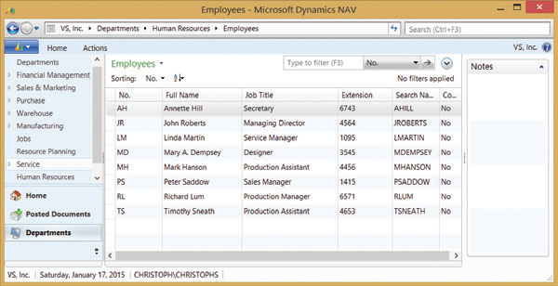
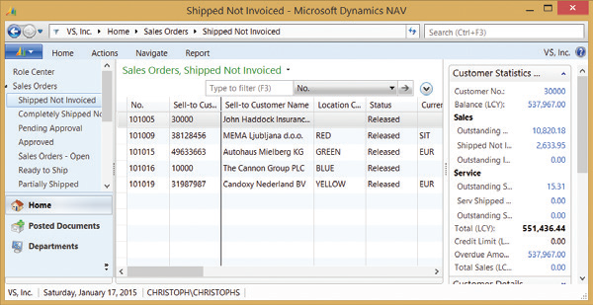
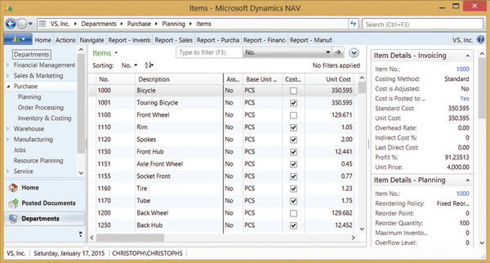
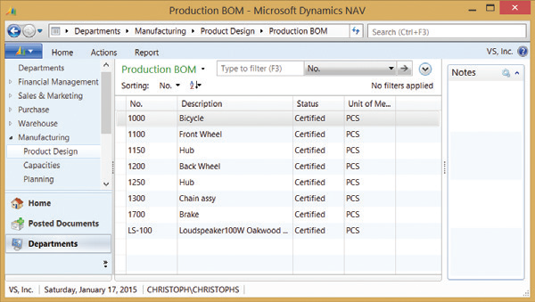
Core Business Process Support
Source: Courtesy of Microsoft Corporation
Notes:
These screenshots of the Microsoft Business Dynamics NAV system show support of human resources, order-to-cash, procure-to-pay, and production processes.

Slide 27
ERP Installation
Configuration is critical
  Specifying the data to be in the underlying database
  Thousands of decisions related to business processes
  Companies need to understand how they do business to implement and configure their ERP systems
Notes:
All ERP systems require extensive configuration to map to a specific business. A company needs to understand its processes to make the thousands of necessary configuration decisions. Often, companies will hire outside experts to help them understand their own business and then implement the ERP based on this understanding.

Slide 28
ERP Limitations
ERP systems often require organizations to change their business processes
Once implemented, a company is locked in
Difficult and costly to make future changes
Modifications require extra and costly programming
Notes:
ERP systems, for all their benefits, are essentially focused on the internal workings of an organization.
To achieve benefits in external functions such as supply chain management or customer relationship management, companies need to implement externally focused modules or systems designed to handle that aspect of the business.

Slide 29
Achieving Enterprise System Success
Core Business Processes and Organizational Value Chains
Explain core business processes that are common in organizations.
Enterprise Systems
Describe what enterprise systems are and how they have evolved.
Enterprise Resource Planning
Describe enterprise resource planning systems and how they help to improve internal business processes.
Achieving Enterprise System Success
Understand and utilize the keys to successfully implementing enterprise systems.

Slide 30
ERP Recommendations
Recommendations
  Secure executive sponsorship
  Get help from outside experts
  Thoroughly train users
  Take a multidisciplinary approach to implementations
  Evolve the implementation
Notes:
ERP installation is a complex and involved process. It needs top-level support in the form of active executive sponsorship. The lack of executive support is believed to be the primary reason ERP installations fail.
Beyond executive sponsorship:
Hiring experts who know how to implement ERP systems is very beneficial. Companies may only install an ERP system once a decade, whereas experts do it for a living, and thus understand the unique challenge specific ERP systems may present.
Users need training before and after the implementation to ensure they can use it when deployed, and then as they become proficient can learn advanced features specific to their job functions.
When implementing an ERP system, it typically affects large portions of or the entire organization. Involving all the business functions affected helps ensure needs are met and buy-in is achieved.

Slide 31
Secure Executive Sponsorship
Executive Sponsorship is Critical
  Primary reason for ERP failure
  Critical for buy-in
  Dictates resource availability
  Necessary to authorize business improvements
  Key to removing obstacles
Notes:
Executive support and sponsorship is the most critical aspect of a successful ERP implementation.
It dictates whether managers will prioritize the implementation and if the required resources will be available.
When opportunities arise to make process changes and improve the business, these changes need authorization to be implemented.
When unexpected roadblocks crop up, executive sponsorship can pave the way to success.

Slide 32
Get Help from Outside Experts
ERP systems are very complex
Typically, IS departments aren’t familiar with new systems
Experts can help
  Specify needs
  Select a suitable vendor
  Manage the implementation project
  Provide technical expertise
Notes:
ERP systems are typically very large and complex, and may take years to master. By hiring experts to help select a vendor, then help manage the vendor and execute the installation, companies can leverage the knowledge of experts who do implementation for a living without having to develop the expertise in-house.

Slide 33
Thoroughly Train Users
ERP systems are complex from the user perspective as well
  Training costs are often poorly judged
  When systems go live it takes employees time to regain productivity
Proper training can alleviate concerns
Proper training can mitigate productivity loss
Proper training can set expectations
Notes:
Training is critical to ERP success but often poorly planned for and executed.
ERP systems are more complex to use than stand-alone systems, and users need to be prepared for that.
Proper training not only shows users what to do, but can prepare them for expected hurdles like a temporary drop in productivity as they get up to speed and become proficient with the system.

Slide 34
Take a Multidisciplinary Approach to Implementations
ERP systems often affect the entire organization
  The entire organization is a stakeholder
  The entire organization needs involvement
  Failure to have representatives can result in unmet critical needs
  The project team can’t be experts in every aspect of user needs
  Departments may become hostile if left out of the implementation and needs assessment
Notes:
ERP systems affect entire organizations. To ensure that the needs of the organization are met, representation is needed from all affected parties. This can surface critical requirements, and can also ensure that there is buy-in and understanding of the system and the implementation goals.

Slide 35
Evolve the Implementation
Recent trend is to move away from large-scale ERP
  Using cloud-based ERP allows scalability and agility
Another trend: managing businesses in real time
  Take advantage of in-memory computing and mobile access
Notes:
Implementing ERP systems is a highly complex and risky undertaking. They are difficult to install, maintain, and upgrade. Perhaps an evolutionary approach is better and more flexible.

Slide 36
End of Chapter Content

Slide 37
Managing in the Digital World:
Amazon.com
Amazon has grown from an online bookstore to a complete marketplace
  Almost any product can be purchased though Amazon
  Amazon uses enterprise information systems to optimize processes, and now provides this to others
  Amazon Web Services (AWS) is an IS infrastructure rented to companies for their enterprise system needs
  AWS provides cloud services and hosting for other companies

Slide 38
Brief Case: Crowdsourcing Cinema at Amazon Studios
Amazon Studios is an innovative film production venture
  Lets anyone submit screenplays and movies
  Aims to discover talent that hasn’t yet made it to the big time
  Original content is aired on Amazon Instant Video
  After feedback, Amazon Studios decides whether to produce a full season
  Two successes: Alpha House and Mozart in the Jungle

Slide 39
Ethical Dilemma:
Too Much Intelligence? RFID and Privacy
RFID tags being used to tag pharmaceuticals
  RFID tags can be read by anyone with an RFID reader, creating concerns that a person’s medications could be revealed
RFID chips can be embedded in people
  Mexico’s attorney general and senior staff
  Alzheimer’s and diabetes patients
  Implant in kids to prevent kidnapping?
Lots of public opposition, what are the dangers?

Slide 40
Coming Attractions: Combating Counterfeits Using Liquid Crystal Lasers
University of Cambridge is developing a liquid crystal laser pattern print for product labels
Can distinguish a real product from fraudulent knockoffs
Inexpensive
Pharmaceutical application
  Counterfeit pharmaceuticals is a big problem
  Unlawful and potentially dangerous for patients
  This technology can help prevent counterfeits

Slide 41
Key Players:
The Titans of ERP
SAP
  German company founded in 1972
  Many of the worlds largest companies use SAP software
  24% of the ERP market in 2012
Oracle
  Best known for database software
  ERP acquisitions: JD Edwards, PeopleSoft, Siebel CRM
  13% of the ERP market in 2012
Microsoft
  Largest software company in the world
  Gained ERP software through acquisition of Great Plains
  5% of the ERP market in 2012

Slide 42
Who’s Going Mobile: Big ERP Systems Embracing Small Mobile Devices
ERP users originally used client PCs to access ERP systems
Mobile users can now access ERP systems on the road
There are many benefits to mobile ERP
  Improved service quality
  Improved productivity
  Strengthened customer relationships
  Improved competitive advantage
  Improved data timeliness and accuracy
Examples: SAP, Microsoft

Slide 43
When Things Go Wrong:
The Not-So-Beautiful ERP Implementation
Avon announced its “Promise” program in 2009
  Mobile app and Web site for local sales reps entering product orders
  Pilot launched in 2012 was a miserable failure
  Difficult to use; sales reps quit in droves
  $125 million loss, 30% stock price decline
  Finger pointing: Avon, SAP, third party

Slide 44
Industry Analysis:
The Automobile Industry
More than 800 million cars on the road, 83 million sold worldwide in 2013
  Sales predicted to climb to 100 million by 2018
  China, Brazil, Russia, India, other developing nations
Growing global demand for energy-efficient cars
Auto industry efforts:
  Evolving global network of suppliers
  Broader supply chains bring new innovations to market
  USB ports, hard drives, mobile data connectivity
  Google working on a self-driving car
  Marketing enhancements via virtual showrooms

