Slide 1
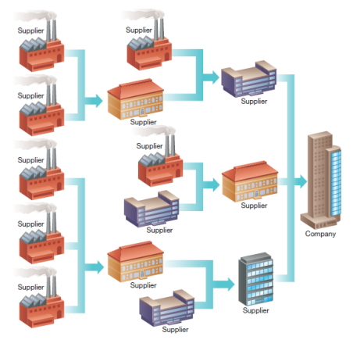
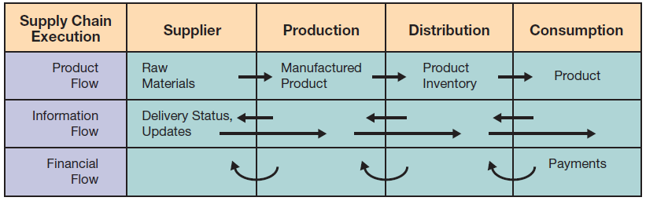
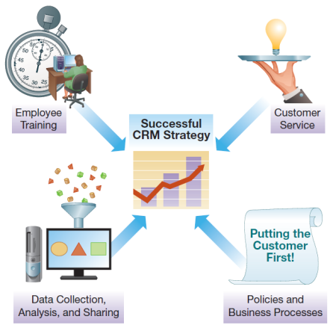
Chapter 8: Strengthening Business-to-Business Relationships via Supply Chain and Customer Relationship Management
Supply chain management (SCM) systems support business-to-business (B2B) transactions; customer relationship management (CRM) systems promote sales and long-term customer relationships

Slide 2
Chapter 8 Learning Objectives
Supply Chain Management
Describe supply chain management systems and how they help to improve business-to-business processes.
Customer Relationship Management
Describe customer relationship management systems and how they help to improve the activities involved in promoting and selling products to customers as well as providing customer service and nourishing long-term relationships.

Slide 3
Supply Chain Management
Supply Chain Management
Describe supply chain management systems and how they help to improve business-to-business processes
Customer Relationship Management
Describe customer relationship management systems and how they help to improve the activities involved in promoting and selling products to customers as well as providing customer service and nourishing long-term relationships.

Slide 4
What Is a Supply Chain?
A collection of companies and processes involved in moving a product from the suppliers of raw materials to the suppliers of intermediate components, then to final production, and, ultimately, to the customer
Referred to as a “chain” as one supplier feeds into the next, then the next, then the next
A “network” is more accurate because businesses have multiple suppliers, who have multiple suppliers
Notes:
A supply chain is comprised of the companies that buy and sell goods to each other to create a product from raw materials. Because one company sells to the next, who then in turn sells to another, often with multiple links before an end product is developed, it is referred to as a chain. In reality, it typically looks more like a network with many suppliers feeding into each company.

Slide 5

A Typical Supply Network
Notes:
A simple example of a Supplier Network. Each Supplier may have one or many upstream suppliers feeding into their business or factory.
At the same time, each supplier is typically selling to many downstream customers, although that isn’t shown here.

Slide 6
Business-to-Business Electronic Commerce: Exchanging Data in Supply Networks
Business-to-Business (B2B) Electronic commerce
  90% of all EC in the United States
  Involve Proprietary Information
  Originally facilitated using Electronic Data Interchange (EDI) prior to the Internet
  Now suppliers use Web-based EDI protocols
  Companies also use Extranets (Chapter 3), Portals and Marketplaces to facilitate B2B EC
Notes:
Business-to-Business Electronic Commerce comprises the lions share of the Electronic Commerce market.
This makes sense because businesses typically make multiple purchases from the same supplier over time.
Automating the procurement process so these can be made electronically and automatically can result is significant procurement cost savings as well as reducing errors and related expenses.

Slide 7
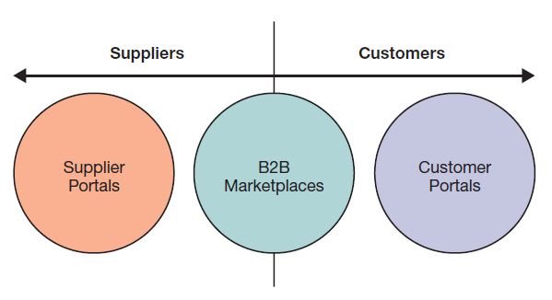
Business-to-Business Electronic Commerce: Exchanging Data in Supply Networks
Portals
  Supplier Portals
  Customer Portals
Notes:
Supplier and Customer Portals are extranets a company sets up for either Suppliers or Customers that contain the communication tools and the proprietary information they need to interact with the company.
Often set up when there is a large number of suppliers or customers to interact with and the cost of the portal is less than the cost of interacting with all the suppliers (or customers) without the functionality of the portal. Portals can also include value-added services such as management tools for customers.

Slide 8
B2B Marketplaces
Link many supplies and customers together
Allow smaller businesses to participate in the markets
Many focused on vertical markets
  A vertical market is a market within an industry sector
  Highly efficient
Some more general—Alibaba.com
Notes:
B2B marketplaces are different from portals in that they are controlled by a third party and allow many suppliers and buyers to get together.
For a smaller company that can’t justify the expense of its own portal, B2B marketplaces are efficient ways to participate in the market.
Although many B2B marketplaces are industry specific, some are very general, such as the Chinese export marketplace Alibaba.com

Slide 9
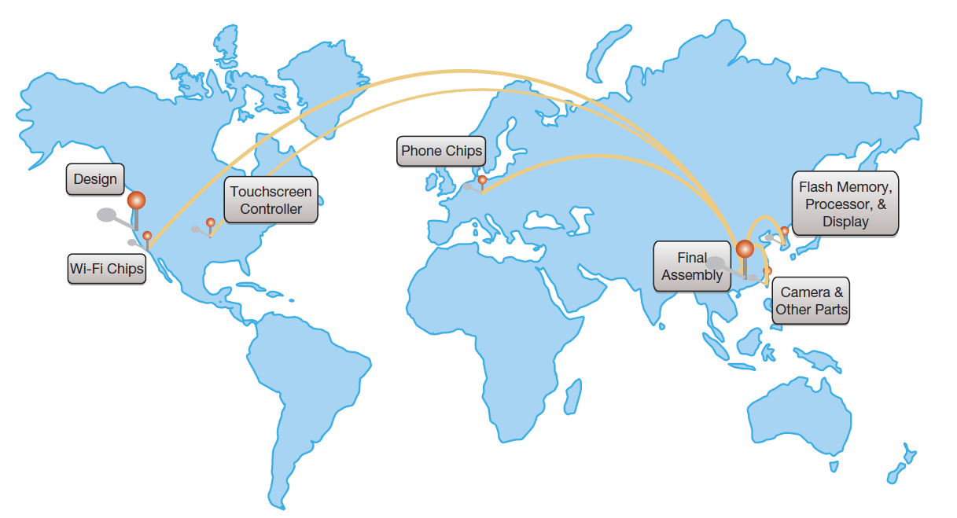
Managing Complex Supply Networks
Notes:
The supply network for the iPhone involves multiple suppliers around the world.
This requires coordination to ensure that all the components are in supply at the assembly plants on an as-needed basis.
When unexpected interruptions occur, such as from an earthquake, the supply chain can cease to flow and manufacturing lines can come to a halt.
Having transparency throughout the supply chain helps management know what is going on and, whenever possible, make adjustments for the unexpected.

Slide 10
Benefits of Effectively Managing Supply Chains
Just-in-Time Production
  Inventory delivered just as it is needed
  Minimizes stock and handling costs
  Reduces obsolescence charges
Vendor-Managed Inventory
  Vendors track usage and replenish supplies
  Reduces procurement and inventory replenishment costs
Notes:
Modern manufacturing practices, such as just-in-time production, that eliminate bringing in large stocks of manufacturing supplies and the associated storage, inventory, and handling costs, are part of a lean manufacturing system focused on efficiency.
These practices can significantly reduce manufacturing overhead, but do create the risk of stock-outs if the supply chain isn’t operating effectively.
Vendor-managed inventory is another practice that offloads inventory management to the vendor selling the inventory, placing the burden for maintaining a suitable supply on the vendor’s shoulders, which reduces operating costs yet again.

Slide 11
Benefits of Effectively Managing Supply Chains
Reducing the Bullwhip Effect
  Ripple effects due to forecast errors
  Coordinated supply chain helps mitigate this
Corporate Social Responsibility
  Product recalls
  Sustainable business practices
Notes:
Demand forecasting can create errors. When demand forecasts are being adjusted too rapidly within the supply chain, these errors can create an oscillation of large and small orders. This oscillation will not level out to a steady state, resulting in wildly varying demand within a distribution chain.
As supply chains become global and products are sourced from countries with varying levels of quality standards, substandard parts can enter the supply chain without the knowledge of the downstream manufacturers, resulting in large product recalls or worse.
Good supply chain visibility allows companies to narrow down problems, recall only affected products, and take steps to ensure future quality.
A related issue is sourcing from suppliers that are not engaged in humane or sustainable business practices, resulting in damage to the environment, workers, and the company’s goodwill once the practice is discovered.

Slide 12
Optimizing the Supply Chain Through SCM
Supply Chain Management (SCM)
  Supply Chain Planning
  Supply Chain Execution
  Supply Chain Visibility and Analytics
Notes:
Over the next several slides we will look at each of these in order, and then at an example list of supply chain management modules from an ERP vendor.

Slide 13
Functions the Optimize the Supply Network
SCM Module | Key Uses
Demand planning and forecasting | Forecast and plan anticipated demand
Safety stock planning | Assign optimal safety and target stock levels
Distribution planning | Optimize the allocation of available supply
Supply network collaboration | Work with partners across the supply network
Materials management | Ensure production materials are available
Manufacturing execution | Support production processes
Order promising | Provide answers to customer queries
Transportation execution | Manage logistics
Warehouse management | Support receiving, storing, and picking of goods
Supply chain analytics | Monitor key performance indicators
Source: Based on http://www.sap.com.
Notes:
SCM systems often have multiple modules available to meet specific organizational supply chain needs.

Slide 14
Developing an SCM Strategy
Trade-offs
  Supply Chain Efficiency
    Minimizes cost, but increased risk of stock-outs
    May sacrifice customer service
  Supply Chain Effectiveness
    Maximizes likelihood of meeting objectives
    Increased costs associated with
      Redundancy
      Sticking levels
      Cross-functionality
Notes:
A supply chain strategy should be developed that mirrors the corporation’s overall strategy.
If the corporation is focused on customer service, then the company should ensure customer needs can always be met on a timely basis.
If a company is focused on being the lowest-cost provider, then the supply chain should push for cost reduction wherever possible, even though that increases the probability that sometimes the supply chain will not meet immediate customer needs.

Slide 15
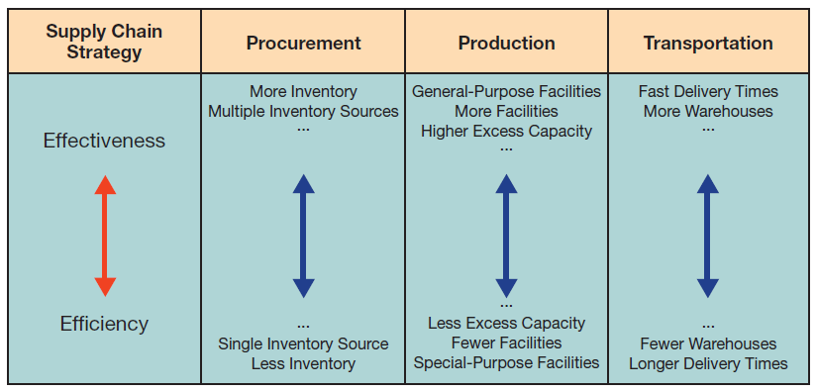
Developing an SCM Strategy
Notes:
The trade-offs between effectiveness and efficiency are shown here, where the more effective company will be better positioned to ensure delivery, while the more efficient company is taking every possible step to drive down operating and supply chain costs.

Slide 16
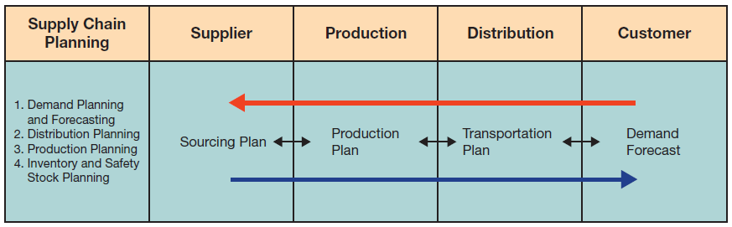
Supply Chain Planning (SCP)
SCP involves multiple SCM tools and modules working together to meet business needs and customer demand
Notes:
The supply chain plan starts with demand planning, and works backwards through the distribution plan, the production plan, and finally to the sourcing plan to determine what materials need to be sourced and when to ensure effective business operations.

Slide 17
SCP Processes
Demand Planning and Forecasting
  Based on historical data, build a demand forecast
Distribution Planning
  How to move products to distributors, transportation planning
Production Scheduling
  Coordinate product/service creation, production plan
Inventory and Safety Stock Planning
  Developing inventory estimates, determine optimal inventory levels, sourcing plan
Notes:
Various types of analytical tools—such as statistical analysis, simulation, and optimization—are used to forecast and visualize demand levels, distribution and warehouse locations, resource sequencing, and so on. These in turn guide supply chain execution.
SCP is an ongoing process, constantly updated.

Slide 18
Supply Chain Execution (SCE)
SCE focuses on the efficient and effective flow of materials, information, and financial transactions
Notes:
Supply chain execution is the implementation of the supply chain plan, and involves placing the orders, shipping the goods and materials, and paying for them.
It also includes the information flows necessary to track and monitor the processes involved.

Slide 19
SCE Flows
Product Flow
  Movement of goods from supplier to production to distribution to consumer
  RFID is an important enabling technology
Information Flow
  Movement of information through supply chain (e.g., order processing and delivery status updates)
  XML is an important enabling technology
Financial Flow
  Movement of financial assets through supply chain
  Payment schedules, consignment, ownership
  Linkages to electronic banking and financial institutions
Financial Flow
Notes:
SCE puts the SCM planning into motion and reflects the processes involved in improving the collaboration of all members
of the supply chain—suppliers, producers, distributors, and customers.

Slide 20
Key Technologies for Enhancing SCM
Radio Frequency Identification (RFID)
  Replaces bar codes
  As low as 10 cents
Extensible Markup Language
  XML, much like HTML for Web sites, creates a standard many businesses can use to help facilitate data exchange
Notes:
RFID is an electronic radio equivalent of a bar code, without a bar code’s need to be visible or clean in order to be read.
XML is a text-based markup language that businesses can easily use to exchange machine-readable data.

Slide 21

Key Technologies for Enhancing SCM:
Radio Frequency Identification
Notes:
RFID tags can range from fractions of an inch to much larger, and can include passive tags that generate power from the reader’s radio signal to active tags that have internal batteries.
Passive tags may only have a range of a few feet, whereas active tags may have a range of hundreds of feet.

Slide 22
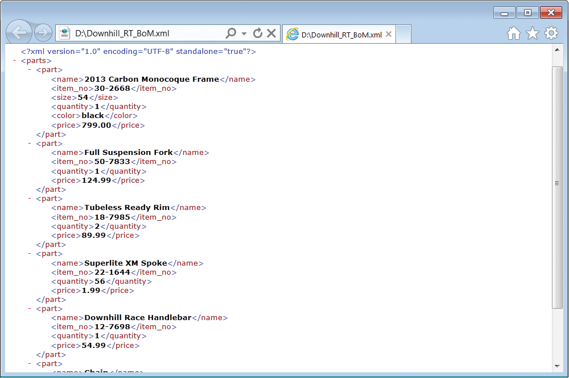
Key Technologies for Enhancing SCM:
Extensible Markup Language
Source: Courtesy of Microsoft Corporation.
Notes:
Extensible Markup (XML) allows creating documents consisting of customized tags, enabling the definition, transmission, validation, and interpretation of data between applications and between organizations.
Like HTML, XML also uses tags, but focuses on the content rather than the presentation.
XML is customizable, and variations of XML have been developed. For example, Extensible Business Reporting Language (XBRL) is an XML-based specification for publishing financial information. XBRL makes it easier for public and private companies to share information with each other, with industry analysts, and with shareholders.

Slide 23
Managing B2B Financial Transactions
B2B Financial Transactions
  B2C often uses e-payments such as PayPal
  But B2C still primarily uses payment by check (75%)
  Others: purchasing cards, letters of credit, Western union
Unknown suppliers and customers create significant fraud risk
Notes:
Business-to-business financial transactions involve financial risk, particularly with partners who have an unknown track record.
Buyers may receive inferior goods or no goods at all; sellers may not be paid according to the terms of the agreement.

Slide 24
Supply Chain Visibility and Analytics
Supply chain visibility
  Product tracking
  Anticipating adverse impacts
    Weather impacts
    Labor negotiations
Supply chain analytics
  Monitoring SC performance
  Identifying problem spots
Notes:
Supply chain visibility is the ability to track products as they move through the supply chain as well as external events that impact or might impact the supply chain.
Supply chain analytics is the analysis and use of key performance indicators to facilitate more effective management and avoid ongoing problems such as suppliers that regularly miss delivery deadlines.

Slide 25
Customer Relationship Management
Supply Chain Management
Describe supply chain management systems and how they help to improve business-to-business processes
Customer Relationship Management
Describe customer relationship management systems and how they help to improve the activities involved in promoting and selling products to customers as well as providing customer service and nourishing long-term relationships.

Slide 26
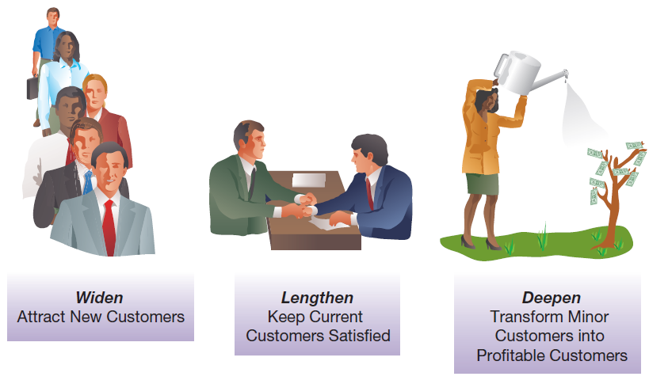
Customer Relationships
Notes:
Companies are constantly looking for opportunities to get new customers, keep current customers longer, and sell more products to their existing customers.
CRM systems are designed to support these efforts.

Slide 27
Customer Relationship Management (CRM) Benefits
Benefit | Examples
24/7/365 operation | Web-based interfaces
Individualized service | Learn how each customer defines product and service quality
Improved information | Integrate all information for all points of contact
Improved problem identification/resolution | Improved record keeping and efficient methods of capturing customer complaints
Optimized processes | Integrated information removes information handoffs
Improved integration | Information from the CRM can be integrated with other systems to streamline business processes
Improved product development | Tracking customer behavior over time helps to identify future product and service offerings
Improved planning | Provides mechanisms for managing and scheduling sales follow-ups
Notes:
Customer relationship benefits range from increased levels of customer service to more efficient and effective execution.

Slide 28

Developing a CRM Strategy
Notes:
Successful CRM strategies need to integrate the different facets of CRM functions. This includes consistent policies and business processes, employee training, customer service, and data collection and analysis.

Slide 29
Key Elements of a CRM Strategy
Policies and Business Processes
  Reflect a customer-focused culture
Customer Service
  Quality, satisfaction, enhanced customer experience
Employee Training
  For employees from all areas
Data Collection, Analysis, and Sharing
  Track all aspects of the customer experience
Notes:
The closer an organization is to the end customer, the more important CRM becomes.
Additionally, a successful CRM strategy must carefully consider the ethical and privacy concerns of customers’ data.

Slide 30
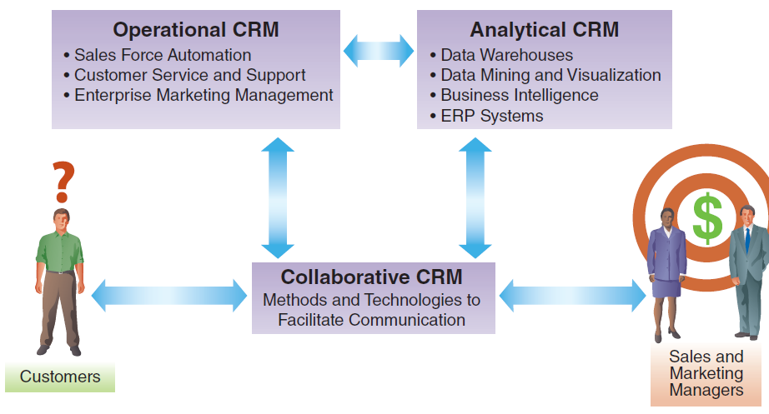
Architecture of a CRM System
Notes:
A complete CRM system includes not only the operational CRM, which manages customer interactions, but also analytical CRM, which is focused on having appropriate business intelligence, and collaborative CRM, which facilitates communication.

Slide 31
Operational CRM
Sales Force Automation (SFA)
  Supports day-to-day sales force activities
Customer Service and Support (CSS)
  Automates service requests, complaints, product returns, and information requests
Enterprise Marketing Management (EMM)
  Improves the management of promotional campaigns
Notes:
Operational CRM is focused on the execution of customer relationship management.
It has three components, sales force automation, customer service and support, and enterprise marketing management.
We will discuss each of these in more depth next.

Slide 32
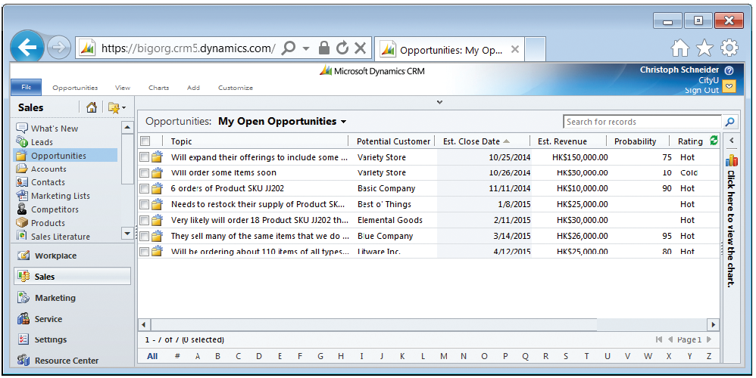
Operational CRM:
Sales Force Automation
Source: Courtesy of Microsoft Corporation.
Notes:
Sales force automation supports the day-in-and-day-out sales force and sales manager functions.
It automates paperwork functions, allowing more time to be spent with customers, reducing errors, and ensuring that leads are followed up.

Slide 33
Operational CRM:
Customer Service and Support
  Customer interaction centers (CIC) support multiple communication channels
  Evolved from help desks and call centers
  Phone—automatic call distribution systems, virtual hold technologies
  Web—self-service technologies
  Facebook
  Industry blogs
  Face-to-face
Notes:
Customer service and support technologies allow companies to provide customer service and support across multiple channels ranging from 24/7 Web sites that incorporate self-service technologies to face-to-face interactions, and everything in between.

Slide 34
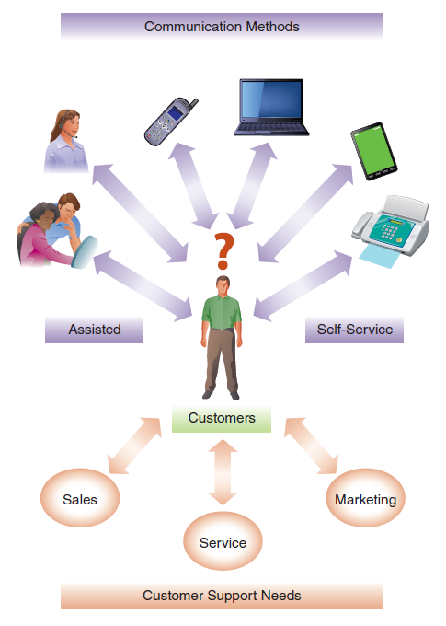
Operational CRM:
Customer Service and Support
A CEC allows customers to use a variety of self-service and assisted technologies to interact with the organization
Notes:
Successful CSS systems enable faster response times, increased first-contact resolution rates, and improved productivity of service and support personnel. Managers can utilize digital dashboards to monitor key metrics such as first-contact resolution and service personnel utilization, which allows for improved management of the service and support functions.

Slide 35
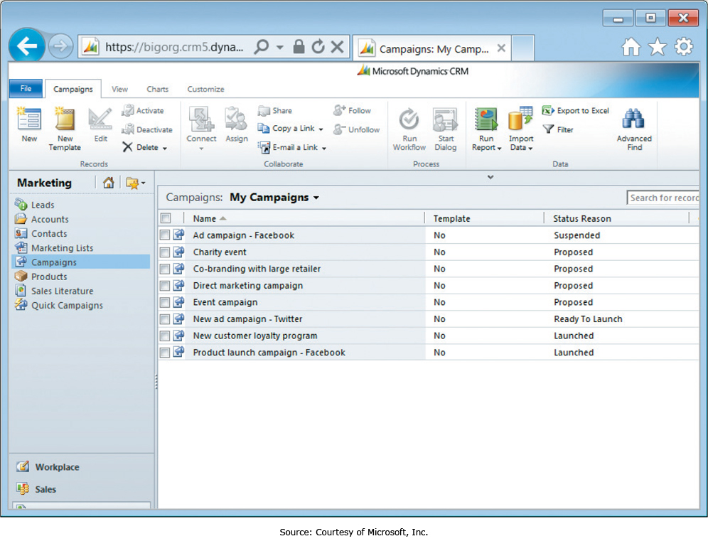
Operational CRM:
Enterprise Marketing Management
Notes:
Enterprise marketing management, or EMM, helps companies manage the efficient and effective execution of marketing campaigns across different media.
This helps make sure the right message reaches the right people at the right time.
EMM systems also provide extensive capabilities to track and analyze campaign effectiveness.

Slide 36
Analytical CRM
“Analyzing customer behavior and perceptions in order to provide the business intelligence necessary to identify new opportunities and to provide superior customer service”
Key Analytical Technologies (Chapter 6)
  Data mining
  Decision support
  Other business intelligence technologies
Notes:
Analytical CRM is closely tied to business intelligence and uses business intelligence tools to identify new business, sales, and marketing opportunities.

Slide 37
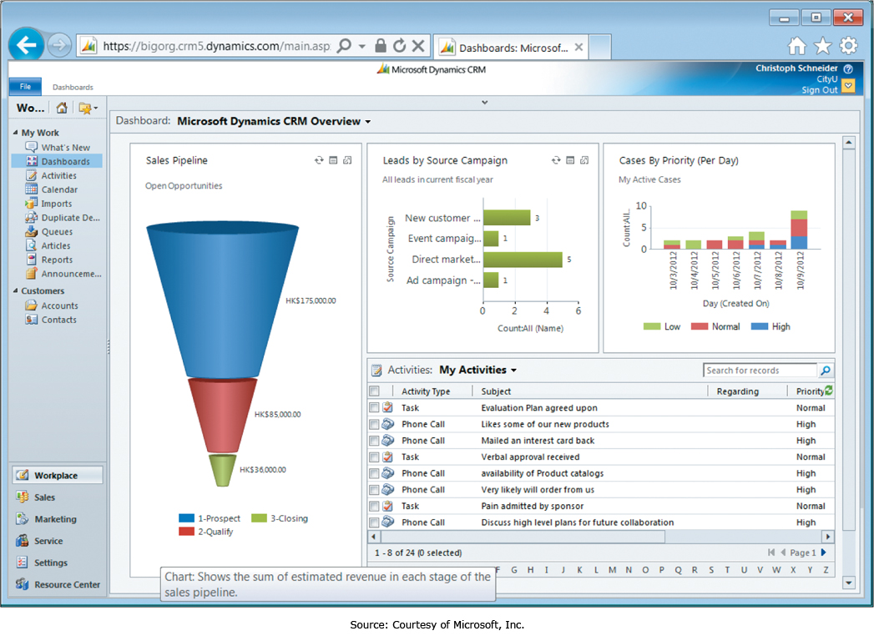
Analytical CRM:
Digital Dashboards
Notes:
Digital dashboards allow managers to rapidly see the status of key performance indicators (KPIs) and evaluate CRM performance metrics.
Often digital dashboards provide extensive functionality, such as the ability to click on a chart or graph and “drill down” to see more detailed information.

Slide 38
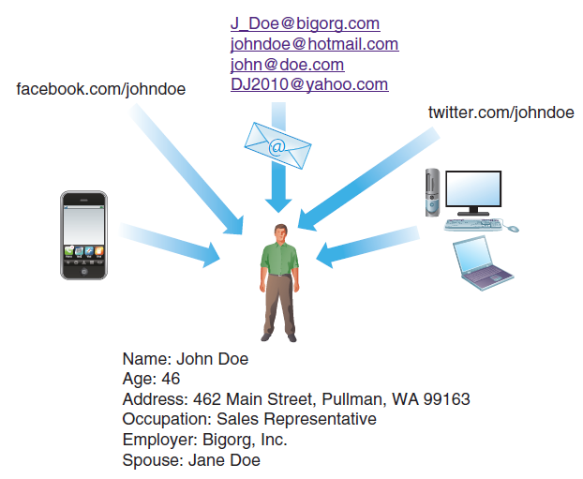
Analytical CRM:
Online Identities
Notes:
Customers often have multiple online accounts, both e-mail and social media.
Identity management helps companies integrate these so a clear and complete picture of the customer emerges from the data.

Slide 39
Social CRM
Customers use Facebook and Twitter to comment on products and services
Monitoring social media conversations helps to understand public perceptions
Analytical CRM applications
  Microsoft’s Social Networking Accelerator
  Google Alerts
  Dell’s Social Media Listening Command Center
Notes:
Social media monitoring is the process of identifying and assessing the volume and sentiment of what is being said about a company, individual, product, or brand. To collect this information, organizations utilize a variety of tools to track and aggregate social media content from blogs, wikis, news sites, microblogs such as Twitter, social networking sites like Facebook, video-/photo-sharing Web sites like YouTube and Flickr, forums, message boards, blogs, and user-generated content in general.

Slide 40
Collaborative CRM
“Systems for providing effective and efficient communication with the customer from the entire organization”
Greater Customer Focus
  Understanding customer history and current needs
Lower Communication Barriers
  Personnel have complete customer information
  Personnel use customer-preferred communication methods
Increased Information Integration
  Personnel know prior and ongoing communication
Notes:
Collaborative CRM is focused on ensuring customer support personnel have the tools and information they need to effectively interact with the customer regardless of the last point of contact with the company.
It provides customer support personnel with a history of customer interactions and ongoing communication, ensuring personnel have complete and accurate information and are able to readily address customer needs.

Slide 41
Ethical Concerns with CRM
CRM systems may facilitate coercive sales practices
Systems may categorize customers in a way customers take offense to
Personalized communication may become too personal
Notes:
CRM can provide companies with a great deal of information about their customers, some of which may be considered sensitive or private by those customers.
Using this information to make a sale may result in the customer feeling intruded upon, or could have a coercive effect.
Either of these can create ethical issues, and could also create negative publicity for a company.

Slide 42
End of Chapter Content

Slide 43
Managing in the Digital World:
Walmart
Walmart is known for cutting costs and prices
Effective use of technology for supply chain
Vendor-managed inventory
  Suppliers monitor inventory in Walmart’s warehouses
  Cross-docking: direct transfers from inbound to outbound truck trailers
Powerful CRM capabilities

Slide 44
When Things Go Wrong:
Switching Switches—Failure at a Global Scale
Supply chains are increasingly global
Failure to carefully monitor partnerships can lead to expensive product recalls
Example: GM’s faulty ignition switches took 10 years to resolve
An engineer covered up a mistake by leaving part number unchanged
Led to difficulty identifying faulty switches

Slide 45
Brief Case: The Formula for Success: Demand Media
Demand Media, Inc. focuses on providing answers to common questions
  Uses search data and auction data to identify topics with high interest
  Demand Media crowdsources solutions as articles and video clips and posts them to its own sites and YouTube
  The traffic to view the answers generates advertising revenue
  Demand Media has created a very large content base
    45 sites with more traffic than ESPN and NBC combined
    Now collaborating with Google

Slide 46
Coming Attractions:
Saving Lives Through 3D Bioprinting
3D printing is an alternative to cutting and milling materials to create a part
  3D printing builds a part up, eliminating waste
  3D printing is now very precise and accurate
3D printing now moving into the world of medicine
  Researchers in the Netherlands used 3D printing to replace a patient’s skull
  A UK-based company is using 3D printing to print up to 150 prosthetic eyes an hour
  3D bioprinting researchers attempting to print complete organs for transplants

Slide 47
Key Players:
Salesforce.com
CRM software is becoming key to business success
  Critical for most medium to large organizations
  Becoming a necessity for many small businesses
  Small business often don’t have the infrastructure to host complete CRM solutions
Salesforce.com hosts a CRM SaaS in an online cloud
  The Sales Cloud
  The Service Cloud
  Chatter

Slide 48
Who’s Going Mobile:
The Power of Mobile CRM
In many organizations, the sales staff is often in the field
  Mobile CRM allows staff to use CRM features on the road
  The best mobile CRM has all the functionality of desktop CRM
  Mobile CRM promotes efficiency and effectiveness, with many benefits
    Increased revenue growth and customer renewals
    Larger deal size
    Increased user adoption and higher quota attainment
    Lower sales force turnover
  CRM, including mobile CRM, spending is increasing faster than any other application software investment

Slide 49
Ethical Dilemma:
CRM: Targeting or Exploiting?
CRM systems allow companies to look closely at customer behavior and send targeted offers to select customers
Benefits include less advertising to uninterested parties
Fine segmentation may allow companies to take advantage of population groups
Some companies also sell data, without user knowledge or consent, at times in violation of their own stated practices
Verizon’s “Relevant Mobile Advertising” campaign monitors customers’ Internet browsing habits
Often these practices are legal, but are they ethical?

Slide 50
Industry Analysis:
Manufacturing
Computer-Aided Design (CAD)
  Facilitates drawing, design, sharing, and collaboration
  CAD design prototypes can be printed on 3D printers
  This is called “fabbing,” and speeds up creation of models
  3D printing adds successive layers of materials
SCP and ERP are used for inventory planning, job scheduling, and warehouse management

