Slide 1
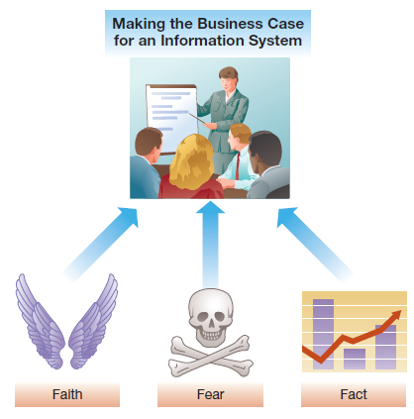
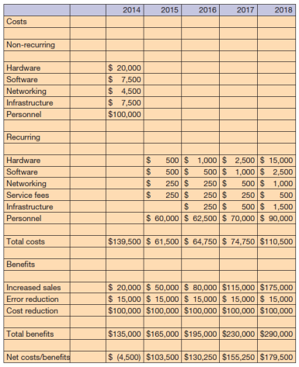
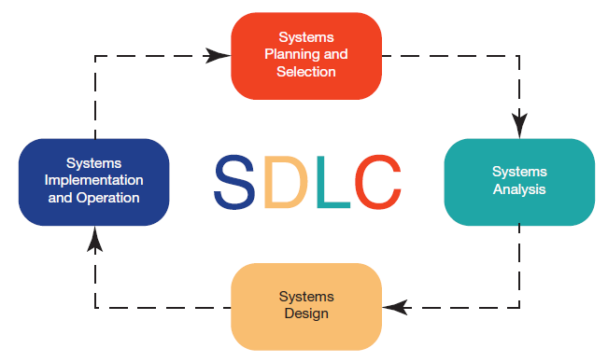
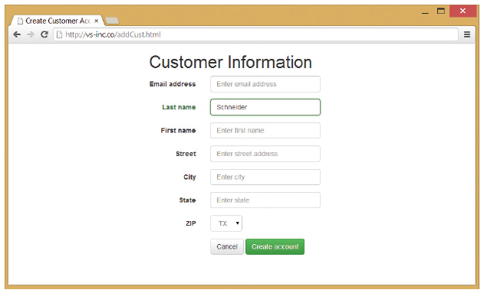
Chapter 9: Developing and Acquiring Information Systems
No matter what area of an organization you are in, you will be involved in systems development or technology acquisition processes

Slide 2
Chapter 9 Learning Objectives
Making the Business Case
Describe how to formulate and present the business case for technology investments.
The Systems Development Process
Describe the systems development life cycle and its various phases.
Acquiring Information Systems
Explain how organizations acquire systems via external acquisition and outsourcing.

Slide 3
Making the Business Case
Making the Business Case
Describe how to formulate and present the business case for technology investments.
The Systems Development Process
Describe the systems development life cycle and its various phases.
Acquiring Information Systems
Explain how organizations acquire systems via external acquisition and outsourcing.

Slide 4
Business Case Objectives
The business case sells an investment
  Build a strong, integrated set of arguments
  Show how an IS adds value to the organization
  Lays out the costs and benefits
  Used to make a “go” or “no-go” decision
  May be used to justify continued funding
Notes:
A business case is, quite simply, a complete justification for making or continuing to make an investment in a new or ongoing information system.
It demonstrates how the investment is justified and better than the possible alternatives.

Slide 5
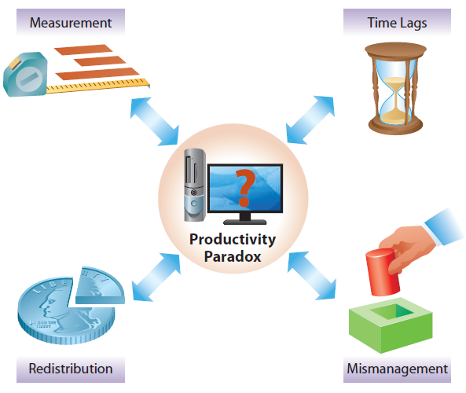
The Productivity Paradox
Notes:
The Productivity Paradox stems from the difficulty many early professionals had showing that worker productivity, measured as worker output per employee hour, was increasing due to investments in information technologies. There are, however, many reasons for this apparent dilemma that have come to light since the initial research.
One problem has been in measurement. Companies typically focus on efficiency, or doing something with few resources, over effectiveness, or doing something well, and information systems sometimes increase effectiveness over efficiency. Hence businesses are doing things better, which can then impact competitiveness and product quality and lead to other changes, but initial efficiency measurements may show little or no improvement.
There is also a timing issue; many information systems take years to hit the bottom line, so any measurement immediately after implementation may show no, or even a negative, productivity impact.
Some industries have a limited size, so the first mover in the industry may get a bigger slice of the pie, but overall it is a zero-sum game, so once everyone has implemented the new technology to catch up, overall it looks like there is no improvement across the industry.
Finally, some IS implementations are the result of mismanagement and aren’t appropriate, so the investment actually has a negative return.

Slide 6
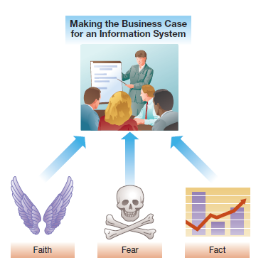
Making a Successful Business Case:
Types of Business Cases
Type of Argument | Description
Faith | Arguments based on beliefs about organizational strategy, competitive advantage, industry forces, customer perceptions, market share, and so on
Fear | Arguments based on the notion that if the system is not implemented, the firm will lose out to the competition, or worse, go out of business
Fact | Arguments based on data, quantitative analysis, and/or indisputable factors
Based on Wheeler and Marakas, 1999
Notes:
Arguments based on faith or fear can be the most compelling and can drive the decision to invest in an information system despite the lack of any hard data on system costs. Arguments based on faith should clearly describe the firm’s mission and objectives, the strategy for achieving them, and the types of information systems that are needed.
An argument based on fear may go something like this: “If we don’t implement this enterprise resource planning system, we’ll get killed by our competitors because they’re all implementing these kinds of systems—we either do this or we die.”
Arguments based on fact involve rigorous cost-benefit analysis.

Slide 7
Making a Successful Business Case:
Identifying Costs and Benefits
Identifying Costs
  Tangible costs—total cost of ownership (TCO)
    Non-recurring costs (acquisition)
    Recurring costs (use and maintenance)
  Intangible costs (e.g., loss of customers)
Identifying Benefits
  Tangible benefits (e.g., estimated sales gains)
  Intangible benefits (e.g., improved customer service)
Notes:
The business case needs to have system costs and benefits at its heart.
Costs and benefits can be tangible or intangible, with all tangible costs being rolled up using an approach of total cost of ownership.

Slide 8

Making a Successful Business Case:
Performing Cost-Benefit Analyses
Notes:
Here is an example cost-benefit analysis for a project starting in 2014 and running through 2018, which is a reasonable time frame for an IS development project.
Costs are divided into recurring and non-recurring, and benefits are shown here as recurring, with sales benefits growing slowly over time.
The bottom line is the net of costs and benefits, and is suitable for a return on investment (ROI) analysis.

Slide 9
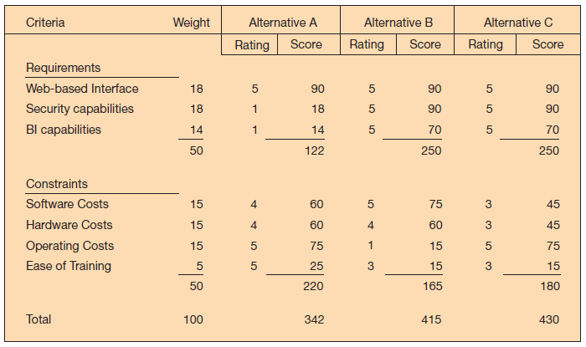
Making a Successful Business Case:
Comparing Competing Investments
Weighted Multicriteria Analysis
Notes:
Sometimes the justification for a system has more intangibles then tangibles, or a financial analysis doesn’t paint a clear picture between alternatives.
In these cases a weighted multicriteria analysis can be performed instead, showing which alternatives meet organizational goals and priorities more completely than others.
Weights indicate the importance of each criterion. Because these can be subjective, they should be arrived at through extensive discussion among decision makers, including the analysis team, users, and managers.

Slide 10
Presenting the Business Case
Know the Audience
  Know who you are presenting to, what their background is, and what they care about
Convert Benefits to Monetary Terms
  Show benefits as $ per time period, often annual
Devise Proxy Variables
Measure What Is Important to Management
  Know management “hot-button” issues
  Describe how the system impacts them
Notes:
Although the financials may speak for themselves, it is still important to make the business case.
The first rule is know your audience—you don’t want to talk above or below them, you want to know what they care about, you want to make sure you are presenting what they need to hear.
Once you know your audience, make sure you put everything into financial terms; translate benefits into a uniform measure such as an annual cost savings. This allows your audience to readily grasp what you are saying and compare it to other alternatives.
A proxy variable is a variable that is relevant to the audience if your normal metrics aren’t. For example, if spending hours with the customer is important, you could translate hours saved planning each days sales stops to annual additional customer contact hours.
Finally, be sure to address any specifics that management considers key and would want to hear something about.

Slide 11
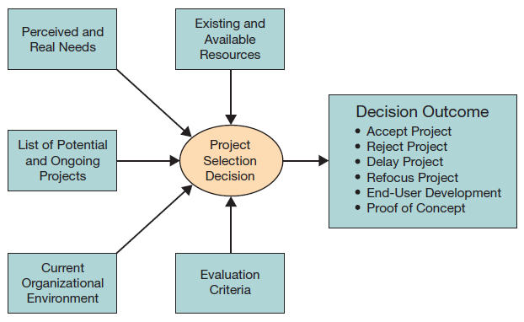
Making a Successful Business Case:
Stakeholders and Factors
Stakeholder | Focus and Project Characteristics
Management | Greater strategic focus; largest project sizes; longest project durations
Steering Committee | Cross-functional focus; greater organizational change; formal cost-benefit analysis; larger and riskier projects
User department | Narrow, non-strategic focus; faster development
IS Executive | Focus on integration with existing systems; fewer development delays; less concern with cost-benefit analysis
Notes:
There are at least four different perspectives among stakeholders. Managers and user groups may come from different functional units within the firm, and therefore have narrower interests. The steering committee is made of representatives from all across the organization, so will have broader focus. And the IS executive has a better view of the costs and benefits of IS projects, and the likelihood of how much time and resources will be required.
Making a business case requires looking at multiple factors, and based on these there may be a variety of decisions for any particular project.

Slide 12
The Systems Development Process
Making the Business Case
Describe how to formulate and present the business case for technology investments.
The Systems Development Process
Describe the systems development life cycle and its various phases.
Acquiring Information Systems
Explain how organizations acquire systems via external acquisition and outsourcing.

Slide 13
Customized Versus Off-the-Shelf Software
Customized Software
  Customizability—tailored to unique needs
  Problem specificity—pay only for what is needed
Off-the-Shelf Software (Packaged Software)
  Less costly than customized systems
  Faster to procure than customized systems
  Of higher quality than customized systems
  Less risky than customized systems
Notes:
Customized software is unique, customized, focused, and expensive.
Off-the-shelf software is typically cheaper, easier, faster, more thoroughly tested, and less likely to fail.

Slide 14
Off-the-Shelf Software:
Examples
Category | Application | Description | Examples
Business information systems | Payroll | Automation of payroll services, from the optical reading of time sheets to generating paychecks | ZPAY Intuit Payroll
 | Inventory | Automation of inventory tracking, order processing, billing, and shipping | Intuit QuickBooks InventoryPower 5
Office automation | Personal productivity | Support for a wide range of tasks from word processing to graphics to e-mail | OpenOffice Corel Microsoft Office
Commercial off-the-shelf (COTS) software—typically developed by software companies that spread the development costs over a large number of customers
Notes:
This chart includes both business information systems and office automation systems, but there are many more types of off-the-shelf software.

Slide 15
Open Source Software
Program’s source code is freely available for use and/or modification
  Linux and MySQL are prevalent example
Free to use, but “hidden” support costs
  Typically no support for the free version
  Commercial vendors may offer commercial-grade support to industry users for a fee
MySQL database is used by Yahoo!, Facebook, and Associated Press
Notes:
Open source software can be a boon, as the up-front costs can be very low, but there can be many hidden support costs when there is no vendor to call when a problem arises.
Companies typically have to internalize the support or sometimes hire a commercial vendor to provide support for the open source software.

Slide 16
Combining Customized, Open Source, and Off-the-Shelf Systems
Off-the-shelf systems can often be customized
Off-the-shelf systems may interact with open-source systems (e.g., the MySQL open source database can be used to store data for a small business ERP system)
Notes:
There is no reason companies can’t use all three types of software where it makes sense.
However, using all three types will mean integrating them, which could require additional custom code.
Some commercial applications are designed to work with specific open source products.

Slide 17
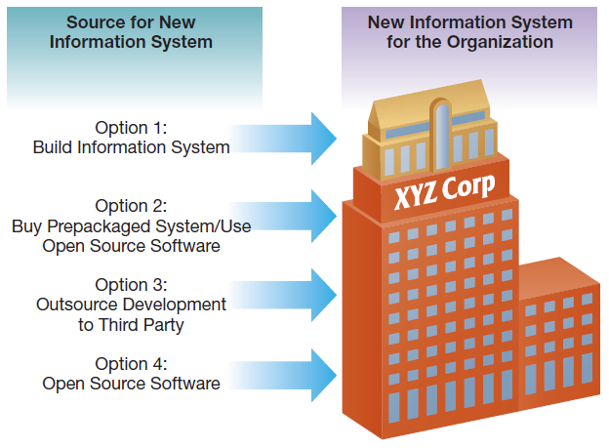
IS Development in Action
Notes:
There are a variety of sources for any new information system initiative a company is considering.
Which one makes the most sense will depend on many factors, and a structured approach is necessary to ensure a suitable solution is found and implemented.

Slide 18
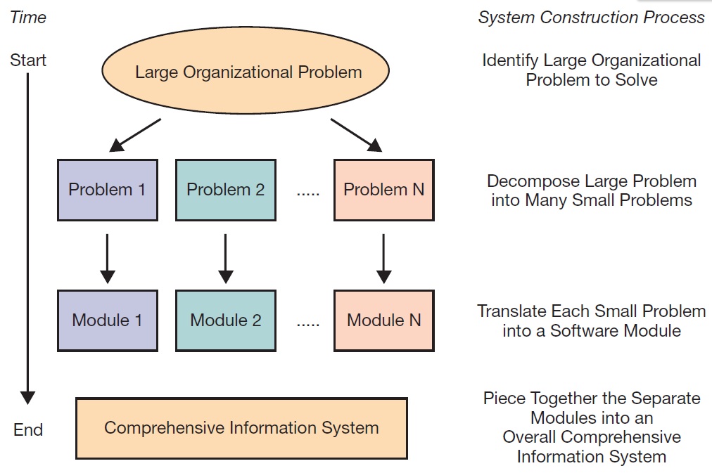
IS Development in Action
Notes:
Large organizational problems may require large solutions, but decomposing the large problem down into manageable problems that can be readily addressed makes the overall process manageable. It’s like working with LEGO blocks.
The systems analyst (SA) has primary responsibility in a systems development project. The SA studies the problems and needs of an organization in order to determine how people, methods, and information technology can best be combined to bring about improvements in the organization. A systems analyst helps systems users and other business managers define their requirements for new or enhanced information systems. And the systems analyst also manages projects, as a project manager.

Slide 19
The Role of Users in the Systems Development Process
System analysts design the system
System users know what is needed
System analysts depend on system users
System users are key throughout the process
Notes:
Although system analysts have the background to design new systems, they typically aren’t the subject-matter experts in every aspect of the business. That honor generally goes to the users, who know what the current system does, and often what the new system needs to accomplish, even if they aren’t versed on the latest technologies that might be implemented to accomplish it. As such, system user involvement is critical throughout the process.

Slide 20
Steps in the Systems Development Process
Systems planning and selection
Systems analysis
Systems design
Systems implementation and operation
Notes:
The systems development life cycle is a four-step structured process starting with systems planning and selection, going through analysis, design, and ending with implementation and operation.
Note that this is a cyclical process. At any phase, you may return to an earlier phase. For example, during design there may be the recognition that more analysis is needed.

Slide 21
Phase 1: Systems Planning and Selection
Resources are limited so projects must be limited
Analyst gathers information and builds the case
Multiple approaches to selecting projects
  Formal IS planning process
  Ad-hoc planning process
The business case role
  Business cases for different projects compared
  Multiple selection criteria
Notes:
All organizations face resource constraints of one kind or another, and hence they need to limit their IS projects to those that can succeed given the resources at hand.
This may take place through a very formal IS planning process or organizations may have a more informal ad-hoc process for generating and approving IS investments.
Regardless of the approach, each project typically has its own business case that is used to justify the resources necessary to go forward with it, and often this business case is compared with the other business cases for competing IS projects.
The criteria for selecting from competing projects can be varied, but ideally will be based on core criteria such as alignment with the firm’s objectives, or strategic alignment, as well as tangible benefits.
Additional factors such as intangible benefits, risk, project size, and resource availability will all also play a role.

Slide 22
Phase 2: Systems Analysis
Collecting Requirements
  May be the most important part of systems development
  Dictates how the proposed system should function
Modeling Data
  What data are needed
  Modeled using entity-relationship diagrams
Modeling Processes and Logic
  Model the data flow
  Model the processing logic
Develop System Designs and Evaluate, Selecting One
Notes:
Systems analysis involves determining what the optimal approach will be. This requires gathering requirements and performing modeling at a deeper level than in Phase 1, but not at the level that will be required in Phase 3. This is almost an iterative step, where the goal is to just gather enough information and put together enough models that an optimal final direction can be chosen and pursued.

Slide 23
Phase 3: Systems Design
The system design chosen from Phase 2 is now elaborated to where it could be built
  Human–computer interface
    Point of contact between the user and the system
    Data entry and management forms
  Databases and files
  Processing and logic
    Modeled using one of many techniques
    Models converted into code in Phase 4
Notes:
The systems design phase takes the output of Phase 2, the analysis phase. This includes the Phase 2 models and optimal architecture or system design.
In this phase the system is completely modeled based on those decisions, the prior knowledge from the analysis phase, and the additional work being done to complete the design.

Slide 24
Phase 4: Systems Implementation and Operation
Convert design into a working system
  Software programming and software testing
  System conversion, documentation, training, and support
    User and reference guides
    User training manuals and tutorials
    Installation procedures and troubleshooting suggestions
Notes:
The final phase is implementation and operation, which involves converting the design to a system, implementing the database, creating the user guides, conducting the training, and switching over to the new system.

Slide 25
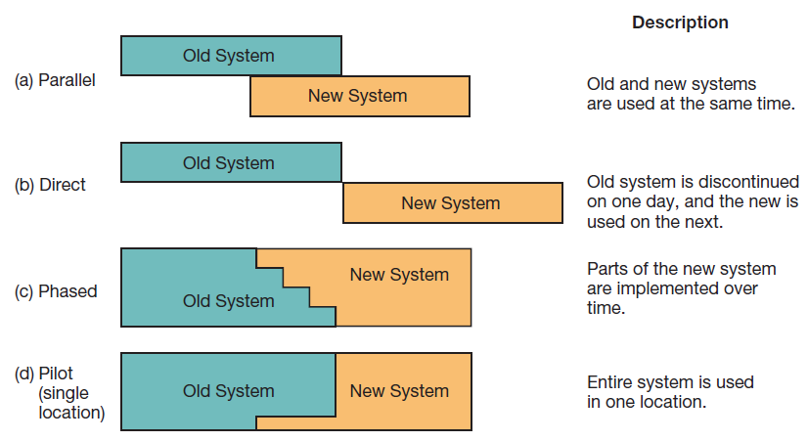
Phase 4: Systems Implementation and Operation: Conversion Strategies
Notes:
There are multiple strategies available for converting from an organization’s old software to a new system, including parallel, direct, phased, and pilot.
Most organizations choose a pilot or phased implementation, due to the large resource requirements of a parallel conversion and the large risk involved in a direct conversion.
However, a parallel conversion has the lowest risk, and as such is sometimes implemented.
A direct conversion may be mandated where for one reason or another it isn’t possible to have a phased or pilot implementation with different parts of the organization running on different systems.

Slide 26
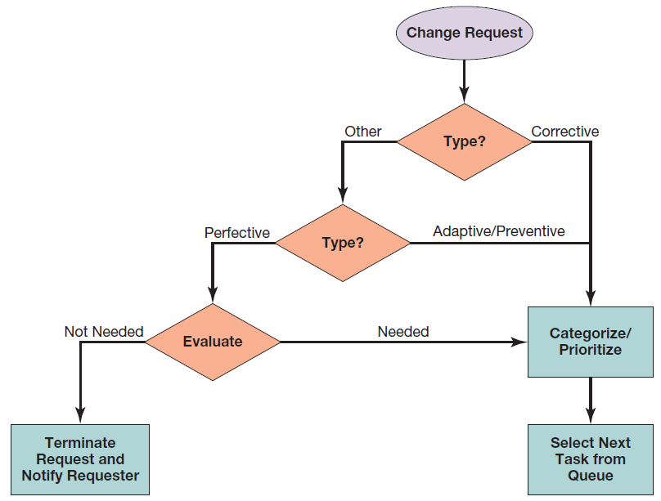
Repeating the SDLC: Systems Maintenance
Notes:
Once the system is implemented it enters a maintenance phase.
At this point in time there will still be regular changes, upgrades, and maintenance activities to perform.
Change management is necessary to ensure that the system remains stable and functional, and that change requests are appropriate and justified.
Each change request is like a miniature SDLC.

Slide 27
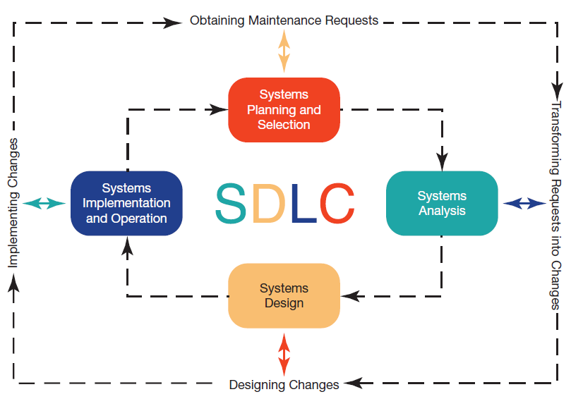
Repeating the SDLC: Systems Maintenance: Activity Mapping
Notes:
As you can see, each phase of the maintenance process maps directly to an SDLC phase.
Because the system maintenance processes are repeated over and over, the total amount of development during the systems maintenance phase typically exceeds the amount of development during the original SDLC implementation.

Slide 28
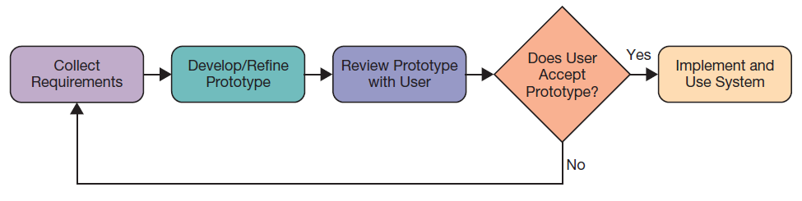
Other Approaches to Designing and Building Systems
Prototyping
  Trial-and-error
  Works even when the desired endpoint isn’t known, if there is a basis for determining when one prototype is better than another
RAD & Extreme Programming
Notes:
The SDLC isn’t always a practical approach to every problem. It requires the output be known up front, for example, and that isn’t always possible.
One alternative is prototyping, where after the analyst learns some core needs, a prototype is developed and evaluated. Good features are retained and problematic ones replaced with candidate alternatives. As prototypes are iterated the process will ideally converge on a working solution.
There are also processes such as rapid application development and extreme programming, which are applicable to a limited set of situations. They won’t be covered here, but do have their place.

Slide 29
Acquiring Information Systems
Making the Business Case
Describe how to formulate and present the business case for technology investments.
The Systems Development Process
Describe the systems development life cycle and its various phases.
Acquiring Information Systems
Explain how organizations acquire systems via external acquisition and outsourcing.

Slide 30
External Acquisition:
Reasons for External Acquisition
Possible situations:
  Situation 1: Limited IS staff
  Situation 2: IS staff has limited skill set
  Situation 3: IS staff is overworked
  Situation 4: Problems with performance of IS staff
When this is the case, there are two options:
  External acquisition of a prepackaged system
  Outsourcing systems development
Notes:
There are many reasons to go outside a corporation for a system.
Often the IS staff doesn’t have the resources or expertise to attempt the systems development effort in-house.
Systems development takes dedicated resources with the project management, system analyst, database design and management, systems architecture, programming, testing, and training skills necessary to make it a success. These skills are often specialized, and may not exist or be available within the organization.

Slide 31


External Acquisition:
Steps
Systems planning and selection
Systems analysis
Development of a request for proposal
Proposal evaluation
Vendor selection
Notes:
The first two steps of an external acquisition are the same as the first two steps in the SDLC. The third step is where the paths diverge. We’ll cover them in the next three slides.

Slide 32
External Acquisition: Steps:
Development of a Request for Proposal
A summary of existing systems and applications
Requirements for system performance and features
Reliability, backup, and service requirements
The criteria that will be used to evaluate proposals
Timetable and budget constraints (how much you can spend)
Notes:
Creating a request for proposal, or RFP, can be an involved process in and of itself. In fact, some companies outsource the RFP development to a consulting firm, which then helps them select and manage the vendor that will perform the systems development work.
The RFP needs to include enough information that vendors can submit an informed proposal that will meet the company’s needs. This includes the current situation, all the requirements for the new system, how the new system will be evaluated, and any constraints on the proposal.

Slide 33
External Acquisition: Steps:
Proposal Evaluation
Evaluation may include:
  Viewing system demonstrations
  Evaluating system performance
  Judging how system stacks up to important criteria
Use of system benchmarks
  Response time given a specified number of users
  Time to sort records
  Time to retrieve a set of records
  Time to produce a given report
  Time to read in a set of data
Notes:
The evaluation of the proposal will involve looking at all the financials, but will also involve comparing the proposed solution to the requested features, and noting differences and capabilities.
Some variations may be insignificant, whereas others could be deal-breakers.
Finally, each proposal should be looked at in terms of risk—the probability that things won’t work out, and the impact if that is the case.

Slide 34
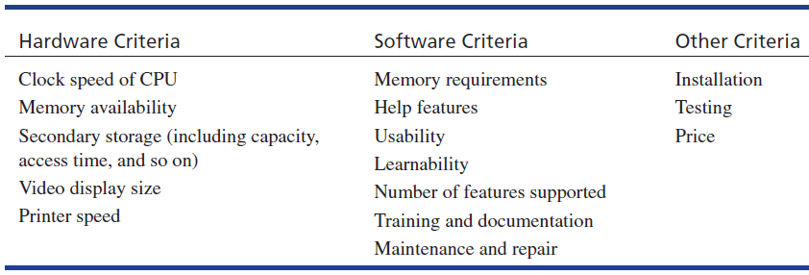
External Acquisition:
Commonly Used Evaluation Criteria
Notes:
The system involves both hardware and software components, so these need to be accounted for. In addition, there are issues about the vendor to consider, as well as financial factors.

Slide 35
External Acquisition: Steps—Vendor Selection
Typically multiple feasible solutions
Prioritize or rank competing proposals
Weighted scoring system works well for this
Other approaches include
  Simple checklists
  Subjective processes
Once vendor is selected, external acquisition is complete
Notes:
Once all the proposals are in and evaluated, those that meet your needs should be scored and ranked to provide a solid basis for comparison.

Slide 36
External Acquisition:
Managing the Software License
Varying degrees of restrictiveness or freedom
Types of licenses
  Shrink-wrap or click-wrap licenses
    Typical for off-the-shelf and system software
  Enterprise or volume licenses
    Usually negotiated
Software asset management
  Performing a software inventory
Notes:
Licenses can vary from full rights such as public domain to no rights such as trade secret software. In between includes non-protective open source, protective open source, and proprietary software. Linux is an example of protective open source software. Windows is an example of proprietary software.

Slide 37
Outsourcing Systems Development:
Why Outsourcing?
Outsourcing Reasons | Description
Cost and Quality Concerns | Vendors have economies of scale, and can develop better systems at a lower cost
Problems in IS Performance | Outsourced vendors are more reliable and consistent
Supplier Pressures | Aggressive sales forces
Simplifying, Downsizing, and Reengineering | Companies retreating to core competencies, outsourcing functions not core to value creation
Financial Factors | An arm’s-length relationship with vendors can create more efficient use, IT assets can be liquidated
Organizational Culture | Internal politics may block IT from moving forward
Internal Irritants | If the IS staff and users are not interacting well together, removing that source of tension can be a relief
Notes:
There are many different reasons to outsource systems; often the driving factor is the limitations of the internal IT staff.
Many companies aren’t systems development companies and hence have limited resources and skillsets in that area.
Beyond that, an organization may see outsourcing as an opportunity to streamline the business, remove liabilities, or eliminate ongoing problems.

Slide 38
Outsourcing Systems Development:
Managing the IS Outsourcing Relationship
Outsourced relationships take continuous management
Realistic, tangible measures of performance should be developed and tracked
Multiple levels of interaction based on the type of interaction
  Operational and tactical
  Policy and relationship
Notes:
The outsourced IT relationship needs continuous monitoring and management.
The company doing the outsourcing cannot simply let all its internal IT staff go and just assume the vendor will do “good” things.
A solid CIO, working with the legal team and IT staff members, needs to manage the relationship.

Slide 39
End of Chapter Content

Slide 40
Managing in the Digital World:
Microsoft Is “Kinecting” Its Ecosystem
Apple, Google, Microsoft, and Amazon are building app ecosystems
System development is a cooperation between large companies and small independent app developers
Microsoft released the Kinect in 2010, a motion capture device for the Xbox with a USB interface
  Programmers saw the potential to use the Kinect in new and novel ways
  Microsoft resisted at first, but now includes an SDK
  In 2013, Microsoft released an improved version with the help of independent app developers

Slide 41
Brief Case:
Software Patent Wars
In the mobile space
  Apple patented slide-to-unlock features
  Samsung patented 4G data transmission
  Microsoft sued Motorola for video encoding
  Motorola sued Microsoft for email, IM, and Wi-Fi
  Oracle sued Google for basing Android on Java
  Samsung and Apple battle over their patents
Are patent wars preventing productivity?

Slide 42
Coming Attractions:
IBM’s 5 in 5
5 innovations that will transform our lives in 5 years
Based on Big Data and machine learning
  Offline retail stores will learn about customers
  Doctors will learn about your DNA
  Digital guardians will protect you from cybercriminals
  The classroom will learn about its students
  Smart cities will improve their citizens’ lives

Slide 43
Ethical Dilemma:
Ethical App Development
Nowadays anyone can build an app, not just major software companies
Mobile apps are especially prevalent, with opportunities to build the next “killer app”
This leads to possible ethical issues, especially related to privacy concerns
  Facebook privacy policies always changing, often violating privacy preferences of users
  iOS social media Path app secretly sends users’ complete address list to Path’s servers
Apps can easily retrieve user data, but can does not imply ought

Slide 44
Who’s Going Mobile
Creating Mobile Apps
Smartphone apps are being rapidly developed and deployed
In 2013, Google and Apple announced more than 1 million apps in their app stores
Only a relatively few are highly successful
  Flappy Bird took only three days to complete, but netted $50K per day
  Game templates are available for as low as $199 for developers, not even needing code
Other app possibilities
  Productivity tools for students
  Managing your passwords
  Plenty of other ideas

Slide 45
Key Players:
Game Development Studios
Some tech companies (IBM, Apple) receive only a small amount of their total revenue from software
Others (e.g., Microsoft) are primarily software vendors
All software involves SDLC, but game software SDLC has unique characteristics
  Begin with general project goal
  After that, it’s more like movie production than normal software production
  Leading games sometimes cost more than $100 million to develop

Slide 46
When Things Go Wrong:
Conquering Computer Contagion
Blue Frog had a new solution to combat spam
  For every e-mail received, sent a response e-mail
  Six of the top 10 spammers dropped Blue Frog’s clients from their lists
  One spammer fought back, inundating Blue Frog’s clients with so much spam that ISP servers crashed
  Blue Frog decided to fold instead of creating a new cyberwar
  2014 top malware issues: growth in botnets, Android-based malware, Linux and Mac OS vulnerabilities, Web-based malware, attacks on financial accounts, Windows XP, spam evolving to overcome blocking

Slide 47
Industry Analysis:
Broadcasting
Broadcasters of radio and television are facing dwindling viewership
  The Internet has opened new entertainment sources and competition to viewers
  Advertisers are willing to pay less for smaller audiences
  Broadcasters now use the Internet as another distribution channel, and can charge for online show advertising
  Some formats are requiring shorter broadcast formats to cater to online audiences

