Slide 1
PERTEMUAN MINGGU KE 3

Slide 2
OUTLINE
Graph
Kinds of graph
Single data graph
Double data graph

Slide 3
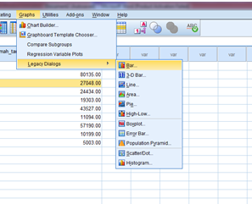
Graph type

Slide 4
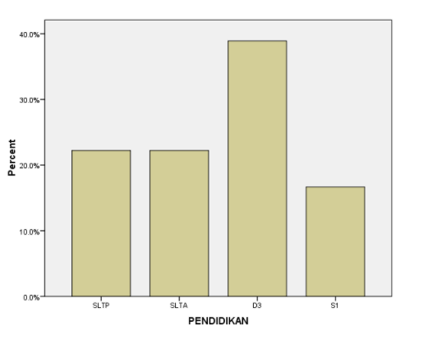
Grafik data tunggal (Single data graph)

Slide 5
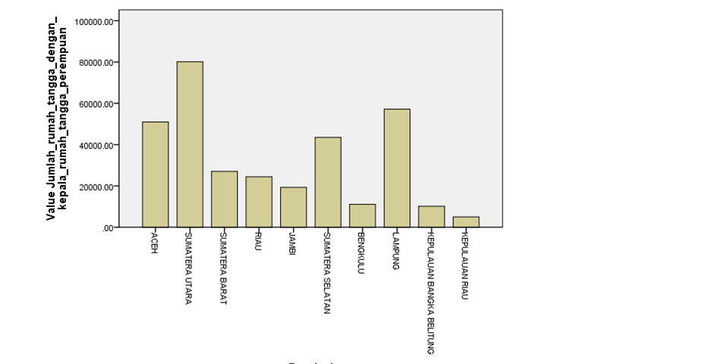
Grafik data ganda (Double data graph)

Slide 6
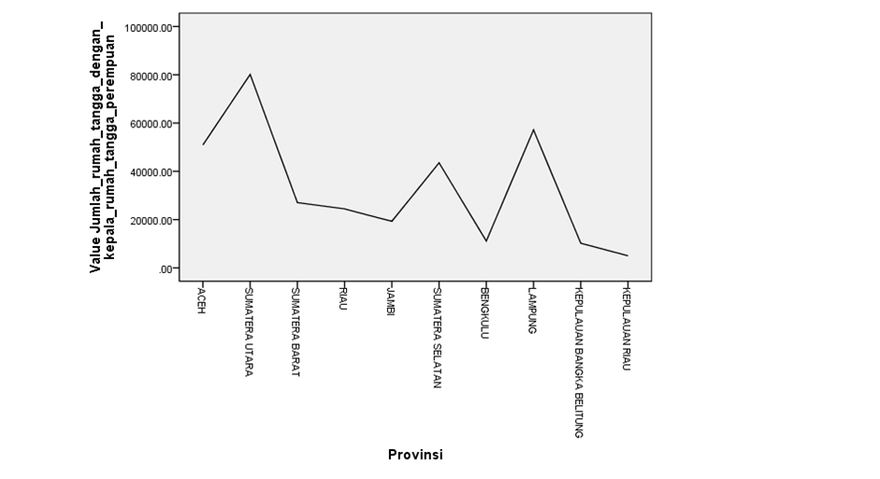

Slide 7
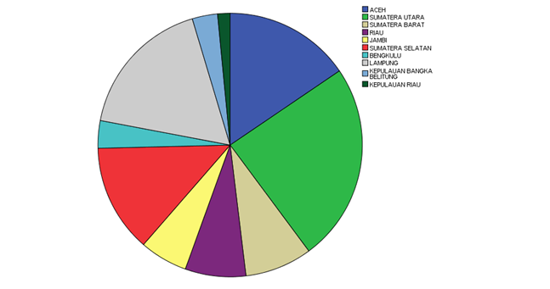

Slide 8
THANK YOU

