Slide 1

POSITIONING

Slide 2
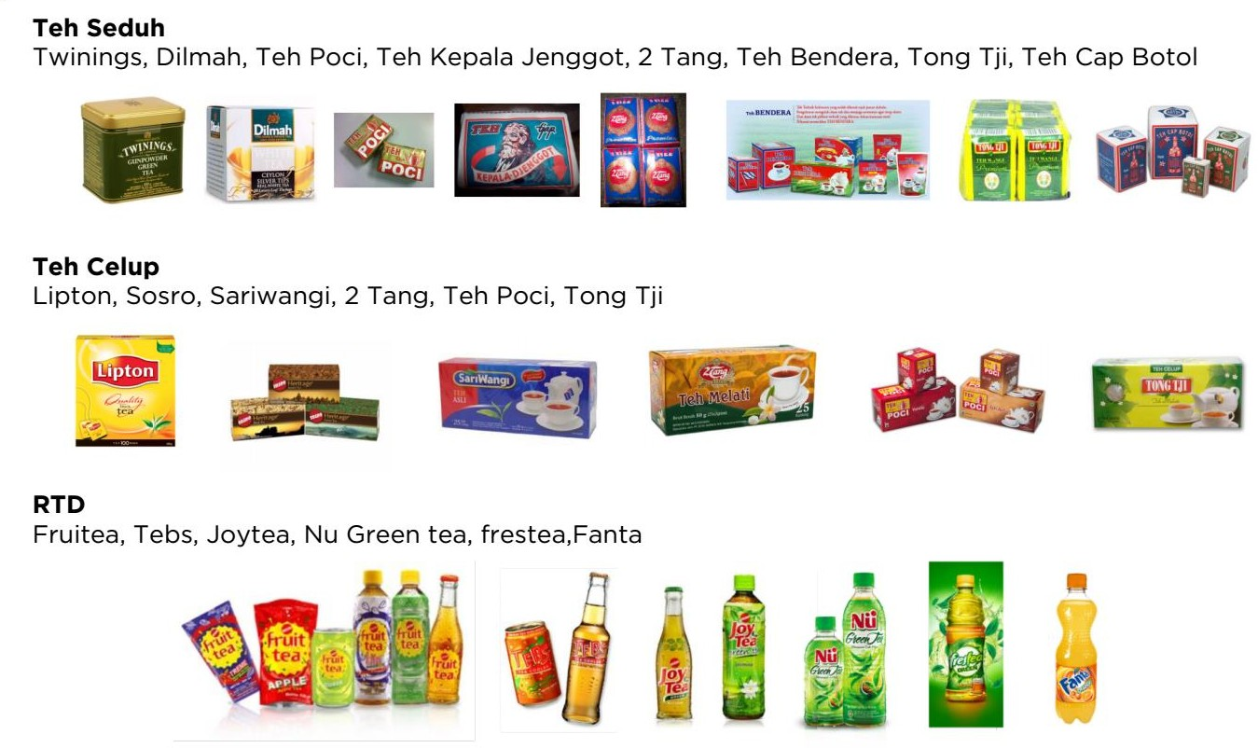
Know your Competitors

Slide 3


Slide 4

Which one?

Slide 5


Slide 6














Which One?

Slide 7
Fungsi
Product
Bahan
Proses
Harga
USP
Unique Selling Proposition
Exclusive
Service
Daerah
Quality

Slide 8


Slide 9

Thank You

